Slide 1
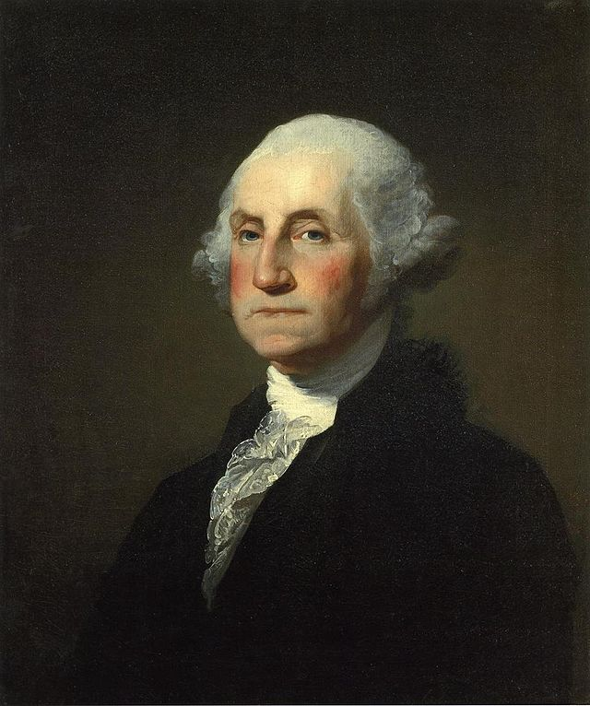
Launching a New Nation

Slide 2
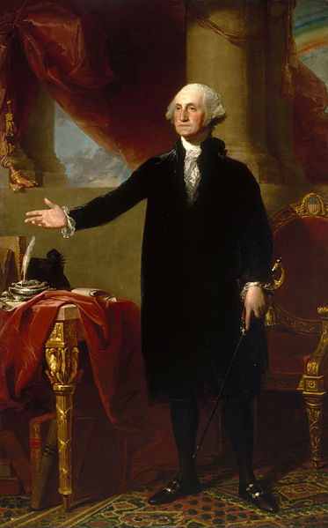
Essential Question:
Why and how was George Washington such an effective leader?
George Washington (Lansdowne portrait) by Gilbert Stuart, oil on canvas, 1796
National Portrait Gallery, Smithsonian Institution.

Slide 3
What made George Washington such an effective leader?
Compared to other political leaders of his time, such as Thomas Jefferson, Alexander Hamilton and James Madison, Washington was far from outstanding.
He had little formal education.
He knew no foreign languages.
He had never traveled to Europe.
Personally aloof, even cold
he was not a great thinker, writer, or speaker.
Despite these shortcomings, Washington still places near or at the top of the list of great presidents even today. Why?

Slide 4
As Commander of Continental Army During the Revolution (1774-1783) Washington was considered a hero.
Had to overcome the inability of the military or the Continental Congress to compel individual states to assist the war effort.
The problem of keeping troops supplied.
The presence of many colonists loyal to the British crown.
The difficulty of defeating the powerful British

Slide 5
As Commander of Continental Army During the Revolution (1774-1783) Washington gained more popularity by giving up power.
after Yorktown, Continental Army held together until Treaty of Paris was signed
people began to talk about the need for a strong leader to put things in order. This talk common among the men in Washington’s Army
Army officer, Col. Lewis Nicola, sent a letter to Washington in May 1752. arguing that a republic would not work in the United States. What was needed, wrote Nicola, was a king.
Washington totally rejected the idea of establishing a monarchy in America with himself as king.
had made his first important decision as a political leader.

Slide 6
As president of the Constitutional Convention in 1787 he convinced different factions to work together
Unlike the other founding fathers, Washington was a true non-partisan.
He hated it when people divided into hostile groups
He tried to avoid taking sides during political disputes.
He contributed almost nothing to the heated debates that took place, but
He used his prestige to calm people down and get them back to their main job

Slide 7
As president of the United States (1789-1797) he established a precedent for other presidents to follow
Washington could have retired at Mount Vernon a military hero.
His ability to lead an entire nation was untested.
He became the first and only president to be unanimously elected
He formed a cabinet of advisors that differed in opinion led by Jefferson and Hamilton
He served only two terms when he could have served longer
He established American neutrality during the French Revolution
He put down the first test of the government’s power-the Whiskey Rebellion

Slide 8
Washington’s Inauguration
In 1788, the Confederation Congress scheduled the first presidential inauguration for the first Wednesday in March of the following year.
Bad weather delayed many members of the First Federal Congress from arriving promptly in New York City, the temporary seat of government.
Finally, on April 6, 1789 enough members had reached New York to tally the electoral ballots.
The ballots were counted on April 6 and George Washington won unanimously with 69 electoral votes.
Washington was then notified of his victory and traveled to New York City from his home in Virginia.
Washington met with much celebration along the journey to NYC

Slide 9
U.S. Problems after Constitutional Convention
Inherited a national debt of $52 million from the Confederation
No Navy and only a 400 man army
US not respected in foreign countries
Everything is new – learning on the fly

Slide 10
Domestic Policy Issues
George Washington (1789-1797)

Slide 11
Presidential Policy-Domestic
George Washington inaugurated on April 30, 1789
Had to put a working government in place-Established Cabinet
Set up Department of Treasury, Dept. of State and Dept. of War
Secretary of Treasury – Alexander Hamilton
Secretary of State – Thomas Jefferson
Secretary of War – Henry Knox
Appoint Attorney General to advise on legal matters
Attorney General – Edmund Randolph

Slide 12
Judiciary Act of 1789
Constitution called for one Supreme Court and several smaller ones.
This act established a system of courts or judiciary.
Made up of thirteen federal district courts, three circuit courts, and a six member Supreme Court.
Established the office of Attorney general to prosecute and defend cases on behalf of the federal government.
John Jay--First Chief Justice of the United States

Slide 13
Hamilton’s Financial Plan
U.S. deeply in debt after Revolution
Secretary of Treasury – Alexander Hamilton set up Financial Plan with 4 parts (BEAT)
1. U.S. govt. would charter a national bank (BUS) for depositing govt. funds – sparked large debate; some felt this was unconstitutional
2. U.S. govt. would pass an excise tax on certain goods such as whiskey.
3. U.S. govt. would fully assume (agree to pay) all federal and state debts (Sold government bonds which paid annual interest to the holders)
4. govt. would impose a high tax on goods imported into the country (tariff)– this part of plan not passed by Congress
Hamilton believed that this system would establish the nations credibility, buy political support and enrich investors
Redistribute wealth from farmers to merchants and South to North

Slide 14
Opposition to Hamilton’s BUS
Opposition grew in the south.
Loose Construction (Broad interpretation-used broad language of constitution Article 1, Section 8, Clause 18 “elastic” clause) vs.
Strict Construction (Limited the federal government to powers only granted by the constitution)
1791 Congress approves National Bank, excise taxes, and funding of the national debt.
Compromise-For Southerner’s to agree to Hamilton’s Plan, they were promised to have the national capital move from the North (NYC) to the South on the banks of the Potomac River. (Washington, D.C.)

Slide 15
Whiskey Rebellion
1791 – Congress imposed tax on all whiskey made and sold in U.S. in hopes to raise funds for treasury
Angered farmers – many backcountry farmers made extra money by turning corn into whiskey
Organized protest & refused to pay the tax
Started a revolt
Burned down home of tax collector
Militia sent to Pennsylvania and stopped rebellion
Whiskey Rebellion tested new govt. – showed govt. strong

Slide 16
Political Parties Emerge
Before political parties, there were factions (organized political groups)
Factions were frowned upon – they were considered selfish and unconcerned with well-being of the nation as a whole
Washington hated factions
Disappointed as he saw Jefferson and Hamilton growing apart based on political views
1790s two political parties began to form:

Slide 17
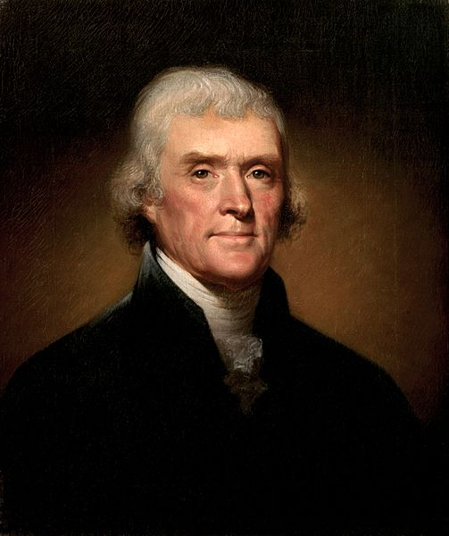
Democratic-Republicans
Led by Thomas Jefferson
Believed people should have political power
Favored strong state governments
Emphasized agriculture
Favored a strict interpretation of the Constitution
Pro-French
Opposed national bank
Opposed protective tariff

Slide 18
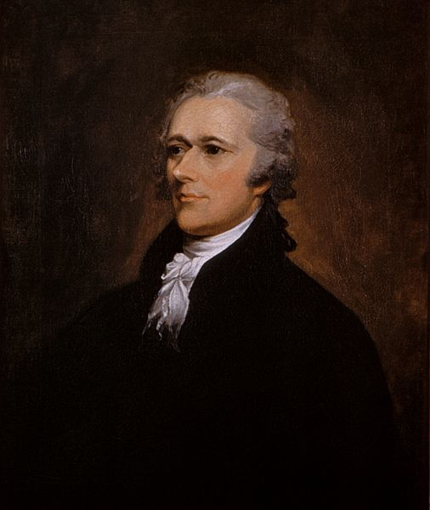
Federalists
Led by Alexander Hamilton
Believed the wealthy and educated should lead
Favored a strong central government
Emphasized manufacturing, shipping, and trade
Favored a loose interpretation of the Constitution
Pro British
Favored national bank
Favored protective tariff

Slide 19
Foreign Policy Issues
George Washington 1789-1797

Slide 20
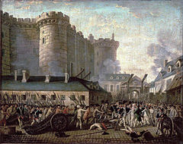
Presidential Policy-Foreign French Revolution-1789
Most Americans initially supported
1793 Jacobins took over in France and beheaded the king, Louis XVI; launching a reign of terror against all European monarchs
Support for Revolution was split-Federalists supported British; Republicans supported French
April 22, 1793-Washington issued declaration of neutrality
Edmond Genet-Frenchmen whose unofficial visit caused an uproar and led to Jefferson resigning

Slide 21
Jay’s Treaty
November 19, 1794; negotiated by John Jay
Despite Treaty of Paris in 1783, British still maintained forts in Northwest territory
British agreed to evacuate posts in Northwest Territory after American success at Battle of Fallen Timbers
Many Americans angered at terms because British able to keep fur trade on Canadian border and it did little to stop the British policy of impressment
Given the climate of the French Revolution, Federalists like Hamilton pushed for an easy settlement with the British to secure a trading relationship with Britain

Slide 22
Pinckney’s Treaty
October 27, 1795; negotiated by southerner Charles Pinckney
Spain gave up all claims east of Mississippi River except Florida
Spain recognized 31st parallel as southern boundary of U.S.
Spain agreed to open Mississippi River for trade
Allowed American traders to use port of New Orleans
Appeased Southerners who wanted to migrate westward

Slide 23
Treaty of Greenville
signed on August 3, 1795, at Fort Greenville, now Greenville, Ohio
British had encouraged Native Americans (Shawnee, Miami, Chippawa, Ottowa, etc.) to help resist U.S. settlement in the area
On August 20, 1794, U.S. defeated Miami Confederacy at the Battle of Fallen Timbers in present day Toledo, Ohio
Led to Treaty of Greenville in which the Miami Confederacy gave up most of their land claims in exchange for $
Led to settlement of Cleveland, Detroit and Chicago along the Great Lakes

Slide 24
Election of 1796
1796, Washington announced he would not seek a third term as President
Thomas Jefferson ran as Republican candidate
John Adams ran as Federalist candidate
Back then, Pres. and VP were not elected together on the same ticket – instead candidate with most votes became Pres. and 2nd place candidate became VP
Adams became Pres. (Federalist), Jefferson became VP (Republican) – led to serious tension over next 4 years

Slide 25
Washington Retires
George Washington made a “Farewell Address”
Praised benefits of federal govt.
Stressed importance of morality
Warned against national debt and deems taxes necessary
Warned against political parties
Warned against involvement in foreign affairs and creating alliances
Warned against creating a military that is too over-powering
Washington’s accomplishments
U.S. had a functioning govt.
Economy was improving
Had avoided war
British had been forced to leave forts in NW Territory

Slide 26
