Slide 1
Thomas Jefferson
President of the United States

Slide 2
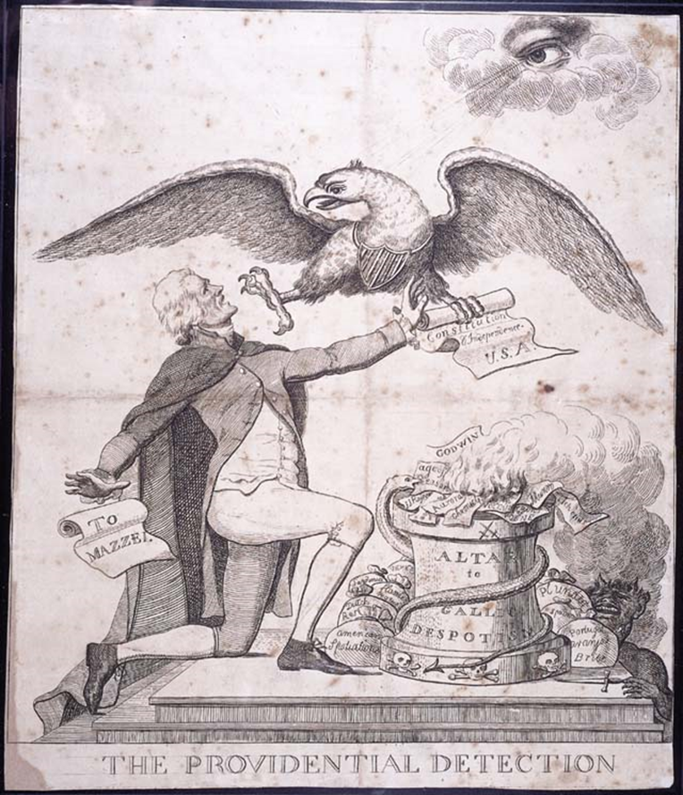

Slide 3
Election of 1800
The Federalists attacked Jefferson as a godless Jacobin who would unleash the forces of bloody terror upon the land.
With Jefferson as President, so warned one newspaper, "Murder, robbery, rape, adultery, and incest will be openly taught and practiced, the air will be rent with the cries of the distressed, the soil will be soaked with blood, and the nation black with crimes."
Others attacked Jefferson's deist beliefs as the views of an infidel who "writes aghast the truths of God's words; who makes not even a profession of Christianity; who is without Sabbaths; without the sanctuary, and without so much as a decent external respect for the faith and worship of Christians."

Slide 4
Election of 1800
Adams was ridiculed from two directions: by the Hamiltonians within his own party and by the Jeffersonian-Republicans from the outside.
For example, a private letter in which Hamilton depicted Adams as having "great and intrinsic defects in his character" was obtained by Aaron Burr and leaked to the national press. It fueled the Republican attack on Adams as a hypocritical fool and tyrant.
Republicans also spread the story that Adams had planned to create an American dynasty by the marriage of one of his sons to a daughter of King George III. According to this unsubstantiated story, only the intervention of George Washington, dressed in his Revolutionary military uniform, and the threat by Washington to use his sword against his former vice president had stopped Adams's scheme.

Slide 5
Election of 1800
Thomas Jefferson-Republican
John Adams-Federalist

Slide 6
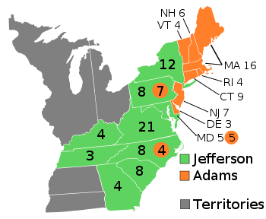
Election of 1800
Democratic-Republicans were well organized at the state and local levels,
Federalists were disorganized, and suffered a split between their two major leaders, President Adams and Alexander Hamilton.

Slide 7
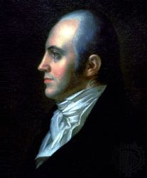
Election of 1800
The election exposed one of the flaws in the original Constitution.
Members of the Electoral College were authorized by the original Constitution to vote for two names for President.
The Democratic-Republicans had planned for one of the electors to not cast his second vote for Aaron Burr, which would have led to Jefferson receiving one electoral vote more than Burr.

Slide 8
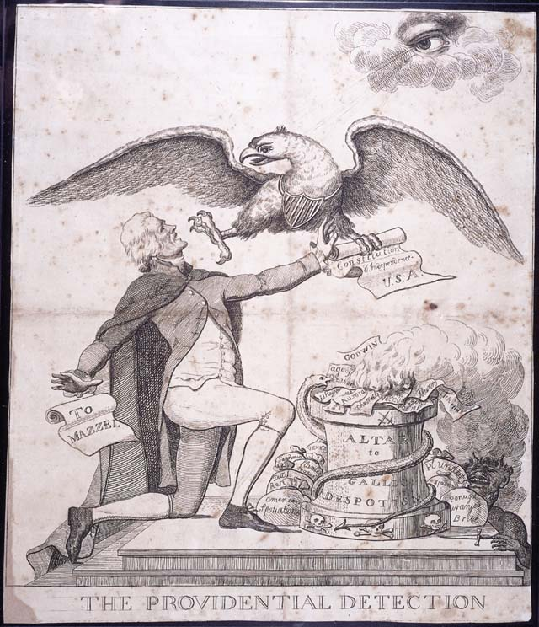
Election of 1800
Each elector who voted for Jefferson also voted for Burr, resulting in a tied electoral vote.
The election was then put into the hands of the House of Representatives, which, after 35 votes was tied.
Alexander Hamilton convinced New York delegates to break the tie on the 36th ballot
To rectify the flaw in the original presidential election mechanism, the Twelfth Amendment ratified in 1804, was added to the United States Constitution, that electors make a choice between their selections for president and vice-president.

Slide 9
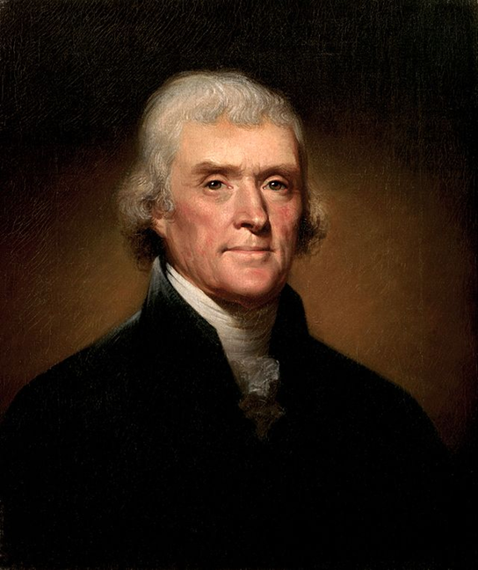
Inauguration Speech
Why would Jefferson’s victory against Adams in 1800 be considered “revolutionary”?
What of the inaugural speech addresses this “revolution”?

Slide 10
President Thomas Jefferson
Republican “Revolution”
Marbury v. Madison
Louisiana Purchase
Barbary Wars
Embargo Act of 1807

Slide 11
Louisiana Purchase-1803
Under Napoleon Bonaparte, France took back the Louisiana territory from Spain in 1800 in the hope of building an empire in North America.
James Monroe and Robert Livingston originally sent by President Jefferson to just purchase New Orleans
A slave revolt in Haiti and an impending war with Britain, forced France to give up these plans and sell the entire territory to the United States
Territory sold to U.S. was 828,000 square miles
Cost was 15 million dollars (around 4 cents per acre)
Included all or part of 15 present U.S. states and two Canadian provinces.
Jefferson’s popularity increased and he was reelected in 1804

Slide 12
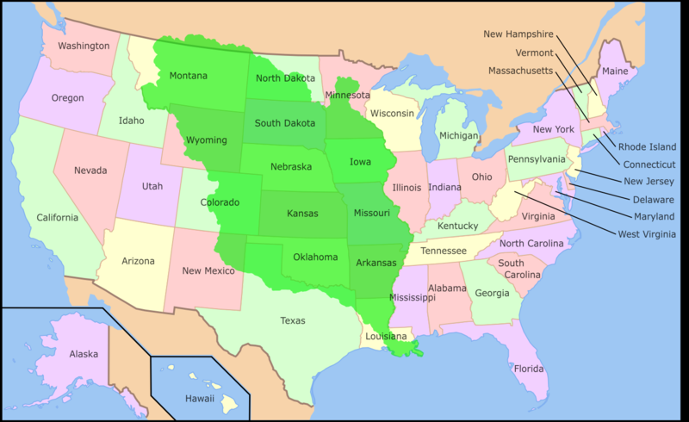
Louisiana Purchase

Slide 13
Corps of Discovery
Commissioned by Jefferson shortly after the Louisiana Purchase in 1803
First American expedition to cross what is now the western portion of the United States
Left in May 1804 from near St. Louis on the Mississippi River, making their way westward to the Pacific coast
Select group of U.S. Army volunteers under the command of Captain Meriwether Lewis and his close friend Second Lieutenant William Clark.
Journey lasted to September 1806
primary objective was to explore and map the newly acquired territory
secondary objectives were scientific and economic: to study the area's plants, animal life, and geography, and establish trade with local Indian tribes
Sacajawea, was a Shoshone woman, who accompanied the Lewis and Clark Expedition, acting as an interpreter and guide

Slide 14
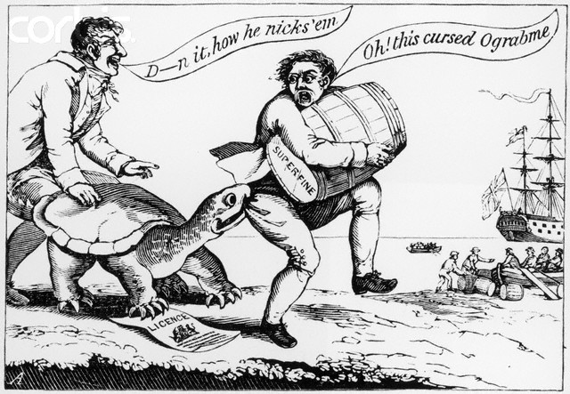

Slide 15
Embargo Act of 1807
During Jefferson’s second term, fighting between Britain and France threatened American shipping
In 1806 Napoleon decided to keep British goods from the rest of Europe
Britain reacted by blockading ports of Europe
By 1807 Britain had taken more than 1000 American ships; France had taken about 500
Americans were more angry at British because of their policy of impressment
Americans also angry over Chesapeake incident of June 1807 (3 Americans killed when U.S. captain refused to allow British to board and search ship)
Jefferson responded by signing Embargo Act (stated that American ships could not carry cargo to foreign ports and that foreign ships could not load cargo in American ports)
Jefferson believed that an embargo would hurt Britain and force them to accept American neutrality
1809 Congress lifted ban on trade except with Britain and France (Non-Intercourse Act)

