Slide 1
Themes in American History I

Slide 2
Review
What is History?
What are Primary Sources of Evidence? Secondary Sources?
APPARTS
Why Study History?

Slide 3
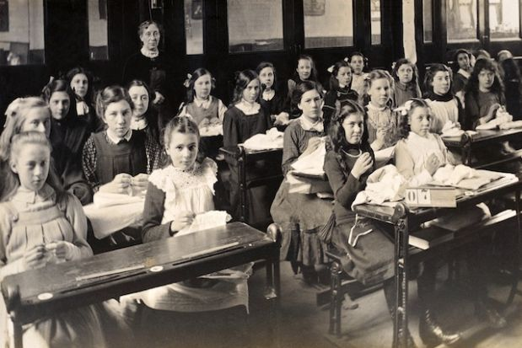

Slide 4
Why Study History?
1.“That men do not learn very much from the lessons of history is the most important of all the lessons of history.” Aldous Huxley
2. “History will have to record that the greatest tragedy of this period of social transition was not the strident clamor of the bad people, but the appalling silence of the good people.” Martin Luther King Jr.
4.“Few will have the greatness to bend history itself; but each of us can work to change a small portion of events, and in the total; of all those acts will be written the history of this generation.” Robert Kennedy

Slide 5
Homework Peter Stearns “Why Study History?”
What does he say?
How does he support what he says?
Do you agree with him? Why or why not?

Slide 6
What are we going to study this semester?
Unit 1: Exploration and Colonization
Unit 2: Revolution and Independence
Unit 3: Confederation, Constitution & Compromise
Unit 4: Nationalism and Sectionalism
Unit 5: Religious Awakening and Reform
Unit 6: Expansion and Manifest Destiny
Unit 7: Civil Crisis and Civil War
Unit 8: Reconstruction

Slide 7
Themes in American History I
Exploration
Diversity
Migration
Conflict
Compromise
Expansion
Liberty
Equality
Power
Progress
Reform
Identity

Slide 8
Theme
An organizing idea or concept; a mental construct that is timeless, universal, abstract, represented by 1-2 words, examples may be factual and share common attributes

Slide 9
Themes in American History 1
In your group of three use your textbook and/or a website to research and display the following information about your assigned theme:
A general definition of the theme written in one or two concise statements
A picture or symbolic representation of the theme
Identify this theme’s significance in the study of history (So what? Why is it important?)
Provide a list of three historical examples of this theme in action (include dates for these examples, what happened and who was involved)
Exploration
Diversity
Migration
Conflict
Compromise
Expansion
Liberty
Equality
Power
Progress
Reform
Identity
This should be neatly completed on a poster.
Split your poster into a quad.

