Slide 1
The World’s Columbian Exposition, 1893 (Chicago World’s Fair)
Unit 2-Industrialism and Urbanization during the Gilded Age

Slide 2
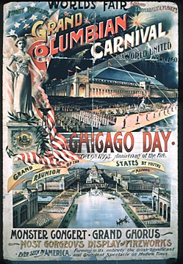
World’s Columbian Exposition
The World's Columbian Exposition, celebrating the 400th anniversary of Christopher Columbus's landing in America, was actually held in 1893, a year later than had been planned.

Slide 3
World’s Columbian Exposition
New York City, Washington, D.C., St.Louis, and Chicago competed to host
N.Y. millionares Cornelius Vanderbilt, William Waldorf Astor and J. P. Morgan pledged to raise $15 million to cover the city’s expenses
Chicago’s mercantile and meatpacking millionaires Marshall Field, Philip Armour and Gustavus Swift countered with an offer
Editor of the New York Sun, dubbed Chicago "that windy city."
April 25, 1890, President Benjamin Harrison signed the act that designated Chicago as the site of the exposition.
It took three frantic years of preparation and work to produce the exposition. Although dedication ceremonies were held on October 21, 1892, the fairgrounds were not opened to the public until May 1, 1893.
The exposition closed on October 30, 1893.

Slide 4
Architecture
The exposition occupied 630 acres
Frederick Law Olmsted, America's foremost landscape architect, was responsible for laying out the fairgrounds. Jackson Park, the product of that effort, is still one of Chicago's most beautiful parks
Planners like Daniel Burnham selected a classical architectural theme for the fair
More than 200 buildings occupied the exposition's grounds; today, only one remains.
Buildings had exterior walls of staff, a temporary building material made from plaster of paris and hemp fiber. Bright paint gave the exposition the nickname of the White City

Slide 5
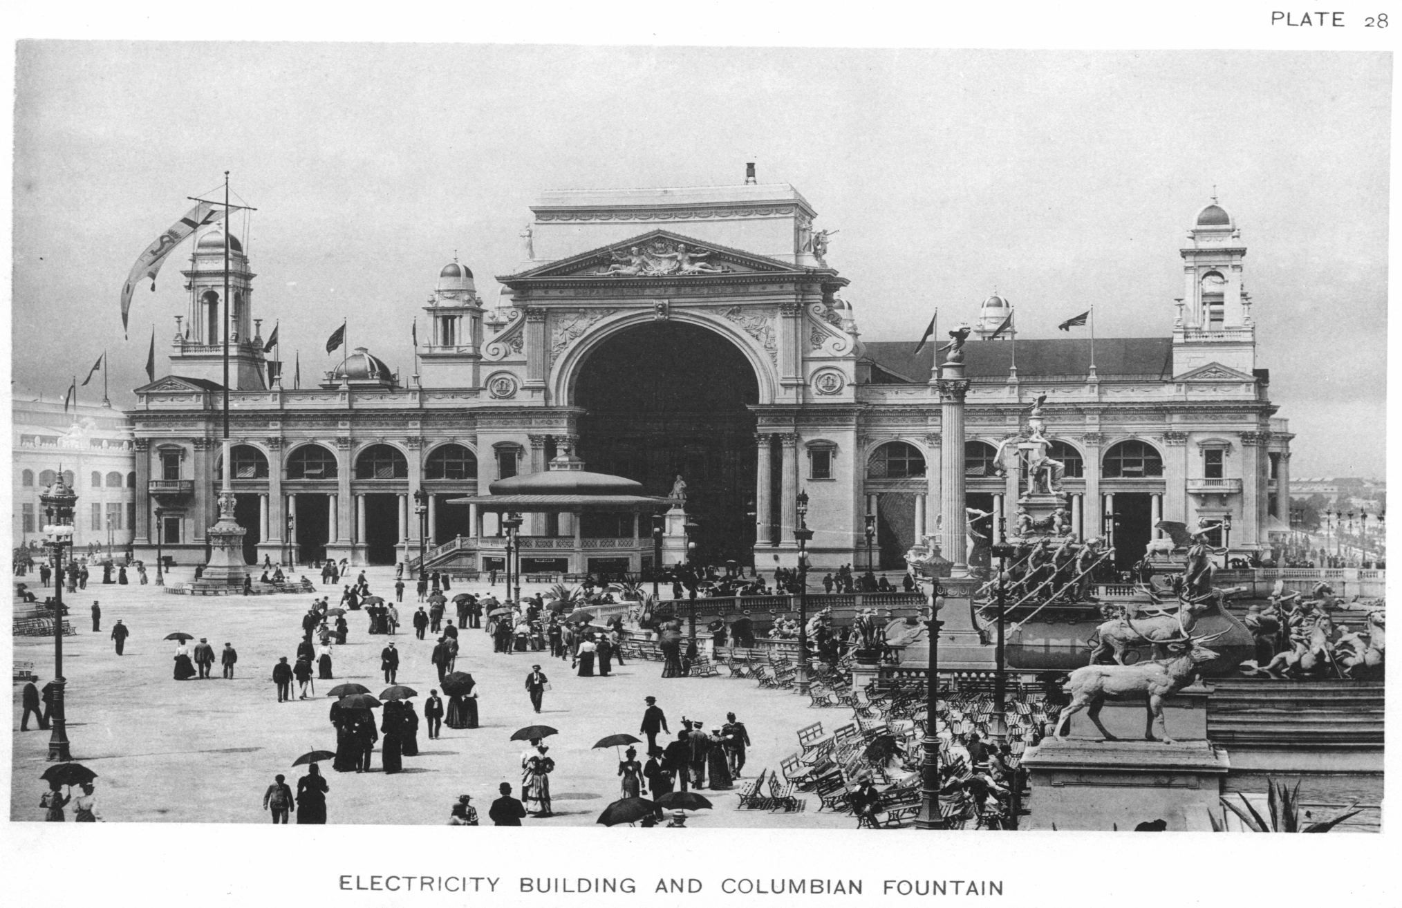

Slide 6
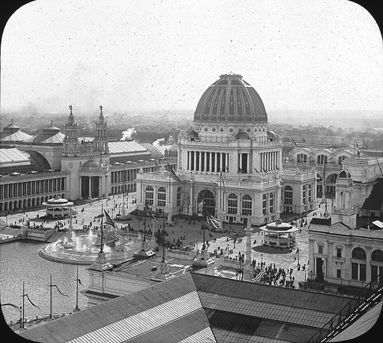
Administrative Building

Slide 7
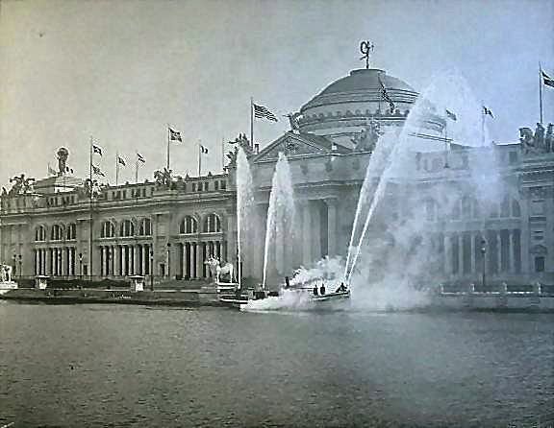
Agricultural Building

Slide 8
Exhibits
The buildings housed sixty-five exhibits that followed the theme of the building.
Nearly 50 foreign countries and 43 states and territories were represented in Chicago.
American exhibits included a replica of George Washington’s Mount Vernon estate, a century-old palm tree from California, a massive stained glass display by Louis Comfort Tiffany and a full-service Creole restaurant from Louisiana.
Philadelphia even sent the Liberty Bell
Norway sailed a full-sized replica of a Viking ship across the ocean for the fair
German industrial giant Krupp spent the equivalent of more than $25 million in today’s money to mount a massive artillery display including a number of weapons that would later be used in World War I.
Prior to the exposition's opening, more than 72,000 tons of exhibit materials were shipped to the grounds.
Over 250,000 displays--ranging from milk sterilization machines to works of art--were presented by nearly 70,000 individual exhibitors.

Slide 9
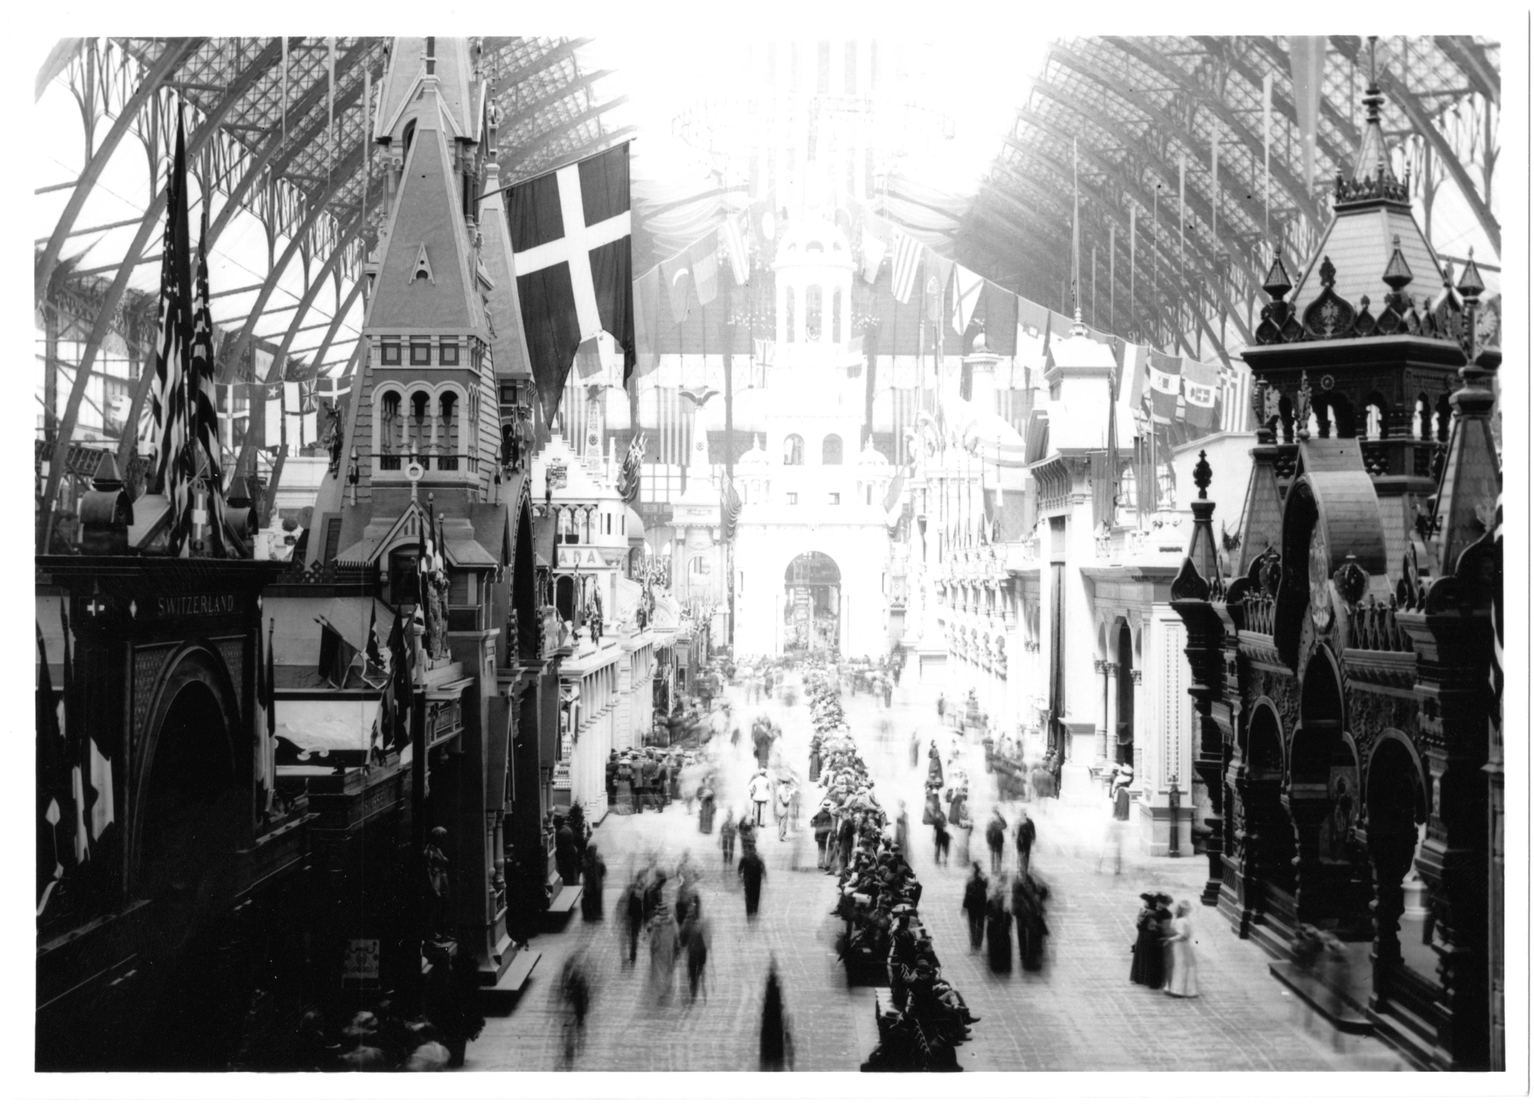
Exhibit Hall Interior

Slide 10
Amusement
The Columbian Exposition was the first world's fair with a separate amusement area--the Midway
The goal of the Midway was to not disturb the parklike atmosphere of the rest of the exposition.
One of the exhibitors on the Midway was Buffalo Bill and his Wild West Show
The world's first Ferris Wheel, invented by George W. Ferris, was also on the Midway. The 250-foot high steel structure had 36 cars carrying 60 persons each.
The first permanent version of the concept of the Midway was established at Coney Island, New York,
Inspired other theme parks throughout the country--including Disneyland and Disneyworld.

Slide 11
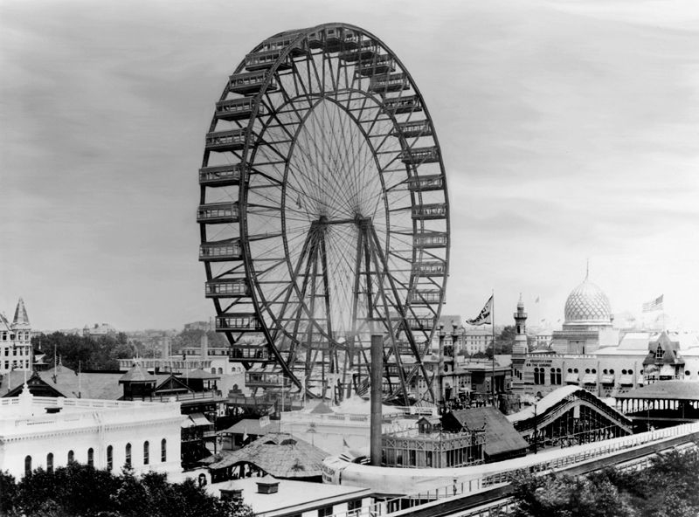

Slide 12
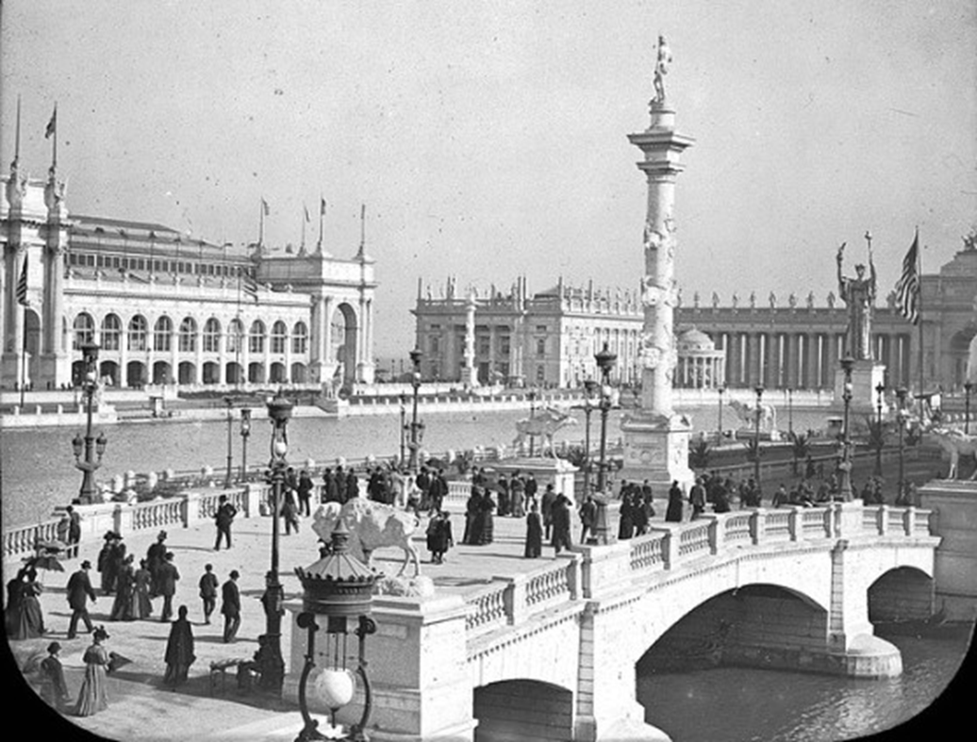
Participation/Attendance
Forty-six nations participated in the exposition, which cost $28,340,700.
There were 25,836,073 admissions to the fair,
The admission price was fifty cents

Slide 13
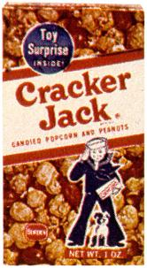
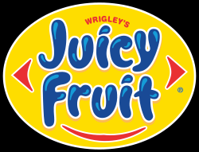
World’s Columbian Exposition
Many of the consumer products displayed at the exposition later became everyday features of American life.
Cracker Jack, Cream of Wheat, Shredded Wheat, Pabst Beer, Aunt Jemima syrup, and Juicy Fruit gum, Hershey’s Chocolate carbonated soda and hamburgers.
The Exposition provided the United States with a new holiday, Columbus Day, and a new method of securing patriotism in schoolchildren-- the Pledge of Allegiance.
Children's writer L. Frank Baum never forgot the fair and used it as an inspiration to write the Wizard of Oz

Slide 14
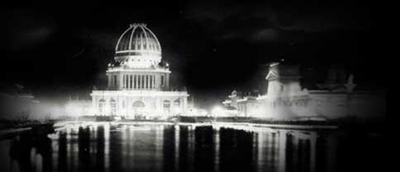
Electricity
One of the most visited exhibits was one on electricity. The fair showed how safe George Westinghouse’s and Nikola Tesla’s AC current could be.
The fair itself would be lit at night. On May 1, 1893, President Grover Cleveland pushed a button and near 100,000 incandescent lamps illuminated the fair
The “City of Light”was powered by 12 thousand-horsepower AC polyphase generators.
The exhibits displayed how electricity could reshape the nation.

