Slide 1
The Progressive Era (1890-1914)

Slide 2
progressivism
Progressivism was a crusade against the problems associated with the rapid growth of industries and urbanization
Progressive Reformers specifically targeted the abuses of urban political bosses and corporate robber barons.
Progressives believed in greater democracy and social justice, a more effective regulation of businesses and a revived commitment to public service
Progressives believed that government could be used as an “agency of human welfare”; Government at all levels (local, state, and federal) should help accomplish progressive reform.
Progressives believed that the complex social ills of an urban-industrialized revolution required new responses: Government should provide direct services such as schools, public health, welfare, care of the handicapped, farm loans

Slide 3
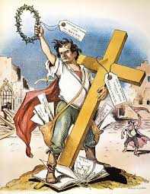
Origins of Progressivism
Populists
The Populist platform of 1892 outlined many reforms that would be accomplished during the Progressive Era (i.e., government regulation of businesses, progressive income tax, secret ballot)
Kansas editor William Allen White said progressivism was just populism that had “shaved its whiskers, washed its shirt, put on a derby, and moved up into the middle class”

Slide 4
Origins of Progressivism
Middle Class
Progressives were more college educated/intellectual, middle class and urban. They brought a more business like, efficient approach to reform
Middle class reformers, such as Thomas Nast, had worked for years to reform boss politics and the political machines
Promoted the idea that government itself needed to reform through civil service legislation (Pendleton Act); had caused a split in political parties between “Mugwumps” and “Stalwarts”; goal had been to destroy spoils system and patronage jobs; people should get political jobs based on merit.
These reformers felt government should confront the urban problems of crime and enable efficient provisions of gas, electricity, water, sewers, mass transit and garbage collection

Slide 5
Origins of Progressivism
Muckrakers
Writers who thrived on exposing scandals; got their name from Theodore Roosevelt who compared them to a character in John Bunyan’s Pilgrim’s Progress: “A man that could look no way but downward with a muckrake in his hands”
Jacob Riis-Danish immigrant and New York journalist who exposed slum conditions in How the Other Half Lives (1890)
Lincoln Steffens-wrote about municipal corruption in The Shame of the Cities (1904)
Ida Tarbell-wrote about the History of the Standard Oil Company (1904)
Upton Sinclair-The Jungle (1906)
McClure’s Magazine, Ladies Home Journal

Slide 6
Origins of Progressivism
Socialists
The left wing of progressivism who had criticized living and working conditions
Most progressives found socialist remedies unacceptable
The catalyst for the progressive movement was the depression of 1890s and the growing social unrest of the nation;
the depression brought hard times to cities which gave rise to a growing middle class and upper middle class social conscience
By the turn of the century there were so many activists at work seeking improved social conditions that people began to speak of an idealistic Progressive Era that could bring about social, economic and political change

Slide 7
Goals of Progressivism
Protect Social Welfare
Promote Moral Improvement
Creating Economic Reform
Fostering Efficiency

Slide 8
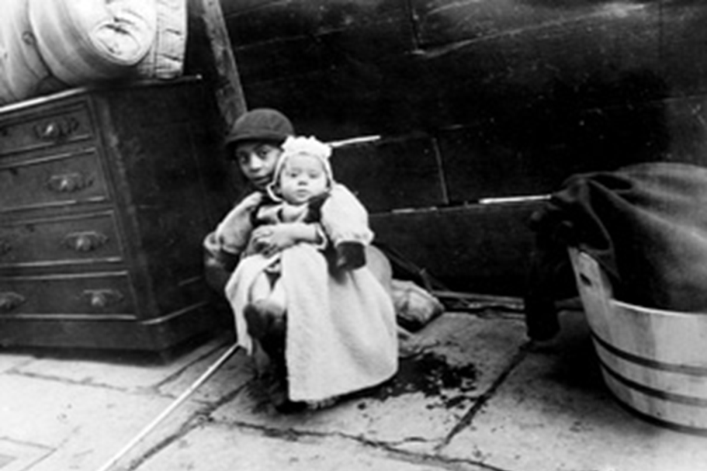
The Origins of Progressivism
I. Protecting Social Welfare – Social welfare reformers strove to relieve urban problems and harsh effects of industrialization. Grew out of the Social Gospel and settlement house movements.

Slide 9
I. Protecting Social Welfare
Social Gospel Movement
Progressive-minded preachers began to tie the teachings of the church with contemporary problems. Christian virtue, they declared, demanded a redress of poverty and despair on earth.
Many ministers became politically active. Washington Gladden, the most prominent of the social gospel ministers, supported the workers' right to strike in the wake of the Great Railroad Strike of 1877.
Ministers called for an end to child labor, the enactment of temperance laws, and civil service reform.

Slide 10
I. Protecting Social Welfare
Social Gospel Movement
The YOUNG MEN'S CHRISTIAN ASSOCIATION and the YOUNG WOMEN'S CHRISTIAN ASSOCIATION were formed to address the problems of urban youth; opened libraries, sponsored classes, and built swimming pools and parks.

Slide 11
I. Protecting Social welfare
Social Gospel Movement
The SALVATION ARMY crossed the Atlantic from England and fed poor people in soup kitchens, cared for children in nurseries, and sent “slum brigades” to convert poor immigrants to the middle-class values of hard work and temperance.

Slide 12
I. Protecting Social welfare
Settlement House Movement
Settlement houses were important reform institutions in the late nineteenth and early twentieth centuries, and Chicago's Hull House was the best-known settlement in the United States.
Most were large buildings in crowded immigrant neighborhoods of industrial cities, where settlement workers provided services for neighbors and sought to remedy poverty.
Hull House was established by Jane Addams and Ellen Gates Starr on September 18, 1889.
By 1907, the converted 1856 mansion had expanded to a massive 13-building complex covering nearly a city block.

Slide 13
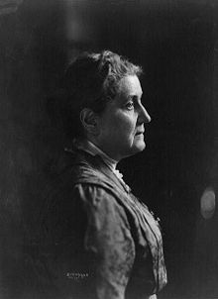
I. Protecting Social welfare
Settlement House Movement
Chicago’s Hull House included a gymnasium, theater, art gallery, music school, boys' club, auditorium, cafeteria, cooperative residence for working women, kindergarten, nursery, libraries, post office, meeting and club rooms, art studios, kitchen, and a dining room and apartments for the residential staff.
Hull House became the flagship of the movement that included nearly five hundred settlements nationally by 1920.

Slide 14
I. Protecting Social Welfare
Settlement House Movement
Many women who frequented Hull House were influenced to become reformers on the local, state, and national levels.
In the neighborhood, these residents established the city's first public playground, campaigned to reform ward politics, investigated housing, working, and sanitation issues, organized to improve garbage removal, and agitated for new public schools.
On the state level Florence Kelly - lived in Jane Addam’s Hull House and became chief inspector of factories for Illinois and helped win the passage of the Illinois Factory Act in 1893

Slide 15
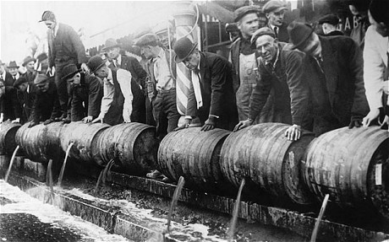
The Origins of Progressivism
II. Promoting Moral Improvement –Reformers offered programs to uplift immigrants and poor city dwellers by improving personal behavior

Slide 16
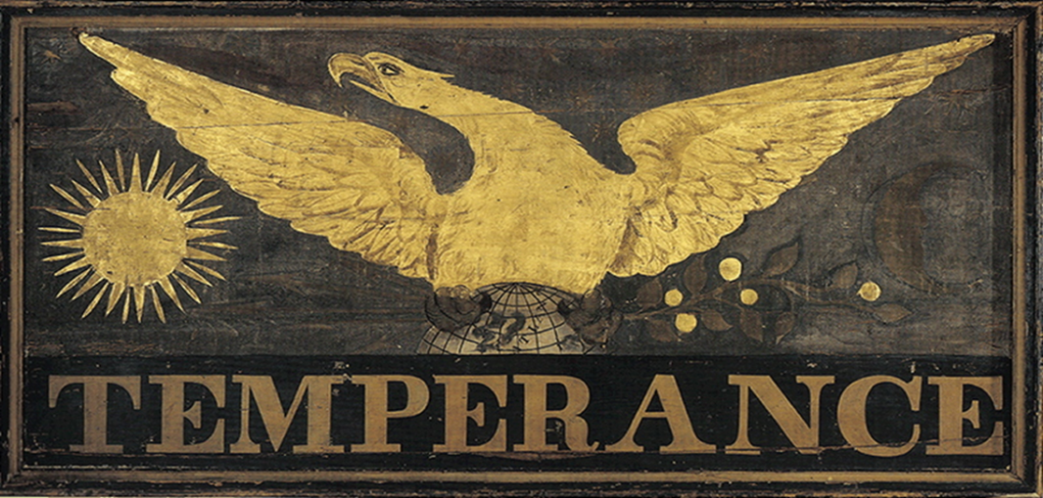
II. Promoting moral improvement
Prohibition, the banning of alcoholic beverages, was one such program
Women’s Christian Temperance Union (WCTU) - founded in Chicago in 1873, promoted the goal of prohibition Members entered saloons, singing, praying, and urging saloonkeepers to stop selling alcohol

Slide 17
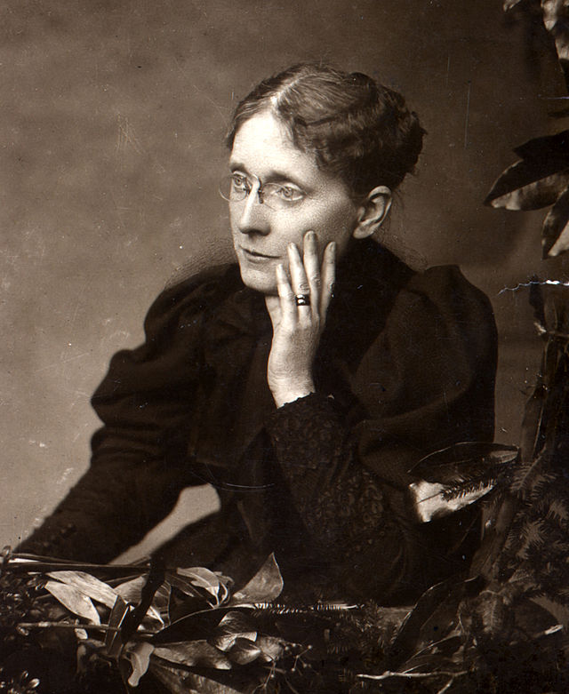
II. Promoting Moral Improvement
Frances Willard - transformed the WCTU from a small mid-western religious group into a powerful national organization
Willard traveled constantly and spoke frequently—in 1883 she spoke in every state of the Union—and was a regular lecturer at the summer Lake Chautauqua meetings in New York.
WCTU members opened kindergartens for immigrants, visited inmates in prisons, worked for suffrage and fought for an 8 hour work day

Slide 18
II. Promoting Moral Improvement
Prohibition
Anti-Saloon League – founded in 1895, called itself “the Church in action against the saloon”; Endorsed politicians that supported Prohibition. Convinced many states, towns, and cities to prohibit the sale, production, or use of alcohol
Carry Nation – worked for prohibition by walking into saloons, scolding the customers, and using her hatchet to destroy the bottles of liquor
Between 1900 and 1910 Nation was arrested some 30 times after leading her followers in the destruction of one water hole after another with cries of "Smash, ladies, smash!"
Prize-fighter John L. Sullivan was reported to have run and hid when Nation burst into his New York City saloon.
Nation mocked her opponents as "rum-soaked, whiskey-swilled, saturn-faced rummies."

Slide 19
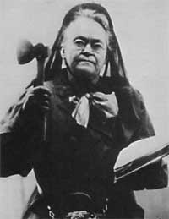
Carrie Nation described herself as "a bulldog running along at the feet of Jesus, barking at what he doesn't like,"

Slide 20
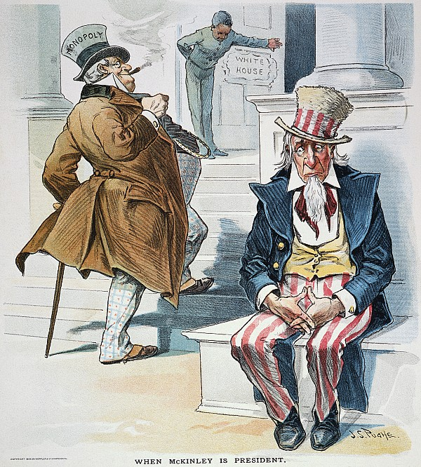
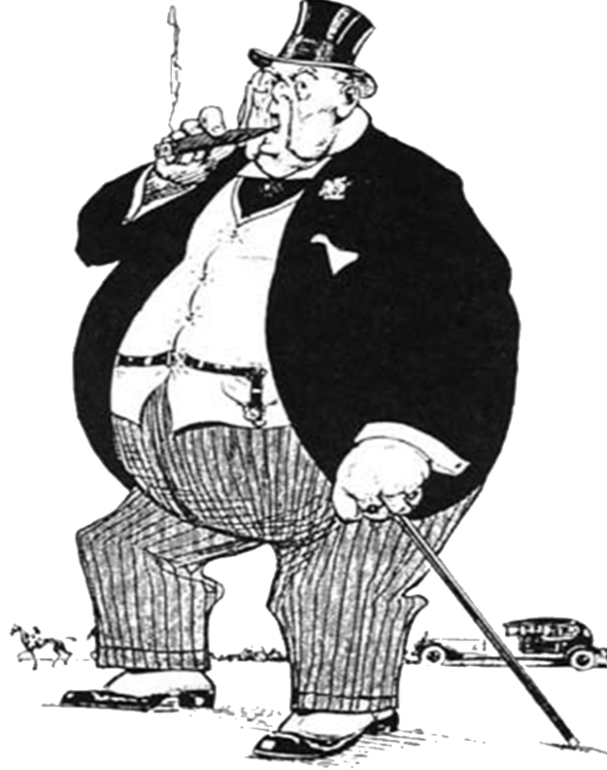
The Origins of Progressivism
Creating Economic Reform –A severe economic panic, or depression, in 1893 prompted some Americans to question the capitalist economic system.

Slide 21
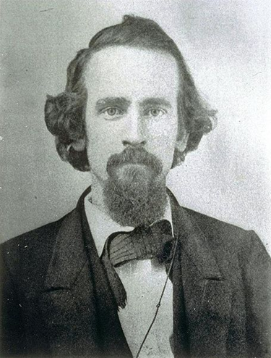
III. Creating economic reform
Henry George writer that criticized the laissez-faire theory
Best remembered as a proponent of the “single tax” on land. The government should finance all of its projects, he argued, with proceeds from only one tax. This single tax would be on the unimproved value of land—the value that the land would have if it were in its natural state with no buildings, no landscaping, and so on
wrote his ideas in Progress and Poverty (1879)

Slide 22
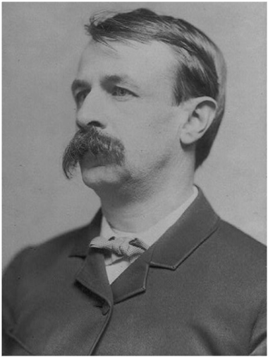
III. Creating economic reform
Edward Bellamy was a writer that also criticized the laissez-faire theory
In Looking Backward (1888), set in Boston in the year 2000, he described the United States under an ideal socialist system that featured cooperation, brotherhood, and an industry geared to human need.
The novel, which sold more than 1,000,000 copies, appealed to a public still suffering the effects of the depression of 1883 and disturbed by such industrial clashes as the Haymarket Riot in Chicago (1886).

Slide 23
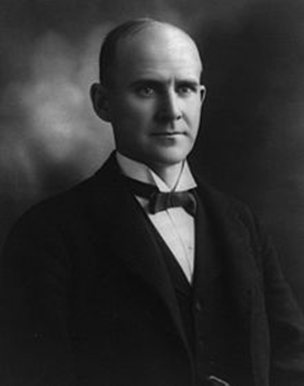
III. Creating economic reform
Eugene V. Debs felt concentrated corporate power had a debilitating effect on the political rights and economic opportunity of the majority of Americans.
Organized the American Railway Union, which waged a strike against the Pullman Company of Chicago in 1894.
After embracing socialism, he became the Socialist Party’s candidate in five presidential elections.
Debs was sentenced to 10 years in prison for his opposition to the United States’ involvement in World War I.

Slide 24
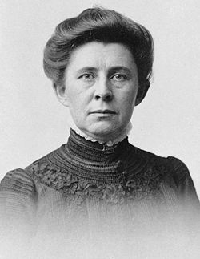
III. Creating economic reform
Ida M. Tarbell – muckraking author of “History of the Standard Oil Company” in McClure’s Magazine
For almost two years, she looked through volumes of public records, including court testimony, state and federal reports and newspaper coverage. From these, she gathered a wealth of information on Rockefeller's rise to power and the methods used by Standard Oil.
Became 19 part series; Tarbell finished the series with a two-part character study; she called Rockefeller "the oldest man in the world -- a living mummy," and accused him of being "money-mad" and "a hypocrite."
Led to the breakup of Standard Oil as a monopoly in 1911

Slide 25
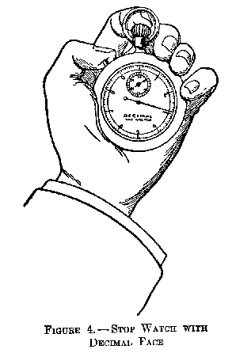
The Origins of Progressivism
IV. Fostering Efficiency – Reformers tried to increase the efficiency of American society

Slide 26
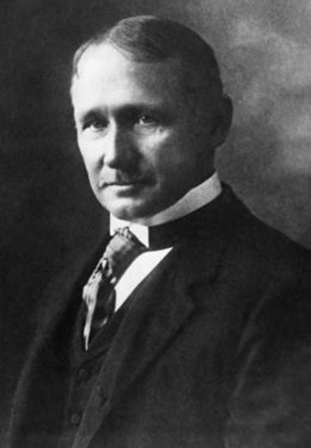
IV. Fostering efficiency
Scientific Management – the effort to improve efficiency in the work place by applying scientific principles to make tasks simpler and easier
Principles of Scientific Management – author Frederick Winslow Taylor declared, “time studies of work forms the basis of modern management”
Assembly Line Production – introduced by Ford Motor Company in 1913; led to a huge increase in production, but exhausted workers

Slide 27
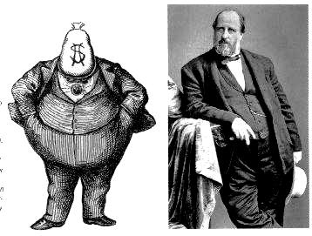
IV. Fostering Efficiency
In many states, political machines rewarded their supporters with jobs and kickbacks and openly bought votes with favors and bribes.
During the progressive movement, efforts were made to reform politics to make government more efficient and responsive to its constituents.

Slide 28
IV. Fostering Efficiency-State Level Political Reform
The first step in reforming political machines was the adoption of the secret ballot, also called the Australian ballot.
Next, the initiative and the referendum gave citizens the power to create laws.
Citizens could petition to place an initiative—a bill originated by the people rather than lawmakers—on the ballot.
Then voters, instead of the legislature, accepted or rejected the initiative by referendum, a vote on the initiative.

Slide 29
IV. Fostering Efficiency-State Level Political Reform
The recall enabled voters to remove public officials from elected positions by forcing them to face another election before the end of their term if enough voters asked for it.
To force Senators to be more responsive to the public, progressives pushed for the popular election of senators.
Before 1913, state legislatures had chosen United States senators, a process that put even more power in the hands of party bosses and wealthy corporation heads.
The Seventeenth Amendment allowed states to begin choosing senators by means of the direct primary.

Slide 30
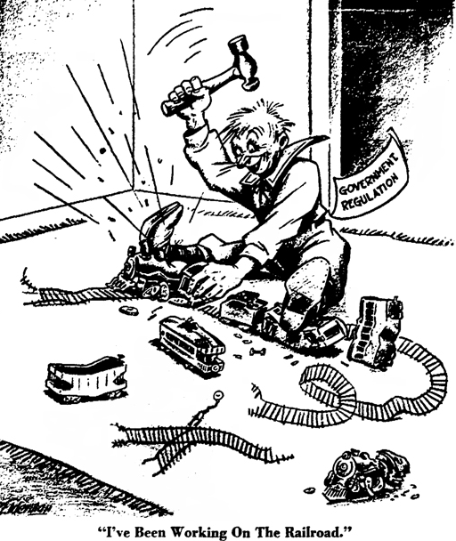
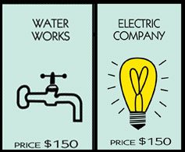
Spurred by progressive governors, many states passed laws to regulate railroads, mines, mills, telephone companies, and other large businesses.

Slide 31
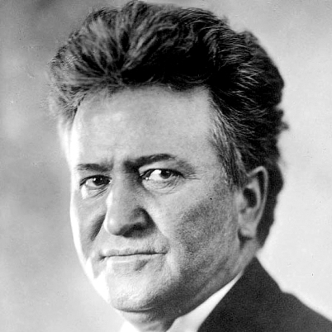
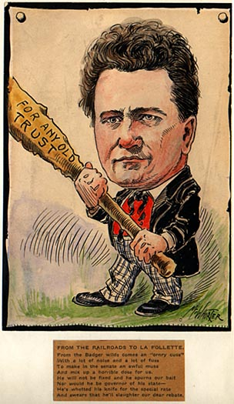
The Origins of Progressivism
Wisconsin Governor, Robert M. La Follette, led the way in driving big businesses out of politics.

Slide 32
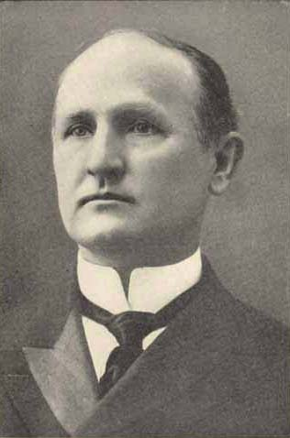
IV. Fostering efficiency
North Carolina’s Progressive Governor was Charles B. Aycock (1901-1905)
“Gentlemen of the General Assembly, you will not have aught to fear when you make ample provision for the education of the whole people. Rich and poor alike are bound by promise and necessity to approve your utmost efforts in this direction.”

