Slide 1
The New Deal (1933-1937)

Slide 2
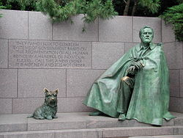
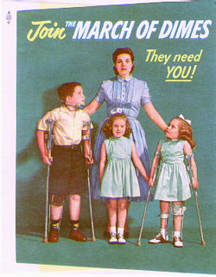
Franklin Delano Roosevelt
Went into politics shortly after college – earned a reputation as a Progressive
Became Assistant Secretary of the Navy and then a nominee for VP in the 1920 election
Contracted polio (misdiagnosed) which paralyzed and numbed both of this legs – took a break from politics

Slide 3
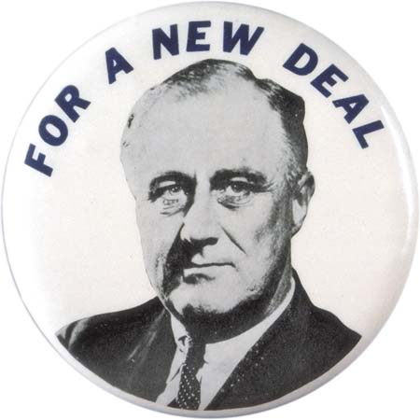
Franklin Delano Roosevelt
1928 – Roosevelt won the election of New York’s governor and brought many successful reforms during the depression
His popularity, and people’s hatred for Hoover, won him the presidency in a landslide in 1932

Slide 4
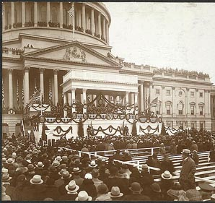
FDR Restored Confidence
In his inaugural address, he said “The only thing we have to fear is fear itself….”
He promised vigorous leadership and bold action, called for discipline and cooperation, expressed his faith in democracy, and asked for divine protection and guidance.

Slide 5
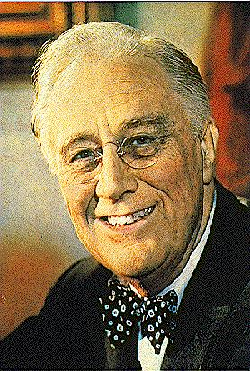
FDR’s Personal Qualities
He was a charismatic person who exhibited a warmth and understanding of people.
He knew how to handle press by focusing attention on Washington.
He provided dynamic leadership in a time of crisis.
He was willing to experiment

Slide 6
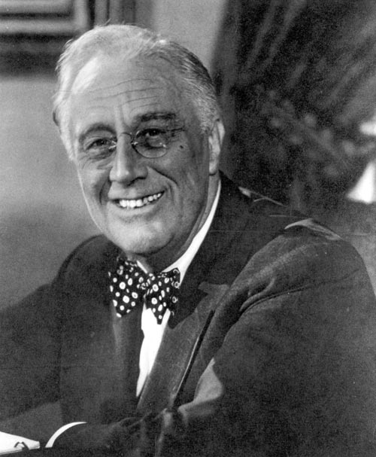
New Deal
Roosevelt’s policies for ending the Great Depression became known as the New Deal
Had a large group of experts working with him to help him generate ideas and programs (“the Braintrust”) – he then made the final decision

Slide 7
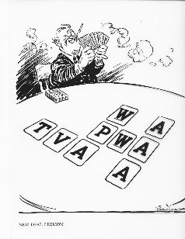
New Deal
Between March 9 and June 16, 1933 he had passed over 15 major acts to try and bring Relief, Recovery and Reform to the Depression – called the Hundred Days

Slide 8
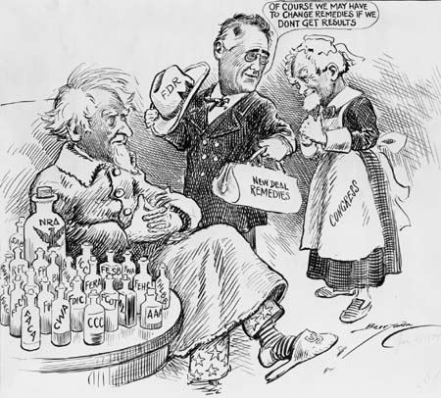
Purposes of the New Deal
Relief: to provide jobs for the unemployed and to protect farmers from foreclosure
Recovery: to get the economy back into high gear, “priming the pump”; regulate business and banks
Reform: To provide social security, to abolish child labor, and to conserve farm lands
Overall objective: to save capitalism

Slide 9
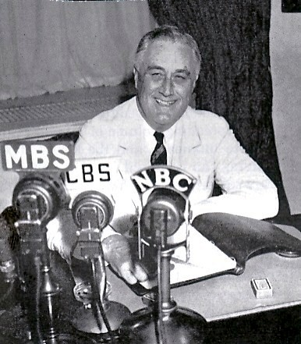
New Deal
Roosevelt then went on the radio to talk to Americans
Assured Americans that it was safe to put their $$$ back in newly licensed banks
FDR kept America informed with radio-broadcast called “fireside chats”

Slide 10
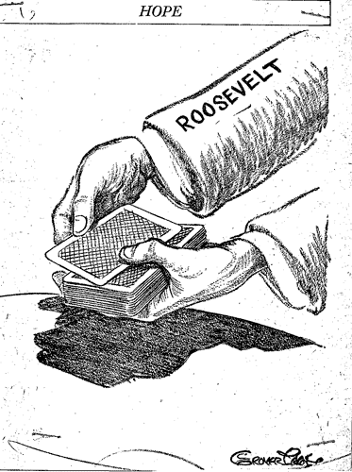

Slide 11
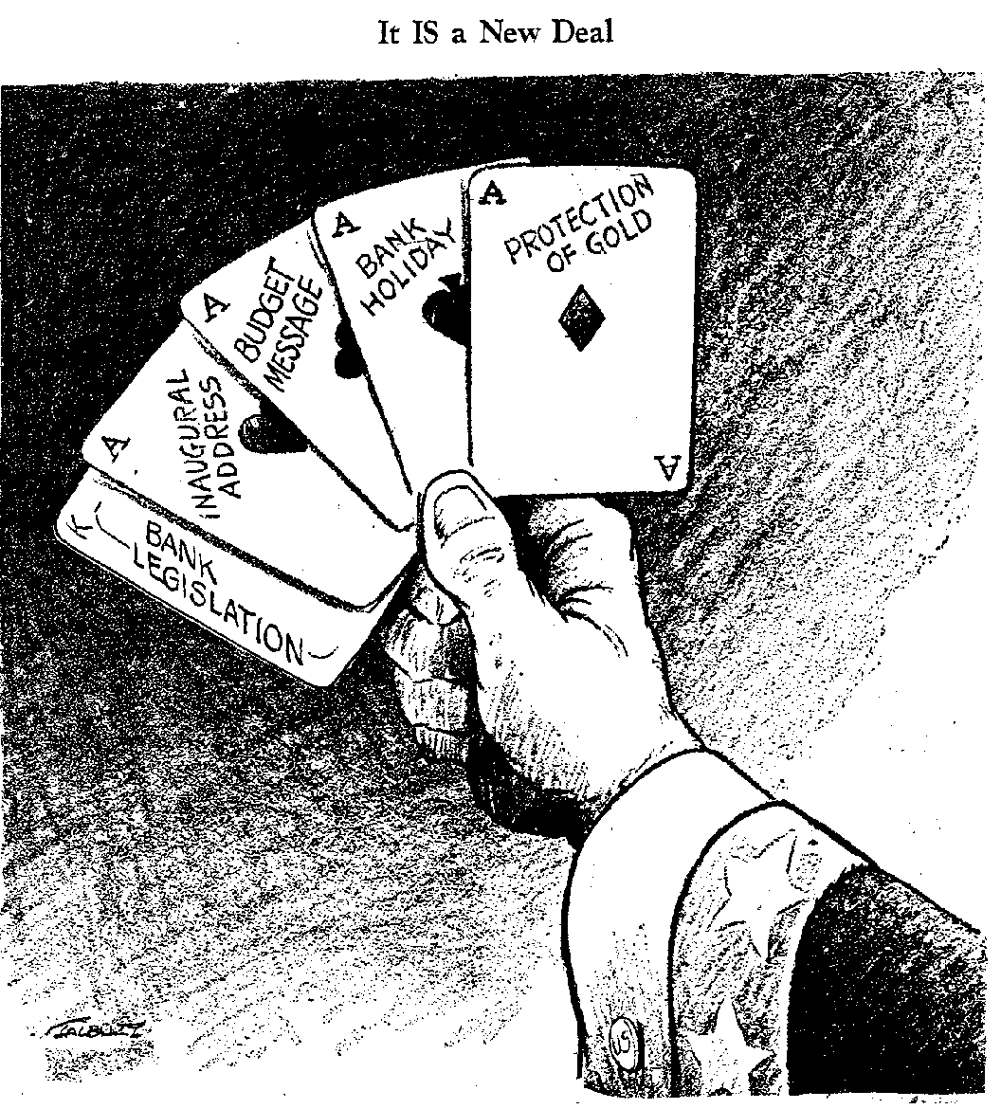
The First New Deal

Slide 12
New Deal Quad Activity
EQ: What were the most impactful and significant New Deal agencies?
With a partner research an assigned New Deal agency and divide the research using the quadrant guidelines of the assignment.
Use the following websites to guide your research:
http://www.fdrlibrary.marist.edu/education/resources/periodictable.html
http://dp.la/exhibitions/exhibits/show/new-deal/relief-programs
http://dp.la/exhibitions/exhibits/show/new-deal/recovery-programs
http://newdeal.feri.org/morefeat2.htm
http://www.history.com/topics/new-deal

Slide 13
Gallery Walk
Using the chart provided yesterday, take a gallery walk around the classroom
Take note of the purpose of each of the New Deal agencies that were researched.
Take a picture to use as a study guide for the Unit 5 Test.
Be prepared to share out.

Slide 14
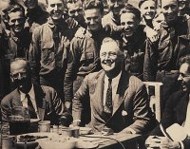
First Hundred Days New Deal (1933-1934)

Slide 15
“Bank Holiday” (1933)
Americans had lost faith in the banking system.
March 5, one day after taking office, FDR declared a bank holiday; all banks were closed to prevent any more withdrawals
Emergency Banking Relief Act allowed Treasury Department to inspect the country’s banks
Revived confidence in banks
March 12, the day before first banks were to reopen, FDR delivered his first “fireside chat” on the banking industry (simple language, informative)

Slide 16
Glass-Steagall Act (1933)
Established the Federal Deposit Insurance Corporation (FDIC )
Provided federal insurance for individual banks accounts up to $5,000
Required banks to act cautiously with customer’s money

Slide 17
Federal Securities Act (1933)
Government regulation of the Stock Market
Required corporations to provide complete and accurate information on all stock offerings
Made company liable for misinformation
1934 established the Securities and Exchange Commission (SEC )

Slide 18
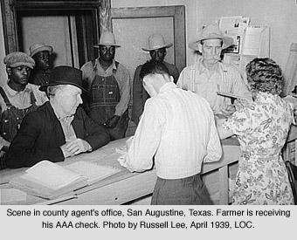
First Agricultural Adjustment Act (AAA)
Purpose: the recovery of agriculture
Paid farmers who agreed to reduce production of basic crops such as cotton, wheat, tobacco, hogs, and corn
Paid farmers $200 million to plow under 10 million acres of crop; paid farmers to slaughter 6 million pigs
upset many Americans, but helped raise farm prices

Slide 19
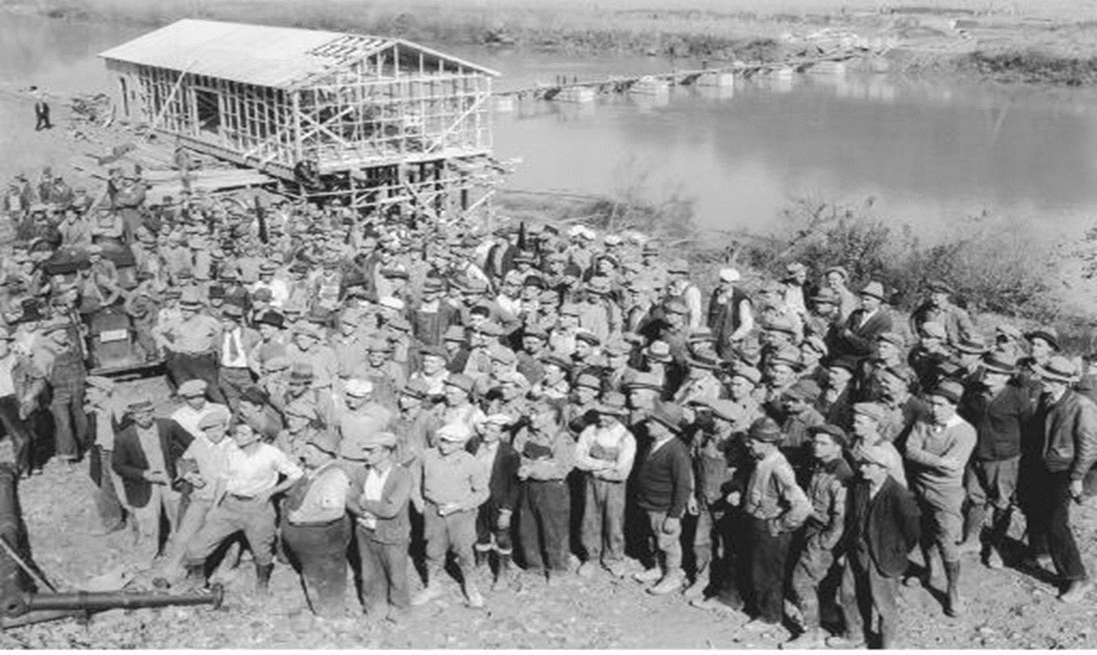
Tennessee Valley Authority
May 18, 1933
Focused on depressed Tennessee River Valley
Built 20 new dams, created thousands of jobs
Provided flood control, hydroelectric power

Slide 20
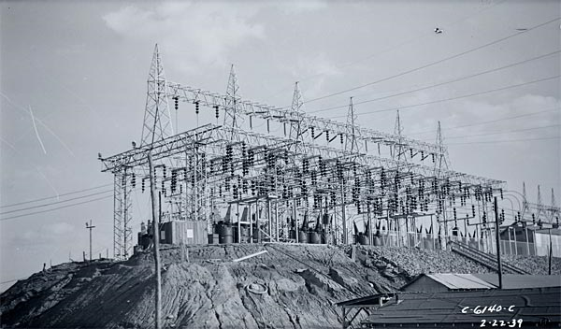

Slide 21
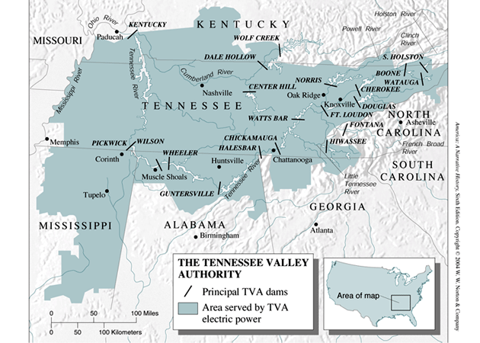
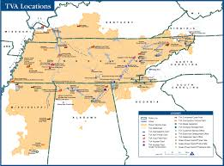

Slide 22
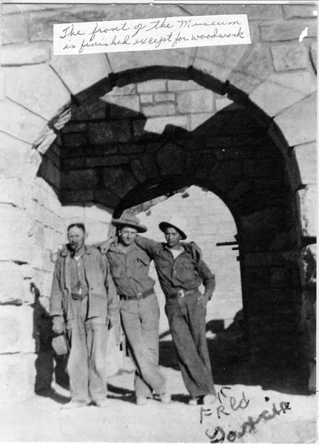
Civilian Conservation Corp (CCC)
Purpose: relief
Gave outdoor work to unemployed men between the ages of 18 and 25
They received $30 per month, but $25 went back to the family
Built roads and bridges (46,000)
developed over 800 state parks, planted over 3 billion trees, helped with soil erosion
Segregated (11% African American by 1938)

Slide 23
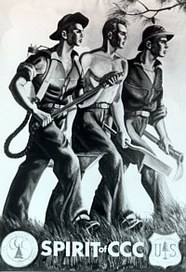
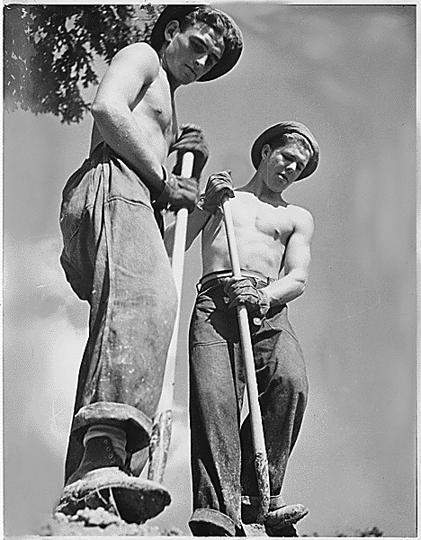

Slide 24
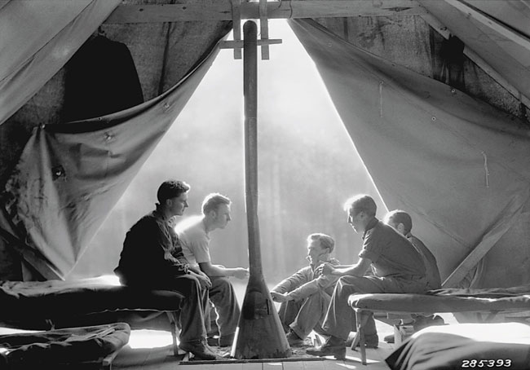

Slide 25
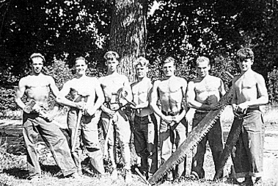

Slide 26
National Recovery Act (NRA)
Purpose: recovery of industry
Created a partnership of business, labor, and government to attack the depression with such measures as price controls, high wages, and codes of fair competition
Blue Eagle; “We do our Part”

Slide 27
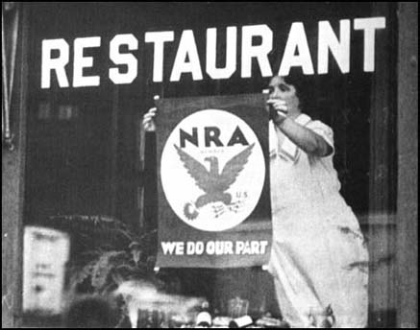

Slide 28
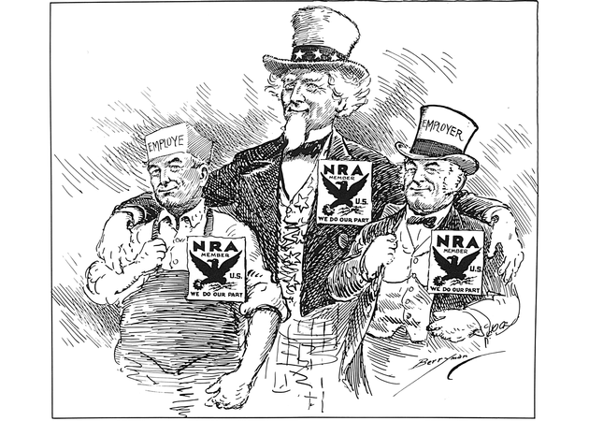

Slide 29
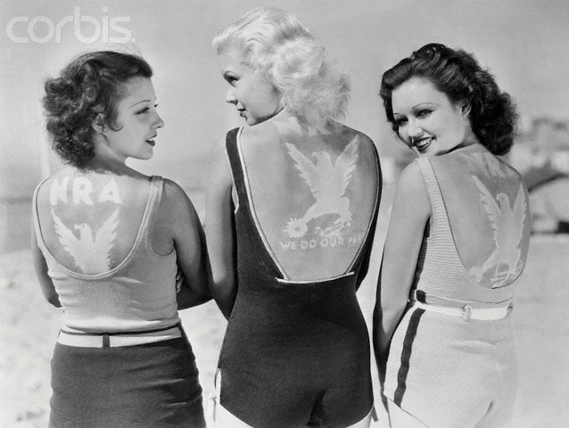

Slide 30
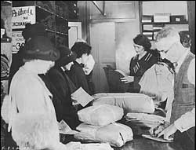
Federal Emergency Relief Admin (FERA)
Purpose: relief
Gave over $500 million to states and municipalities so they could distribute money, clothing, and food to the unemployed

Slide 31
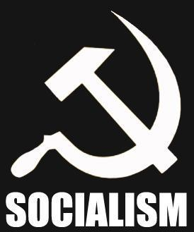
Criticisms by Conservative Opponents
Conservative opponents said the New Deal went too far:
It was socialism (killed individualism)
It added to the national debt because of “deficit spending” ($35 billion)
It wasted money on relief and encouraged idleness
It violated the constitution & states rights
It increased the power of the Presidency (FDR was reaching toward dictatorship, Congress a rubber stamp, independence of judiciary threatened, separation of powers shattered)

Slide 32
Anti-New Deal Organization
Conservative opponents to the New Deal had an organization called the American Liberty League. They had money but were small in numbers, so FDR was not worried.

Slide 33
Supreme Court Reacts to New Deal
By mid 1930s the U.S. Supreme Court agreed with conservative opposition to New Deal
1935 declared the NIRA unconstitutional (enforcement of labor codes wen beyond the federal government’s constitutional powers to regulate interstate commerce)
1935 declared the AAA unconstitutional-ruled that agriculture was a local matter and should be regulated by the state

Slide 34
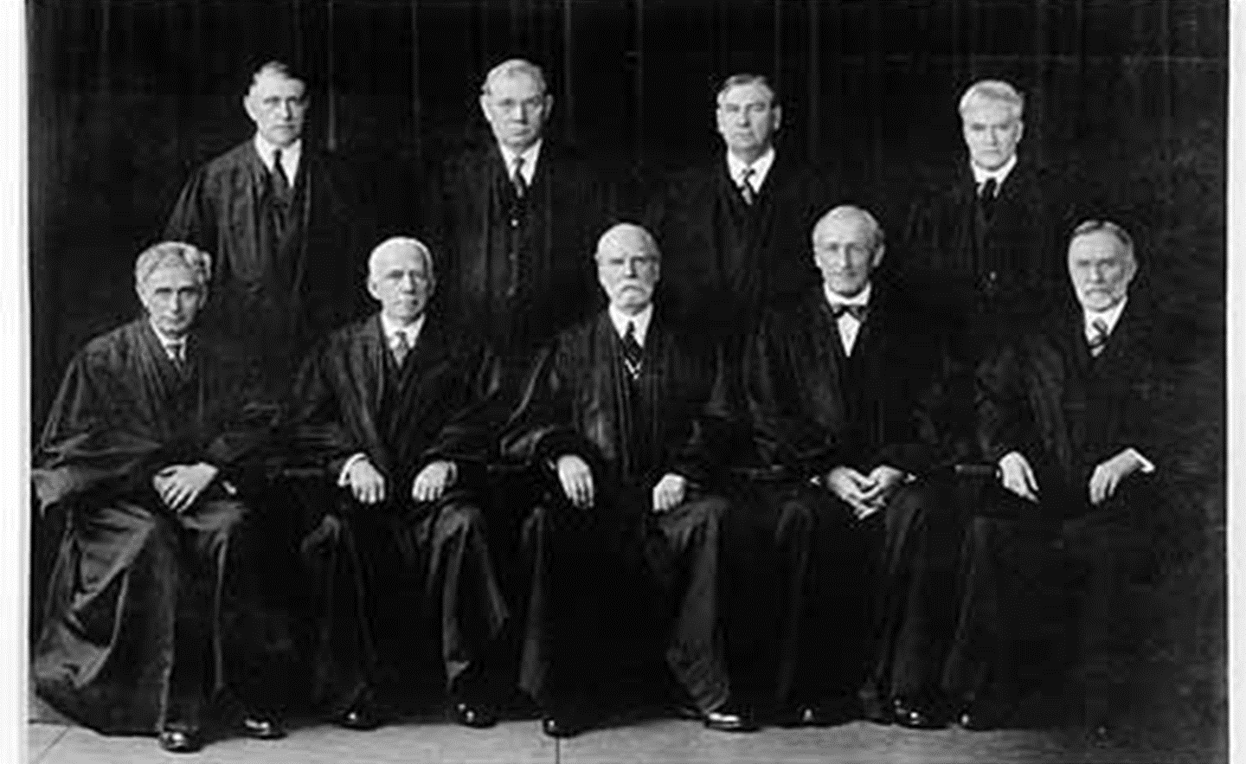
Court Packing Plan
FDR proposed in February 1937 that Congress enact a court-reform bill to reorganize the U.S. Supreme Court
FDR wanted to appoint six new Supreme Court justices
Uproar-many people though president was violating principles of separation of powers
FDR got his way by appointed liberal Hugo S. Black to the court. Rulings began to favor New Deal
Over time he would appoint seven new justices

Slide 35
Criticisms of Radical Opponents
Radical opponents said the New Deal did not go far enough. They were demagogues and had popular followings

Slide 36
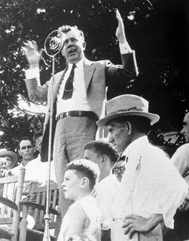
Senator Huey Long (LA)
Senator Huey Long said New Deal relief measures were not enough and advocated a share the wealth plan
(i.e., a guaranteed annual income of at least $5,000 for every American, financed by confiscating wealth of people who made over $5 million per year).
“Every Man a King”

Slide 37
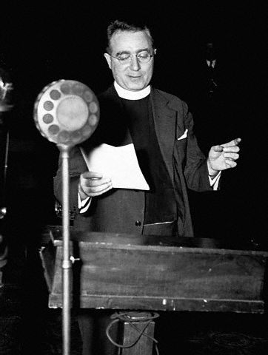
Father Charles E. Coughlin
Father Charles Coughlin was a radio priest from Detroit.
His broadcasts were called the “Golden Hour of the Little Flower.”
He claimed there was an international bankers conspiracy and Jews were responsible.
He advocated nationalization of banking and currency and national resources and demanded a “living wage.”

Slide 38
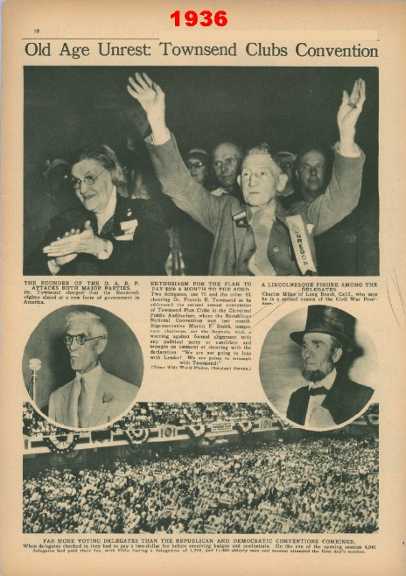
Dr. Francis E. Townsend
Dr. Francis E. Townsend was an elderly physician from CA.
He had a plan for the federal government to pay $200 per month to unemployed people over 60.
The program would be financed by a 2% national sales tax and each pensioner would be required to spend the money in 30 days. This would stimulate the economy.

Slide 39
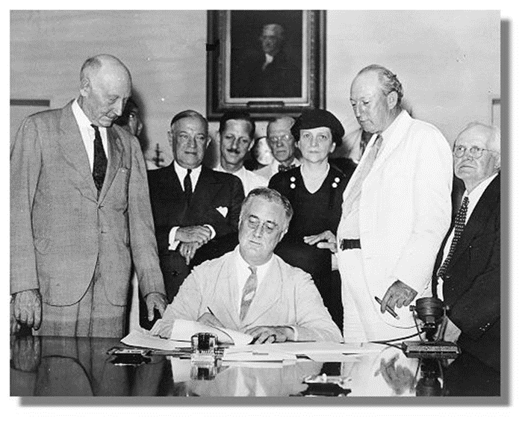
2nd New Deal
FDR’s Second New Deal was between 1935-1938
His last programs tried to help farmers, the poor, workers and children

Slide 40
Works Progress Administration
1935 Works Progress Administration, headed by Harry Hopkins, to replace FERA.
Largest New Deal agency; spent $11 billion to give jobs to more than 8 million workers
Left permanent monuments on the landscape in the form of 125,000 public buildings,651,000 miles of hard-surfaced roads, 850 airports and schools (gave hope)
The WPA also employed a variety of talents in the Federal Writer’s Project, the Federal Art Project, Federal Music Project, and the Federal Theatre Project (criticized)

Slide 41
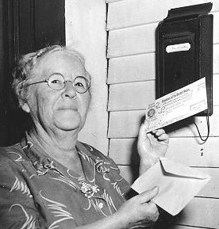
Social Security Act
1935 created by committee chaired by Sec. of Labor Frances Perkins
Three major parts:
Old-age insurance for retirees over 65 and their spouses
Unemployment compensation insurance
Aid to families with dependent children and the disabled
FICA: the Federal Insurance Contributions Act. Today on your pay stub, FICA refers to Social Security tax

Slide 42
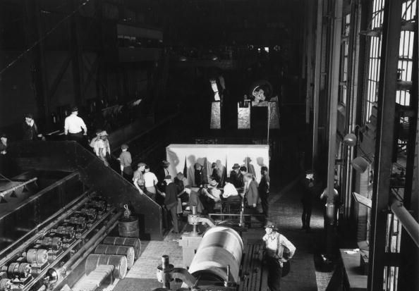
National Labor Relations Act
Purpose: reform
Put restraints on employers and set up a National Labor Relations Board to protect the rights of organized labor to bargain collectively with employers.

Slide 43
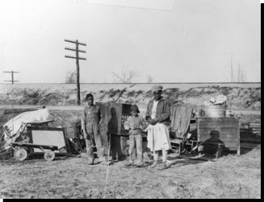
Second Agricultural Adjustment Act
Purpose: recovery for agriculture
Paid farmers for conservation practices, but only if they restricted production of staple crops.

Slide 44
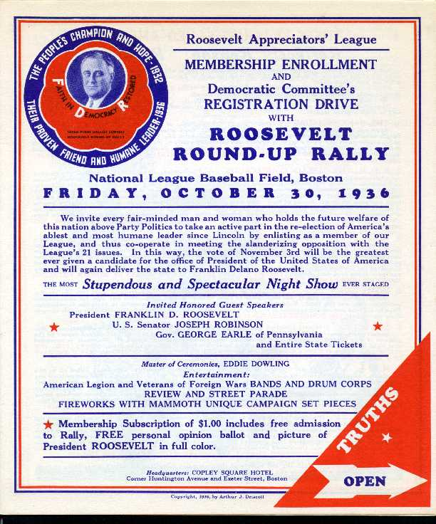
The Election of 1936
The Election of 1936:
Made the Democratic party the majority party
Created a new Democratic coalition composed of both traditional elements and new elements

Slide 45
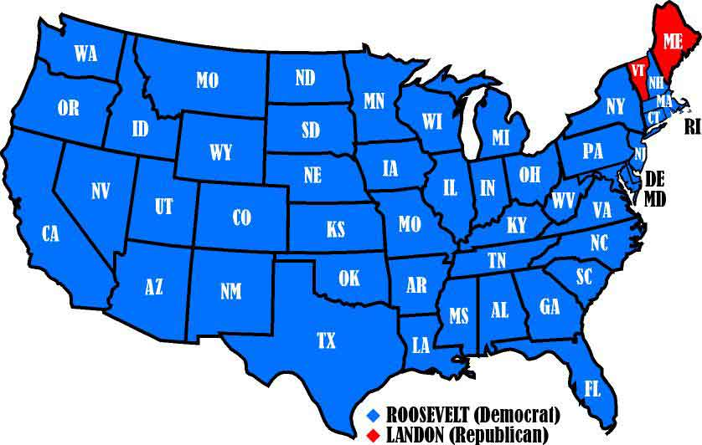

Slide 46
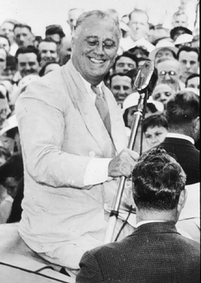
The Roosevelt Coalition
Republicans were still relying on their traditional base of political support (big business, big farmers, and conservatives)
Democrats broadened their constituency by appealing to small farmers in the Midwest, urban political bosses, ethnic blue collar workers, Jews, intellectuals, and African Americans.

Slide 47
Legacy and effects of the New Deal

Slide 48
Larger Role in Economy and Economic Effects
Much more and needed focus on West and South – many of the large-scale public works programs were in these areas
Increased regulatory functions of the federal government to stabilize problem areas (banks, stock market, etc)
Provided tools for the US to promote and regulate economic growth in the future

Slide 49
Introduction of “Welfare State”
“Welfare State” – a government that assumes the responsibility for providing for the welfare of children and the poor, elderly, sick, disabled, and unemployed
Relief programs – jobs, loans, insurance, etc
Social Security System
Direct benefits from the Federal Government
New roles and expectations of government – the federal government is responsible for the welfare of the American people

Slide 50
Political Effects
Changed the office of the presidency
Increase the power of the presidency and the executive office
Made mass media very popular in politics (radio)
Expanded role of the President to manage the economy & the social policy of the nation
22nd Amendment later passed to limit the powers of the President
Rise of the Democratic Party and dominance for the next 40 years

Slide 51
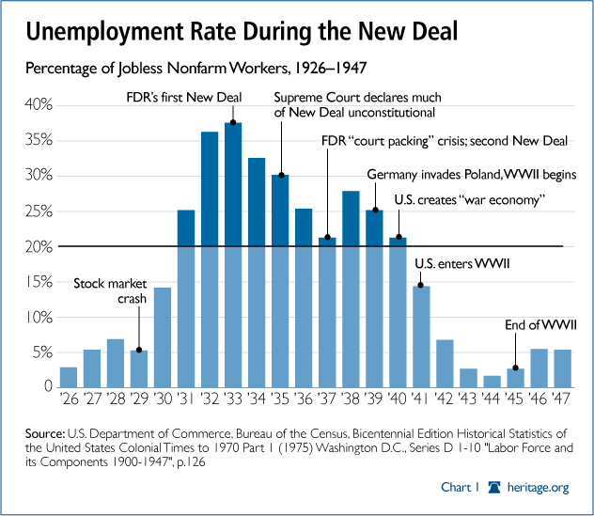

Slide 52
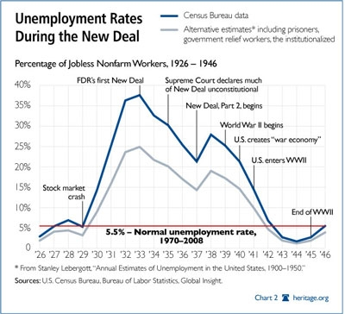

Slide 53
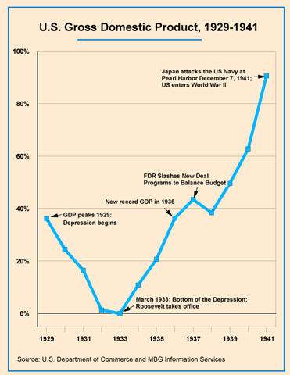

Slide 54
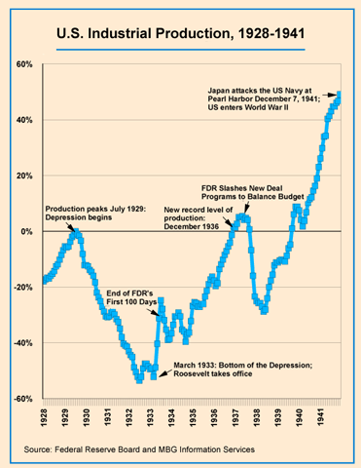

Slide 55
Failures of the New Deal
The New Deal failed to challenge Jim Crow in the South
In some cases whites received more aid than minorities
Unemployment and poverty remained high throughout the Great Depression
The structure and distribution of wealth and power of the American economy remained about the same
The New Deal failed to reform the American economy
The New Deal did not end the Great Depression, it prevented it from getting worse

