Slide 1
The Long Shadow of FDR and the New Deal
Truman, Kennedy, Johnson

Slide 2
Harry Truman and the Fair Deal

Slide 3
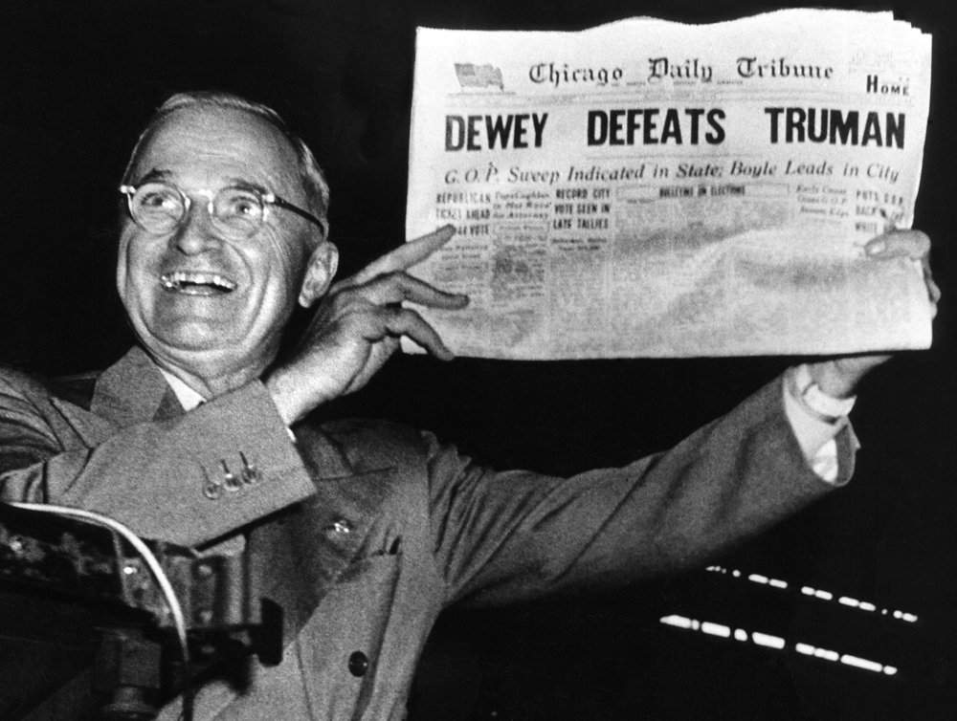
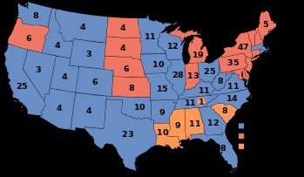
The Fair Deal
In the Election of 1948 Southern Democrats had formed the State’s Rights Democratic Party (Dixiecrats) and nominated their own candidate for president-South Carolina Senator Strom Thurmond; Truman narrowly defeated Republican Thomas Dewey
The Fair Deal was what Truman termed his domestic program during his second term, mainly building on existing programs and trying to extend the New Deal

Slide 4
The Fair Deal
Truman announced his plans for domestic policy reforms including national health insurance, public housing, civil rights legislation and federal aid to education.
After his landslide re-election in 1948, Truman managed to convince Congress to pass several of his liberal reforms.
It almost doubled the minimum wage—from 40 cents to 75 cents an hour
established the Housing Act, which provided 800,000 new houses for the poor.
approved Truman’s extension of Social Security benefits
Emerging conservative elements of Republican Party and Southern Democrats blocked passage of much of the Fair Deal
Congress rejected the idea of national health care, avoided passing any new civil rights legislation and failed to aggressively tackle concerns over fair labor practices

Slide 5
John Kennedy and the New Frontier

Slide 6
The New Frontier
“We stand today on the edge of a New Frontier -— the frontier of the 1960s, the frontier of unknown opportunities and perils, the frontier of unfilled hopes and unfilled threats. ... Beyond that frontier are uncharted areas of science and space, unsolved problems of peace and war, unconquered problems of ignorance and prejudice, unanswered questions of poverty and surplus”
… John Kennedy, acceptance speech at the 1960 Democratic National Convention at the Memorial Coliseum, Los Angeles, California
New Frontier efforts were designed to lower taxes, protect the unemployed, increase the minimum wage, and to focus on the business and housing sectors to stimulate the economy.
New Frontier also proposed new social programs. These included federal aid to education, medical care for the elderly, urban mass transit, a Department of Urban Affairs, and regional development in Appalachia.

Slide 7
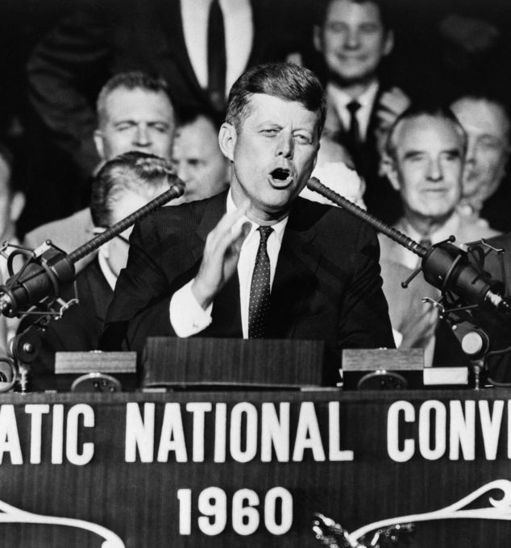
The New Frontier
Lacked deep congressional support because of his small margin of victory in the 1960 election
He did manage an increase in the minimum wage, but a major medical program for the elderly was shot down.
Attempts to cut taxes and broaden civil rights were watered down on Capitol Hill.
The proposal for a Department of Urban Affairs was killed by southern Democrats who thought Kennedy would appoint an African-American as first secretary.
The education bill was dropped on the question of aid to parochial schools
Much of his New Frontier (including civil rights legislation) would be passed as part of LBJ’s Great Society

Slide 8
Lyndon Johnson and the Great Society
“Whatever Lyndon really wants, he gets in the end”

Slide 9
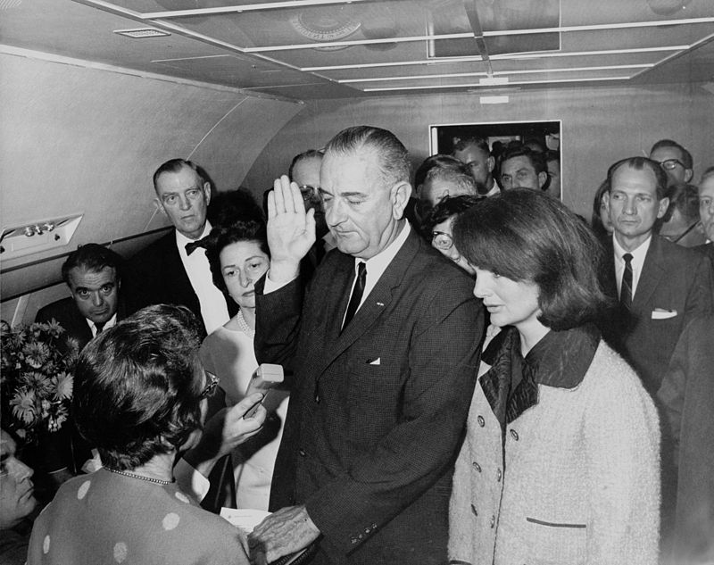
Lyndon Johnson
Texan, took the oath of office for presidency aboard plane that took John Kennedy’s body back to Washington from Dallas
6-3, 55 years old, had spent 26 years on Washington scene and served a decade as Democratic leader of the Senate where he had displayed the greatest gift for compromise since Henry Clay

Slide 10
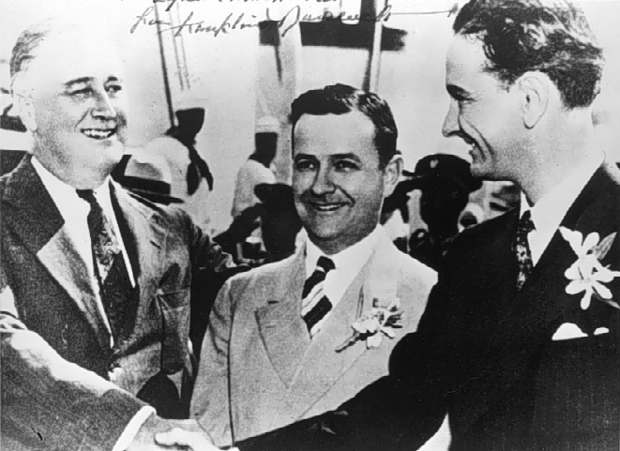
Lyndon Johnson
Had first been sent to Washington from west Texas as a 29 year old congressman in 1937.
Even though he was a New Dealer, he would learn the lesson that liberal politics didn’t always win elections so he positioned himself in the middle.
“I’m damned tired of being called a Dixiecrat in Washington and a communist in Texas”

Slide 11
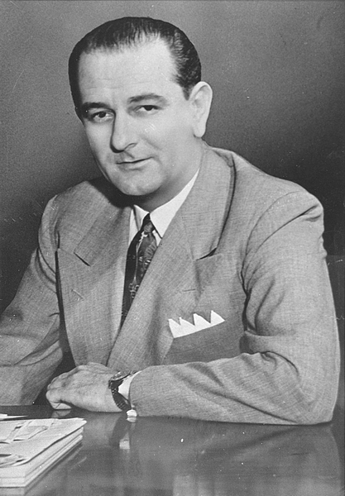
Lyndon Johnson
1948-Lyndon Johnson won a Senate seat from Texas by campaigning in a helicopter. He won with a questionable 87 vote margin (“Landslide Lyndon”).
Became the Democratic majority leader of Senate in 1954 and controlled power second only to President Eisenhower in White House.
After a few drinks in 1958 he told Texas Congressmen Homer Thornberry and Jack Brooks—“I’m a powerful sumbitch, you know that?” “You boys know how damn powerful I am?” “Do you know Ike couldn’t pass the Lord’s Prayer without me?”

Slide 12
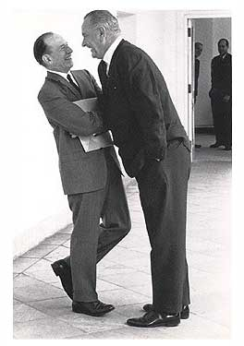
Lyndon Johnson
“Johnson Treatment”—display of flesh pressing, backslapping, in your face arm-twisting that overbore friends and enemies.
His ego and vanity were legendary
on a visit to the Pope, Johnson was presented a precious fourteenth-century painting from the Vatican art collection
in return, LBJ gave the pope a bust—of LBJ

Slide 13
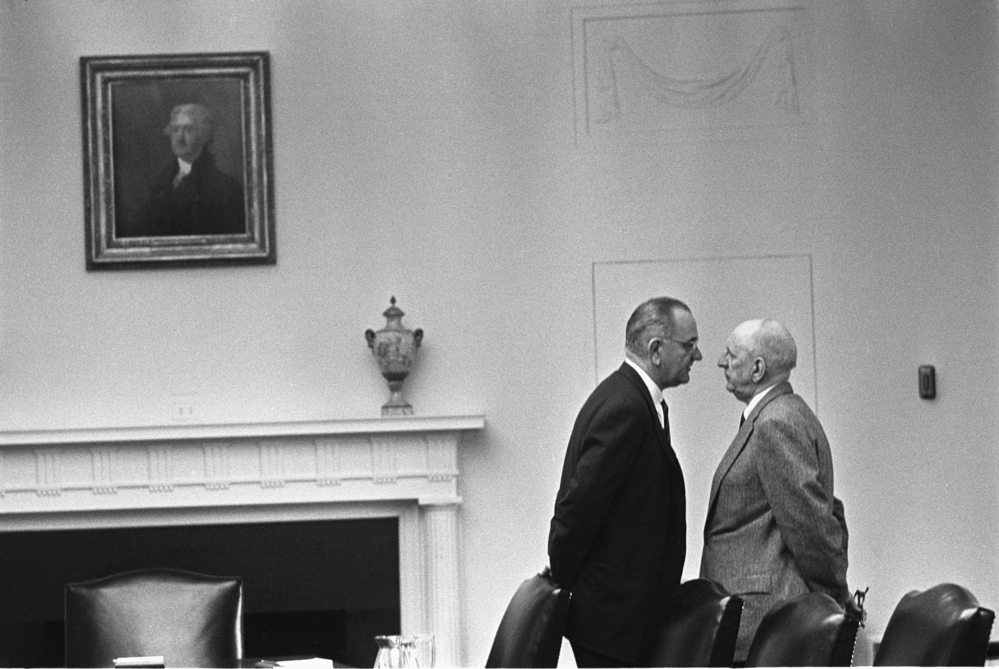

Slide 14
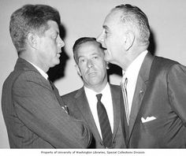
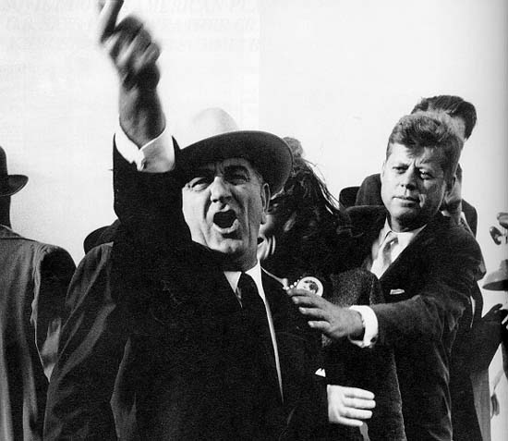

Slide 15
Lyndon Johnson
Self-made man who through determination and manipulation worked his way out of rural Texas to become a powerful politician.
He began his professional life as a school teacher.
Had none of Kennedy’s elegance or charm. Was rough, domineering and craved political power and public affection
First southern president since Woodrow Wilson, and harbored a feeling of being a Washington “outsider” like another southern president—Andrew Jackson
Thought by many to be a typical southern conservative, but held long-standing admiration for Franklin Roosevelt, as well as a commitment to the poor and civil rights. Referred to FDR as his political “Daddy” and had supported New Deal measures
Wanted to be the greatest American president who would do the most good for the most people.
Would not allow anyone or anything to stand in his way.

Slide 16
The War on Poverty
At top of his agenda were tax reductions that Kennedy had proposed and civil rights. He added a bold new idea—“This Administration today, here and now, declares unconditional war on poverty in America”.
Poverty had been “rediscovered” after the social critic Michael Harrington published an expose titled The Other America (1962). He argued that more than 40 million people were mired in a “culture of poverty…To be impoverished is to be an internal alien, to grow up in a culture that is radically different from the one that dominates the society”.
Money for the “War on Poverty” would come from the tax revenues generated by corporate profits that had resulted from capital investment and increased individual purchasing power made possible by tax cuts of 1964.

Slide 17
War on Poverty
Economic Opportunity Act of 1964 incorporated a wide range of programs
Job Corps for inner-city youths aged sixteen to 21
a Head Start program for disadvantaged preschoolers
work study jobs for college students
grants to farmers and rural businesses
loans to those willing to hire the chronically unemployed
the Volunteers in Service to America (VISTA, a domestic “Peace Corps”), and the Community Action Program, which would provide maximum participation of the poor in directing neighborhood programs designed for their benefit

Slide 18
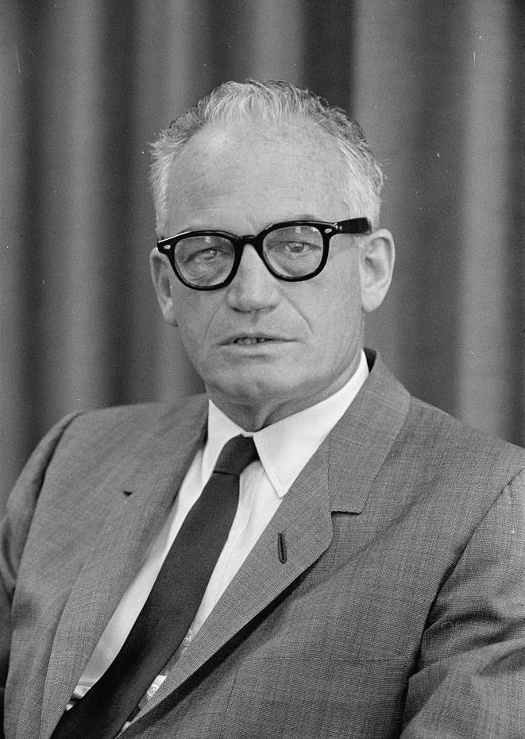
Election of 1964
New conservative movement offered the voters “a choice, not an echo”.
By 1960, Arizona Senator Barry Goldwater, a millionaire department store magnet had become the leader of the Republican right; His book, The Conscience of a Conservative (1960)
During the 1964 campaign, Goldwater developed a knack for frightening voters.
He urged wholesale bombing of North Vietnam.
He trashed Johnson’s “War on Poverty” and the entire New Deal tradition.
He was foolishly candid—He proposed the sale of the Tennessee Valley Authority while in Tennessee
in St. Petersburg, Florida, a major retirement community, he questioned the value of Social Security.
He opposed the nuclear test ban and the Civil Rights Act.

Slide 19
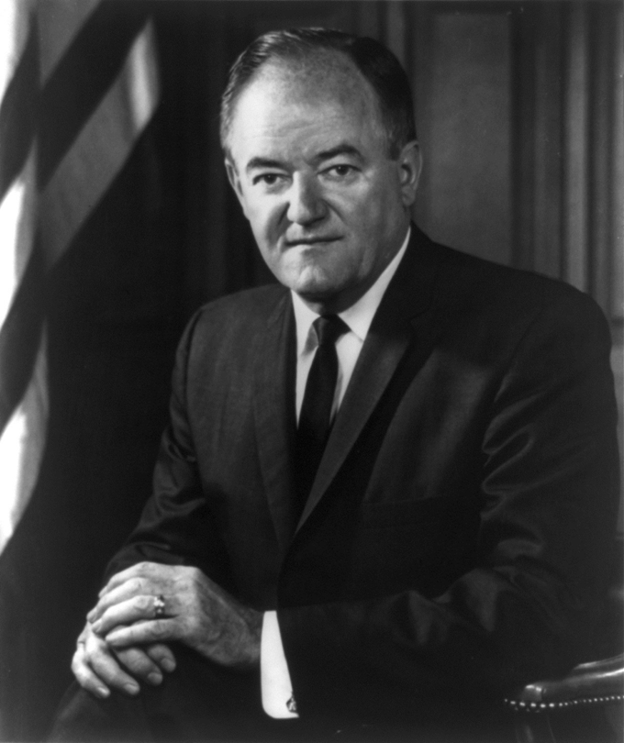
Election of 1964
Republican campaign buttons—“In your heart, you know he’s right”. Democrats—“In your guts, you know he’s nuts.”
Johnson chose the center again. He chose Hubert Humphrey, liberal Senator from Minnesota and a promoter of civil rights as his running mate.
He toned down his rhetoric on Vietnam—“We are not about to send American boys nine or ten thousand miles from home to do what Asian boys ought to be doing for themselves.”
Daisy Commercial

Slide 20
Election of 1964
True Landslide—Johnson won 61% of the popular vote and took the electoral votes 486—52. In the Senate the Democrats increased their majority by two (68—32) and in the House by thirty seven (295—140).
As a foreshadowing politically of things to come the solid Democratic South broke and voted for Goldwater—Louisiana, Mississippi, Alabama, Georgia, and South Carolina.
Other than Jimmy Carter in 1976, this would be the last time a Democratic presidential nominee took the state of North Carolina until Barack Obama in 2008

Slide 21
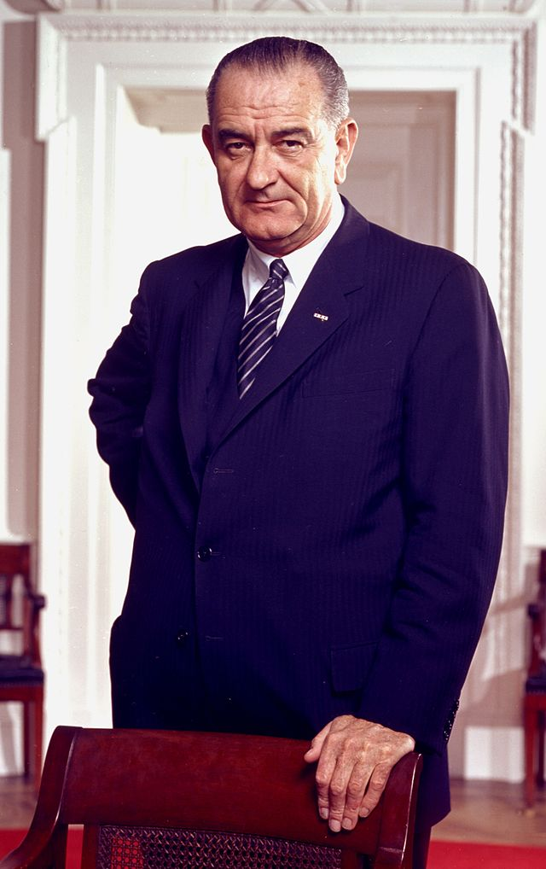
The Great Society
President Johnson announced his "Great Society" during the presidential campaign of 1964.
During the campaign, in Ann Arbor Michigan in 1964, Johnson called for a “Great Society” resting on “abundance and liberty for all. The Great Society demands an end to poverty and racial injustice, to which we are fully committed in our time”.
He described the Great Society as "A place where men are more concerned with the quality of their lives than the quantity of their goods."

Slide 22
The Great Society
Johnson—“every day I’m in office, I’m going to lose votes…I’m like a sweetheart to Congress right now. They love me because I’m new and courting ‘em, and it’s kinda exciting, like that first kiss. But after a while the new will wear off. Then Congress will complain that I don’t bring enough roses or candy and will accuse me of seeing other girls… I’m going to alienate somebody…We’ve got to get this legislation fast. You’ve got to get it during my honeymoon…”
As a result, Johnson flooded Congress with legislation in 1965

Slide 23
The Great Society
Bill for Medicare and Medicaid signed into law on July 30, 1965 in Independence, Missouri with 81 year old Harry Truman looking on. Medicare provided hospital insurance and low-cost medical insurance for anyone over 65. Medicaid extended health insurance to welfare recipients under the Social Security system.
Elementary and Secondary Education Act proposed $1.5 billion in federal aid to elementary and secondary education for textbooks, library materials, and special education. His elementary school teacher, Katie Deadrich was there in Johnson City, Texas to watch Johnson sign it into law—April 11, 1965
The Appalachian Regional Development Act of 1966—provided $1 billion for programs in remote mountain areas
Housing and Urban Development Act of 1965 provided $3.5 billion for urban renewal and the construction of 240,000 housing units. Funds for rent supplements followed for low-income families

Slide 24
The Great Society
Department of Housing and Urban Development was created and headed by Robert Weaver, the first black cabinet member.
Immigration Act of 1965—signed in a ceremony on Liberty Island, New York Harbor. Abolished discriminatory national quotas of 1920s. Caused huge influx of Asians and Latin Americans
Highway Safety Act and Traffic Safety Act (1966) set safety standards for automobile manufacturers and highway design (influence by Ralph Nader’s Unsafe at Any Speed)
Higher Education Act (1965) provided scholarships and low interest loans
Water Quality Act (1965) and Air Quality Act (1967) Set federal guidelines for states to follow on pollution and emissions (influence by Rachel Carson’s 1962 publication of Silent Spring)

Slide 25
The Great Society
National Foundation on the Arts and the Humanities (1965) created to financially assist painters, musicians, actors, and other artists
Corporation for Public Broadcasting (1967). Formed to fund educational TV and radio broadcast

Slide 26
The Great Society and the war in Vietnam
Economic Costs: LBJ believed that the United States could simultaneously wage war and fulfill the goals of the Great Society.
But the United States, could not afford to invest in both "guns" and "butter."
The war cost the United States more than $140 billion. Vietnam drained American coffers, took money away from Johnson's ambitious domestic programs, and undermined his ambitious Great Society.
“That damn war killed my lady”

