Slide 1
The Great West
APUSH: KC 6.1.3 The Populists

Slide 2
KC 6.1.3
Key Concept 6.1: Technological advances, large-scale production methods, and the opening of new markets encouraged the rise of industrial capitalism in the United States.
III. New systems of production and transportation enabled consolidation within agriculture, which, along with periods of instability, spurred a variety of responses from farmers.
A) Improvements in mechanization helped agricultural production increase substantially and contributed to declines in food prices.
B) Many farmers responded to the increasing consolidation in agricultural markets and their dependence on the evolving railroad system by creating local and regional cooperative organizations.
C) Economic instability inspired agrarian activists to create the People’s (Populist) Party, which called for a stronger governmental role in regulating the American economic system.

Slide 3
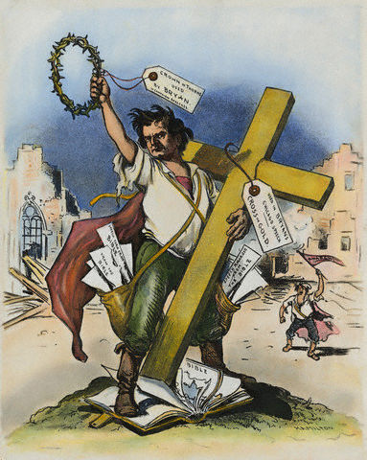
What’s the main idea of this cartoon? How do you know?
What Association Links can you make?

Slide 4
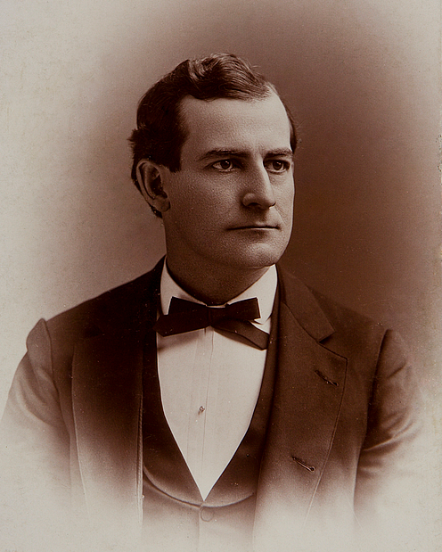
Populism
The belief that the will of ordinary citizens should prevail over that of a privileged elite.

Slide 5
Big Idea
The financial problems facing 19th century American farmers in the South and West contributed to the rise of political movements that permanently changed American politics.
Essential Questions:
What were the financial problems facing farmers and what were their causes?
How did farmers organize and protest politically?
What were their demands?
How did these demands influence American politics well into the 20th century?)

Slide 6
I. What were the financial problems facing farmers and what were their causes?
Decline in commodity prices between 1870 and 1898
Caused by increased production and international competition for world markets
Led many farmers to question the American economic system…How can one speak of overproduction when so many people were in need
Railroads and Bankers were seen as the villains
Railroads charged high rates and could get away with them in remote western areas
Farmers failed to get rebates from railroads like other big businesses
Farmers had little political or economic power (when farmers went to sell their crops, the buyer set the price; when farmers had to buy goods, such as a plow, the seller set the price)

Slide 7
I. What were the financial problems facing farmers and what were their causes?
High Tariffs
Protected manufacturers, not farmers. Allowed manufactures to raise prices of factory goods that farmers had to buy (plow, mechanical reaper)
Farmers had to sell their wheat, cotton, etc. in foreign markets where competition lowered prices
Debt
Western farmers got mortgages to cover the cost of land and machinery
As commodity prices dropped, the debt burden increased; farmer’s solution was typically to grow more which further lowered the price

Slide 8
I. What were the financial problems facing farmers and what were their causes?
Deflation
From 1865 to 1890 the amount of currency in circulation decreased 10%. This deflation increased the cost of borrowing money as a tight money supply caused bankers to hike interest rates on loans
Depression of 1893
Philadelphia and Reading Railroad declared bankruptcy and started a panic on Wall Street; by fall of 1893 600 banks had closed; by 1894 750,000 workers were on strike
1894 Coxey’s Army marched on Washington demanding the federal government provide unemployed meaningful work

Slide 9
II. How did farmers organize and protest politically? What were their goals or demands?
The Granger Movement
Founded by Oliver H. Kelley as the Patrons of Husbandry, or the Grange
Reached a membership of 1.5 million people by 1874
Began as a way for farmers to have a social and educational outlet; then shifted to promotion of farmer-owned cooperatives for the buying and selling of goods (create your own marketplace)
Goals/Demands
State regulation of railroad rates and crop warehouses
Five states passed “Granger Laws”; Supreme Court supported in Munn v. Illinois (1877) that state had the right to regulate property that had a public interest
Grange members would help form the Greenback party which favored currency expansion with more paper money

Slide 10
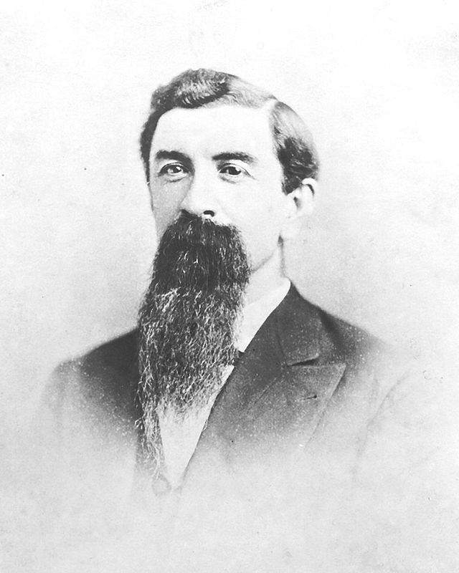
Leonidas L. Polk
Polk was an early leader of the Grange (the Patrons of Husbandry), an agricultural organization that had limited success in North Carolina.
In 1886, Polk founded the Progressive Farmer and editorialized for agriculture improvement, farmer club organization, and establishment of a separate state agricultural college under the Morrill Act.
In 1887, the North Carolina College of Agricultural and Mechanic Arts (later N.C. State) was established;
In 1889, Polk was elected president of the National Farmers’ Alliance; he was re-elected in 1890 and 1891.
In early 1892, rumors were that Polk would be the Populist presidential nominee.

Slide 11
II. How did farmers organize and protest politically? What were their goals or demands?
Farmer’s Alliances
Similar to the Grange because they offered social and recreational opportunities for isolated farming families; but also emphasized political action
Farmers joined to get relief from debt, declining prices, and droughts
Grassroots local organization
Strong in Kansas and the Dakotas
In 1886, the Texas alliance helped organize the Colored Alliance stressing economic justice, not social equality
By 1890, the Alliance Movement had 1.5 million members while the Colored Farmers’ Alliance had over 1 million
Welcomed rural men and women over 16 who displayed “good moral character”, believed in God and demonstrated “industrial habits”
Tom Watson was respected southern alliance leader from Georgia; took lead in the fusion movement of black tenant farmers and sharecroppers with their white counterparts to challenge the white political elites
Goals/Demands
Pushed for “subtreasury plan” where farmers could store their crops in government warehouses and obtain government loans for up to 80% of their crop value at 1% interest; goal was to allow the farmer to hold the crop for a better price

Slide 12
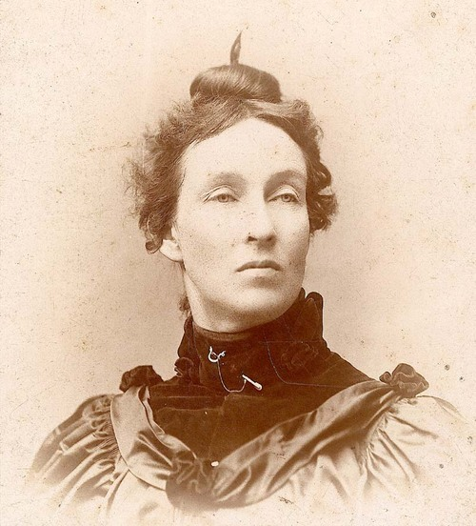
Mary Elizabeth Lease
Best-known orator of the Populist movement
Born in Pennsylvania in 1850 to Irish parents, Lease became a school teacher in Kansas in 1870. She and her husband, spent ten years trying to make a living farming, but finally gave up in 1883
Lease entered political life as a speaker for the Irish National League, and later emerged as a leader of the Populists.
Lease mesmerized audiences in Kansas, Missouri, the Far West, and the South with her powerful voice and charismatic speaking style.

Slide 13
Mary Elizabeth Lease
…You wonder, perhaps, at the zeal and enthusiasm of the Western women in this reform movement. Let me tell you why they are interested. Turn to your old school-maps and books of a quarter of a century ago, and you will find that what is now …To this sterile and remote region, infested by savage beasts and still more savage men, the women of the New England States, the women of the cultured East, came with husbands, sons and brothers to help them build up a home upon the broad and vernal prairies of the West…We left the old familiar paths, the associations of home and the friends of childhood. We left schools and churches—all that made life dear—and turned our faces toward the setting sun. We endured hardships, dangers and privations; hours of loneliness, fear and sorrow; our little babes were born upon these wide, unsheltered prairies; and there, upon the sweeping prairies beneath the cedar trees our hands have planted to mark the sacred place, our little ones lie buried. We toiled in the cabin and in the field; we planted trees and orchards; we helped our loved ones to make the prairie blossom as the rose. The neat cottage took the place of the sod shanty, the log-cabin and the humble dug-out. Yet, after all our years of toil and privation, dangers and hardships upon the Western frontier, monopoly is taking our homes from us by an infamous system of mortgage foreclosure, the most infamous that has ever disgraced the statutes of a civilized nation.

Slide 14
II. How did farmers organize and protest politically? What were their goals or demands?
The Populist Party
1892-meeting in St. Louis proposed a national convention of the People’s Party at Omaha to adopt a platform and choose national candidates
Platform demanded subtreasury plan, free and unlimited coinage of silver, increase of amount of money in circulation and graduated income tax; government should nationalize the railroads, and the telephone and telegraph systems; reclaim excess land from railroads;
Platform also called for 8 hour workday and immigration restriction—hoped to gain support from urban workers
Nominated James B. Weaver from Iowa as first presidential candidate; gained 1 million votes (10% of total votes cast) and won the states of Colorado, Kansas, Nevada and Idaho (22 electoral votes)

Slide 16
II. How did farmers organize and protest politically? What were their goals or demands?
The Election of 1896
Republicans chose William McKinley on a gold-standard platform
William Jennings Bryan would be nominated as the Democratic candidate (and Populist candidate)
Baptist and advocate of free coinage of silver
2 term congressman from Nebraska
At 1896 Democratic convention, his “Cross of Gold” speech had 20,000 delegates on their feet and in tears
His nomination split the Democratic party as pro-gold Democrats nominated Alton Parker
McKinley won the popular vote by 7.1 million to 6.5 million for Bryan and the electoral college vote by 271 to 176

Slide 18
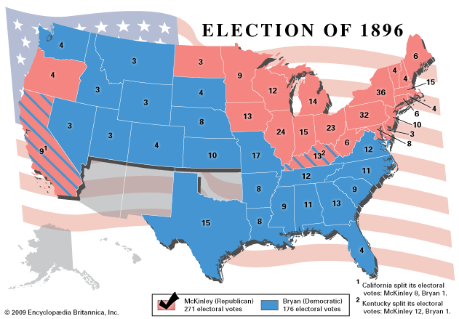

Slide 19
III. How did these demands influence American politics well into the 20th century?)
All of the Populist demands would eventually be made into law initially by Progressive Presidents (T. Roosevelt, Taft, Wilson) and later by F. Roosevelt and New Deal Democrats
Populism represents a strand of political activism that periodically rises up during Presidential Elections, often represented by third party candidates and often influential in shaping the platform of the major two parties
Ralph Nader (Green Party in 1996 and 2000)
H. Ross Perot (1992 Independent and 1996 Reform Party)
Bernie Sanders (2016 Democratic candidate)

Slide 20
Big Idea Extension Activity
The financial problems facing 19th century American farmers in the South and West contributed to the rise of political movements that permanently changed American politics.
Use the following documents in a group jigsaw activity to support the big idea.
Populist Party Platform
William Jennings Bryan, “Cross of Gold” speech
Political cartoons on the Railroad
Leonidas L. Polk, Biography
Mary Elizabeth Lease, speech

Slide 21
Populist Party Platform
Wealth belongs to him who creates it, and every dollar taken from industry without an equivalent is robbery. “If any will not work, neither shall he eat.” The interests of rural and civic labor are the same; their enemies are identical. ..
We believe that the time has come when the railroad corporations will either own the people or the people must own the railroads,
FINANCE.—We demand a national currency, safe, sound, and flexible, issued by the general government only, a full legal tender for all debts, public and private, and that without the use of banking corporations, a just, equitable, and efficient means of distribution direct to the people... We demand free and unlimited coinage of silver and gold at the present legal ratio of l6 to 1…We demand a graduated income tax.
TRANSPORTATION—Transportation being a means of exchange and a public necessity, the government should own and operate the railroads in the interest of the people. The telegraph, telephone, like the post-office system, being a necessity for the transmission of news, should be owned and operated by the government in the interest of the people.
LAND.—The land, including all the natural sources of wealth, is the heritage of the people, and should not be monopolized for speculative purposes, and alien ownership of land should be prohibited.

Slide 22
William Jennings Bryan
The most famous speech in American political history was delivered by William Jennings Bryan on July 9, 1896, at the Democratic National Convention in Chicago.
The issue was whether to endorse the free coinage of silver at a ratio of silver to gold of 16 to 1.

Slide 23
William Jennings Bryan “Cross of Gold”
If they dare to come out in the open field and defend the gold standard as a good thing, we shall fight them to the uttermost, having behind us the producing masses of the nation and the world. Having behind us the commercial interests and the laboring interests and all the toiling masses, we shall answer their demands for a gold standard by saying to them, you shall not press down upon the brow of labor this crown of thorns. You shall not crucify mankind upon a cross of gold.

Slide 24
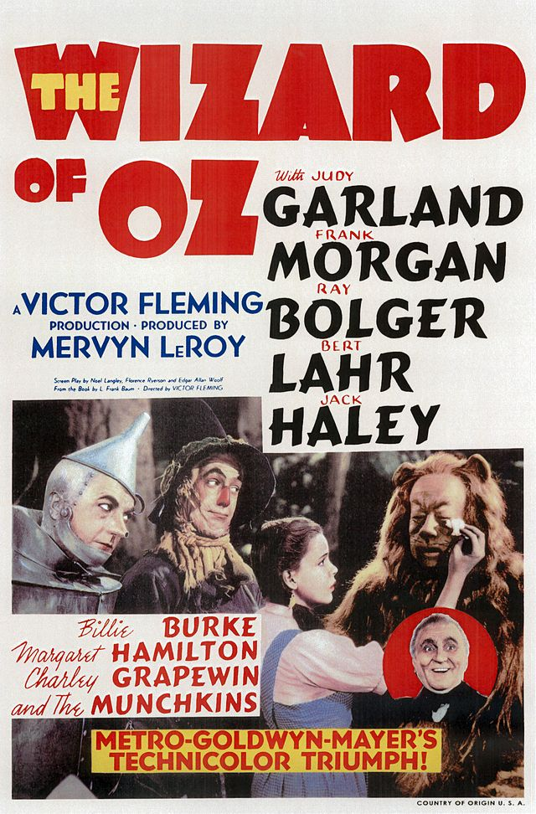
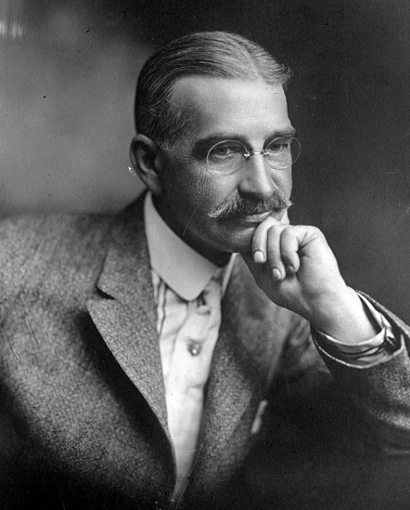
The Wizard of Oz-Allegory for Populism
Originally published by L. Frank Baum in 1900.
Dorothy’s shoes were originally silver!
The movie was produced in 1939

