Slide 1
The Great West
Cowboys

Slide 2
Cowboys
American settlers had never managed large herds on the open range, but quickly learned from Mexican neighbors how to round up, rope, brand, and care for animals
Texas longhorns dated back to Spain; they had become accustomed to dry grasslands
American cowboy’s way of life came directly from the first Spanish ranchers in Mexico
Cowboy clothes, food and vocabulary heavily influenced by the Mexican vaquero (chaparreras, bronco caballo, rancho, corral, rodeo)
Despite plentiful herds, the cowboy was not in demand until railroads reached the Great Plains.

Slide 3
Growing Demand for Beef
After the Civil War the demand for beef skyrocketed, partly due to rapidly growing cities
To meet the demand Illinois cattle dealer Joseph McCoy approached several towns with plans to create a shipping yard where the trails and rail lines would come together
Abilene, Kansas agreed to the plan by 1867
McCoy built cattle pens, a three-story hotel and helped survey the Chisholm Trail-the major cattle route from San Antonio, Texas through Oklahoma to Kansas

Slide 5
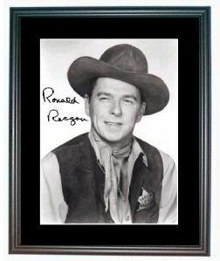
Cowboys
The meeting of the Chisholm Trail and the railroad in Abilene began the height of the cowboy
55,000 worked the plains between 1866 and 1885
Romanticized version of cowboy—rode the open range, herding cattle and fighting Indians. The real life cowboy was different

Slide 6
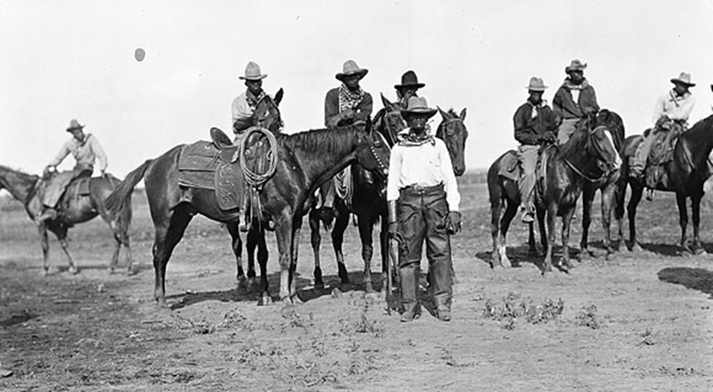
Although novels, folklore, and picture postcards depicted the cowboys as Anglo-American 25% of all Cowboys were African American; 12% were Mexican

Slide 7
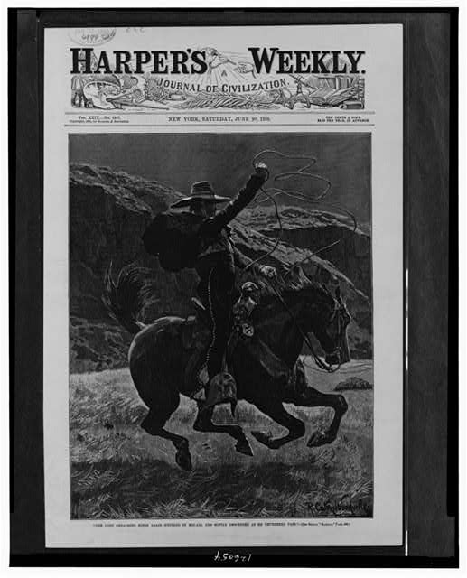
Cowboy’s Day
Worked 10-14 hours a day on a ranch and 14 or more on the trail; alert at all times for dangers that might harm or upset the herds
Some cowboys as young as 15; most too broken down by the age of 40.
Cowboy might own his own saddle, but not the horse, which was usually owned by his boss
Gun might be used to protect heard from wild animals, but not to chase outlaws

Slide 8
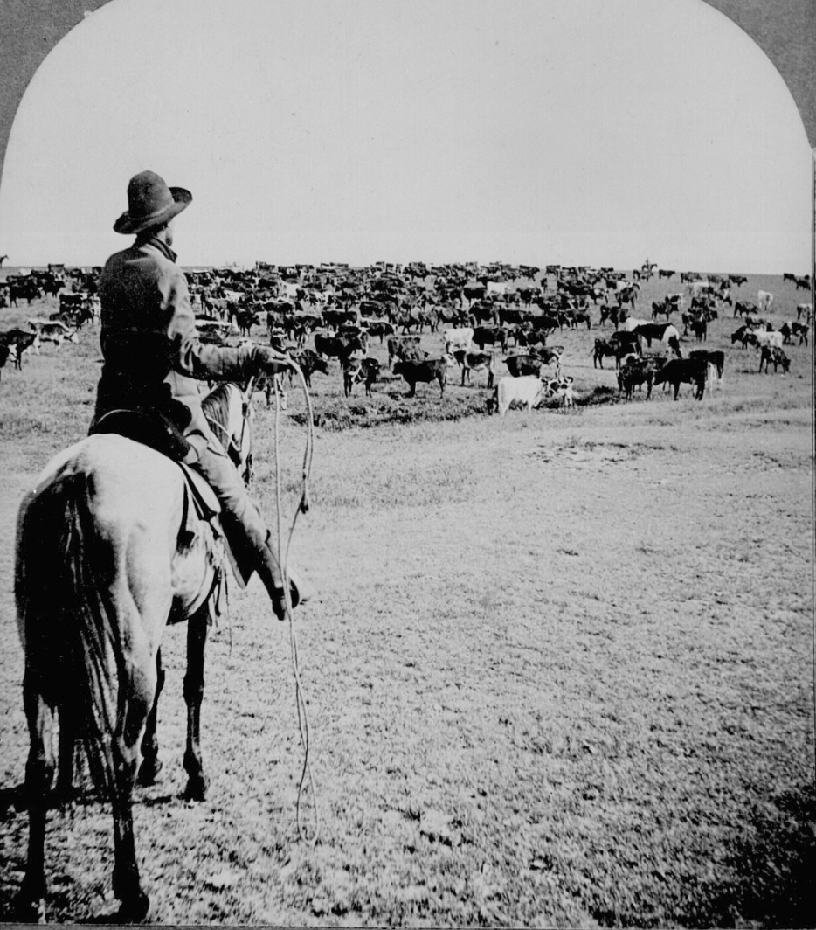
The Long Drive
After a herd was gathered and branded, the trail boss chose a crew for the long drive
Long drive lasted about 3 months
1 cowboy for every 250 head of cattle
During the drive, cowboy was in the saddle from sun up to sun down; slept on the ground, bathed in rivers
Risked death everyday, especially at river crossings where cattle could be swept away if they hesitated
Lightning was the greatest danger

Slide 9
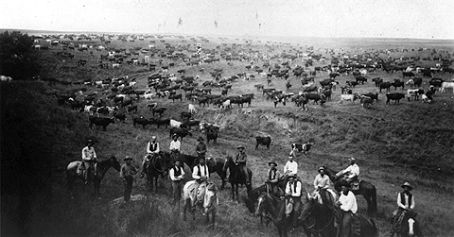
Cowboys
Almost as quickly as cattle herds had multiplied
and ranching had become big business,
the cattle frontier met is end.

Slide 10
End of Cowboys and the Frontier
Overgrazing of the land, extended bad weather, and the invention of barbed wire were largely responsible.
The simple invention of twisted wire became a major factor in transforming the open plains into a series of fenced-in ranches and farms.
Life of the cowboy 1866-1886

Slide 11
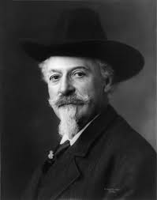
Cowboy mythology
In the 1880s, Buffalo Bill’s “Wild West Show” (William F. Cody) helped propagate the image of the cowboy
Show featured trick riding and roping exhibitions
Thrilled audiences with fake battles between cowboys and Indians
Wild Bill Hickok, Annie Oakley, Calamity Jane, and Sitting Bull toured in Wild West shows

