Slide 1
The Great West
Native Americans

Slide 2
The Culture of the Great Plains Indians
Distinctive and highly developed Native American ways of life existed on the Great Plains
To the east, near the lower Missouri River, tribes such as the Osage and Iowa had hunted and planted crops, settled in small villages for over a century.
Farther west, nomadic tribes such as the Sioux and Cheyenne gathered wild foods and hunted buffalo.
People of the Plains abided by tribal law, traded and produced beautifully crafted tools and clothing

Slide 3
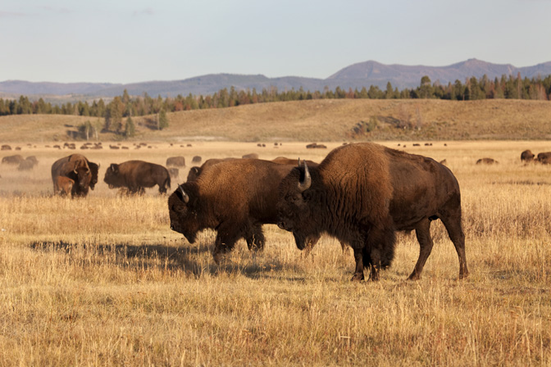
The Horse and the Buffalo
After the Spanish brought horses to New Mexico in 1598, Native American way of life began to change
As natives acquired horses and then guns, they began to travel more efficiently
By the mid 1700s almost all of the tribes roamed the plains to hunt buffalo
This increased mobility caused tribal infighting and war. Taking part in war parties and raids earned prestige. A Plains warrior gained honor by killing his enemies as well as by “counting coup”.
Truces called between warring tribes allowed tribes to trade goods, share news and attend harvest festivals

Slide 4
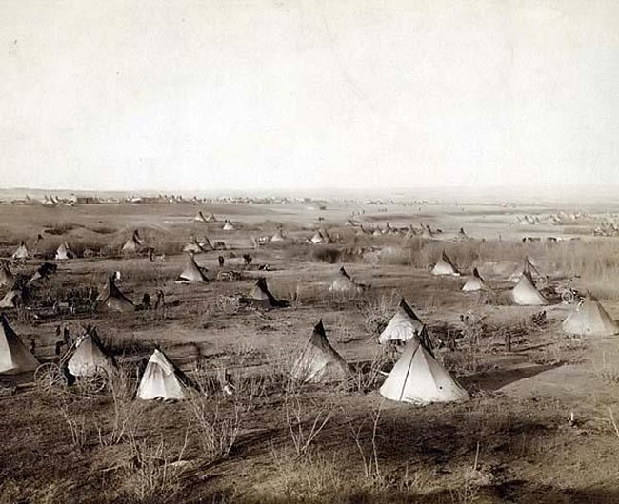

Slide 5
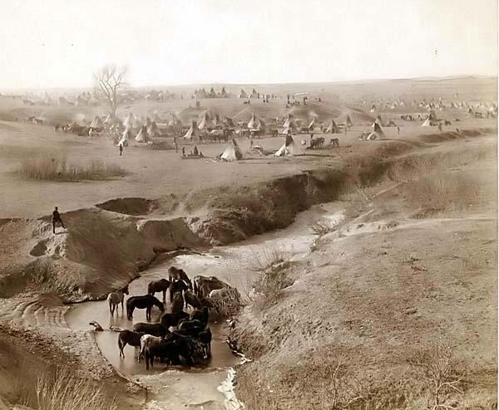
Family Life
Native Americans usually lived in small extended families with ties to other bands that spoke the same language.
Young men became hunters and warriors
Women helped butcher the game
Believed powerful spirits controlled events in the natural world
Children learned proper behavior and culture through stories and myths
No individual was allowed to dominate the group; leaders of a tribe ruled by counsel rather than by force
Land was held in common for the use of the whole tribe

Slide 6
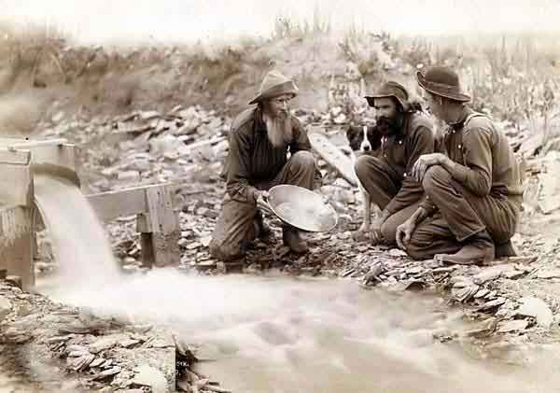
Settlers push forward
Culture of white settlers differed from Native culture in many ways
Native Americans believed that land could not be privately owned; settlers believed that owning land, making a mining claim, or starting a business would give them a stake in the country
White settlers believed that Natives had forfeited their rights to the land because they hadn’t settled down to “improve” it
Migrants, believing that the plains were “unsettled” used any excuse to move west
Power of striking it rich lured many settlers; the discovery of gold in Colorado in 1858 brought 10,000s of miners to the region (Irish, Polish, German, Chinese, African-American men) that would come in conflict with Natives

Slide 7
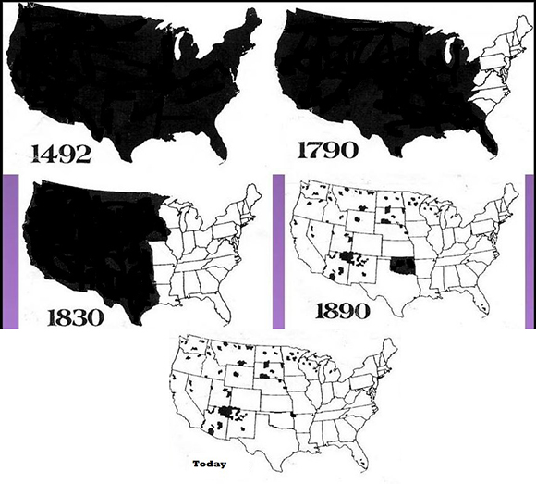

Slide 8
Introduction
As more people in the United States moved westward, Native Americans suffered. They lost their land and were forced onto reservations. Native Americans living on the Great Plains lost their main source of food, shelter, and clothing as buffalo were almost hunted to extinction. Many Native Americans even lost their lives in battles against United States troops. In an attempt to assimilate Native Americans into American culture, Native American children were forced into American boarding schools.

Slide 9
Cultural Conflict
White Culture
Monotheistic (Christians)
Stewards of the Earth
Land as property
Land can be transformed
Hunting for sport
Farming
Native Culture
Polytheistic (Natural World)
One with the Earth
Communal Land
Adapt to land
Hunt to sustain life (Hunter-Gatherers)

Slide 10
Indians Appropriations Act ,1851
In 1851, the U.S. government passed the Indians Appropriations Act, creating the first reservations for Native Americans.
Native Americans fought against being forced onto the reservations. The U.S. government and the Native Americans fought a series of wars known as the American Indian Wars.

Slide 11
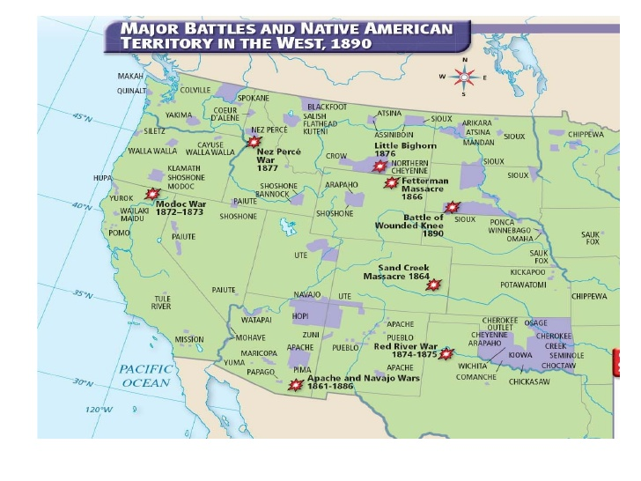

Slide 12
Sand Creek Massacre (1864)
The Sand Creek Massacre took place in southeastern Colorado on November 29, 1864.
Colonel John Chivington attacked an encampment of Cheyenne and Arapaho near Sand Creek. Chivington led this attack as an act of revenge against Native Americans who had attacked white settlers in the area.
Because Cheyenne Chief Black Kettle had sent many of his men to hunt, there were few people who could defend the camp when it was attacked.
The Native Americans put up a white flag to indicate surrender, but Chivington ignored this action. Between 150 and 200 Cheyenne and Arapaho were killed, including elderly men, women, and children.

Slide 13
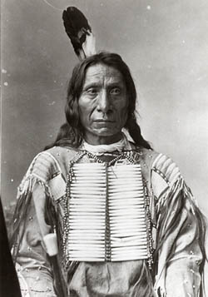
Fetterman Massacre,1866
BozmanTrail ran directly through Sioux hunting grounds in the Big Horn Mountains
Sioux Chief, Red Cloud had appealed unsuccessfully to U.S. government to end white settlement on the trail
In December 1866, Sioux warrior Crazy Horse ambushed Captain William Fetterman and his company at Lodge Trail Ridge.
Over 80 soldiers were killed. Native Americans called it the Battle of the Hundred Slain

Slide 14
Treaty of Fort Laramie, 1868
In the spring of 1868 a conference was held at Fort Laramie, in present day Wyoming, that resulted in a treaty with the Sioux.
This treaty was to bring peace between the whites and the Sioux who agreed to settle within the Black Hills reservation in the Dakota Territory.
The Black Hills of Dakota were sacred to the Sioux Indians. In the 1868 treaty, the United States recognized the Black Hills as part of the Great Sioux Reservation, set aside for exclusive use by the Sioux people.
In 1874, however, General George A. Custer led an expedition into the Black Hills accompanied by miners who were seeking gold. Once gold was found in the Black Hills, miners were soon moving into the Sioux hunting grounds and demanding protection from the United States Army.

Slide 15
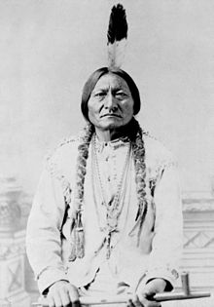
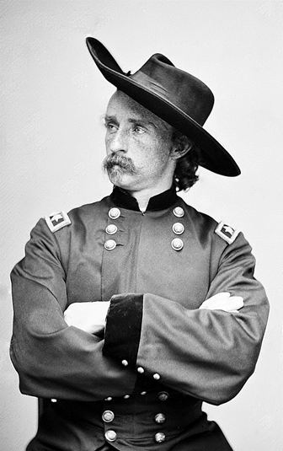
Battle of Little Big Horn, 1876
The Army was ordered to move against wandering bands of Sioux hunting on the range in accordance with their treaty rights.
In 1876, General Custer, leading an army detachment, encountered the encampment of Sioux and Cheyenne at the Little Bighorn River.
Also known as Custer's Last Stand, this battle took place in 1876. It was one of the Native Americans' last victories over U.S. troops. Chiefs Sitting Bull and Crazy Horse led over 2,500 warriors against 264 U.S. troops led by Custer. Custer and all of his men died.
The United States would continue its battle against the Sioux in the Black Hills until the government confiscated the land in 1877.
To this day, ownership of the Black Hills remains the subject of a legal dispute between the U.S. government and the Sioux.

Slide 16
The Nez Perce War, 1877
The Nez Perce lived in Oregon. In the late 1870s, they were forced to move to Idaho.
were forcibly removed from their ancestral lands in the Wallowa Valley by the United States federal government and forced to move northeast, onto a reservation in the Idaho Territory.
Due to a series of violent events the Nez Perce took flight to attempt to reach political asylum in Canada
They were pursued by the U.S. Army in a campaign led by General Oliver O. Howard.
This 1,170-mile fighting retreat in 1877 through Idaho, Wyoming, and Montana, became known as the Nez Perce War.
Less than 50 miles from the border, U.S. troops surrounded the group, and Chief Joseph surrendered.

Slide 17
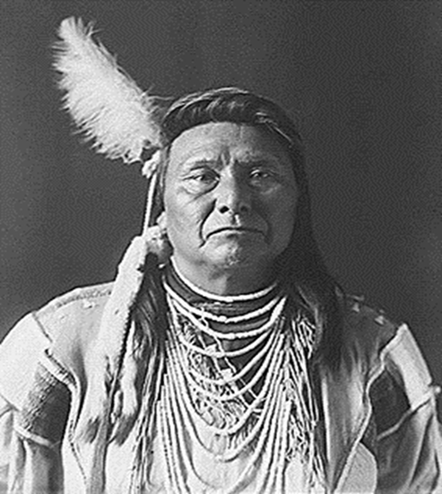
“It is cold and we have no blankets. The little children are freezing to death. My people, some of them, have run away to the hills and have no blankets, no food. No one knows where they are--perhaps freezing to death. I want to have time to look for my children and see how many I can find. Maybe I shall find them among the dead. Hear me, my chiefs. I am tired. My heart is sick and sad. From where the sun now stands, I will fight no more forever. ”

Slide 18
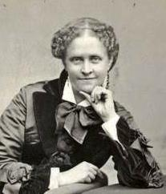
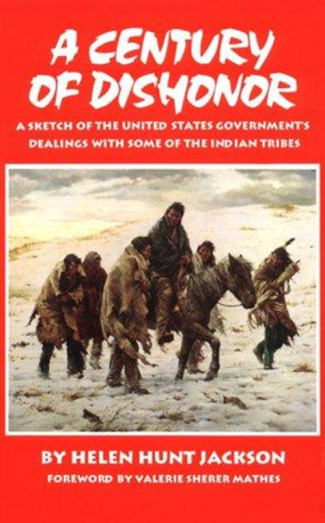
Helen Hunt Jackson's Century of Dishonor, 1881
In 1881, Helen Hunt Jackson published her book, A Century of Dishonor. In the book, Jackson details the injustices that the U.S. government inflicted upon the Native Americans.
During its first 100 years as a country, the U.S. government broke treaties and forced Native Americans off their lands and onto reservations. Jackson's book brought attention to these inequities and influenced a reform movement in Native American policy.

Slide 19
Dawes Severalty Act, 1887
Under this act, the U.S. government broke up the Native American reservations and gave Native American families homesteads.
The families were required to live on the land for 25 years and were required to give up their Native American traditions.
At the end of 25 years, the families would own the land and become U.S. citizens. As a result, Native Americans lost much of their land and were given land in the desert that was not good for farming.
Goal of the Act was assimilation

Slide 20
Wounded Knee, 1890
In December of 1890, the last major armed conflict between Native Americans and the U.S. took place on the Pine Ridge reservation.
The conflict is known as the Battle of Wounded Knee or the Wounded Knee Massacre. It started after a warrior's gun accidentally went off while U.S. soldiers were collecting the Sioux's guns.
In the chaos following the shot, soldiers and other warriors began to fire their guns, and many Native Americans began to flee. Both women and children were shot down as they ran to escape the fighting. By the time peace was restored, over 150 Native Americans were dead.

Slide 21
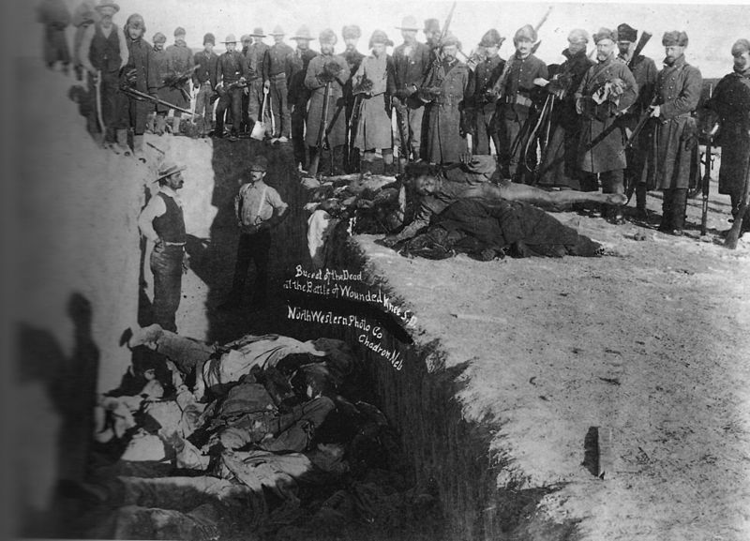

Slide 22
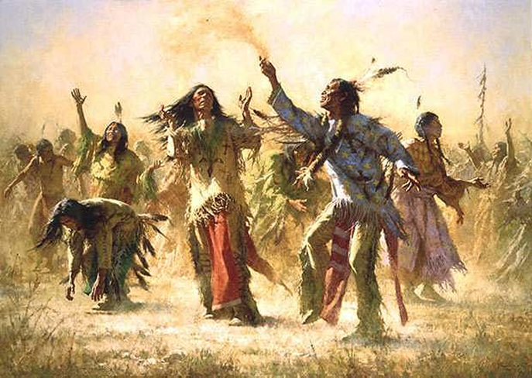
Ghost Dance
Prior to the massacre, the Lakota participated in a spiritual ceremony called the "Ghost Dance." They believed that by doing so, their lost relatives would rejoin them, and the world that they had once experienced would be restored.
This ceremony caused tension between white settlers and the Native Americans, and this tension was one of the causes for the massacre at Wounded Knee Creek.
Defying the orders of the government agent at the reservation, the Lakota continued to perform a ritual called the Ghost Dance

