Slide 1
Outline
What were the causes of the War?
Why did the United States enter the War?
How did the United States mobilize for War?
What were some reactions to the war?
How was the war fought?
How was peace achieved? What were the effects of the war?

Slide 2
I. Long Term Causes of WW I in Europe
Militarism -The process by which a nation builds up its military might to intimidate or deter other countries.
Alliances - Agreements between nations to help each other in the event of war.
Imperialism- practice of extending the power of a nation by direct territorial acquisition of colonial empires.
Nationalism - pride in one’s own country or nationality

Slide 3
“
I. Causes of the War “Powder Keg of Europe”
Archduke Franz Ferdinand- He and his wife were assassinated by a Serb nationalist in June, 1914 causing the start of WW I. Heir to the throne of Austria-Hungary

Slide 4
Alliances
Triple Entente/Allied Powers:
France
Russia
England
Italy
later United States
Triple Alliance/Central Powers:
Austria-Hungary
Germany
Ottoman Empire.

Slide 5
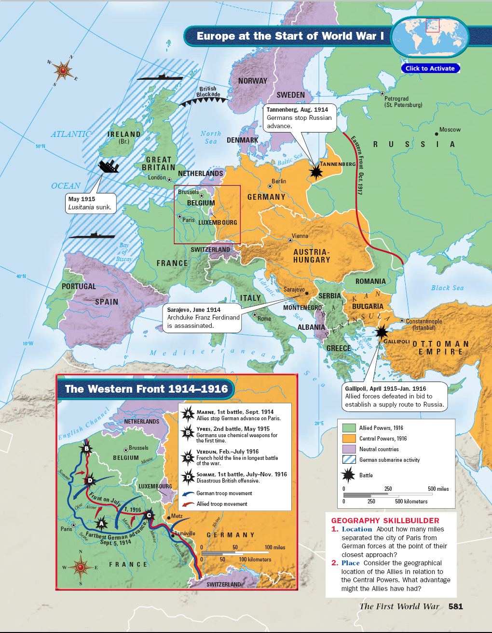

Slide 6
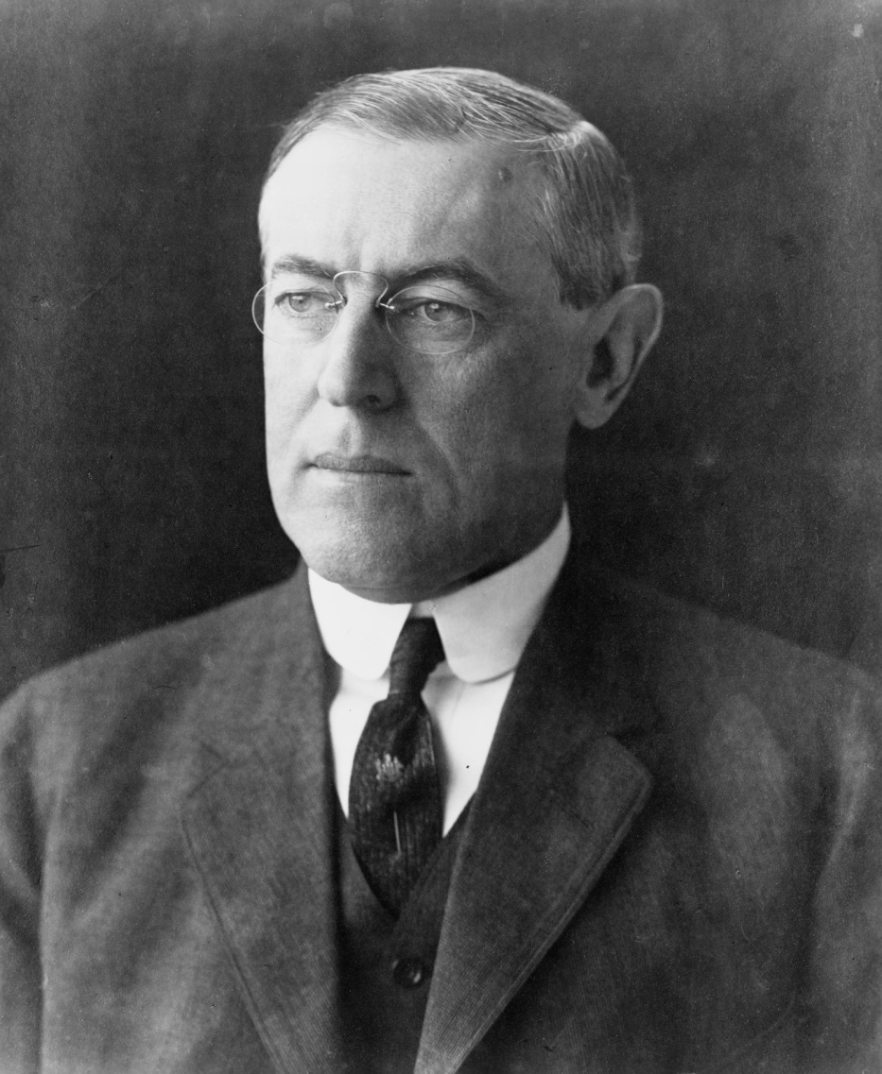
American Neutrality
President Wilson-decided to keep the US “Neutral” at the beginning of WWI
Notes:
http://en.wikipedia.org/wiki/Image:President_Woodrow_Wilson_portrait_December_2_1912.jpg

Slide 7
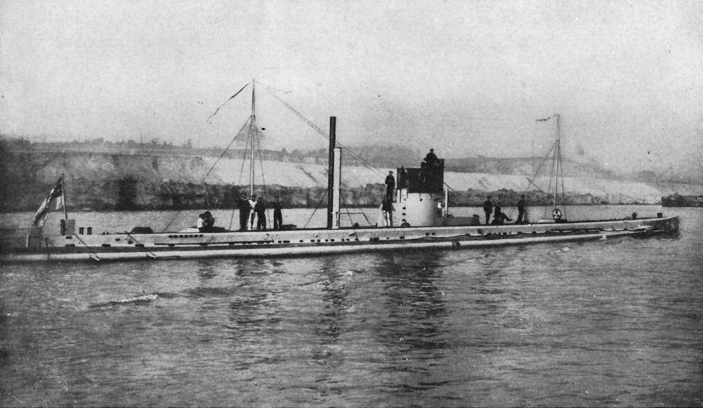
II. Why did the U.S. Enter the War? Threats to U.S. neutrality
A. U-Boat - submarine
warfare
Germany’s fiercest weapon in WW I they would attack all ships entering or leaving British ports.
German Submarines sank ships without warning due in part to the naval blockade by the British of German ports.

Slide 8
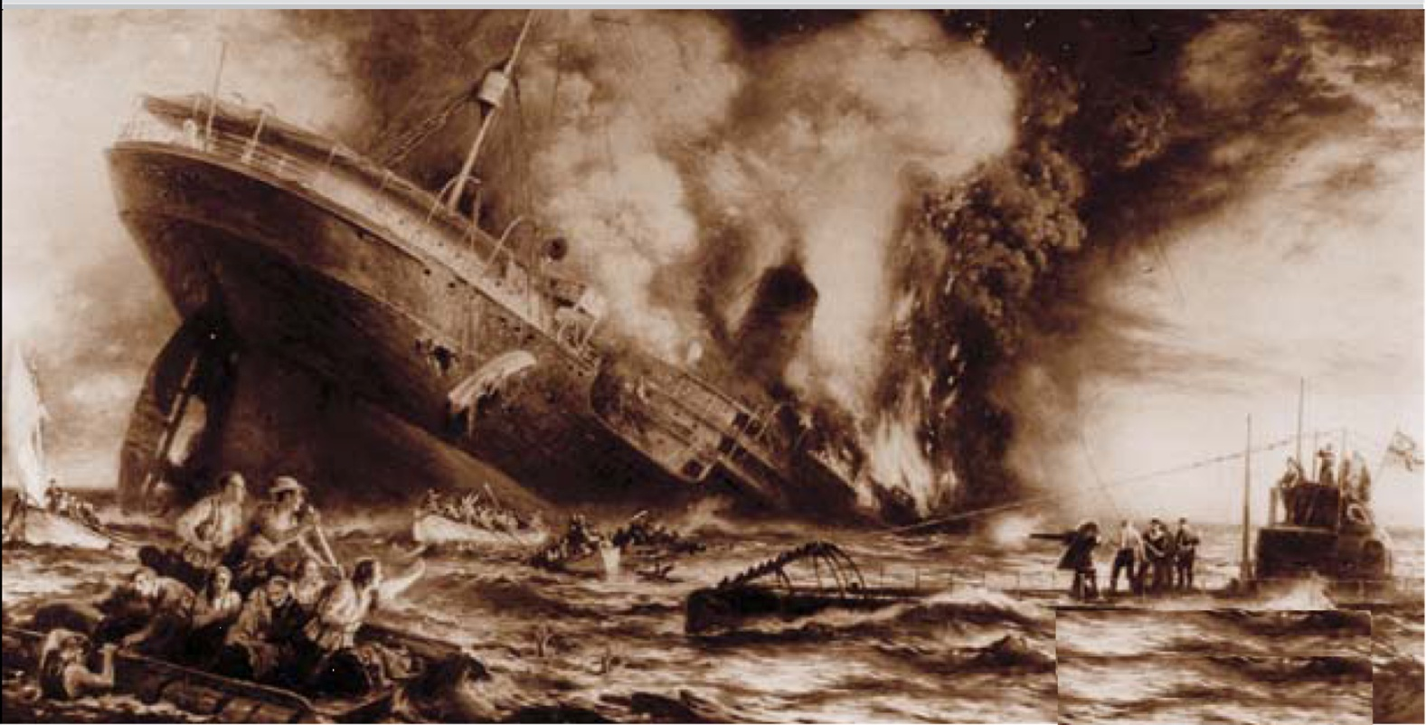
II. Why did the U.S. Enter the War? Threats to U.S. neutrality
B. Lusitania -British ship sunk May, 1915 by German U-boats- 128 Americans die - caused anger in US

Slide 9
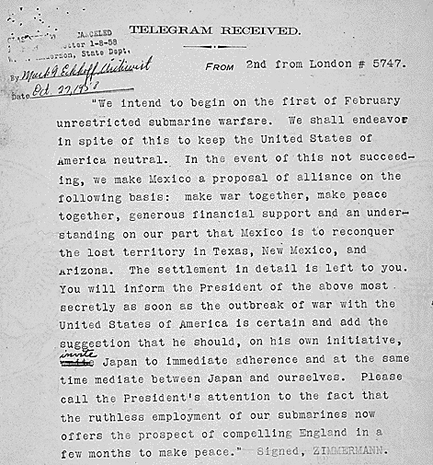
II. Why did the U.S. Enter the War? Threats to U.S. neutrality
C. Zimmerman note (Telegram) - A German telegram trying to convince Mexico to declare war against the US-in return Germany would help Mexico regain lost territories during the Mexican War 1846-48.

Slide 10
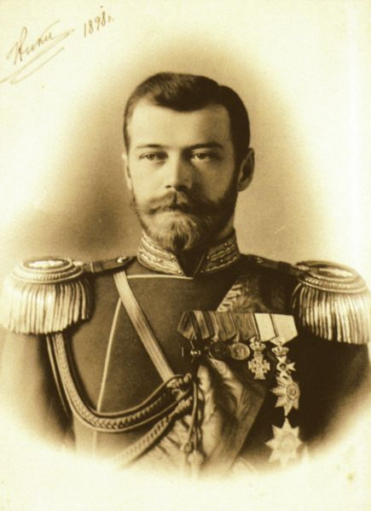
II. Why did the U.S. Enter the War? The Russian Revolution
Russian Revolution – The Provisional Government led Russia from February to October 1917 overthrew Tsar Nicholas II - Kept Russia in WW I.
Notes:
http://www.historylearningsite.co.uk/provisional_government.htm
The Provisional Government is the name given to the government that led Russia from March 1917 to November 1917. Throughout its existence, the Provisional Government met at the Tauride Palace. By July it was led by Alexander Kerensky - the man who had informed the Duma on March 11th that 25,000 troops were on the way to support them.
The Provisional Government also committed two huge blunders:
1. It refused to give land to the poor peasants in the rural areas. This seemed to confirm the point above - that the Provisional Government did not understand the desires of the poor. To survive the peasants needed land and this was refused by Kerensky.
2. By far, the biggest blunder was the decision taken by the Provisional Government to keep Russia in World War One. This was a curious decision as the war was hated by the Russian people who had suffered greatly as a result of it.

Slide 11
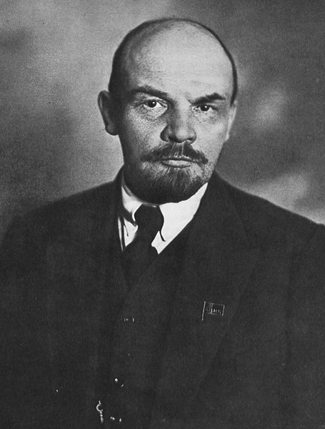
II. Why did the U.S. Enter the War? The Russian Revolution
Bolshevik Revolution -The Communist Revolution occurred in Oct., 1917 led by V.I. Lenin & the Bolsheviks – Withdrew Russia from the War
Notes:
http://www.historylearningsite.co.uk/provisional_government.htm
The Provisional Government is the name given to the government that led Russia from March 1917 to November 1917. Throughout its existence, the Provisional Government met at the Tauride Palace. By July it was led by Alexander Kerensky - the man who had informed the Duma on March 11th that 25,000 troops were on the way to support them.
The Provisional Government also committed two huge blunders:
1. It refused to give land to the poor peasants in the rural areas. This seemed to confirm the point above - that the Provisional Government did not understand the desires of the poor. To survive the peasants needed land and this was refused by Kerensky.
2. By far, the biggest blunder was the decision taken by the Provisional Government to keep Russia in World War One. This was a curious decision as the war was hated by the Russian people who had suffered greatly as a result of it.

Slide 12

II. Why did the U.S. Enter the War?“To Make The World Safe For Democracy”
President Wilson - asks Congress to Declare War on Germany April 2, 1917 to make “the world a safe place for democracy”.
Wilson’s moral justification for us entering into WWI. Congress declares war April 6, 1917.
Wilson Idealism - “Peace without victory”. Wilson’s pledge to the American people that we had no gains in mind from this war

Slide 13
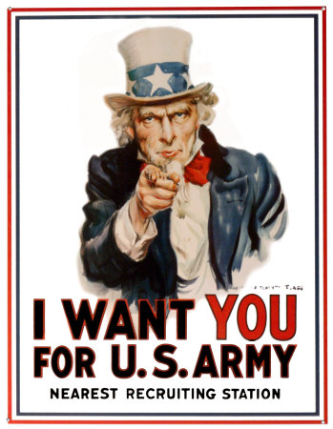
III. How did the U.S. Mobilize for War?
Selective Service Act -Introduced the registration and classification for
military service of all American men between the ages of 21-30.
24 million registered; 3 million drafted

Slide 14
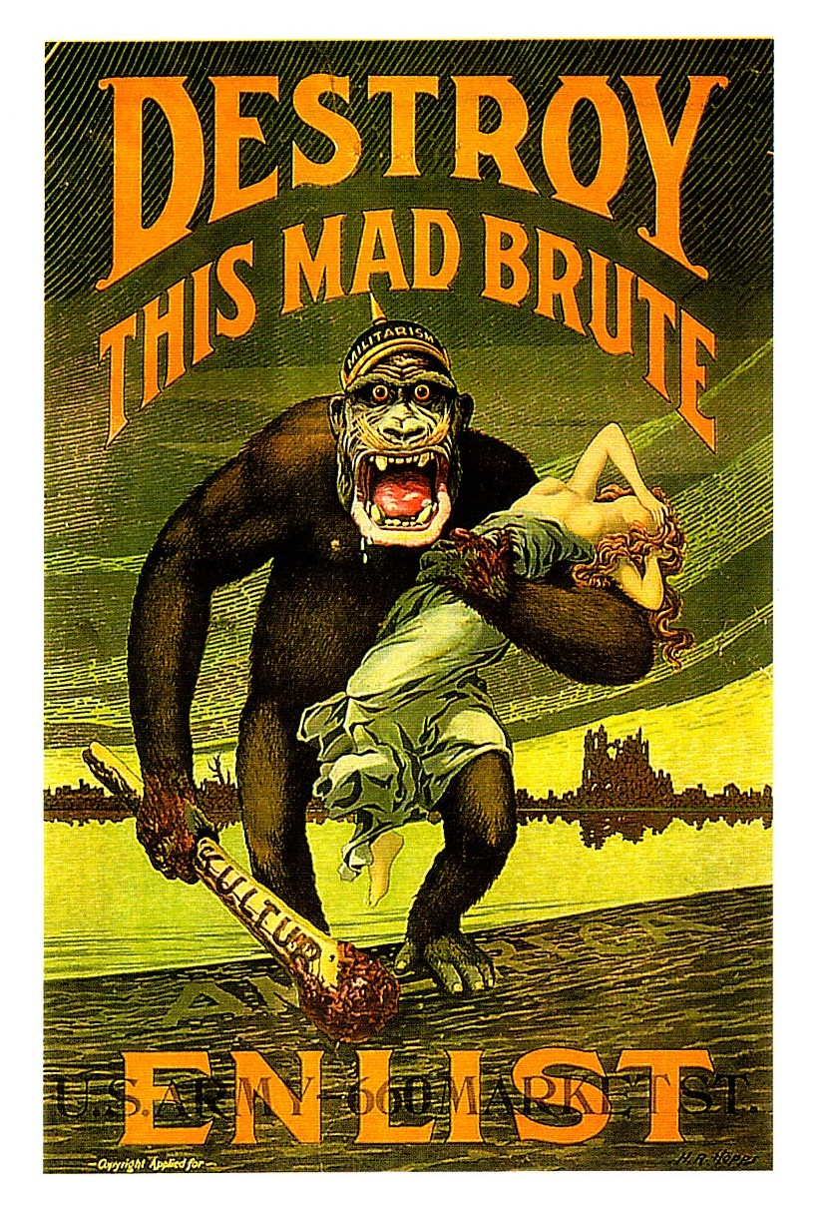
III. How did the U.S. Mobilize for War?
Committee on Public Information- led by journalist George Creel - The propaganda committee during WWI -purpose to encourage public support for the war effort
The committee used newsprint, posters, radio, telegraph, cable and movies to broadcast its message.
It recruited about 75,000 "Four Minute Men”

Slide 15
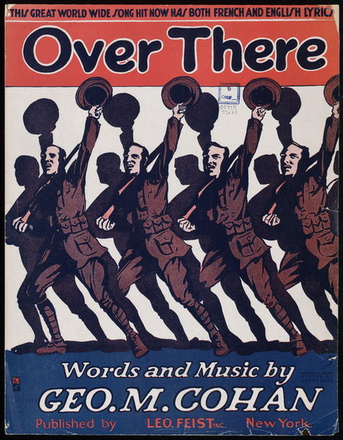
III. How did the U.S. Mobilize for War?
“Over There”-Written by George Cohan. Most popular World War I song produced by the CPI
“Johnny, get your gun, get your gun, get your gun. Take it on the run, on the run, on the run. Hear them calling you and me, Every Son of Liberty. Hurry right away, no delay, go today. Make your Daddy glad to have had such a lad. Tell your sweetheart not to pine, To be proud her boy's in line.”

Slide 16
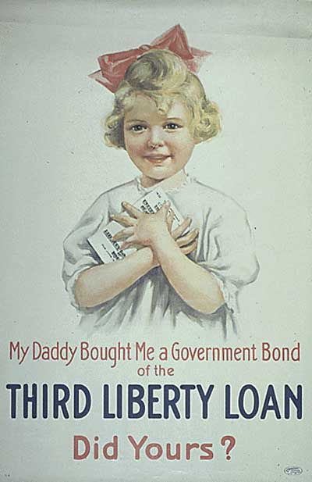
III. How did the U.S. Mobilize for War?
Bond drives—Treasury secretary William McAdoo organized the raising of funds with Liberty Loans
People felt obligated to buy bonds because they didn’t want to appear to be unpatriotic
Raised $21 Billion

Slide 17
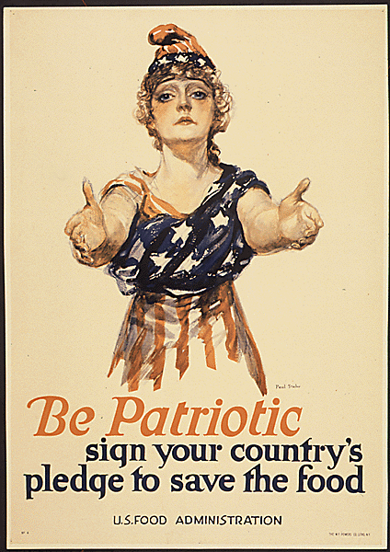
III. How did the U.S. Mobilize for War?
Food Administration/ Herbert Hoover- Established to encourage US to conserve food for war effort.
“meatless Mondays”, “wheatless Tuesdays”

Slide 18
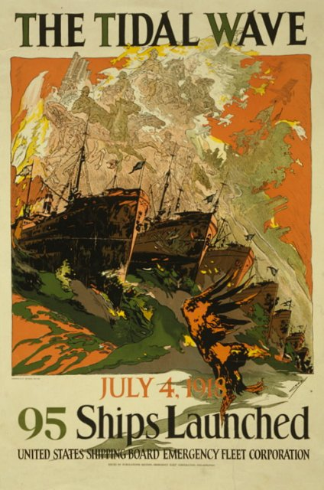
III. How did the U.S. Mobilize for War?
War Industries Board- led by Bernard Baruch - Placed controls on US economy as it sought to get supplies for the US military and its allies
Controlled raw materials, production, prices, and labor relations

