Slide 1
The Great Depression
1929-1941

Slide 2
Stock Market Crash
Black Tuesday, October 29, 1929
More than 16 million shares sold
Entire fortunes gone in hours
Those who bought “on margin”?
Afterwards?
Banks collapse
“Bank runs”
1929 – 641 banks failed
1930 – 1,350 banks failed
1931 – 1,700 banks failed
Who should help this? Federal Reserve?

Slide 3
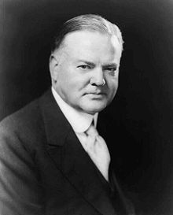
Herbert Hoover
Elected in 1928
1929-1933
Pro-Business
Conservative Republican
Scapegoat

Slide 4
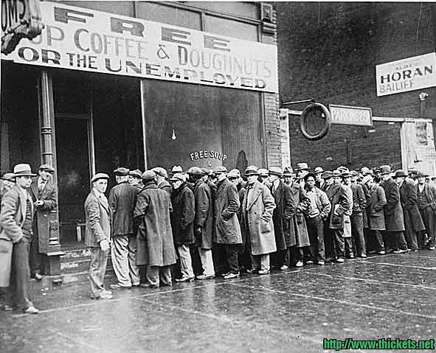
Hoover’s “Hands Off” Policy
1929 – Market crash – Hoover’s response?:
“Just part of the normal business cycle.”
A very “hands off” approach
Results in: Food riots
Rugged Individualism
Volunteerism – people need to volunteer to help those in need
Localism – policy whereby problems could best be solved at the local and state government level

Slide 5
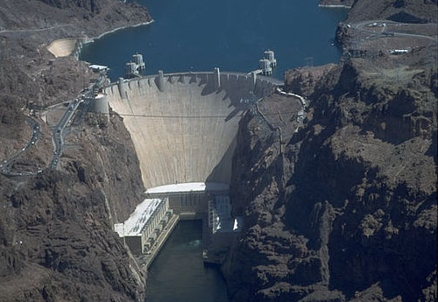
Hoover’s fault?
Hoovervilles
Shanty Towns on vacant lots
So, Hoover more “hands on”
Public Works Projects
Boulder Dam
RFC

Slide 6
Unemployment

Slide 7
The Homeless

Slide 8
Hoovervilles

Slide 9
Americans Protest
Bonus Army (1932) –Marched on Washington
Adjusted Compensation Act (1924) – a lump-sum payment will be paid to veterans in 1945
WWI veterans were scared that they would not get their compensation pay, and many were out of work
Congress approved the early payment – Hoover vetoed it
Veterans marched on Washington – “Bonus Army”
Hoover orders the Army to move the marchers out of D.C.
Tear gas, bayonets

Slide 10
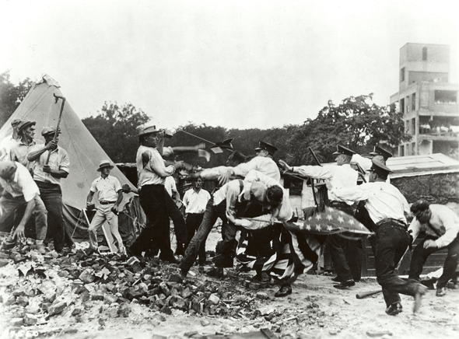

Slide 11
Unit 5 Essential Questions:
How do economic changes impact society?
What caused the Great Depression?

Slide 12
Causes of the Great Depression
Stock Market Speculation
Increased Debt/Easy credit
Farm Sector Crisis
Unbalanced Market
Overproduction by “old school” industries
Mistakes of the Federal Reserve Board
Hawley-Smoot Tariff
Poor Distribution of Wealth
Bank crisis

Slide 13
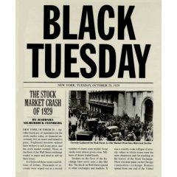
Stock Market Speculation
Investors could put 10% down to purchase stock. Borrowed the remainder of the investment on credit (Buying on Margin)
Drove prices of stock up, but not the value of stocks (In1928, RCA stock rose 400% in price)
On Black Tuesday (10/29/1929), 16.4 million shares were sold (at the time, 3 million shares traded was a busy day)
In October 1929, stocks in NYSE fell in value by 37%

Slide 14
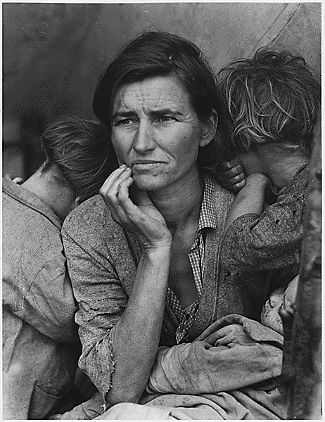
Increased Debt/Easy Credit
Mortgages for farmers increased while their ability to pay them off decreased with falling crop prices
Small banks who had loaned money to farmers went into debt
Large banks also increased debt as they began to speculate in the stock market
Consumers had increased debt with installment plans and easy credit

Slide 15
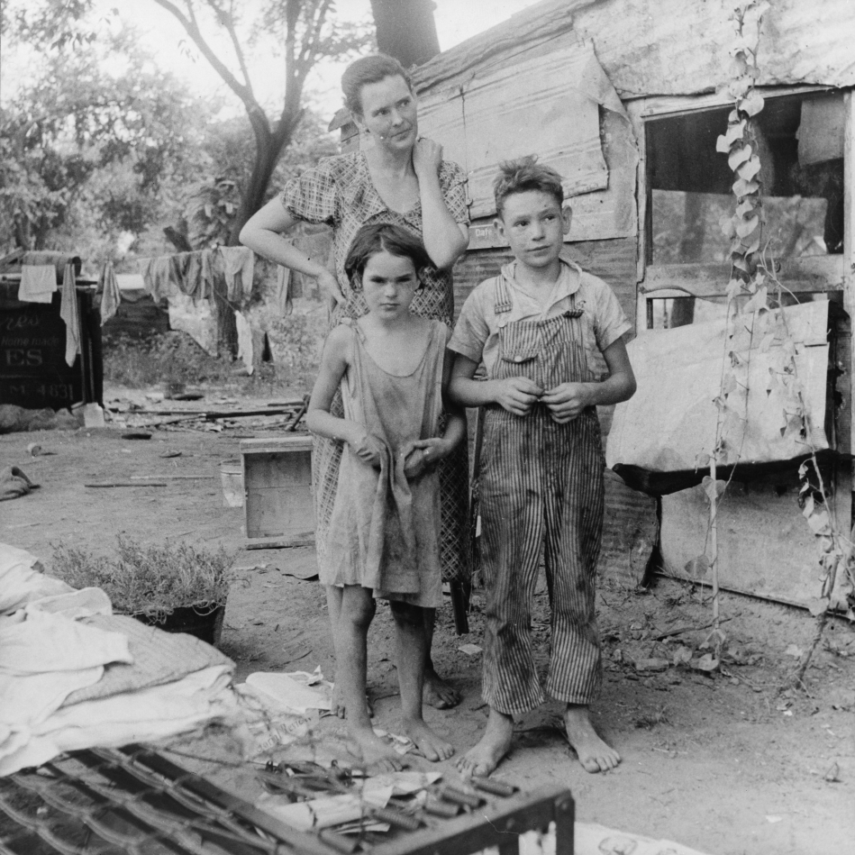
Farm Sector Crisis
After WWI demand for American Agricultural products fell sharply.
As a result prices for crop prices fell as much as 40%. Farm income fell from $10 Billion a year to $4 billion.

Slide 16
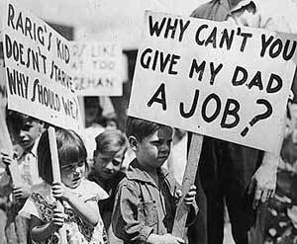
Unbalanced Market
A few industries (automobiles, construction) supported a multitude of other industries
When they slacked off, so did everything else (all the eggs in one basket)

Slide 17
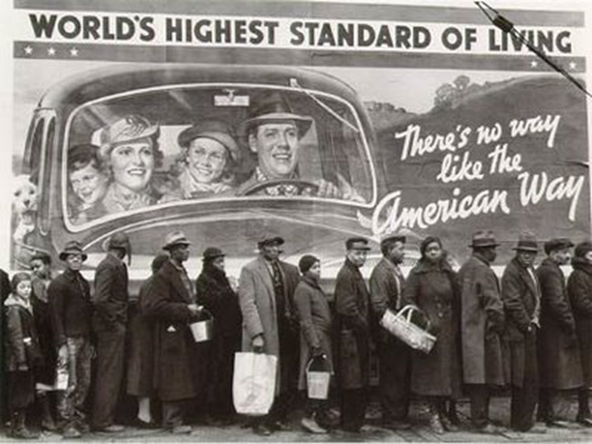
Overproduction by older industries
Old school industries: agriculture, coal, railroads, and textiles suffered as America began transitioning to new industries (automobile, electricity, etc.)
By 1929 unsold inventories had increased; investments in these industries had decreased; unemployment within these industries had increased; consumers were buying less goods from these industries

Slide 18
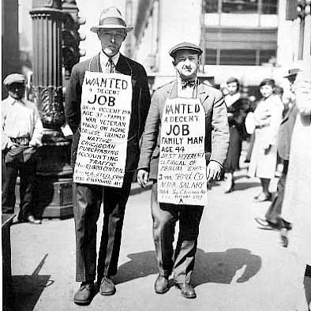
Federal Reserve Board Policies
Increased interest (%) rates which tightened the nation’s money supply.
Harder to get a loan and credit

Slide 19
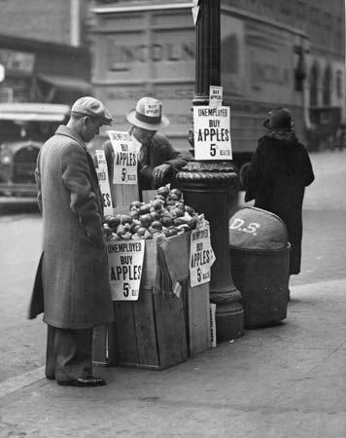
Hawley-Smoot Tariff
Raised tariffs on 75 agricultural goods and 925 manufactured goods by 40%
Economists argued that Hoover should veto the bill because it would raise prices for the consumer, damage export trade and hurt American farmers
This helped create a world wide debt; to pay off debts incurred during World War I, countries needed to trade
Trade actually decreased as European nations responded with their own tariffs

Slide 20
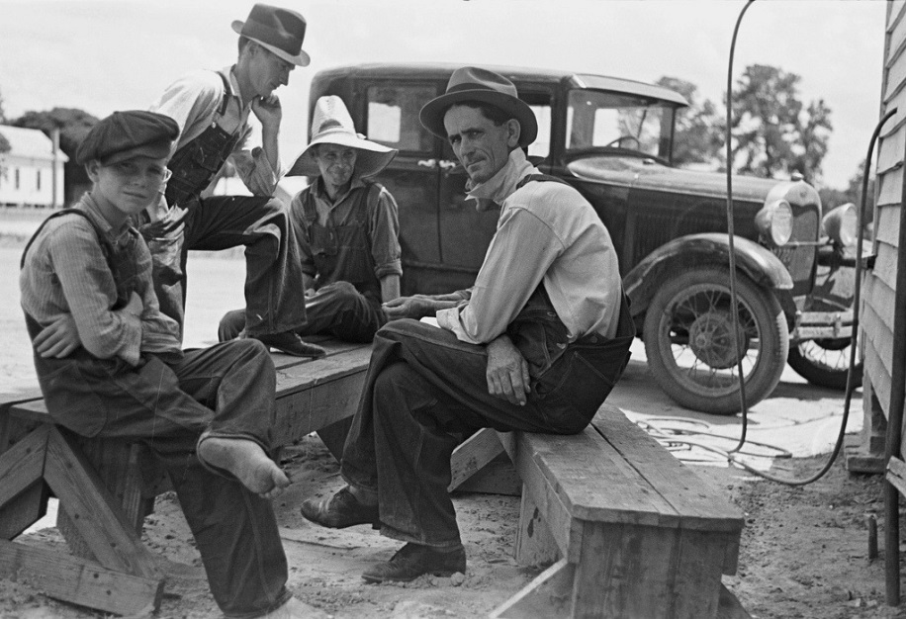
Poor distribution of wealth and purchasing power
Between 1918 and 1929, the share of the national income of the wealthiest 20% of Americans increased 10%; while the share that went to the poorest 60% of Americans fell by 13%
By 1929, 5% of the wealthiest Americans held 33% of the money while 40% had 10% of the money
More than 70 % of the nation’s families earned less than $2,500 per year, then considered the minimum amount needed for a decent standard of living. Families could not afford many of the household products that manufacturers produced.

Slide 21
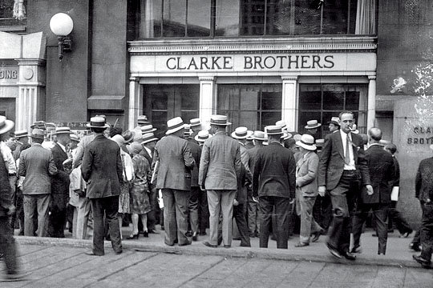
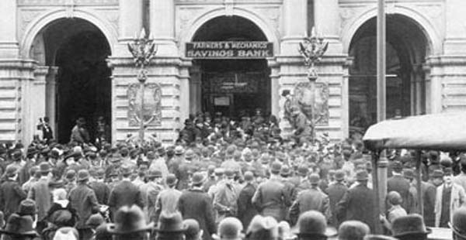
Bank Crisis
Between 1930 and 1933 more than 9,000 banks closed
Bank deposits weren’t insured
People could not invest and banks could not make loans

Slide 22
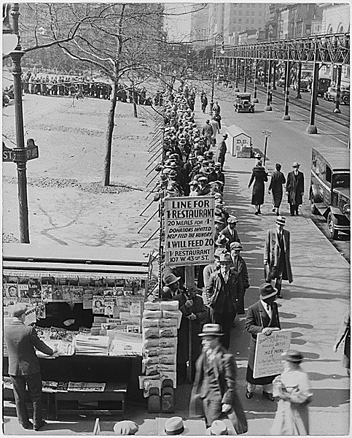
Human toll of the depression
By 1933, 13 million people unemployed
Millions more saw hours and wages reduced
Millions were also homeless
Soup kitchens became popular
Thousands of people “rode the rails” looking for work
Many slept in public places
1929 - 1932, the gross national product—was cut nearly in half, from $104 billion to $59 billion.
Approximately 90,000 businesses went bankrupt.

Slide 23
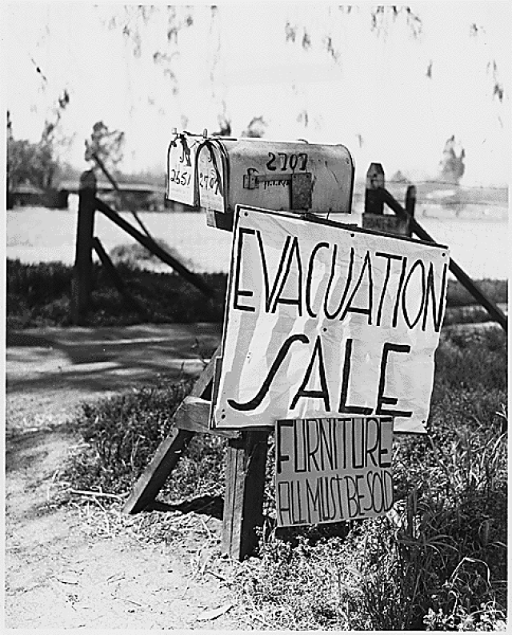
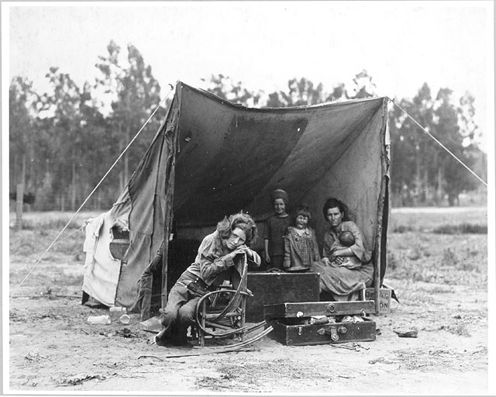
Dust Bowl
Natural disaster that ran from North Dakota to Texas that occurred during the mid 1930s
Average rainfall decreased and soil depletion of nutrients due to farming, caused topsoil to be picked up and blown eastward
John Steinbeck’s The Grapes of Wrath detail trip of Joad family from Oklahoma farm to the “riches” of California (Okies)

Slide 26
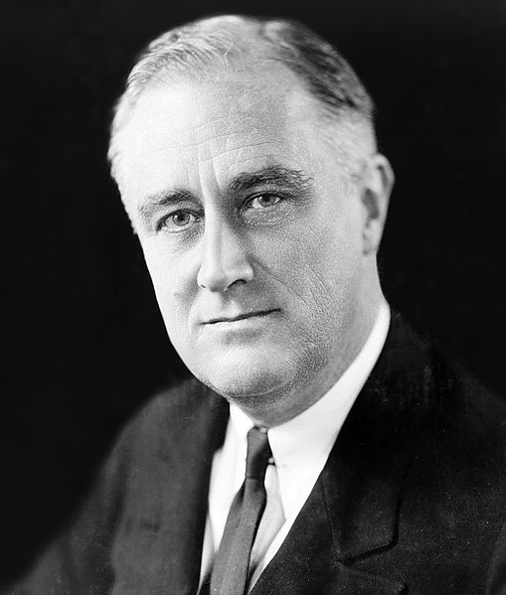
Franklin D. Roosevelt
1933-1945
Democrat
Direct Relief
Deficit Spending
New Deal
CCC
TVA
AAA
WPA
Social Security

