Slide 1
The Great Depression
1929-1941

Slide 2
Bell Ringer
1920s Presentations
Be prepared as a group to share out your Time Magazine Project of the 1920s.
Decide how you would like to present the basic framework and organization of the magazine.
Choose one page per group member to discuss to your class.

Slide 3
1920s-Economy out of control
Since 1921, the idea grew that the American economy had entered a New Era of permanent growth.
But greed had promoted a number of get rich schemes. Speculation fueled the Florida real-estate boom that began with the combination of Coolidge prosperity and Ford’s “tin lizzie”.
Thousands of people invested in Florida real estate, eager for quick profits in the nation’s fastest growing state.
In mid 1926, the Florida bubble burst.

Slide 4
1920s-Economy out of Control
Until 1927 stock values had gone up with profits, but then values went up purely on speculation.
Treasury Secretary Mellon’s tax reductions had released money that found its way to Wall Street with the help of aggressive brokerage houses.
Instead of speculating in real estate, one could buy stock on margin—that is make a small down payment (the margin) and borrow the rest from a broker who held the stock as security against a down market.
If the stock declined and the buyer failed to meet a margin call for more money, the broker could sell the stock to cover his loan. Brokers’ loans more than doubled from 1927 to 1929.

Slide 5
Causes of the Great Depression
Stock Market Speculation
Increased Debt/Easy credit
Farm Sector Crisis
Unbalanced Market
Overproduction by “old school” industries
Mistakes of the Federal Reserve Board
Hawley-Smoot Tariff
Poor Distribution of Wealth
Bank crisis

Slide 6
Essential Questions
What were the causes of the Great Depression?
How did Hoover choose to respond to the conditions of the Depression? How would FDR respond to the same conditions?

Slide 7
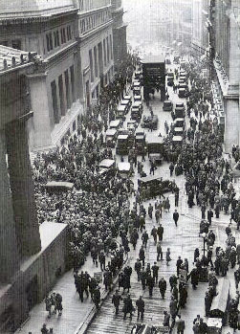
Stock Market Crash
Black Tuesday, October 29, 1929
More than 16 million shares sold
Entire fortunes gone in hours
Those who bought “on margin”?
Afterwards?
Banks collapse/Bank runs
1929 – 641 banks failed
1930 – 1,350 banks failed
1931 – 1,700 banks failed
Unemployment rate as high as 25%

Slide 8
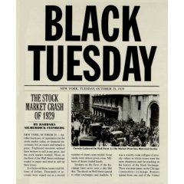
Stock Market Speculation
Investors could put 10% down to purchase stock. Borrowed the remainder of the investment on credit (Buying on Margin)
Drove prices of stock up, but not the value of stocks (In1928, RCA stock rose 400% in price)
On Black Tuesday (10/29/1929), 16.4 million shares were sold (at the time, 3 million shares traded was a busy day)
In October 1929, stocks in NYSE fell in value by 37%
By December stock prices had fallen to 50% of their September high
By 1932, the worst year of the depression, stocks would fall an additional 30% in price

Slide 9
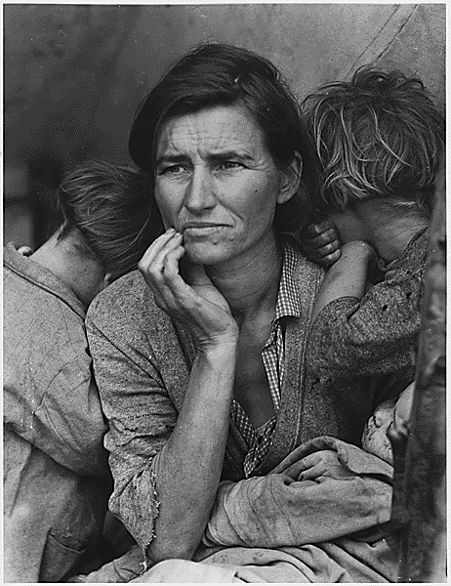
Increased Debt/Easy Credit
Mortgages for farmers increased while their ability to pay them off decreased with falling crop prices
Small banks who had loaned money to farmers went into debt
Large banks also increased debt as they began to speculate in the stock market
Consumers had increased debt with installment plans and easy credit

Slide 10
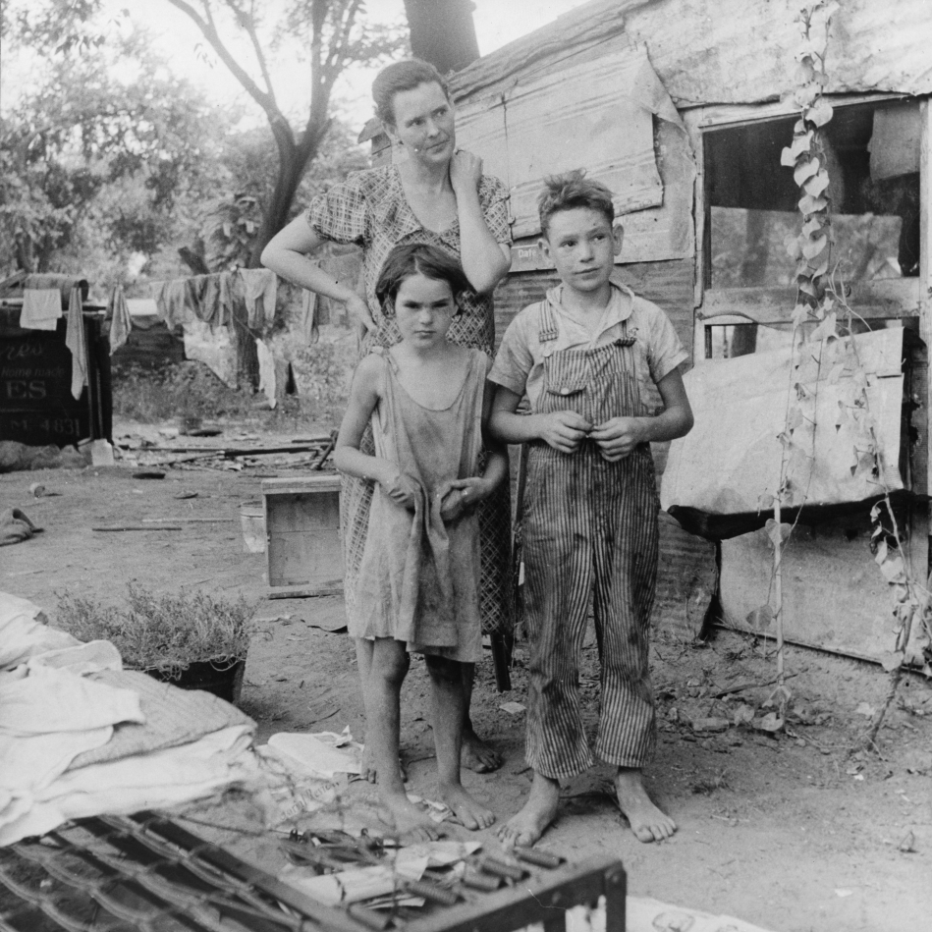
Farm Sector Crisis
After WWI demand for American Agricultural products fell sharply.
As a result prices for crop prices fell as much as 40%. Farm income fell from $10 Billion a year to $4 billion.

Slide 11
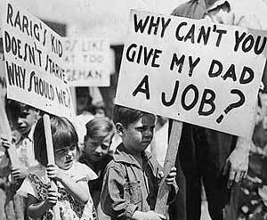
Unbalanced Market
A few industries (automobiles, construction) supported a multitude of other industries
When they slacked off, so did everything else (“all the eggs in one basket”)

Slide 12
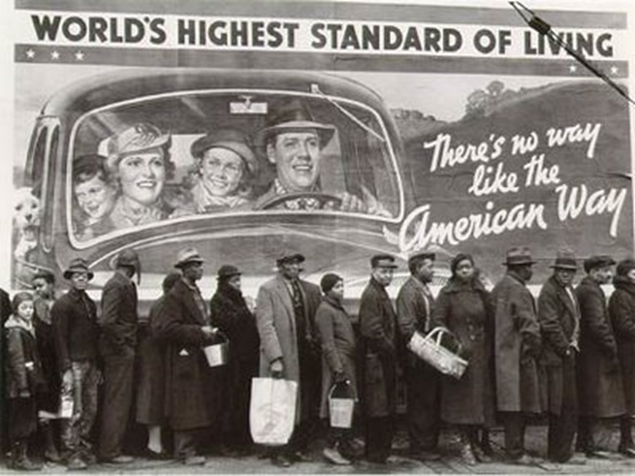
Overproduction by older industries
Old school industries: agriculture, coal, railroads, and textiles suffered as America began transitioning to new industries (automobile, electricity, etc.)
By 1929 unsold inventories had increased; investments in these industries had decreased; unemployment within these industries had increased; consumers were buying less goods from these industries

Slide 13
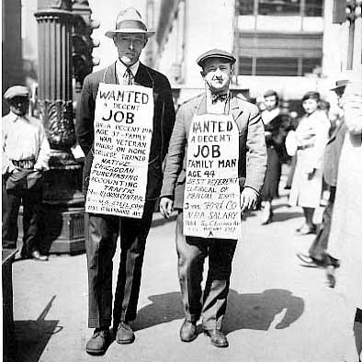
Federal Reserve Board Policies
Decided to Increase interest (%) rates in 1930 & 1931 after market crashed, which tightened the nation’s money supply.
Economy really needed an expanded money supply, lower interest rates and easy credit; so it became harder to get a loan and credit
Caused international crisis as banks of Germany and Austria which were dependent on U.S. loans went bankrupt

Slide 14
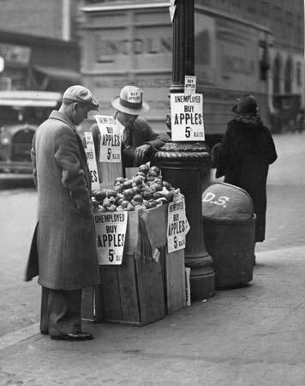
Hawley-Smoot Tariff
Raised tariffs on 75 agricultural goods and 925 manufactured goods by 40%
Economists argued that Hoover should veto the bill because it would raise prices for the consumer, damage export trade and hurt American farmers
This helped create a world wide debt; to pay off debts incurred during World War I, countries needed to trade
Trade actually decreased as European nations responded with their own tariffs

Slide 15
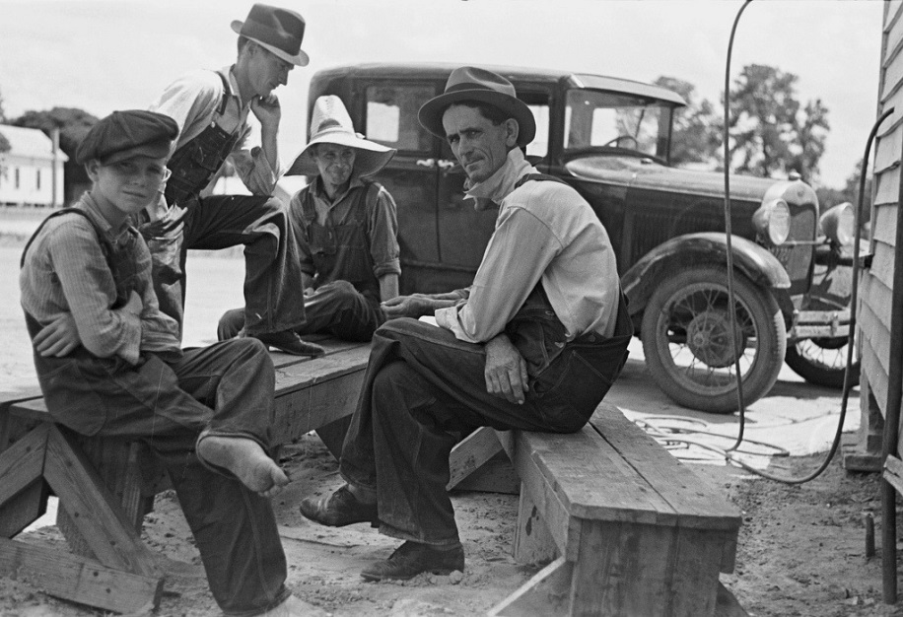
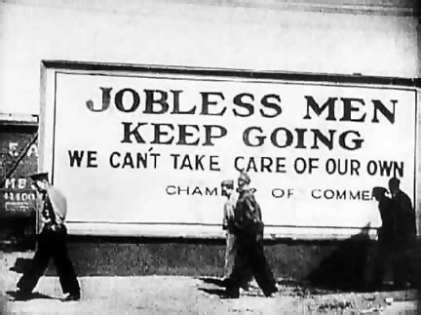
Poor distribution of wealth and purchasing power
Between 1918 and 1929, the share of the national income of the wealthiest 20% of Americans increased 10%; while the share that went to the poorest 60% of Americans fell by 13%
Coolidge administration cut taxes on the wealthy which resulted in slower consumption. This held back the growth of consumer based industries (cars, household appliances, etc.)
By 1929, 5% of the wealthiest Americans held 33% of the money while 40% had 10% of the money
More than 70 % of the nation’s families earned less than $2,500 per year, then considered the minimum amount needed for a decent standard of living. Families could not afford many of the household products that manufacturers produced.

Slide 16
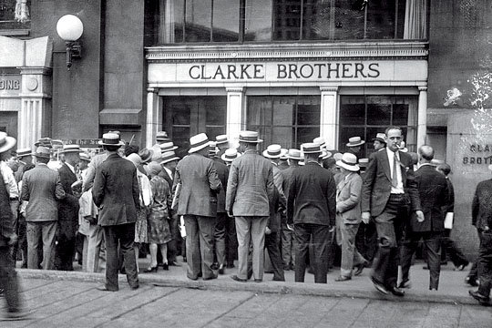
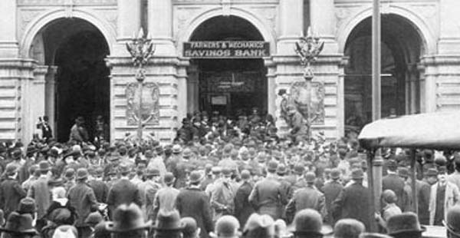
Bank Crisis
Between 1930 and 1933 more than 9,000 banks closed
Bank deposits weren’t insured
“run on the banks”
People could not invest and banks could not make loans

Slide 17
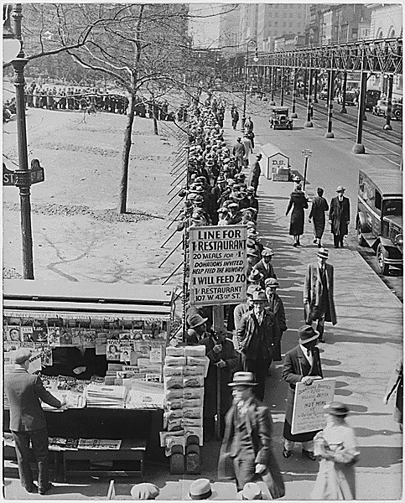
Human toll of the depression
By 1933, 13 million people unemployed
Millions more saw hours and wages reduced
Millions were also homeless
Soup kitchens became popular
Thousands of people “rode the rails” looking for work
Many slept in public places
1929 - 1932, the gross national product—was cut nearly in half, from $104 billion to $59 billion.
Approximately 90,000 businesses went bankrupt.
Hardest hit were urban areas; industrial cities of northeast and midwest
Studs Terkel in Hard Times: “It looked like a permanent situation.”

Slide 18
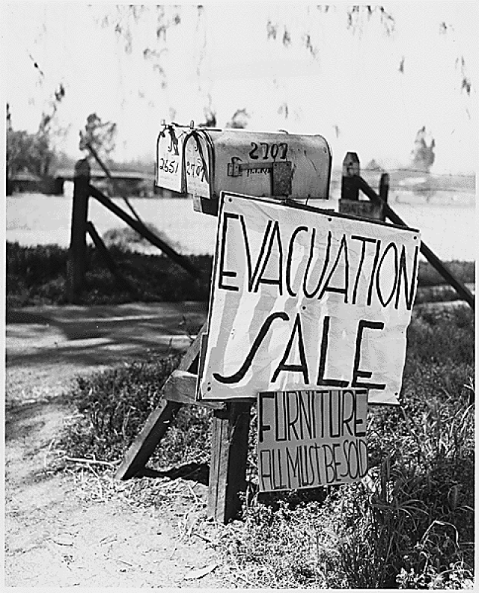
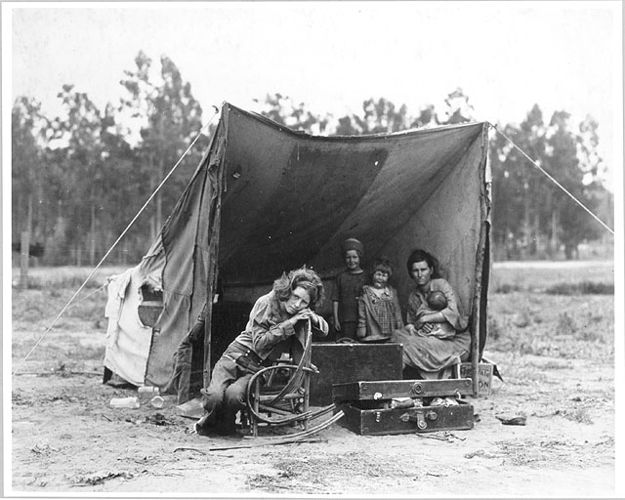
Dust Bowl
Natural disaster that ran from North Dakota to Texas that occurred during the mid 1930s
Average rainfall decreased and soil depletion of nutrients due to farming, caused topsoil to be picked up and blown eastward
John Steinbeck’s The Grapes of Wrath detail trip of Joad family from Oklahoma farm to the “riches” of California (Okies)

Slide 21
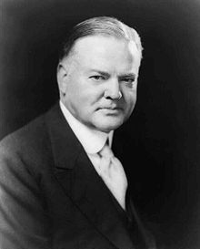
Herbert Hoover
Elected in 1928
1929-1933
Pro-Business
Conservative Republican
Scapegoat
“Hoovervilles”

Slide 22
Herbert Hoover
Hoover believed in the fundamental structure of the economy and though what America needed was confidence.
In speech after speech, he called on the people to keep up hope, and he asked business owners to keep the mills and shops open, maintain wage rates, and spread the work to avoid layoffs.

Slide 23
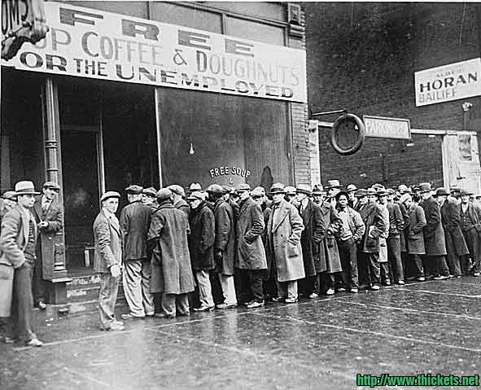
Hoover’s “Hands Off” Policy
1929 – Market crash – Hoover’s response?:
“Just part of the normal business cycle.”
A very “hands off” approach
Results in: Food riots
Rugged Individualism
Volunteerism – people need to volunteer to help those in need; businesses should volunteer to form associations of trade and marketing
Localism – policy whereby problems could best be solved at the local and state government level

Slide 24
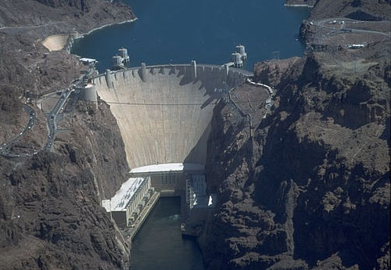
Hoover’s fault?
So, Hoover became more “hands on”
RFC (1932)-$2 billion available for loans to banks and small businesses, public works projects (Boulder Dam)
Home Loan Bank Board-offered funds for savings and loans, mortgage companies, home construction
Hoover’s critics said all these measure reflected a dubious “trickle-down” theory

Slide 25
Unemployment

Slide 26
The Homeless

Slide 27
Hoovervilles

Slide 28
Bonus Army
Bonus Army (1932) –Marched on Washington
Adjusted Compensation Act (1924) – a lump-sum payment will be paid to veterans in 1945
WWI veterans were scared that they would not get their compensation pay, and many were out of work
Congress approved the early payment – Hoover vetoed it
Veterans marched on Washington – “Bonus Army”
Hoover orders the Army to move the marchers out of D.C.
Tear gas, bayonets

Slide 29
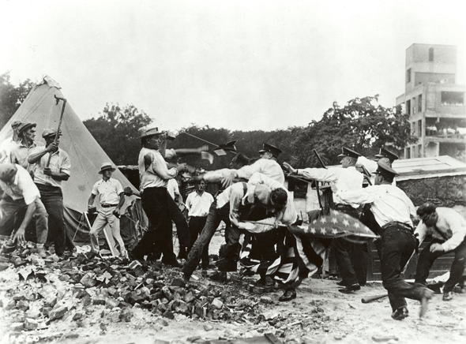

Slide 30
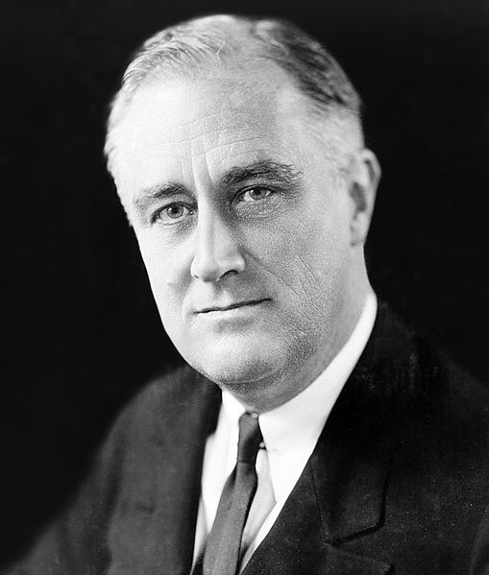
Franklin D. Roosevelt
1933-1945
Democrat
Direct Relief
Deficit Spending
New Deal
CCC
TVA
AAA
WPA
Social Security

Slide 31
FDR’s First Inaugural Address

