Slide 1
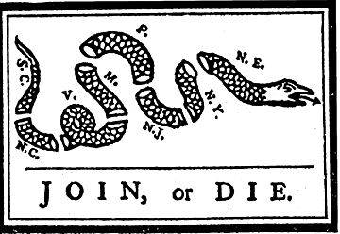

Slide 2
A famous political cartoon created by Benjamin Franklin and first published in his Pennsylvania Gazette on May 9, 1754
A snake severed into eighths, with each segment labeled with the initial of a British American colony or region. However, North England was represented as one colony, rather than the many states it has now.
Shows the importance of colonial unity

Slide 3
1754-Albany Plan of Union
Because of growing backwoods conflict with France the English Board of Trade called for a meeting of all colonies
Albany Congress met but accomplished little
Purpose was to establish a federal body in the colonies that would oversee matters of defense, Indian relations, trade and settlement in the west
This Albany plan was rejected

Slide 4
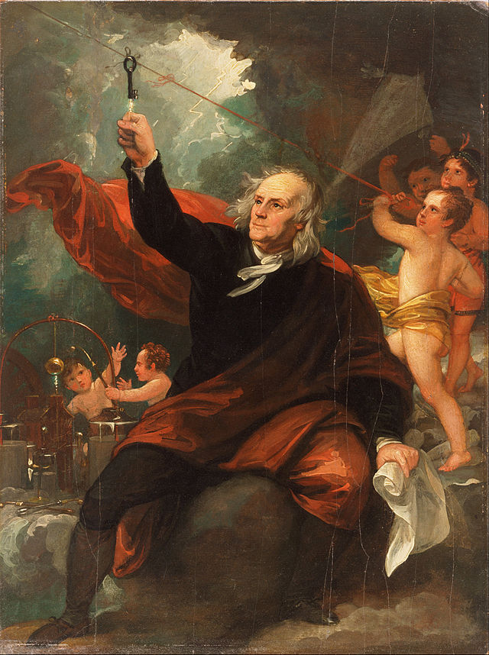
Benjamin Franklin
Enlightened Thinker
1718 - 1723 Apprenticed as a printer to his brother James Franklin
1727 Founded the Junta, a debating club, Philadelphia, Pa. (would become American Philosophical Society)
1729 Purchased Pennsylvania Gazette
1731 Established the Library Company of Philadelphia, Pa
1732 - 1758 Published Poor Richard, 1732-1747, and Poor Richard Improved, commonly known as Poor Richard's Almanack

Slide 5
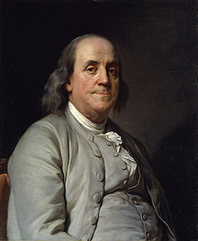
Benjamin Franklin
Enlightened Thinker
1740 Invented the Pennsylvania fireplace (Franklin stove)
1743 Proposed formation of the American Philosophical Society
1751 Founded with others, the Academy for Education of Youth -now University of Pennsylvania, Philadelphia, Pa.
1751 Founded Philadelphia City Hospital, Philadelphia, Pa
1751 Published Experiments and Observations on Electricity
1751 - 1764 Represented Philadelphia at the Pennsylvania Assembly
1754 Represented Pennsylvania at the Albany Congress

Slide 6
Bell Ringer
Thesis Carousal
Take out your inductive reasoning sheet and prepare to share your thesis.
Self-assess your thesis using the Long Essay Scoring Guide Rubric (Do you get the point?)
Peer-assessment: You will exchange each other’s thesis statement at 30 second intervals. For each paper that you receive, score the thesis (Do they get the point? If not, why?)
Be prepared to debrief to the whole class

Slide 7
LEQ
Review Rubric and Core Structure
Use your inductive reasoning sheet, the long essay scoring guide, and the core structure to write an essay response. (40 minutes)
Peer-assessment of LEQ

Slide 8
French & Indian War
How did the colonial wars of the late-seventeenth and early eighteenth centuries alter the relationship between Amerindians and the French and British Empires?
How did the outcome of the French and Indian War alter the balance of power in North America?
How did the French and Indian War alter the relationship between the British Empire and her American colonies?

Slide 9
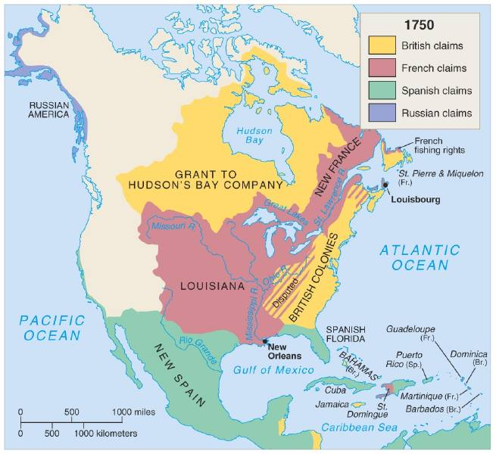
North America in 1750

Slide 10
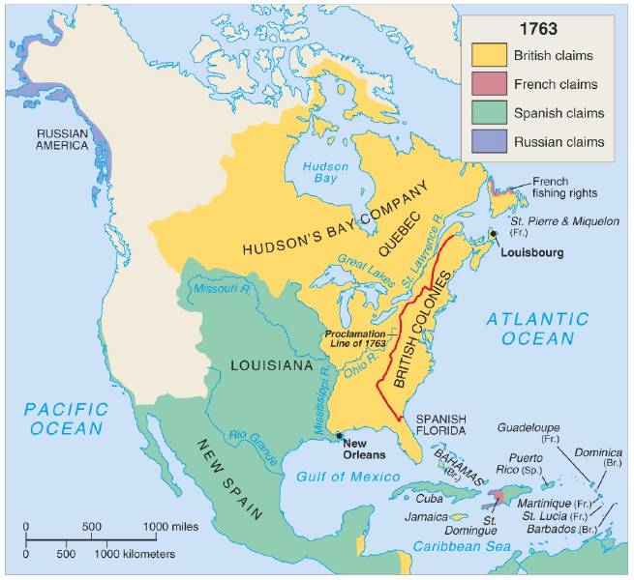
North America in 1763

Slide 11
French Canada
France was late in coming to the New World
1. Much religious conflict between Catholics and Huguenots (Calvinists) in the late-16th century stunted colonial expansion.
2. Edict of Nantes (1598): Granted limited toleration to French Protestants
a. Religious wars ceased and France began looking at expanding its influence in the Atlantic trade.
France later became the dominant power in 17th -century Europe led by King Louis XIV.

Slide 12
New France
The French established Quebec in 1608 (a year after England had established the Jamestown colony in Virginia)
Founded by Samuel de Champlain ("Father of New France")
Entered a friendship with the local Huron, the enemies of the Iroquois Confederation.
Significance: Iroquois, in retaliation, later kept the French from expanding into the Ohio Valley, ravaged French settlements, and allied with the British.
Government
Lacked popularly-elected assemblies or trial by jury.
French population in New France grew slowly

Slide 13
New France
Of the European powers, the French were the most successful in creating an effective trading relationship with Native Americans.
British settlers sought to remove or exterminate them.
Spain sought to Christianize and subdue them via the encomienda system (forced labor in towns), and the mission system where forced conversion often occurred.
The French became great gift givers (the key to getting along with Native Americans who based their inter-tribal relationships on gift giving) during last two decades of the 17th century.
French fur traders often married Native American women and adopted tribal customs.
The beaver trade led to the exploration of much of North America

Slide 14
New France
Jesuits: Catholic Missionaries sought to convert Native Americans and “save” them; (the missionaries typically lived among the tribes)
France established posts in the Mississippi region (New Orleans was the most important)
Sought to block Spanish expansion along the Gulf of Mexico

Slide 15
“The Great War for Empire” was a series of European and Colonial Wars for Empire
King Williams’ War (1689-1697)
Queen Anne’s War (1702-1713)
King George’s War (1744-1748)
French and Indian War (1754-1763)
Goal of British in each conflict was to keep a balance of power against the French; Alliances would change, but in each conflict Britain and France would be against each other.
In all but the last conflict, the greatest battles were in Europe.

Slide 16
“The Great War for Empire” was a series of European and Colonial Wars for Empire
So, for much of the century the colonies were involved in these wars
Consequences were tough on New England colonies because of their location
All of the wars would lead to English debt, a need for a large navy and standing army
Increased British nationalism (patriotism)

Slide 17
King George’s War (1744-1748)
First time English colonists were drawn into the conflicts
New Englanders captured French post at Louisbourg on Cape Breton Island; peace treaty forced them to abandon it.
After the war, relations among the English, French and Iroquois worsened
Iroquois began to grant trading rights to English; French thought this would lead to English expansion into French lands and began to construct new fortresses in Ohio Valley
The British protested and began making military preparations by building their own forts

Slide 18
French and Indian War (1754-1763) (Seven Years' War):
Most important of the colonial wars.
Cause: conflict over the Ohio Valley
British settlers continued to move into the region and were increasingly opposed to French dominance there.
Massachusetts, Connecticut, Virginia, Pennsylvania and New York all laid claim to the same territory as did the French
The French needed to retain the region so to link Canada with the lower Mississippi Valley and the Caribbean.
The French saw Iroquois trading concessions to British merchants in the late-1740s as a threat to French interests in the Ohio Valley.

Slide 19
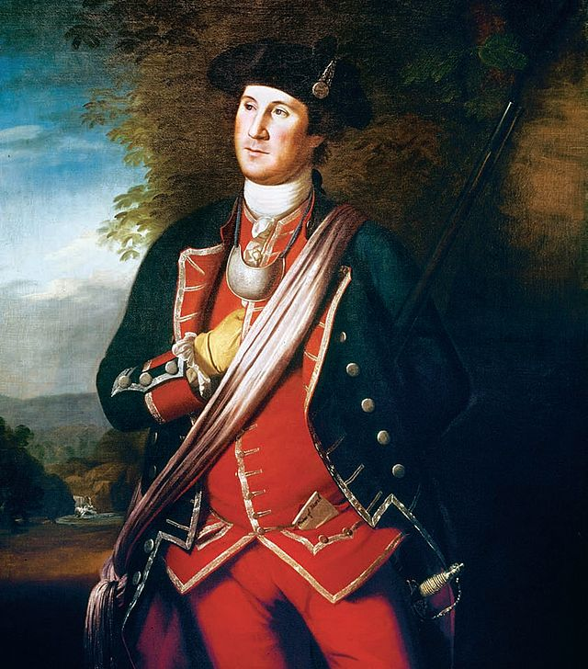
George Washington
The French and Indian War
1753-George Washington delivered the message that the French were trespassing; he returned to tell Dinwiddie that the French were determined to take Ohio Valley
1754-Washington returned with 150 men to take a site south of the French forts where the Monongahela and Alleghany Rivers meet to form the Ohio River

Slide 20
George Washington
The French and Indian War
When he arrived, the French had already built Fort Duquesne
In response, Washington built a crude settlement named Fort Necessity not far from the French.
Washington ordered an attack on a French detachment and the French countered with attack on Fort Necessity.
Outnumbered 4-1 Washington’s group threw up a defensive position and was forced to surrender his command
Washington lost 1/3 of his men and surrendered; allowed to return to VA

Slide 21
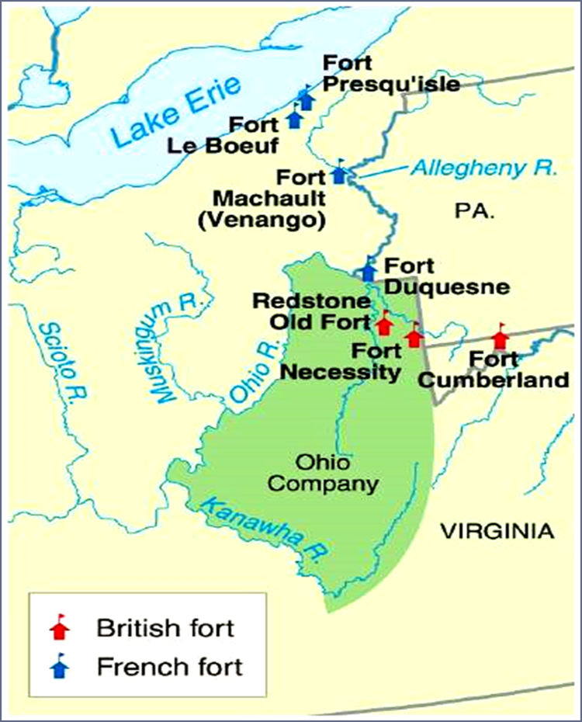
Fort Duquesne, May, 1754
In effect, Washington triggered a world war.
Britain retaliated by clamping down in Nova Scotia.
Relocated 4,000 Nova Scotians throughout the continent, including Louisiana.
French-speaking Acadians became the descendants of modern day "Cajuns."
The war widened into the largest world war: 25,000 American colonials fought in the conflict.

Slide 22
English vs. French
English Advantages by 1754
French Advantages by 1754
Over 150 years, British had established more permanent colonies in North America as opposed to French “courier de bois”
British colonists outnumbered French in North America (1.5 million to 80,000 in 1750)
Access to great water routes (Mississippi River and Great Lakes)
Had established stronger trading relationships with Native Americans
French governors could move more decisively without any worry from quarreling colonial assemblies and separate colonies

Slide 23
Review 9/30/16
Synthesis vs. Contextualization
French and Indian War

Slide 24
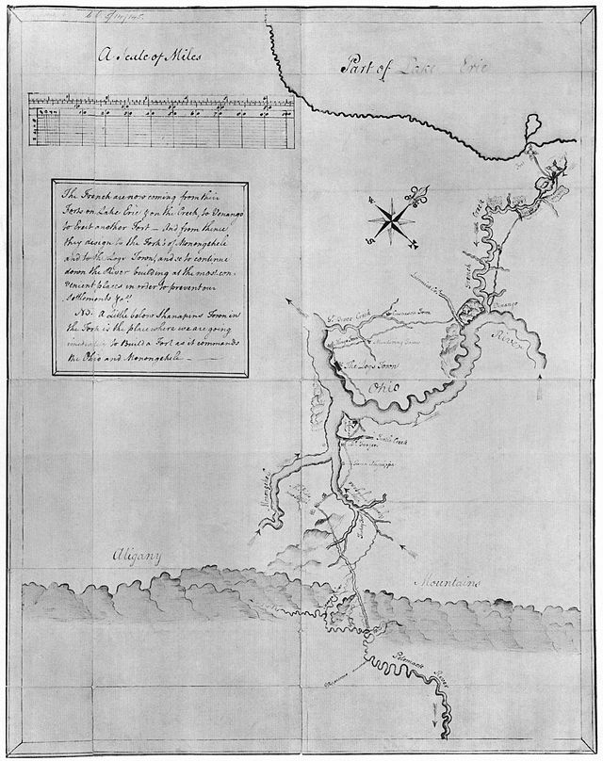
French and Indian War
The war would pit the French and their American Indian allies (i.e., Huron and Potawatami) vs. The British and their American Indian allies (i.e., Iroquois)
English and colonists were initially unorganized, undisciplined, ignorant and arrogant

Slide 25
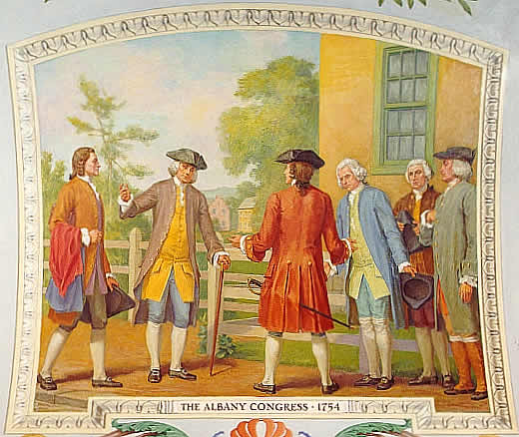
Albany Congress (1754)
Great Britain’s Board of Trade called leaders from all the colonies to meet in Albany to discuss Native American threats and to ask for an alliance with the Iroquois.
The Iroquois refused to commit themselves to the British.
Long-range purpose: increase colonial unity and organize a strong defense against France.

Slide 26
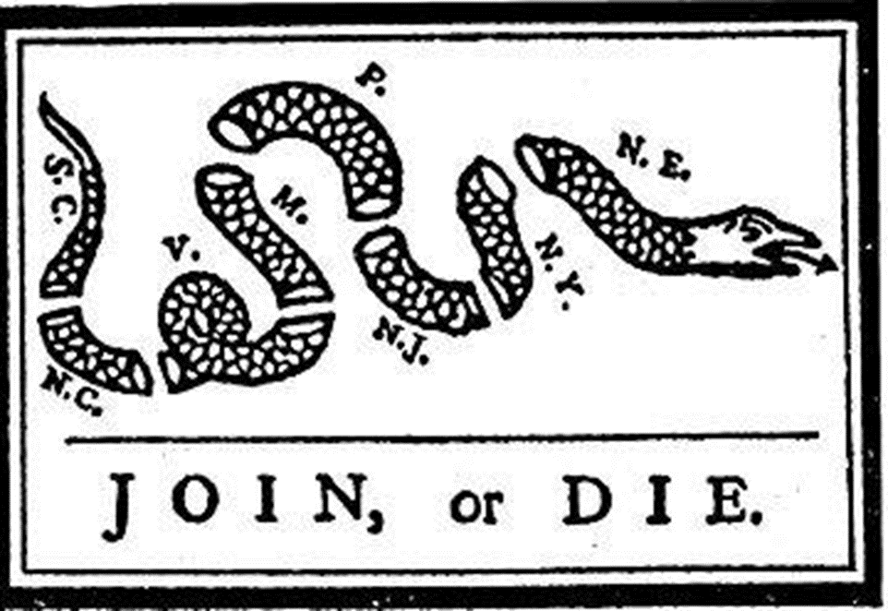
Albany Plan for Union
Benjamin Franklin proposed a plan for colonial home rule: dealt with defense and Native American affairs.
Adopted by delegates
Individual colonies rejected it: not enough autonomy would be given to colonies
Britain rejected it as it might give too much independence to the colonies.

Slide 27
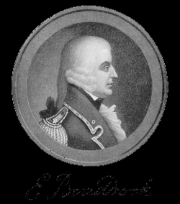
Early losses and General Edward Braddock
Commander in Chief of the British army in America
In a decisive 1755 battle, British General Braddock was defeated a few miles from Fort Duquesne by smaller French and Indian forces.
Braddock was killed in the attack
By late 1755 many English settlers had migrated back east of the Allegheny Mountains to avoid hostilities
Britain failed in a full-scale invasion of Canada in 1756

Slide 28
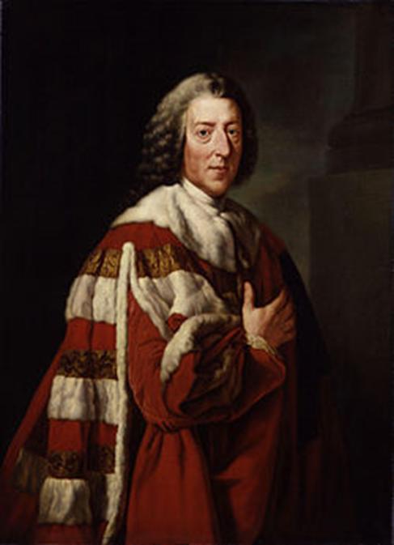
William Pitt
William Pitt (The "Great Commoner") – became leader of British government (Secretary of State and later Prime Minister) and changed Britain’s strategy in the war.
Focused on defeating France in North America in order to win the war instead of remaining bogged down in Europe.
Pitt was very popular among the British people

Slide 29
Tensions between British and Colonists
Some colonists were forced into service without their consent (impressment)
Supplies and equipment for the military were confiscated from farmers and tradesmen.
British troops were quartered by colonists, without compensation.
These injustices were reversed by Pitt in 1758 who ordered colonists be compensated for property and that soldiers be enlisted by the colonies themselves.

Slide 30
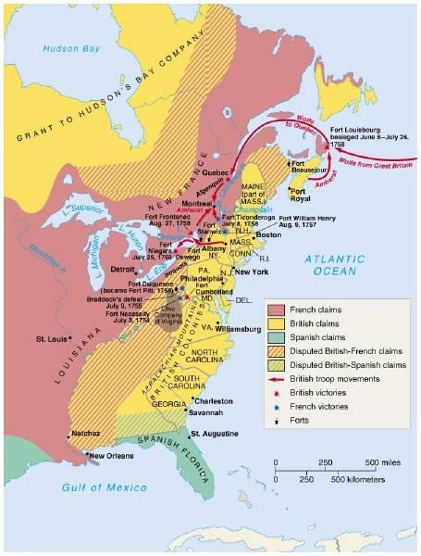
1758-1761 → The Tide Turns for England
1758-59 British cut off French shipping to the Americas; Indians deserted the French
1758—Britain captures Fort Duquesne and renamed it Fort Pitt
June/July 1758--British capture French fortress of Louisbourg which guarded entrance to St. Lawrence River
1759—British General James Wolfe attacked Quebec; Montcalm defeated and died
1760—British captured Montreal and forced French to surrender rest of Canada including Forts around Great Lakes

Slide 31
Treaty of Paris (1763)
France was removed from North America completely.
Technically, lands west of Mississippi River were still French but not yet settled, but France gave it to Spain as compensation for their support in the war.
England received all French lands in Canada, exclusive rights to Caribbean slave trade, and commercial dominance in India.

Slide 32
Significance of Britain’s victory over France in North America
Great Britain emerged as the dominant power in North America and as the leading naval power in the world.
Permanently altered the balance of power in North America between Britain, France, and the Native Americans
Native Americans were now increasingly at the mercy of British American settlers who moved westward without fearing French reprisals.
By 1800, many of the eastern woodlands Indians were removed or killed by American encroachment.
The enormous war debt resulted in new imperial tax policies that eventually led to the American Revolution.

Slide 33
Tension between the colonies and Britain during and after French and Indian War.
The colonies emerged from war with increased confidence in their military strength
1. Colonial military leaders were angry that few Americans were promoted in the British army and that American officers were treated poorly.
2. Yet, British leaders believed Americans had often performed poorly in the war and did not deserve the respect they desired.

Slide 34
Tension between the colonies and Britain during and after French and Indian War.
British authorities were upset that American shippers traded with Spain and the French West Indies during the war.
1. Natives who sided with the French were aided by increased foodstuffs.
2. Britain prohibited the export of all supplies from the New England and Middle colonies during last year of the war.
3. Some colonies refused to supply troops: saw economic gain as more important than loyalty to Britain.
Only later agreed to commit troops when Pitt offered to substantially reimburse the colonies.

Slide 35
Tension between the colonies and Britain during and after French and Indian War.
American westward colonial expansion increased significantly after the war
1. The French barrier west of the Appalachians was removed
2. Spanish and Indian threats were removed in many areas.
3. Settlers were no longer as dependent on British protection in the frontier

Slide 36
Tension between the colonies and Britain during and after French and Indian War.
The legitimacy of British rule in local colonial affairs came into question.
1. Pitt’s reversal of harsh British policies toward the colonies beginning in 1858 convinced many colonists that the British should have little to no role in local matters.
2. The colonies expected the autonomy they had enjoyed during the era of “salutary neglect.”

Slide 37
Summary of Effects of the War on Great Britain
It increased colonial empire in the Americas.
It greatly enlarged England’s debt.
Britain’s contempt for the colonials created bitter feelings.
Therefore, England felt that a major reorganization of her American Empire was necessary

Slide 38
Summary of Effects of the War on the Colonists
It united them against a common enemy for the first time.
It created a socializing experience for all the colonists who participated
It created bitter feelings towards the British that would only intensify.

Slide 39
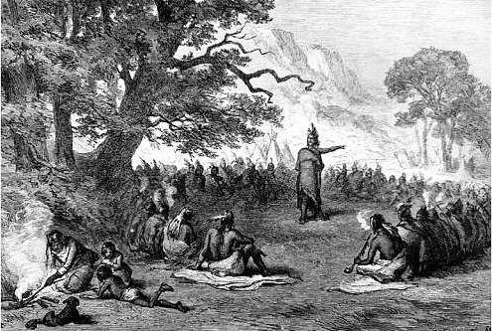
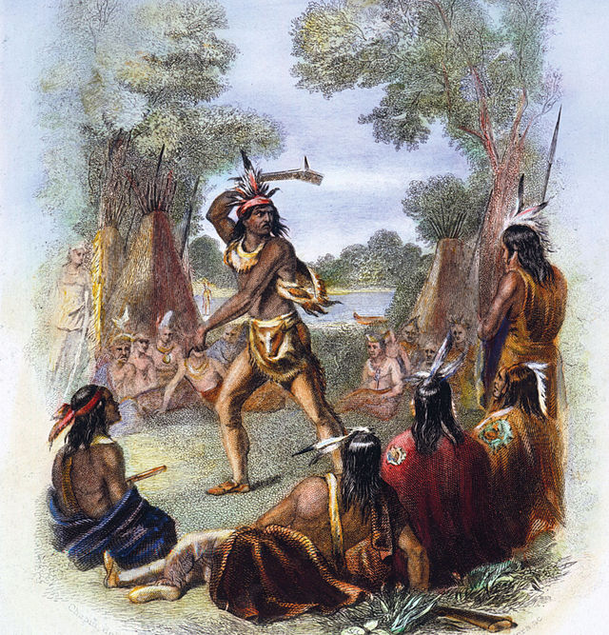
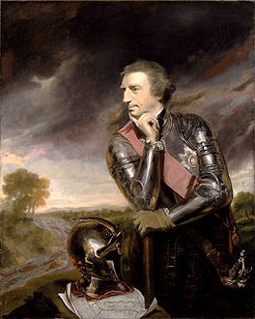
Pontiac’s Rebellion

Slide 40
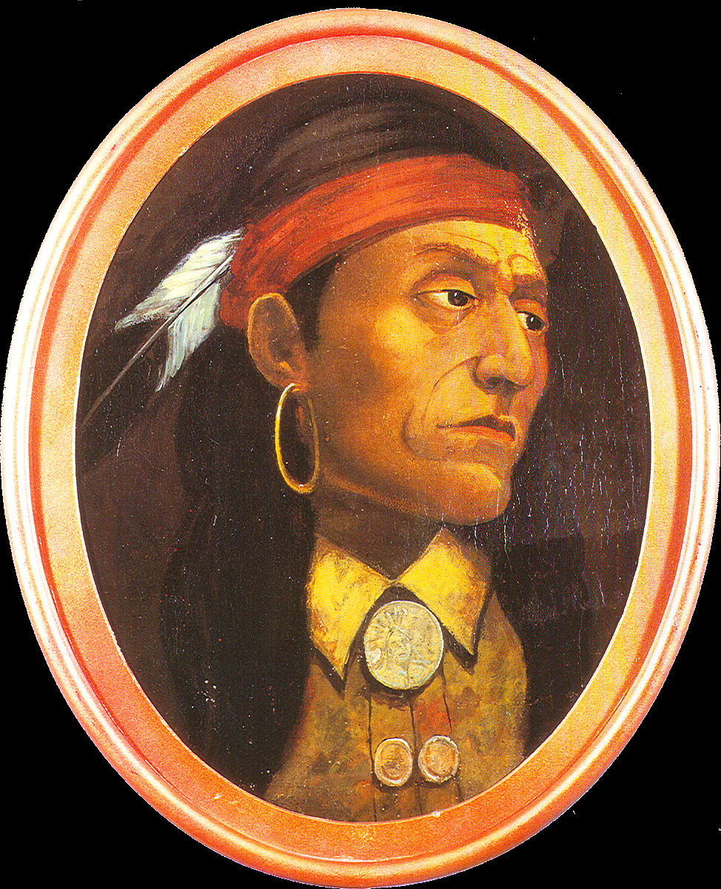
Pontiac’s Rebellion
Native Americans in the Ohio Valley region were angered at British treatment during the last years of the French and Indian War.
Chief Pontiac, an Ottowa chief, refused to surrender his lands to the British although France (their ally in the war) had lost and were now gone.
Chief Pontiac led an Native American alliance against whites in the Ohio Valley and Great Lakes region in 1763.

Slide 41
Pontiac’s Rebellion
9 of 11 British forts were taken and several were wiped out.
Perhaps 2,000 lives were lost during first 6 months of the conflict, and many more colonists were driven from their homes on the frontier back to more settled areas.
It took Britain 18 months to bring the rebellion under control.
Britain retaliated with germ warfare: blankets infected with smallpox were distributed among the Amerindians who thus died in droves.

Slide 42
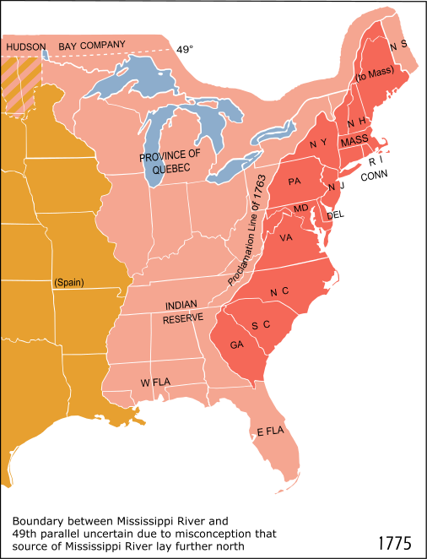
Proclamation Line of 1763

Slide 43
Proclamation of 1763
In response to Pontiac’s Rebellion, King George III signed an edict creating royal colonies in all newly acquired lands in the Treaty of Paris.
The purpose of the proclamation was to organize Great Britain's new North American empire and to stabilize relations with Native North Americans
Prohibited colonials from moving west of the Appalachians
The line drawn from Canada to Florida along the crest of the Appalachians was only intended to be temporary.
British aim: settle land disputes with Amerindians fairly to prevent more uprisings like Pontiac's and organize the eventual settlement and defense of the frontier.

Slide 44
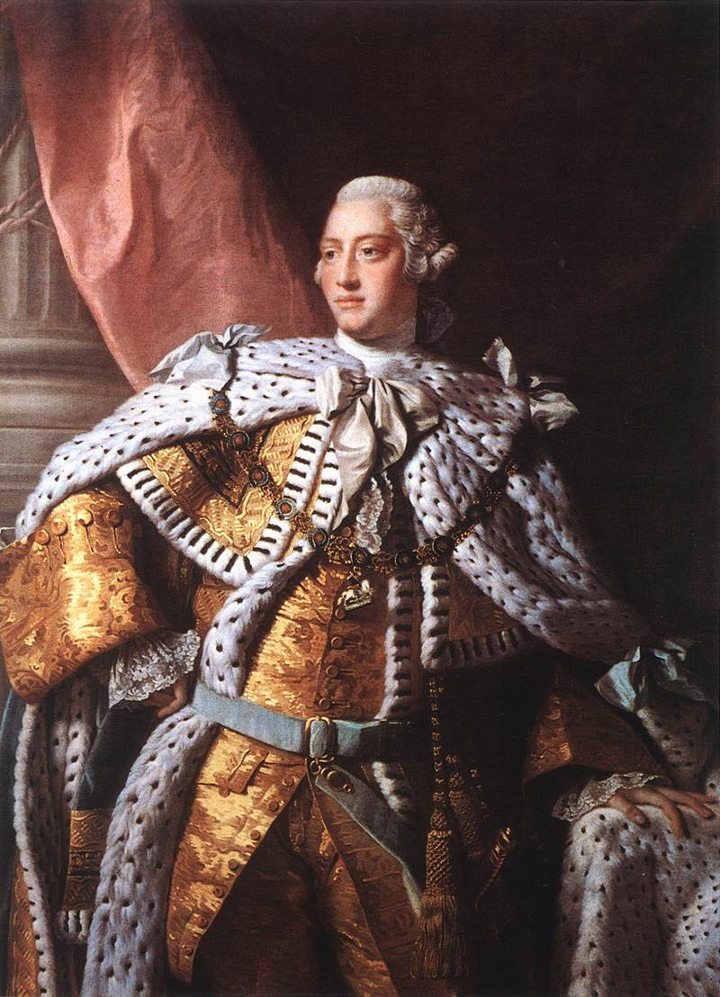
Proclamation of 1763
Colonials were infuriated; saw the edict as being permanent.
Many veterans had fought in the war and felt betrayed.
Land speculators argued that the land was a birthright of British citizens.
Colonials generally ignored the Proclamation and continued to migrate westward.

Slide 45
Reading Check
Brinkley argues that colonial relations with Great Britain were altered by “two Georges”. What role did King George III and George Grenville play in changing that relationship after the French & Indian War?
What impact did the Proclamation of 1763 have on the colonies?
What was the purpose of each of the following acts?
Sugar Act of 1764
Currency Act of 1764
Stamp Act of 1765
Why did social movements, like the rise of the Paxton Boys in Pennsylvania and the Regulator Movement in North Carolina, develop in the colonies after the French and Indian War?

Slide 46
Bibliography
College Board, AP United States History Course and Exam Description (Including the Curriculum Framework), 2014: History, New York: College Board, 2014
Bailyn, Bernard, The Origins of American Politics, New York: Vintage Books, 1968 _____________, The Ideological Origins of the American Revolution, Cambridge, Massachusetts: Belknep, 1967
Brinkley, Alan, Williams, T. Harry, and Current, Richard N., American History, 14th Edition, New York: McGraw-Hill, 2012
Cook, Don, The Long Fuse: How England Lost the American Colonies, 1760-1785, New York: Atlantic Monthly Press 1995
Foner, Eric & Garraty, John A. editors: The Reader’s Companion to American History, Boston: Houghton Mifflin Company, 1991
Hofstadter, Richard, America at 1750: A Social Portrait, New York: Vintage Books, 1971
Josephy, Jr., Alvin M., 500 Nations: An Illustrated History of North American Indians, Alfred A Knopf, New York, 1994.
Kennedy, David M., Cohen, Lizabeth, Bailey, Thomas A., The American Pageant (AP Edition), 13th edition, Boston: Houghton Mifflin 2006
Murrin, John, et al, Liberty Equality Power: A History of the American People, Ft. Worth: Harcourt Brace 1999 Nash, Gary : American Odyssey, Lake Forest, Illinois: Glencoe, 1992

