Slide 1
John F. Kennedy
The Cold War and the New Frontier

Slide 2
John Kennedy
Democrat 1961-1963
VP-Lyndon Johnson
Election of 1960
New Frontier
Flexible Response
Bay of Pigs Invasion
Space Race
Peace Corps
Alliance for Progress
Cuban Missile Crisis
Berlin Wall
Kennedy Assassination

Slide 3
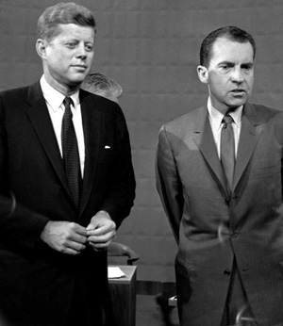
Election of 1960
Democratic nominee for president was Massachusetts Senator, John Kennedy
Kennedy had well organized campaign, backing of wealthy family, charismatic
43 years old
Roman Catholic
Republican opponent was Vice President Richard Nixon

Slide 4
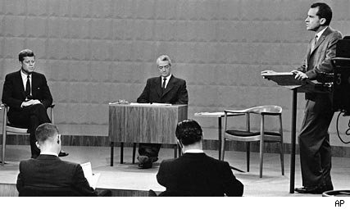
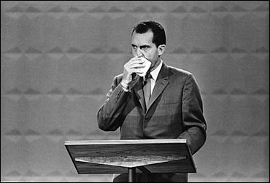
Nixon-Kennedy Debates
Agreed to the first televised presidential debates in American History
Nixon readily agreed because of his expertise in foreign policy
September 26, 1960-70 million viewers watched the first debate

Slide 5
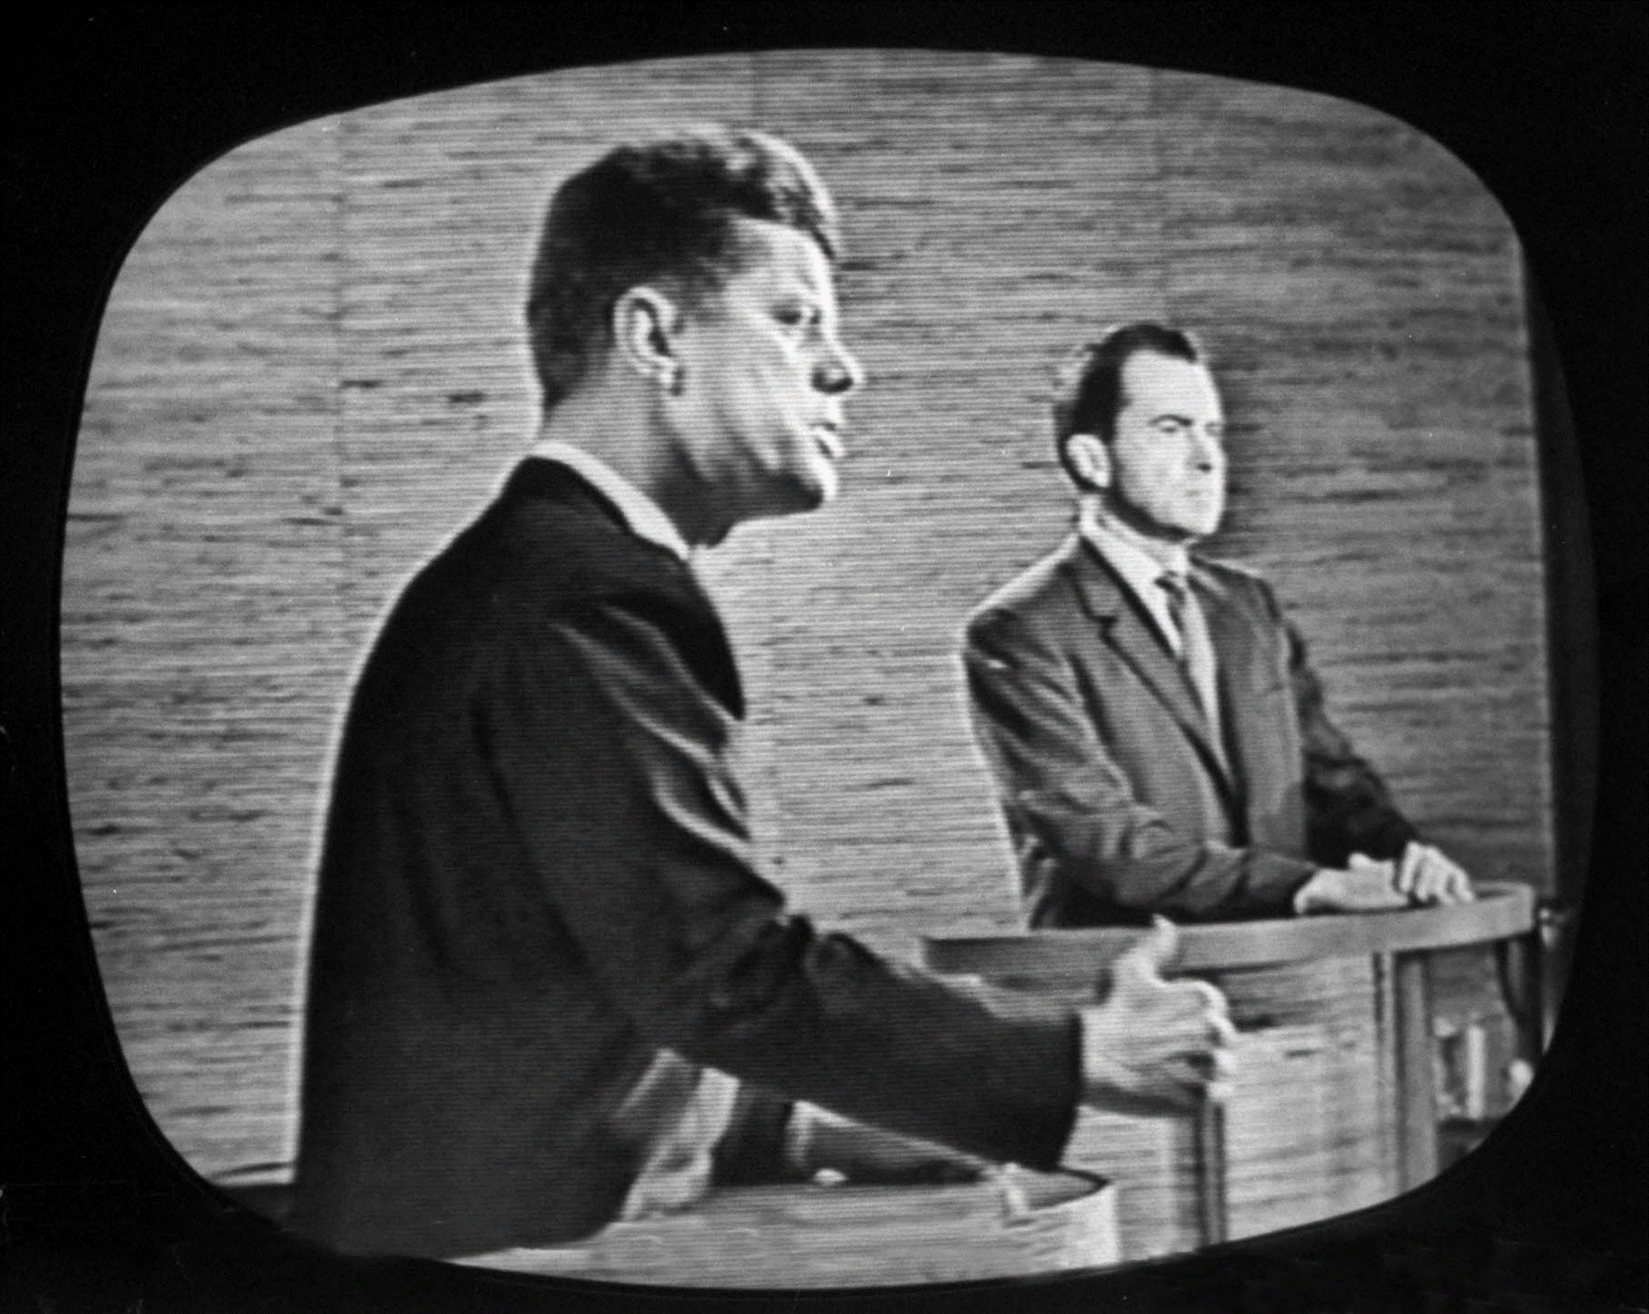
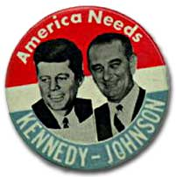
Kennedy earned 49.7% of the popular vote to Nixon's 49.5%. Kennedy polled only about 100,000 more votes than Nixon out of over 68 million votes cast. The electoral college awarded the election to Kennedy by a 303-219 margin, despite Nixon winning more states than Kennedy.

Slide 6
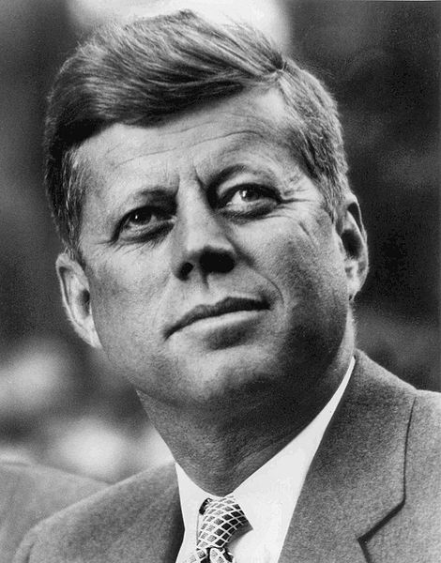
Inauguration-January 20, 1961
“Ask not what your country can do for you, but what you can do for your country”
Camelot Years
“Don’t let it be forgot, that for one brief, shining moment there was Camelot”
Kennedy Mystique
The Best and the Brightest
McGeorge Bundy- Harvard University Dean became national security advisor
Robert Kennedy-his 35 year old brother became Attorney General
Robert McNamara- president of Ford Motor Company became Secretary of Defense
Dean Rusk- President of the Rockefeller Foundation became Secretary of State

Slide 7
The New Frontier
“We stand today on the edge of a New Frontier -— the frontier of the 1960s, the frontier of unknown opportunities and perils, the frontier of unfilled hopes and unfilled threats. ... Beyond that frontier are uncharted areas of science and space, unsolved problems of peace and war, unconquered problems of ignorance and prejudice, unanswered questions of poverty and surplus”… John Kennedy, acceptance speech at the 1960 Democratic National Convention at the Memorial Coliseum, Los Angeles, California
New Frontier efforts were designed to lower taxes, protect the unemployed, increase the minimum wage, and to focus on the business and housing sectors to stimulate the economy.
New Frontier also proposed new social programs. These included federal aid to education, medical care for the elderly, urban mass transit, a Department of Urban Affairs, and regional development in Appalachia.

Slide 8
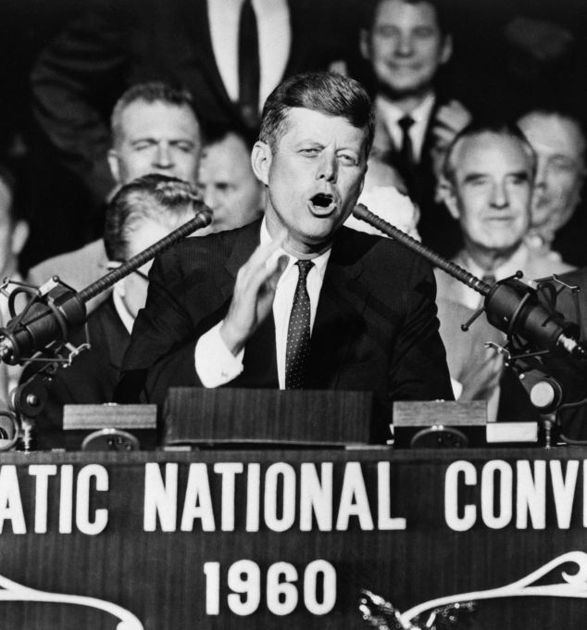
The New Frontier
Lacked deep congressional support because of his small margin of victory in the 1960 election
He did manage an increase in the minimum wage, but a major medical program for the elderly was shot down.
Attempts to cut taxes and broaden civil rights were watered down on Capitol Hill.
The proposal for a Department of Urban Affairs was killed by southern Democrats who thought Kennedy would appoint an African-American as first secretary.
The education bill was dropped on the question of aid to parochial schools
Much of his New Frontier (including civil rights legislation) would be passed as part of LBJ’s Great Society

Slide 9
Foreign Policy during the Cold War
Kennedy believed he needed to redefine U.S. nuclear strategy from the Eisenhower idea of “massive retaliation” or “brinkmanship” to “flexible response”
Campaigned that massive retaliation left the U.S. with only two choices: defeat on the ground or the resort to the use of nuclear weapons.
Claimed that it left the U.S. with a “missile gap” compared to the Soviet Union.
Increased defense spending in order to boost conventional military forces—nonnuclear forces such as troops, ships, and artillery
Created elite army branch called the Special Forces, or Green Berets
Still tripled nuclear capabilities of U.S. with the development of the ICBM

Slide 10
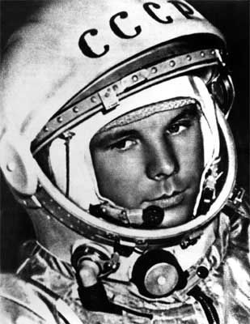
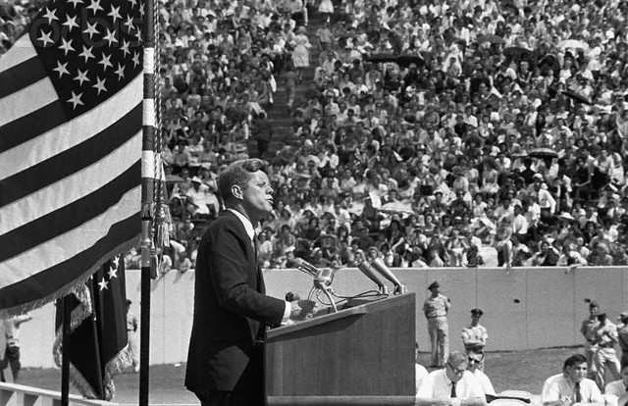
The Space Race Begins
In 1961, Russian cosmonaut Yuri Gagarin blasted off into space, making the Soviet Union the first nation to launch a human into orbit
Kennedy said he wanted U.S. to land a man on the moon by the end of the 1960s

Slide 11
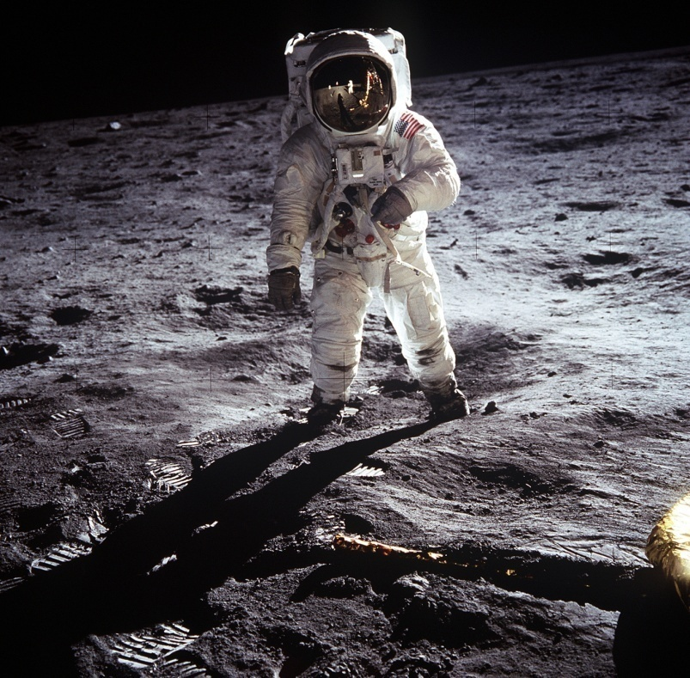
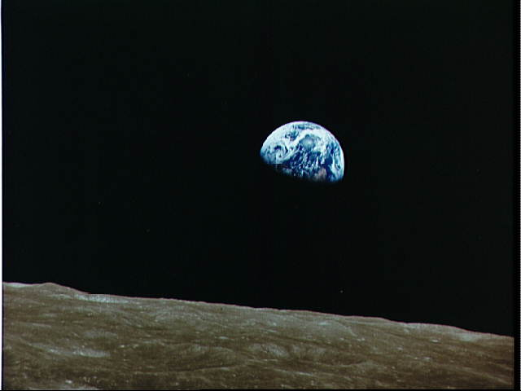
The Space Race Begins
Apollo Program: Kennedy’s challenge was met on July 20, 1969, when Neil Armstrong became the first human to step foot on the moon
“That’s one small step for man, one giant leap for mankind.” – Neil Armstrong

Slide 12
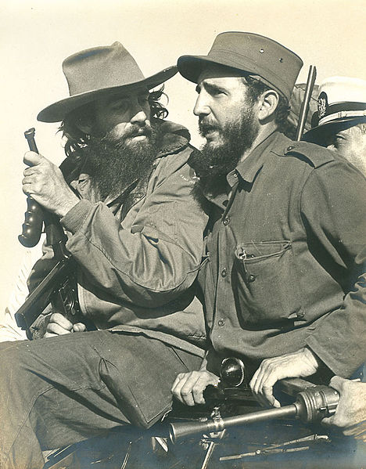
Crisis over Cuba
Fidel Castro led a guerrilla movement from 1956-1959 to topple Cuban dictator Fulgencio Batista
Castro took control of Cuba in 1959 with the promise of democracy
Castro’s government originally supported by the U.S.
Castro took control of American and British oil refineries; broke up commercial farms into communes to be worked by formerly landless peasants
Castro turned to the Soviet Union for help
Cuban exiles (10% of Cubans) fled to Miami

Slide 13
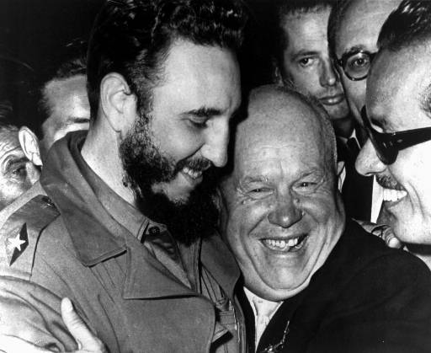
Castro embraces Communism (1959)
Cuban dictator Fidel Castro embraces Soviet premier Nikita Khrushchev

Slide 14
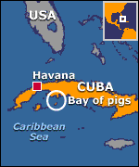
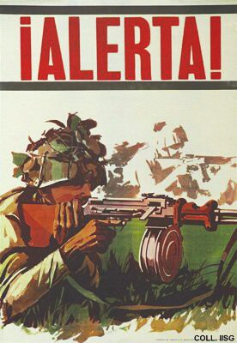
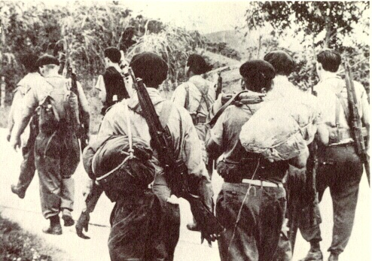
Bay of Pigs
(1961)
CIA-trained Cuban exiles led an attack at the Bay of Pigs in Cuba in an attempt to overthrow Castro
Invasion was a disaster and failed; was a huge foreign policy blunder for the United States

Slide 15
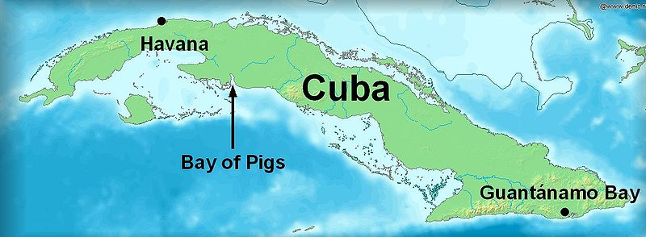
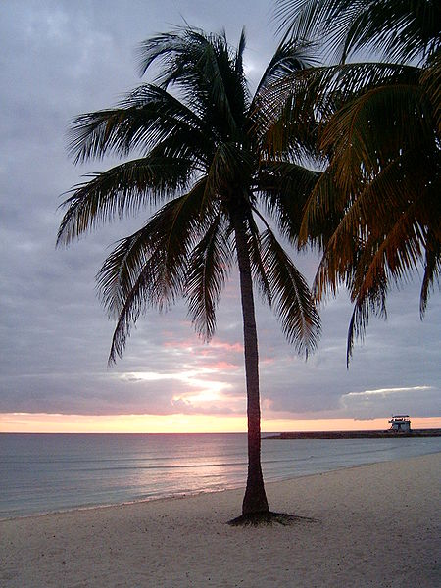
The Bay of Pigs
Eisenhower started CIA training sessions of Cuban exiles during the summer of 1960 in Guatemala
Kennedy followed the plan and authorized April 17, 1961 invasion of Cuba by 1400 Cuban exiles
Nothing went as planned. Air strike failed to knock out Cuban air force. JFK called off the second airstrike
The exiles met 20,000 Cuban troops backed by Soviet tanks and jet aircraft
American bombers sent to protect the retreat of the Cuban exiles, but showed up too late.

Slide 16
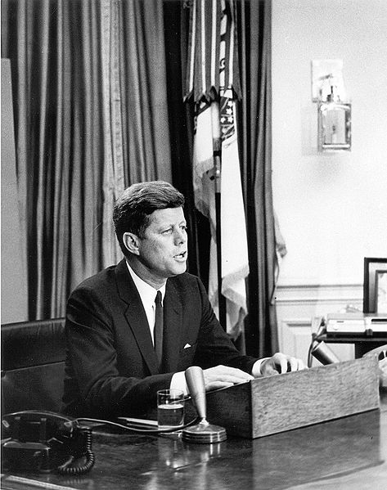
The Bay of Pigs
Kennedy took the blame for the loss
Castro used US failure as public relations triumph; Kennedy negotiated the release of prisoners through $53 million worth of medical supplies
Kennedy warned that he would resist further attempts at Communist expansion in Western Hemisphere; Castro continued to accept Soviet aid

Slide 17
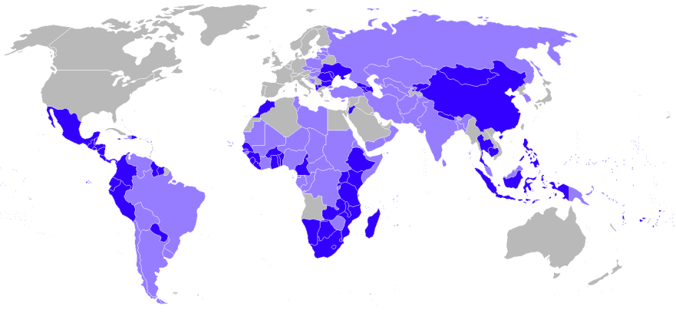
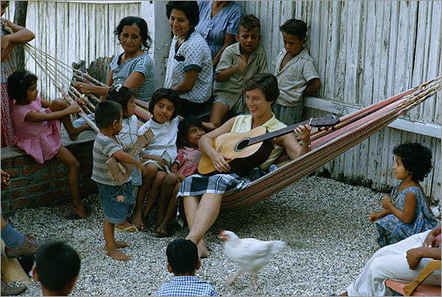
Peace Corps
Within weeks of his inauguration, President Kennedy Signed Executive Order 10924, establishing the Peace Corps
“To promote world peace and friendship through a Peace Corps, which shall make available to interested countries and areas men and women of the United States qualified for service abroad and willing to serve, under conditions of hardship if necessary, to help the peoples of such countries and areas in meeting their needs for trained manpower.”
R. Sargent Shriver is appointed as the Peace Corps' first Director. From March 1961 to February 1966, Shriver developed programs in 55 countries with more than 14,500 Volunteers.

Slide 18
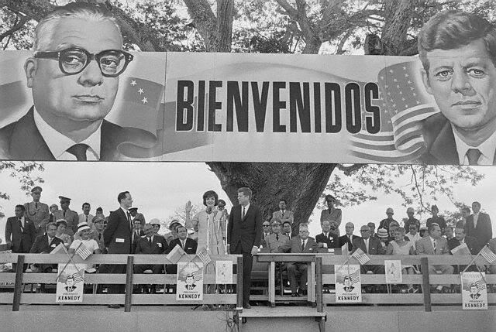
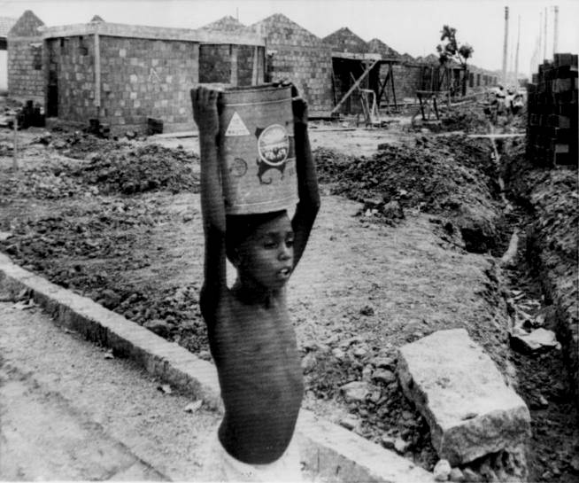
Alliance for Progress
10-year, multibillion-dollar aid program for Latin America.
In requesting funds from Congress, the president stressed the need for improved literacy, land use, industrial productivity, health, and education in Latin America.
would hopefully make the countries stronger and better able to resist communist influences.
Results often deemed a failure

Slide 19
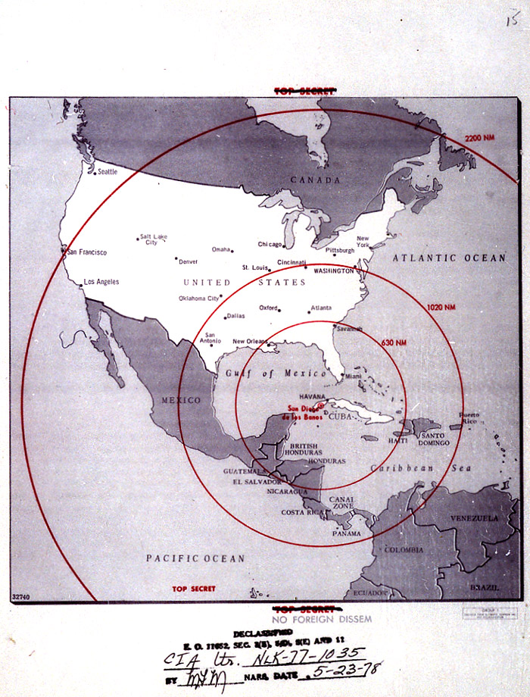
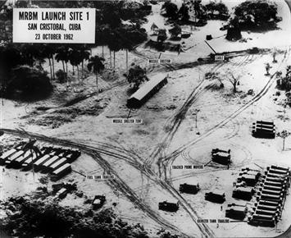
Cuban Missile Crisis
U.S. and Soviet Union came extremely close to nuclear war when Russians place nuclear missiles in Cuba in November of 1962
In response to U.S. missiles in Turkey, the Russians began building missile bases in Cuba

Slide 20
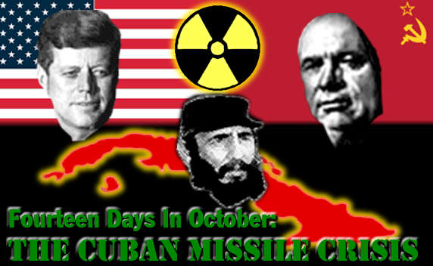
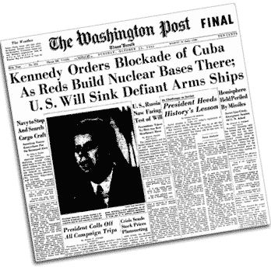
Cuban Missile Crisis
United States places an embargo on incoming shipments to Cuba from the Soviet Union
Soviet ships reach the quarantine line, but receive radio orders from Moscow to hold their positions

Slide 21
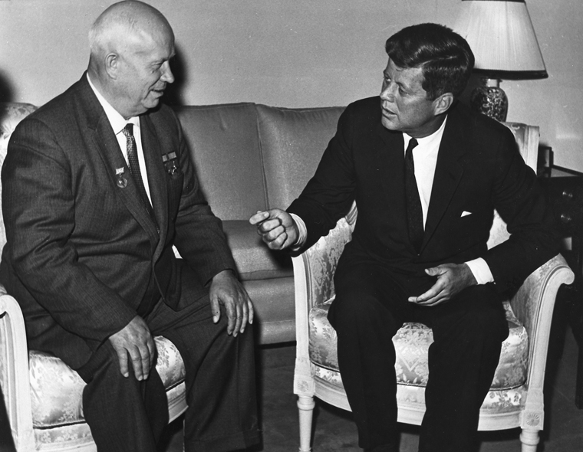
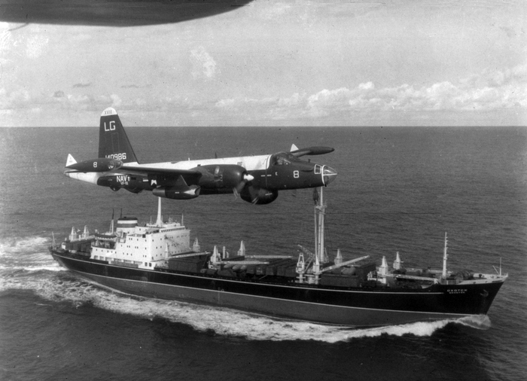
Cuban Missile Crisis
Khrushchev promised to defend Cuba with Soviet arms
During the Summer of 1962, the Soviet flow of weapons to Cuba increased
U-2 planes provided evidence that Soviets were building missile bases in Cuba. Some contained nuclear missiles already prepared to launch
On October 22, 1962 Kennedy delivered a nationally televised speech saying that an attack from Cuba would start an all out war with the Soviets

Slide 22
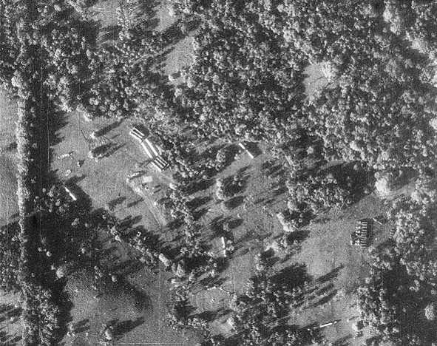
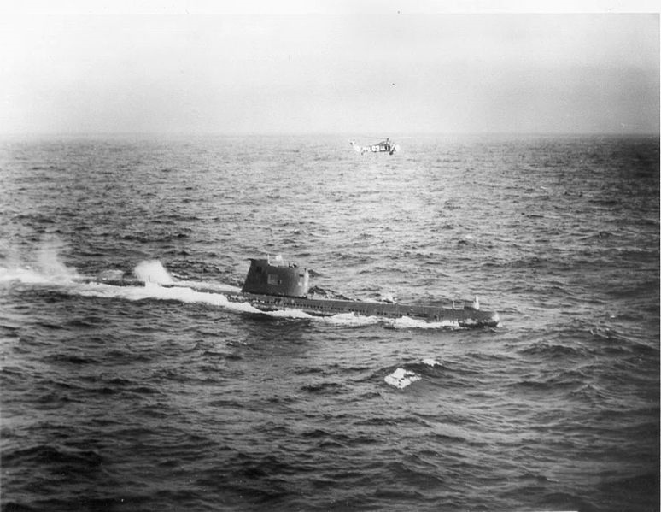
Cuban Missile Crisis
For the next 6 days the world expected war
U.S. Navy sent to intercept Soviet ships supplying Cuba
U.S. goal was to quarantine Cuba and prevent ships from coming within 800 miles of the island
250,000 men prepared to start land invasion of Cuba from Florida
First break in crisis: Soviet ships stopped to avoid a conflict at sea
Secretary of State Dean Rusk: “We’re eyeball to eyeball, and I think the other side just blinked”

Slide 23
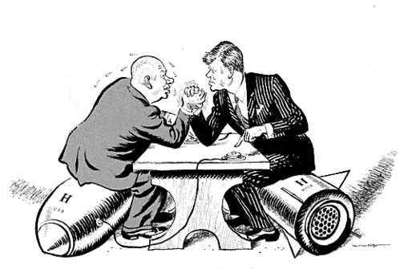
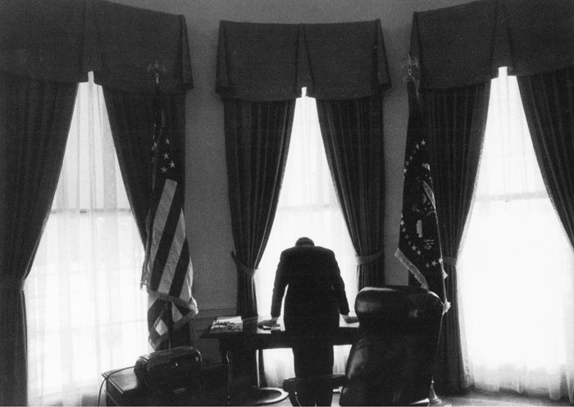
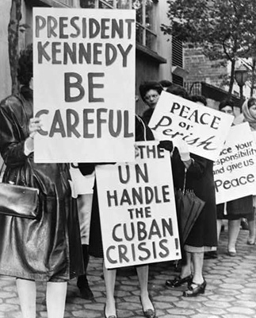
Cuban Missile Crisis
The Russians agreed to take their missiles out of Cuba if the U.S. removed theirs from Turkey
President John F. Kennedy thinking in the Oval Office during the Cuban Missile Crisis in 1962

Slide 24
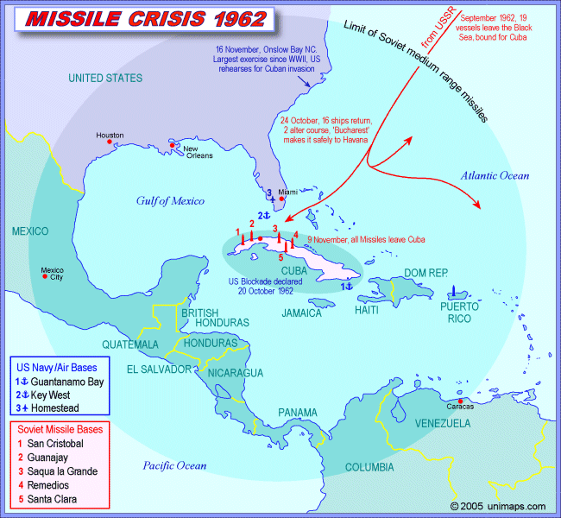

Slide 25
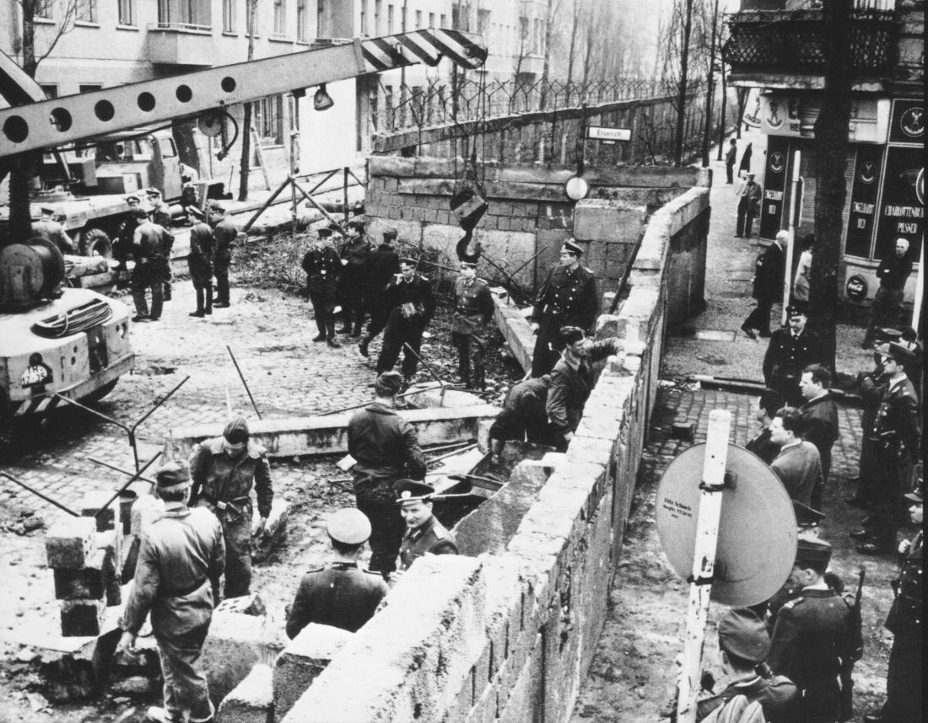
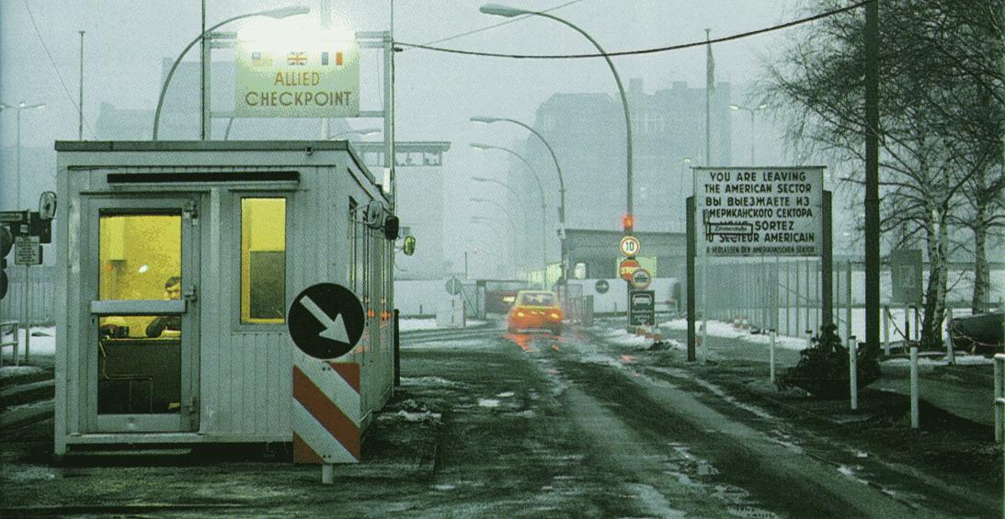
Berlin Wall Built
Soviets wanted to keep Germans from moving out of East Germany into West Berlin, where they could become free
Berlin Wall became the symbol of Communist oppression around the world

Slide 26
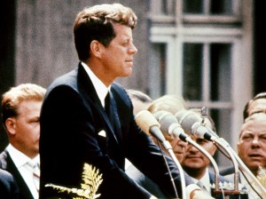
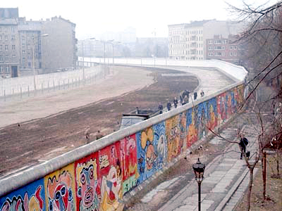
Berlin crisis
In the 11 years since the Berlin Airlift, West Berlin’s economy had flourished
3 million East Berliners had migrated to West Berlin
East Germany’s economy appeared to be a failure as did communism

Slide 27
West Berlin/Berlin Wall
In a television address to the nation on July 25, 1961, he described the embattled city as “the great testing place of Western courage and will” and declared that any attack on West Berlin would be viewed as an attack on the United States.
Nikita Khrushchev described West Berlin, surrounded on all sides by East Germany, as “a bone in my throat” and vowed to “eradicate this splinter from the heart of Europe.”
In early morning of August 13, 1961, the East German government, with Soviet support, began to build a wall of barbed wire across the heart of Berlin.
Berlin Wall became a symbol of Communist oppression

Slide 28
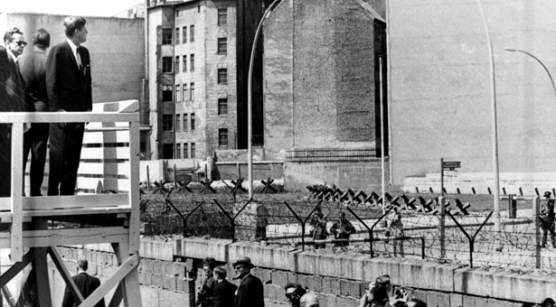
Ich bin ein Berliner! (June 22, 1963)

Slide 29
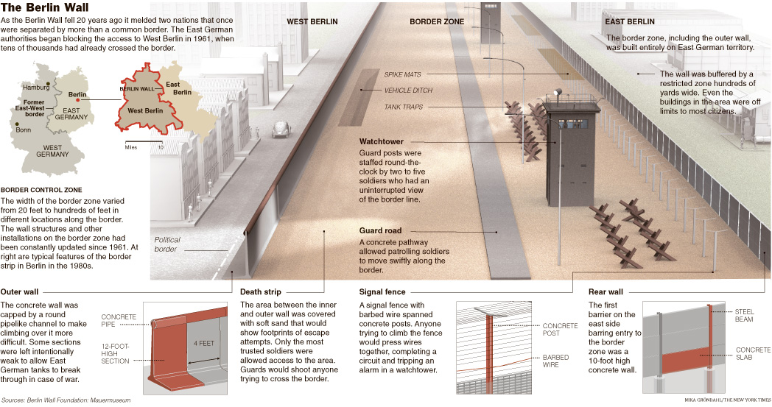

Slide 30
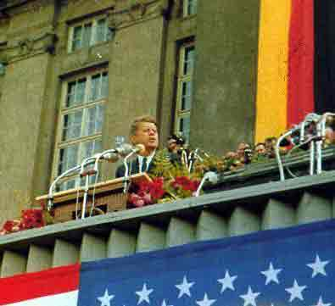
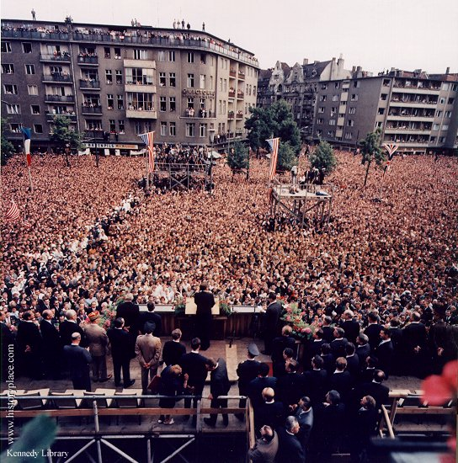
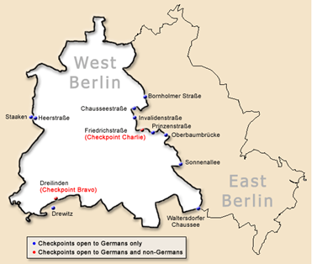
Ich bin ein Berliner! (June 22, 1963)
President Kennedy tells Berliners that the West is with them!

Slide 31
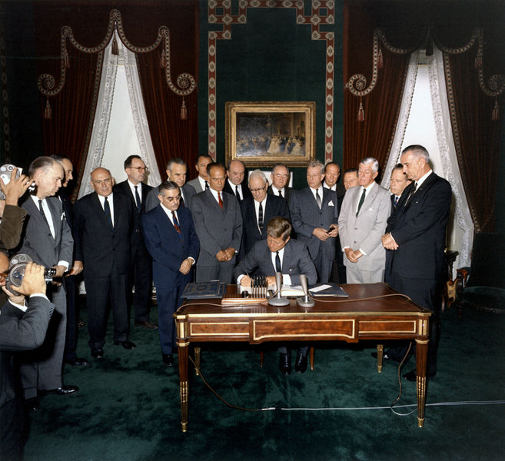
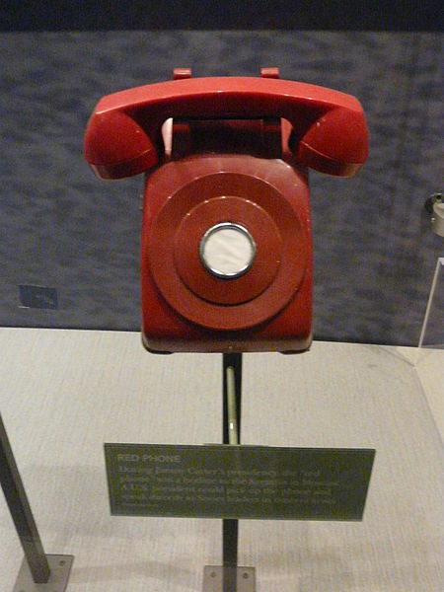
Ways to ease tensions
Hot line
Limited Test Ban Treaty-October 7, 1963

Slide 32
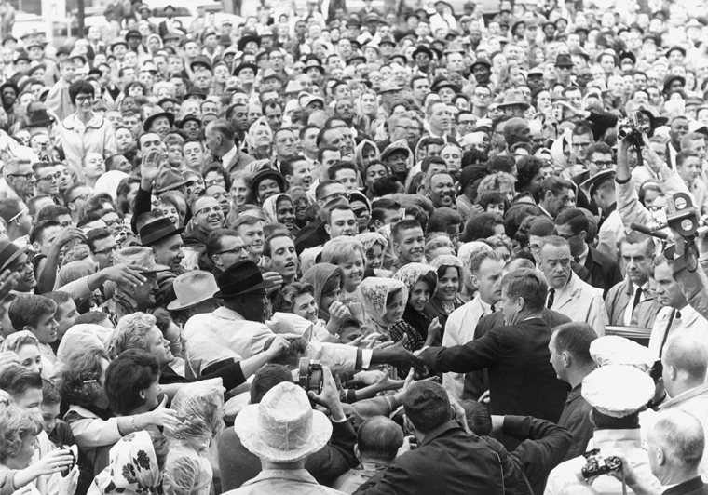
Fort Worth, Texas November 22, 1963

Slide 33
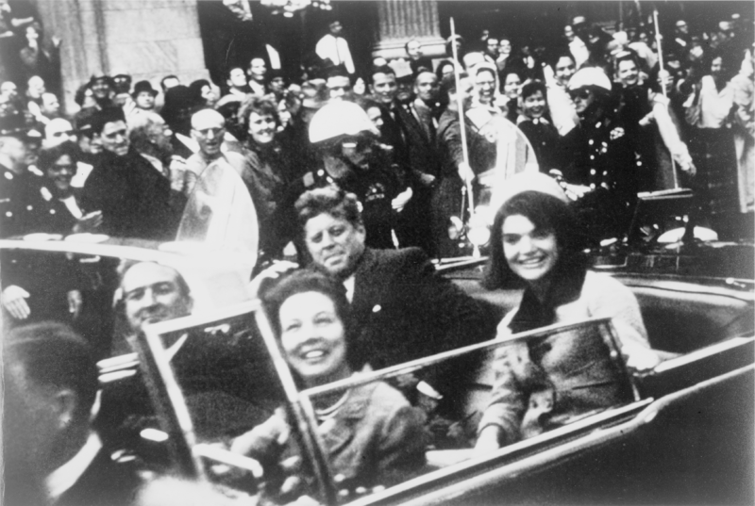
Dallas, Texas November 22, 1963

Slide 34
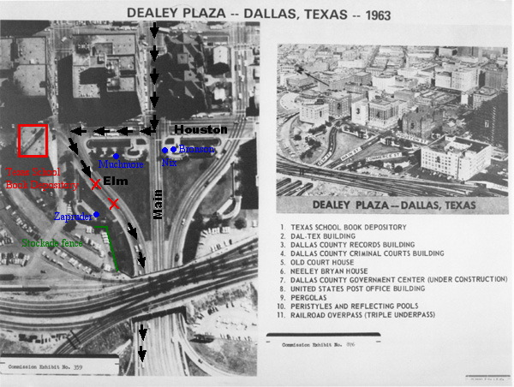

Slide 35
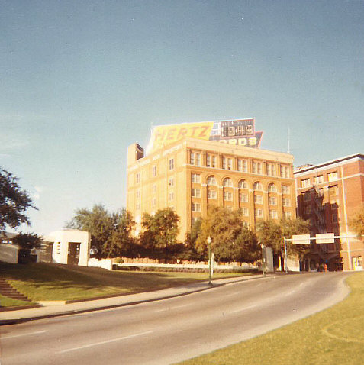
Texas School Book Depository

Slide 36
Lyndon Johnson taking the Presidential Oath of Office, Air Force One

Slide 37
Jack Ruby killing Lee Harvey Oswald

Slide 38
John Kennedy Interactive Timeline
Directions:
With your group research an assigned Cold War event or idea associated with President Kennedy’s administration.
Create a poster to display interactively with the class.
The poster must contain the following information:
Who? What? Where? When? How? and Why?
A symbol representing the event
A quote from someone associated with the event

Slide 39
John Kennedy Interactive Timeline
Directions:
Resources:
Class textbook
Websites:
http://www.jfk.org/
http://www.jfklibrary.org/
https://www.whitehouse.gov/1600/presidents/johnfkennedy
http://www.history.com/topics/us-presidents/john-f-kennedy
You have only 25 minutes to research and create the poster-divide the assignment!

Slide 40
Kennedy Assassination Extra Credit
Research the various theories of President Kennedy’s assassination. The following website may be a good start: mcadams.posc.mu.edu/home.htm
Write a Reflective Journal Entry on the following question: Who killed President Kennedy?

