Slide 1
Spanish Exploration
Period 1

Slide 2
Hernando Cortes
1519-Cortes and 600 men landed at Vera Cruz, Mexico to begin a 200 mile march to the Aztec capital of Tenochtitlan
1521-Cortes and his officers had become rulers of the empire
1522-1528-remants of Indian culture conquered by the Spanish in Yucatan and Guatemala
1531-Francisco Pizarro led a band of soldiers from Panama to Peru to conquer the Incas

Slide 3
Encomienda
System where favored officers became privileged landowners, or encomenderos
Encomenderos protected villages and supported missionary priests and required tributes from the villagers in the form of goods and labor
Spanish exploitation and disease caused devastation to Indian population: from 50 million at the beginning to 4 million in the 17th century
Whites totaled no more than 100,000 in the mid 16th century; up to 3 million by the end of the colonial period
The need for African labor as early as 1503; over 9 million Africans would be transported

Slide 4
Spanish America
Much of what is now the U.S. belonged to Spain during the Colonial period
Possessions more far reaching than English or French: New Spain was centered in Mexico but its territory extended from Florida Keys to Alaska; also included the deep South (Memphis originally founded as San Fernando; Vicksburg as Nogales)
Established provinces in North America as defensive buffers protecting its trade in Mexico and South America
Concerned about

Slide 5
Governing Spanish America

Slide 6
Colonists in Spanish America
Spanish forced thousands of Indians to work in gold and silver mines and on large scale farms (haciendas) controlled by Spanish landlords
Spanish colonies were different than other European colonies given that Natives did most of the work
Main crops grown were native-corn, bean, and squash (three sisters) even though the Spanish introduced livestock, wheat and sugar
Non-Spaniards barred from emigrating, as well as, non Christian Spaniards (Jews and Moors)
Social advancement opportunities did draw people to come: 225,000 in the 16th Century; most of these were single men (laborers, craftsmen, and soldiers)

Slide 7
Colonists in Spanish America
Many also came as government officials, priests, professionals
Peninsulares (persons of European birth) were at the top of the social order
Indians always outnumbered Spanish
By 1600, mestizos (persons of mixed origin) made up a large part of the urban population of Spanish America; helped repopulate disease ridden areas
**Spanish America evolved into a hybrid culture, part Spanish, part Indian and part African; but it had a single faith, language, and government system

Slide 8
Spreading the Faith
Confidence in the superiority of their own culture; expected societies to abandon their old beliefs; failure to do so reinforced the idea that natives were “heathens”
Spanish brought violence and missionary zeal
1492 Treaty of Tordesillas sanctioned by Pope Alexander VI dividing non-Christian world between Spain and Portugal
1517-Martin Luther’s posting of the Ninety-Five Theses and the onset of the Protestant Reformation caused Spain to double its efforts to spread the Roman Catholic faith as the “true faith” to Native Americans
Not only souls to be saved, but a labor force

Slide 9
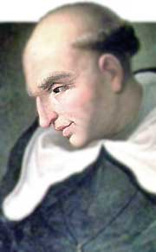
Bartolomeo de Las Casas
1537, Pope Paul III outlawed the enslavement of Indians declaring they were “truly men” who must be treated as “dumb beasts”
15 years later a Dominican priest wrote A Very Brief Account of the Destruction of the Indies: denounced Spain for causing deaths of millions of innocent people
1514 he had freed his own slaves and began to preach against the injustices
Insisted that Indians were rational beings, not barbarians, and that Spain had no ground to deprive them of their lands and liberty
Efforts led to New Laws of 1542 ending slavery and the encomienda system
Replaced by repartimiento system: wage labor, but forced to work a fixed amount per year

Slide 10
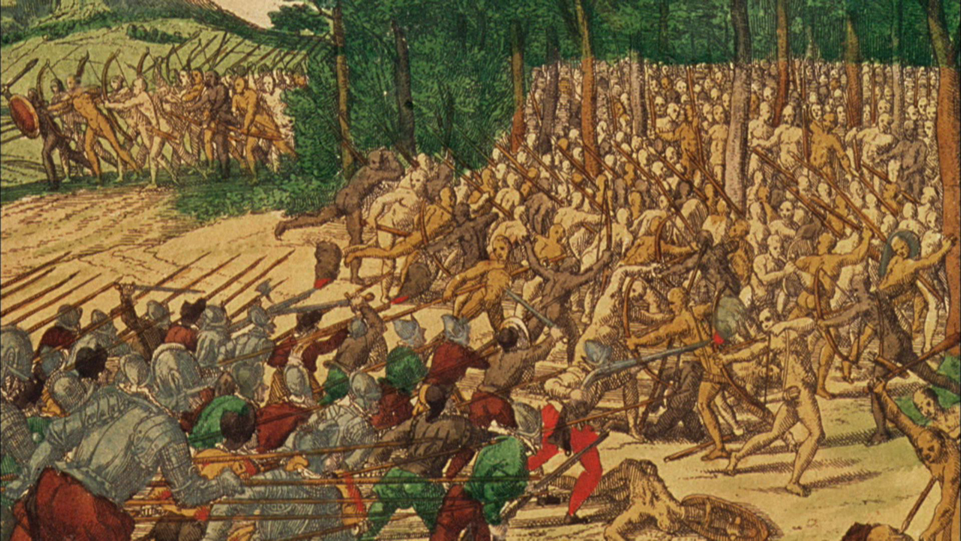
The Pueblo Revolt
In 1680 the people known collectively as “Pueblos” rebelled against their Spanish overlords in the American Southwest.
The Spanish had originally established and maintained their rule with terror, beginning with Juan de Oñate’s invasion in 1598.
When the people of Acoma resisted invasion, Oñate had ordered that one leg be chopped from every man over fifteen and the rest of the population be enslaved

Slide 11
The Pueblo Revolt
1680-less than 3,000 Spanish colonists in New Mexico, most of which were mesitzos, since few European settlers came to the region
Relationship between the Spanish and Pueblo Indians had detoriated over 17th century; governors, settlers and missionaries had sought to control Indian labor
Number of Pueblos had declined from 60,000 in 1600 to 17,000 eighty years later
Some natives accepted baptism to avoid harsh treatment even as they practiced their old religion

Slide 12
The Pueblo Revolt
Cause: as the Inquisition in Spain began to persecute Jews and Muslims; the Franciscan friars increased their efforts in New Mexico to convert the Pueblo; Friars burned Indian idols, masks, and other sacred objects; Pueblos had had enough of Christianity
Cause: prolonged drought began around 1660
Cause: inability of friars to protect the villages and missions from attacks by Navajo and Apache
Cause: Legal enslavement of American Indians by Spaniards had been forbidden by royal decree since the mid-sixteenth century, but that did not stop the actual practice; encomienda system still flourished
Cause: Spanish assumption that the Pueblo could never organize given they had been divided among themselves; There was no distinct “Pueblo” people, speaking one language and sharing one culture. (Keres, Tompiros, Tewas, Tiwas, Towas, Piros, and Zuni, along with Utes, Navajos, and Apaches)

Slide 13
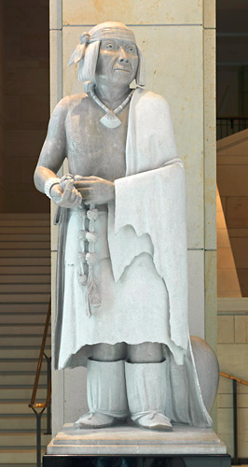
The Pueblo Revolt
Pope became the main organizer of an uprising that drove Spanish out of the colony
In 1675, Pope had been one of forty seven Pueblo Indians arrested for “sorcery” (practicing their original religion)
Pope was forced to Santa Fe to be publically whipped
After this humiliation, Pope returned home to plan the revolt
1680-2000 warriors destroyed isolated farms and missions killing 400 colonists, including 21 Franciscan missionaries
Surrounded Santa Fe and forced Spanish to abandon

Slide 14
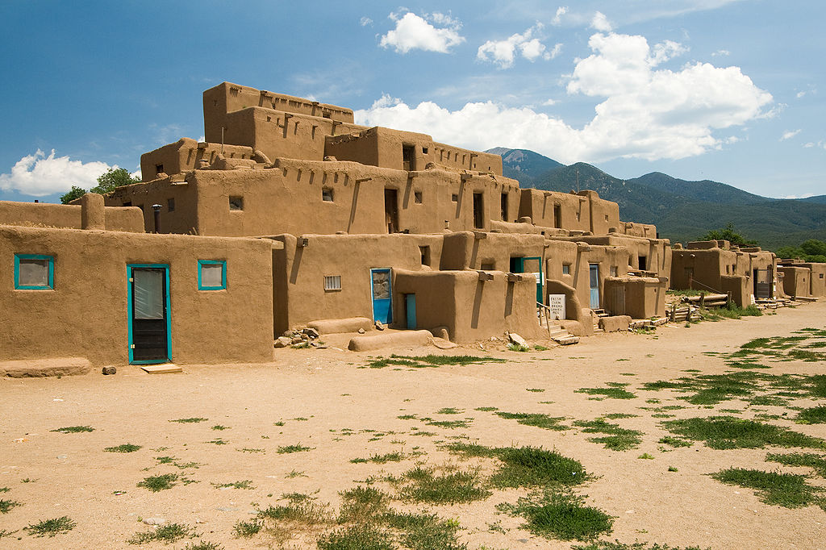
The Pueblo Revolt
**The Pueblo Revolt was the most complete victory for Native Americans over Europeans and the only wholesale expulsion of settlers in the history of North America.**
Pueblos turned with vengeance on all symbols of European culture: uprooted fruit trees, destroyed cattle, burned churches and images of Christ and the Virgin Mary, waded into rivers to wash away their Catholic Baptism
Pueblos rebuilt places of worship known as “kivas”; resumed sacred dances

Slide 15
The Pueblo Revolt
By the end of the 1680s, warfare began between Pueblo and with the Apache and Navajo
Pope died around 1690
1692-Spain launched an invasion to reconquer New Mexico; some Pueblo welcomed the military protection
Spain had learned a lesson: in the 18th century, Spanish authorities began to adopt a more tolerant attitude for traditional religious practices and made fewer demands on labor
New Mexico would act as more importantly a buffer zone, protecting the silver mines from the French and the British
Spaniards remained until Mexican independence in 1821. The Spanish were followed by two successor republics, Mexico and, ultimately, the United States.

Slide 16
Works Cited
Edward Countryman, “The Pueblo Revolt”, History Now-Journal Of the Gilder Lehrman Institute. (https://www.gilderlehrman.org/history-by-era/early-settlements/essays/pueblo-revolt)

