Slide 1
Spanish Exploration & Colonization
17th Century

Slide 2
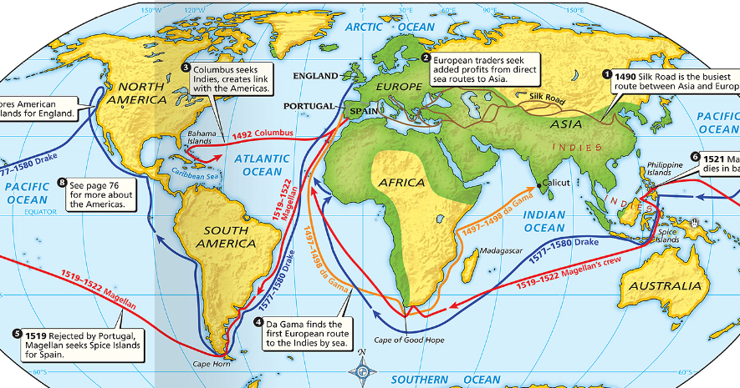
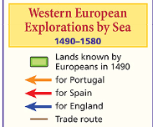
During the Renaissance, a desire for new trade routes to Asia led to an Age of Exploration

Slide 3
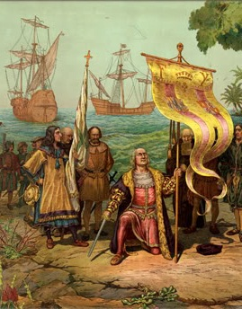
Christopher Columbus’ “discovery” of America in 1492 transformed the future of American Indians & Europeans
European explorers found new trade routes & formed overseas colonies
Portugal was the first country to settle in the Americas (Brazil)

Slide 4
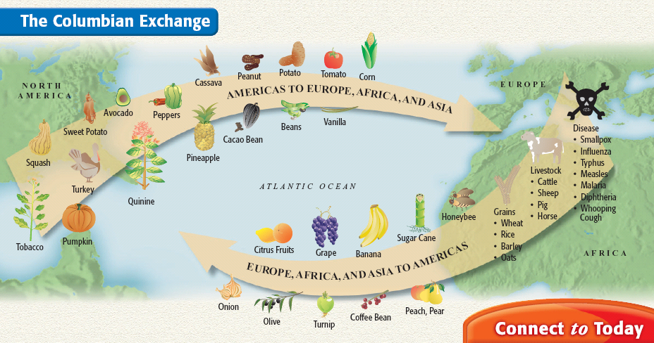
The arrival of Europeans led to the introduction of new products between Indians & Europeans called the Columbian Exchange

Slide 5
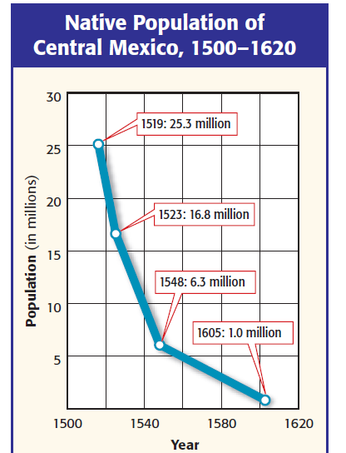
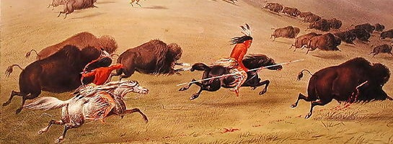
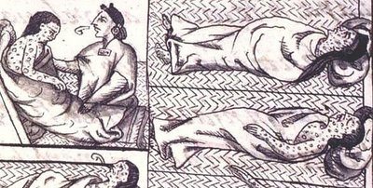
The introduction of potatoes & corn helped improve the diets & life expectancy of people throughout the world
The introduction of European diseases like smallpox & influenza killed as many as 90% of Native Americans

Slide 6
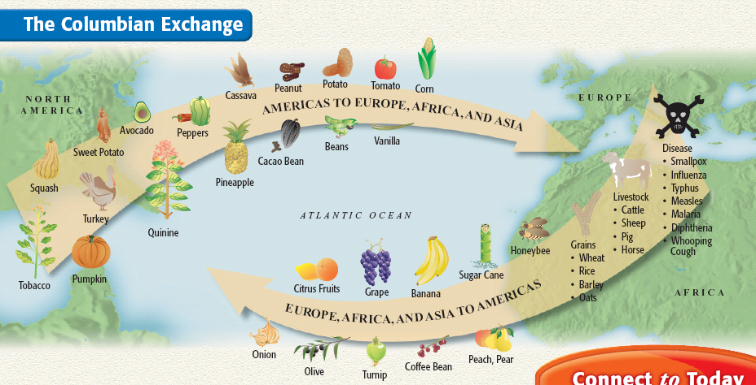
The introduction of European grains, horses, & cattle transformed many Indian cultures

Slide 7
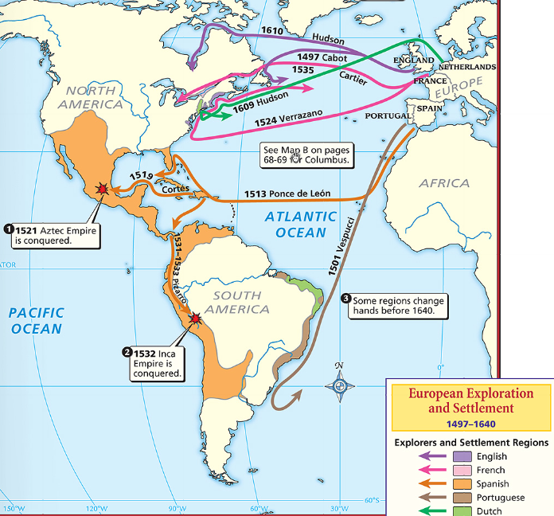
Spain sent explorers called conquistadors to the New World to find gold & conquer lands
Cortez conquered the Aztecs
Pizarro conquered the Inca
Gold from America increased Spain’s wealth & power

Slide 8
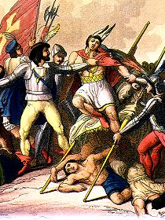
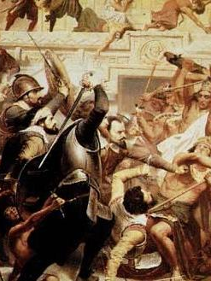
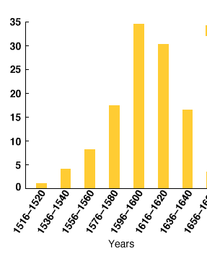

Slide 9
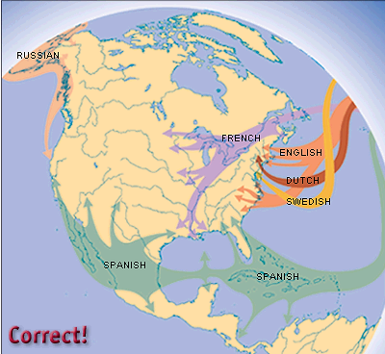
The success of the Spanish colonies encouraged other European powers to form permanent colonies in North America
The very first permanent European settlement in North America was St. Augustine

Slide 10
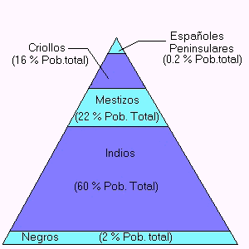
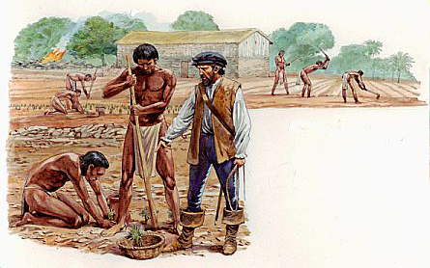
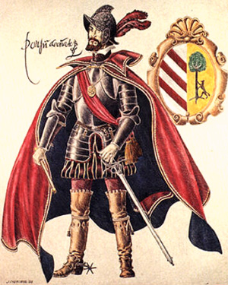
Use these documents to guess what the Spanish colonies in North America were like
“I find it confounding to attempt to Christianize the native peoples, and then, when we have done so, to make slaves of them on our estates. In God’s name is that any way to treat Christians?”
--Bartolome de las Casas
Spanish peninsulare

Slide 11
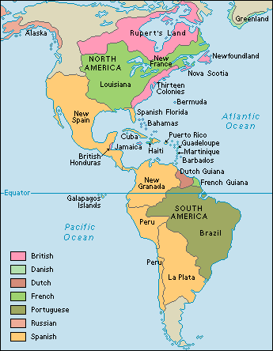
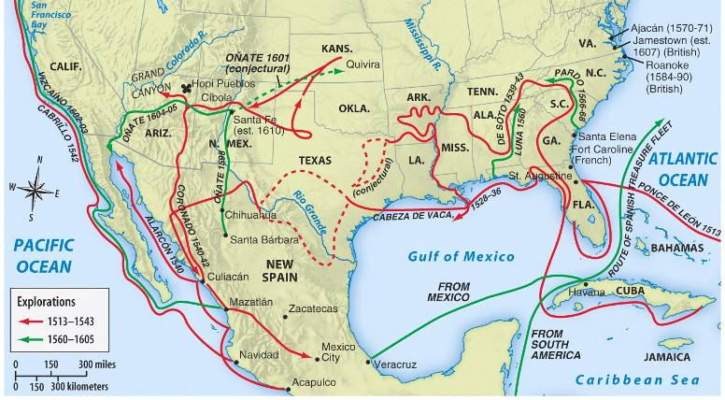
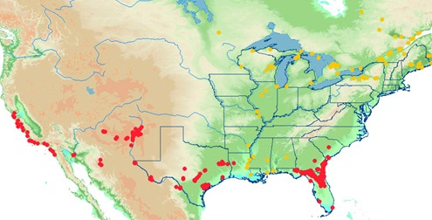
In the 1600s & 1700s, Spain dominated Central & South Americas and the SE & SW regions of North America
Spanish conquistadors searched for gold & silver
Spain converting Indians to Catholicism & created missions in America
Why did the Spanish colonize in America?
Red = Spanish missions

Slide 12
The King of Spain who sent viceroys to strictly govern the colonies (Colonists could not vote & had few freedoms)

Slide 13
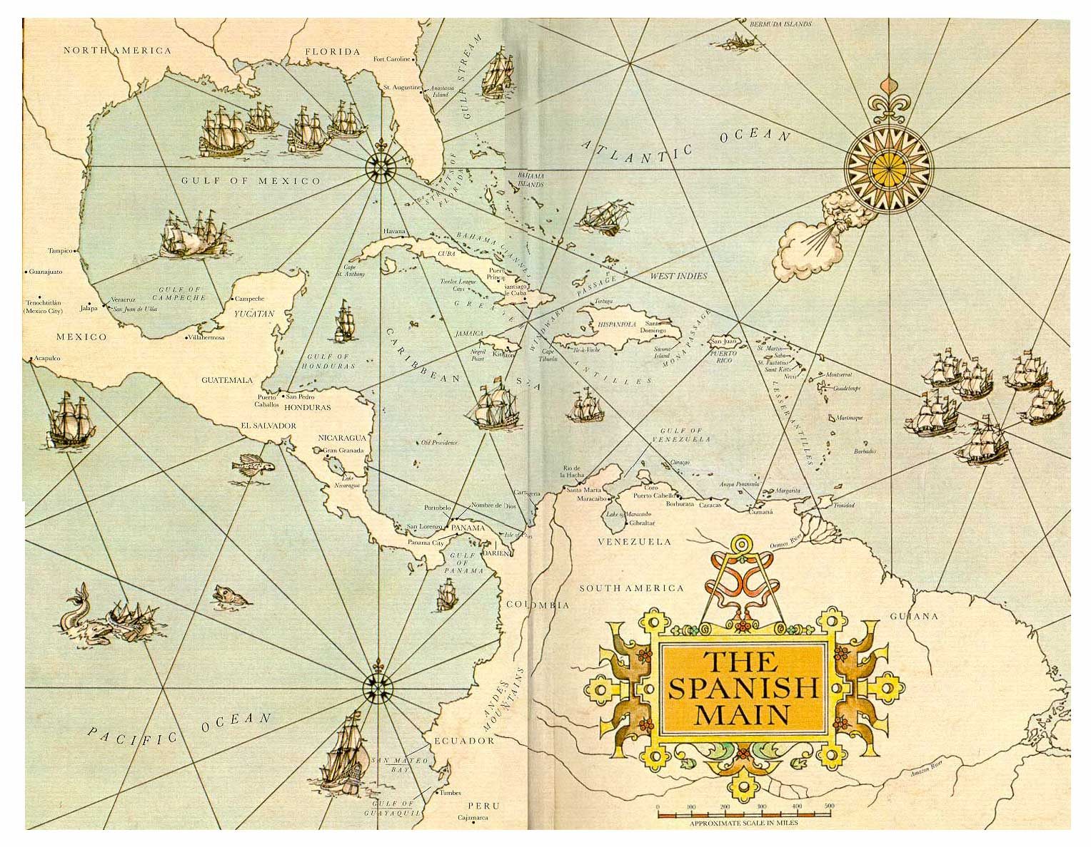
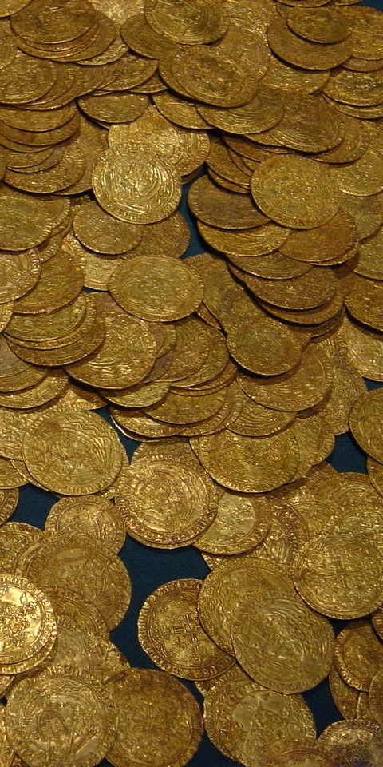
The economy of the Spanish colonies was based on mining gold & silver (bullion)…

Slide 14
… & haciendas (plantations) using the encomienda system of Indian workers to farm cash crops like sugar

Slide 15
Spanish colonial society was strictly controlled
Viceroys (royal governors) had power & were at the top of society
White Spanish colonists (creoles) had land & wealth
The lack of colonial women led to intermarriages between white colonists & Indians (mixed-race Indians were mestizos)
Native Indians & African slaves made up the bottom of colonial society

Slide 16
French Exploration & Colonization
17th Century

Slide 17
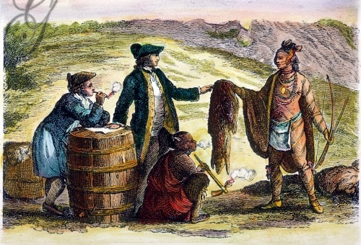
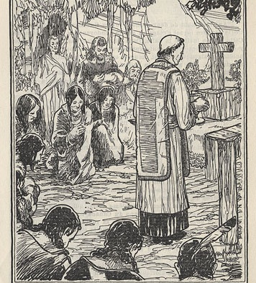
Use these documents to guess what the French colonies in North America were like

Slide 18
In the 1600s, French explorer Samuel de Champlain failed to find a NW passage through Canada but created the French colony of Quebec
France claimed land from Canada to New Orleans & controlled territory along the Mississippi River
Why did the French colonize in America?

Slide 19
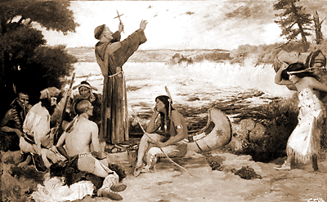
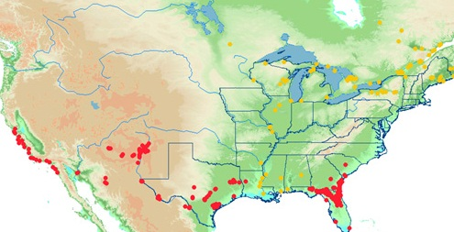
Like Spain, the French colonists focused on wealth & converting Indians to Catholicism
Yellow = French missions

Slide 20
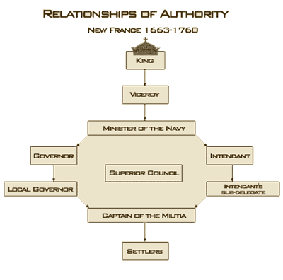
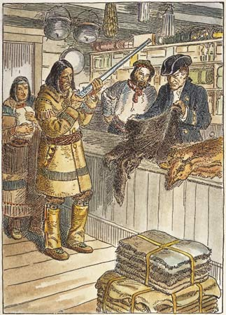
Most French colonists profited from the fur trade, small-scale farming, or lumbering
Because the French needed furs, they were the most friendly with the local Indians…

Slide 21
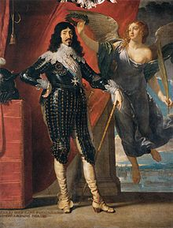
…French colonists had to be Catholic & few people immigrated to America
Like the Spanish colonies, the French colonial gov’ts were strictly controlled by the King of France who ruled via royal governors

