Slide 1
The Southern Colonies
1607-1754

Slide 2
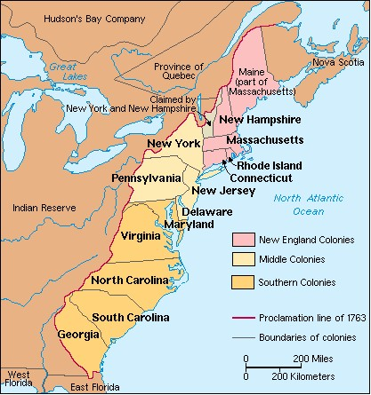

Slide 3
The Lost Colony
A century after Columbus landed in the Caribbean, Europe’s seagoing nations were in full competition for the possible “riches” of the new world
England was latecomer to this race
Spain had already entered into what is now Florida and New Mexico
English pirates had been up and down the east coast of what is now the U.S. since 1562
A colony was not seriously considered until 1578 when Sir Humphrey Gilbert received a charter from Queen Elizabeth “to inhabit and possess…all remote and heathen lands not in actual possession of any Christian prince”
After Gilbert died on his second voyage, Sir Walter Raleigh, his half-brother, decided to carry out the venture

Slide 4
The Lost Colony
England’s motives for settling the New World
Establish a base to loot French and Spanish shipping
Visions of gold and copper mines and cash crops
An attempt to find the Northwest Passage
Spread the new Protestant religion among the “savages”

Slide 5
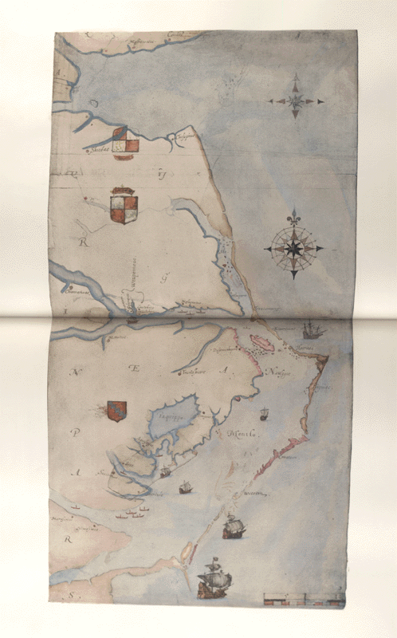
The Lost Colony
1584-Philip Amadas and Arthur Barlowe
1585-Ralph Lane, Richard Grenville, Thomas Harriot, John White
1586-John White
1590-John White returns

Slide 6
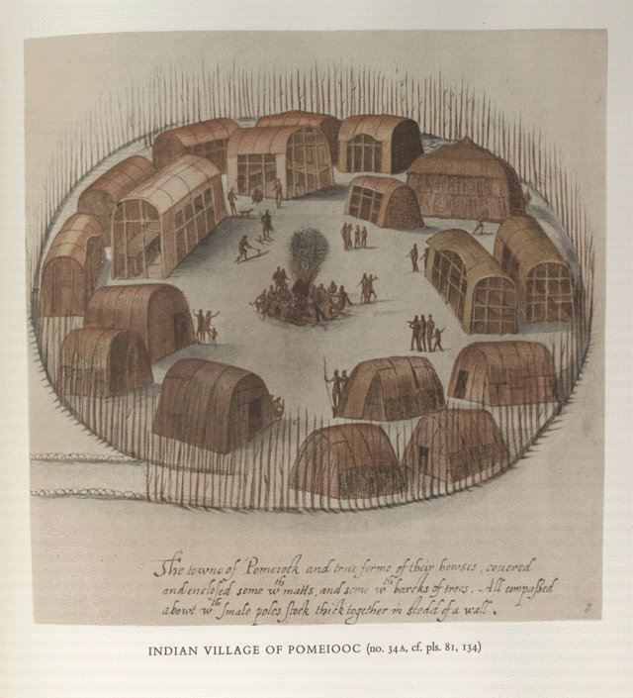
Notes:
A. DRAWING BY JOHN WHITE Plate 31
A bird's-eye view of an Indian village enclosed by a circular palisade of quite irregular light poles, with two entrances, one in the foreground and one in the background at bottom and top left.
The path leading to the front entrance is bordered with hooped sticks. The village consists of eighteen buildings of pole and mat (and perhaps bark) construction, many of them with open ends or sides or both, and some with door openings at the ends, usually off-centre. Most are rectangular in ground-plan, but some may have rounded ends. Several are seen to contain an interior platform along one or both sides and across one end, supported by two rows of posts independent of the house posts. All have simple arched roofs, except the largest, where the cupola-like roof is constructed on ridges springing from the corners and coming to a point in the centre. In three houses the open sides seem to be shaded by an arched section of roof supported on longer vertical poles. The houses are grouped irregularly about a large open space in the centre where a fire is burning and around which a number of apparently naked Indians are sitting with rattles in their hands (see no. 43 (A), pl. 39). Other groups of men, women and children are seen standing or walking near the houses, several of them making signs with their hands towards the fire and one man is splitting timber with an axe, another is carrying wood on his back, yet another carries a bow, while a cloaked figure is dimly seen emerging from a house to the left of the fire. A dog with longish legs and tail is also shown.
Yellow, crimson and gold body-colours, various shades of brown and grey water-colours, touched with black, over black lead; 22.2 x 21.5 cm. or 8 3/4 x 8 1/2 in.
Inscribed in brown ink, at the foot, "The towne of Pomeiock and true forme of their howses, couered | and enclosed some wth matts, and some wth barcks of trees. All compassed | abowt wth smale poles stock thick together in stedd of a wall."
1906-5-9-I (8), L.B. I(7), C-M. & H. 32. Literature: Quinn, p. 415, no. 33 (a); Croft-Murray & Hulton, p. 40, no. 32, pl. 31. OFFSET
The colour has been detached fairly evenly and thinly, the black tints being represented strongly and the brown lightly. The crimson on the cloaked figure emerging from the house is strong and makes the figure in the original rather shadowy.
P. & D., 199.a.2, L.B. 2 (7).

Slide 7
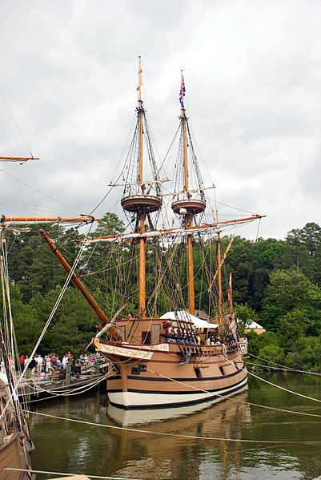
Jamestown/Virginia
1607 the London/Virginia Company arrived on the James River with 104 settlers; London company was a joint-stock company
Investors hoped to find gold or silver, or a northwest passage to Asia
James river became contaminated every summer and produced dysentery, typhoid fever, malaria
Colony had too many gentlemen who considered farming beneath them
Captain John Smith turned the colony around by concentrating on survival

Slide 8
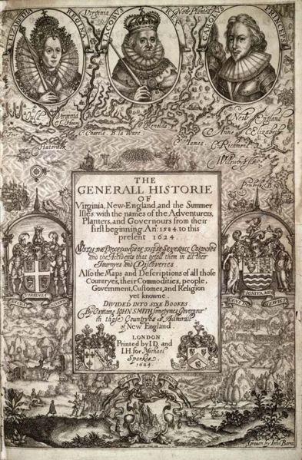
Jamestown/Virginia
Colony suffered a setback in the winter of 1610-”starving time” and an Indian war with the Powhatan
1613-Colony offered first strand of “brown gold”-tobacco under the leadership of John Rolfe
By 1619 the Virginia House of Burgesses had become the first representative government body in the new world
Company started the “headright system”; a colonist received 50 acres of land for each person who passage to Virginia he paid for; these people were considered indentured servants

Slide 9
Trouble in VA – Bacon’s Rebellion
More conflicts with Native Americans caused the Virginia royal governor to increase taxes and restricted expansion into Native territory
After defeating the Natives, Nathaniel Bacon led a group or poor indentured servants against leadership in Jamestown in September 1676
Significance
Colonists would not tolerate a corrupt government
The poor (both black and white) could unite
Increase in African slave trade

Slide 10
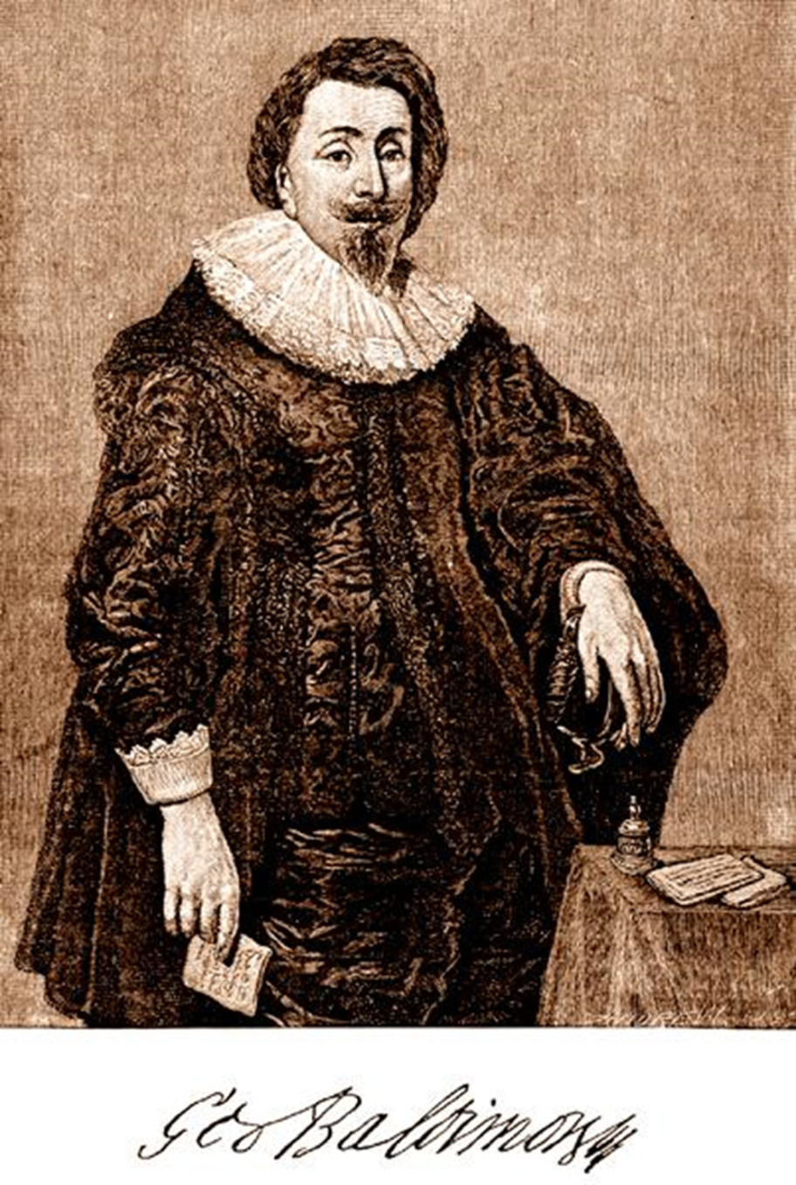
Maryland
In 1632, the English king gave George Calvert land north of Virginia. Calvert was a Roman Catholic who wanted a colony for people of his faith.
King made him baron Baltimore and “lord proprietor” of the colony
Lord Baltimore’s regime overthrown several times by Protestants
Approved Toleration Act of 1649 granting freedom of worship to all Christians

Slide 11
Southern Colonies
Most southern colonists lived on the land. In North Carolina, farms tended to be small.
In Virginia and Maryland, large farms called plantations developed.
Tobacco was the common crop. In South Carolina and Georgia, planters raised rice and indigo.
Plantation owners lived in great comfort. Enslaved Africans, however, endured poverty, violence and a lack of freedom.

Slide 12
