Slide 1
American History I Introduction
What is History?
Sources of Historical Evidence
Analyzing Historical Evidence/APPARTS

Slide 2
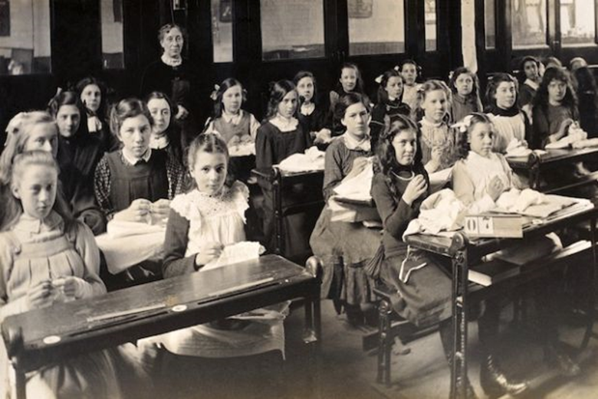

Slide 3
What is History?
History is an account of the past (change over time).
  Accounts/narratives differ depending on evidence and one’s perspective.
  We rely on evidence to construct our accounts of the past (interpretations)
  We must question the reliability of each piece of evidence.
  Any single piece of evidence is insufficient.
  We must consult multiple pieces of evidence in order to build a plausible account.

Slide 4
Historical Evidence/Sources of Information used by Historians
Primary Sources
Secondary Sources

Slide 5

Primary Sources
Primary sources of information are those that provide first-hand accounts of the events, practices, or conditions you are researching.

Slide 6

Examples of Primary Sources
Personal record of events: letters, emails, diaries, photographs and daily planners.
Vital records: Birth certificates, death certificates, and marriage licenses
Literary manuscripts: handwritten, typed, or word-processed versions of novels, stories, poems, articles and speeches

Slide 7


Primary Source Examples
Mass media: newspaper and magazine articles, published photographs, recordings of television and radio broadcasts, sheet music and music recorded for mass distribution, advertisements and magazines
Ephemera: things that are printed for a specific occasion or purpose and aren’t meant to last after their original use. Examples include theatre programs, posters for events, ticket stubs, political leaflets, and bumper stickers
Artifacts: human-made or human-designed objects; examples include coins, items of clothing, tools, commemorative plaques, and furniture

Slide 8
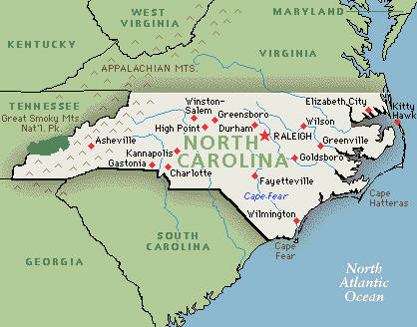

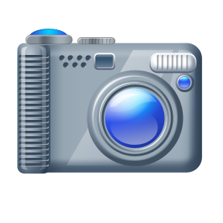
Primary Source Examples
Oral histories: accounts given by a person of events earlier in their life; interviews
Photographs (unpublished): can document events or relationships in a person’s life; can show the history of an organization, institution, municipality, country, or social group
Maps: can reveal how places – a college campus, a city, a street – changed over time.

Slide 9
Secondary Source
a secondary source of information is one that was created later by someone who did not experience first-hand or participate in the events or conditions you’re researching.
For secondary sources, often the best sources are those that have been published most recently.
secondary sources are generally scholarly books and articles. Also included would be reference sources like encyclopedias.

Slide 10
Works Cited
Stanford History Education Group. “Reading Like a Historian”
University of Illinois, “Primary Source Village”. http://www.library.illinois.edu/village/primarysource/mod1/pg1.htm

Slide 11
APPARTS
Author
Place and Time
Prior Knowledge
Audience
Reason
The Main Idea
Significance

Slide 13
Homework-Why Study History?
Access the class website at dedwardsushistory.weebly.com
Find the link to the scholarly essay entitled “Why Study History”?
Read the introduction of the essay and the section that you have been assigned
Answer the following questions:
  What does he say?
  How does he support what he says?
  Do you agree with him? Why or why not?

