Slide 1
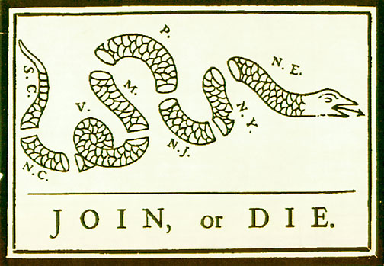
Events Leading to American Self Government

Slide 2
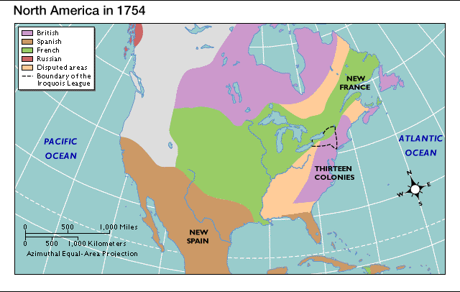
The French and Indian War
French empire collided w/ British empire
Competing over the Ohio River Valley

Slide 3
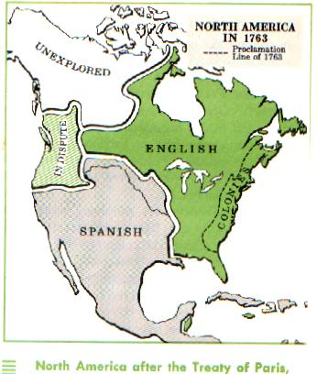
Treaty of Paris Proclamation Line of 1763
Britain claimed land east of the Mississippi River
Proclamation Line: banned all settlement west of Appalachian Mts. (to ease tensions w/ N.A.)
Increased Independent Spirit

Slide 4
1660: The Navigation Acts
British Action:
Designed to keep trade in England and support mercantilism
Colonists could only trade goods with England
All colonial ships must stop in a British harbor before going to another country
Colonial Response:
Ignored them (profitable to trade with other countries) and continued to smuggle goods from other countries
British continued policy of Salutary Neglect (relaxed enforcement of acts in exchange for continued loyalty to the King and to England)

Slide 5
Britain’s New Policy for Colonial America
New Policy had three basic objectives:
Place the colonies under strict British political and economic control
Make the colonies respect and obey British laws
Make the colonies pay their part in maintaining the British Empire

Slide 6
Writs of Assistance
British Action:
Designed to crack down on colonial smuggling
Search warrants that allowed British officials to search any place, seize anything at any time
Colonial Response:
Outraged the merchants of Boston

Slide 7
1764: Sugar Act
British Action:
Cut the tax on molasses but raised it on other goods such as textiles, wine, coffee, indigo, and sugar
Strengthened Vice-Admiralty courts
Cases decided by a single judge, not a jury
Colonial Response:
First time a tax had been passed to raise revenue rather than regulate trade
Colonial merchants protested the increased duties

Slide 8
1765: Quartering Act
British Action:
Purpose to keep troops in the colonies and reduce the cost
Colonists had to keep troops in their homes
Colonial Response:
Colonists did not get along with army and did not want them there permanently

Slide 9
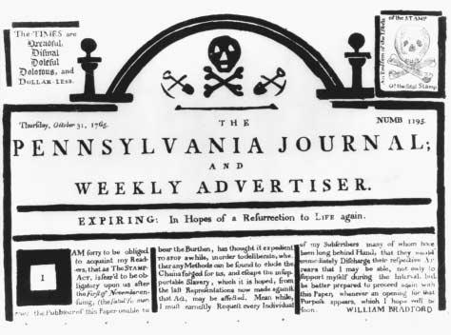
1765: The Stamp Act
British Action:
Taxed all documents, newspapers, and playing cards by forcing colonists to place a special stamp on the items
Direct tax
Colonial Reaction:
Sons of Liberty
Harassed stamp distributors
Boycotted (a collective refusal to use, buy or deal with) English goods
Stamp Act Congress issued a Declaration of Rights and Grievances (9 legislatures)

Slide 10
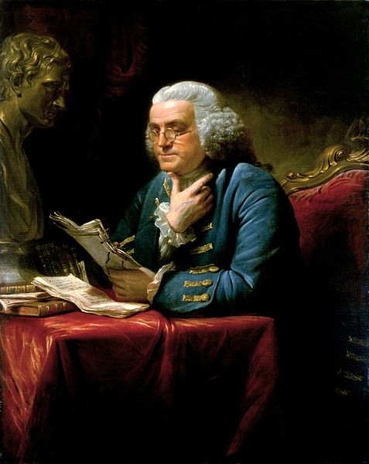
Ben Franklin in England
Pennsylvania Assembly was feuding with William Penn's heirs, who controlled the colony as proprietors
Franklin was in London representing anti-proprietary party of Pennsylvania
Asked to speak on the Stamp Act

Slide 11
Ben Franklin, Testimony Against the Stamp Act, 1766
Primary Source Activity
As you read the document annotate by circling any term that you do not understand.
Define the term in the margins of your paper using the dictionary provided.
Highlight or underline any evidence in the document that will help answer the following question:
How does Franklin support his argument against the Stamp Act?

Slide 12
Stamp Act: British Response
Parliament repealed the Stamp Act
Boycotts so successful not one stamp was ever sold
Declaratory Act – asserted Parliament’s right to make laws that “bind the colonies in all cases whatsoever”

Slide 13
1767: The Townshend Acts
British Action:
Put tax on goods such as paper, glass, paint, and tea
Revenue raised would be to pay salaries of British officials in the colonies
Colonial Reaction
Organize new boycott of goods
Protest “No taxation without representation”
Demonstrations and clashes between colonists and soldiers
Women get involved in protests

Slide 14
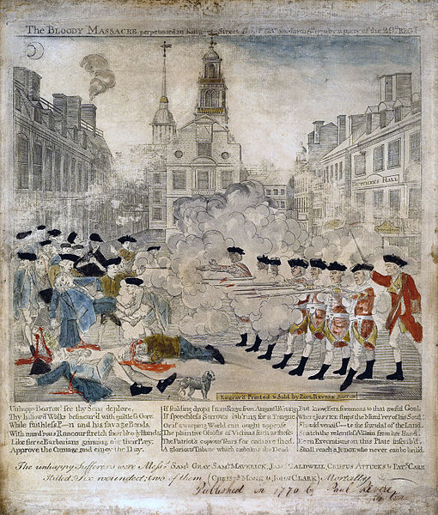
March 5, 1770: The Boston Massacre

Slide 15
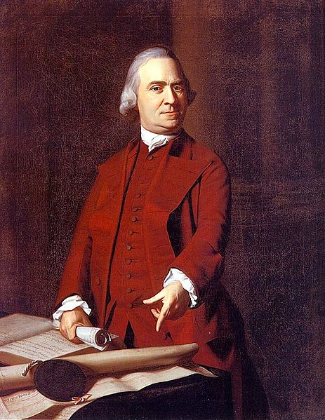
1772: Committees of Correspondence formed
Started by Samuel Adams
Used to pass information between the colonies
It was a secret organization

Slide 16
1773: Tea Act
Parliament repealed Townshend Acts except for the tax on tea
In the first year the taxes raised 295 pounds, but the cost of sending British troops to Boston was 170,000 pounds
Allowed the East India Tea Company to sell tea without the tax to make it cheaper
Had been hurt badly by the boycotts

Slide 17
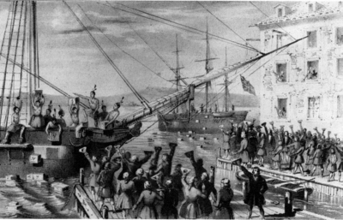
Dec. 16, 1773: Boston Tea Party

Slide 18
Spring 1774: The Intolerable Acts
Designed to punish the colonists for Tea Party
Closed the port at Boston
Brought British soldiers to England for trials
No town meetings allowed in Massachusetts – Boston under military rule
Trying to isolate Massachusetts, but only strengthened the colonies unity

Slide 19
1774: First Continental Congress
Met in Philadelphia
All colonies had representatives except Georgia
Divided on the issue of declaring independence
Sent Declaration of Rights and Grievances to King George III
Defended colonies’ right to run their own affairs
Supported the protests in Massachusetts

Slide 20
April 19, 1775
Shot heard round the world fired at the Battle of Lexington
Start of the revolutionary war
Watch this short video about the “shot heard round the world”:
http://earlyamerica.com/shot_heard.htm

