Slide 1
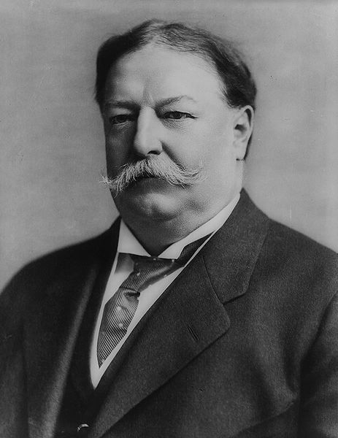
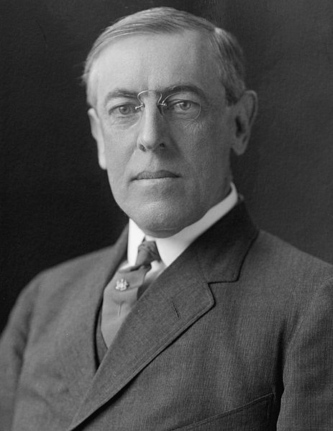
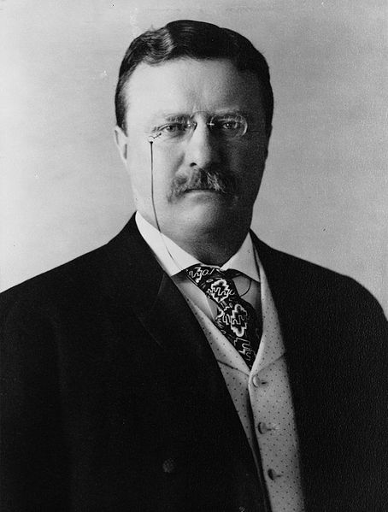
Progressive Presidents

Slide 2
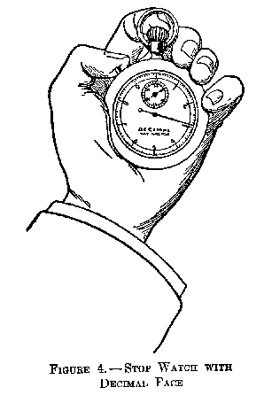
The Origins of Progressivism
Encouraging Political Efficiency – Reformers tried to increase the efficiency of American society

Slide 3
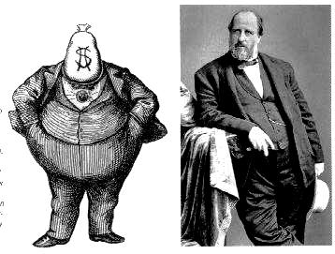
Encouraging political Efficiency-- Municipal political Reform
During the progressive movement, efforts were made to reform politics to make government more efficient and responsive to its constituents.
Political machines had rewarded their supporters with jobs and kickbacks and openly bought votes with favors and bribes.
Printed ballots, or “tickets” had made corruption by political parties and machines possible.
Efforts were led by muckrakers and urban, middle class progressives to become more involved in government
The first step in reforming political machines was the adoption of the secret ballot, also called the Australian ballot.

Slide 4
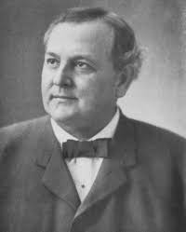
encouraging political efficiency—Municipal political Reform
Local Government (Municipal) Reform-
new forms of government were created by various municipalities to combat the political machine:
Commission system
began in 1900 in Galveston, Texas
Divided power and responsibilities of governing a city
Council-Manager system
Elected officials hired an outside expert or professional to run the city government
Examples of reform mayors-Tom Johnson of Cleveland (rose to power by taking on streetcar interests in the city; pushed for lower fares and municipal ownership of utilities like water, sewage, public transportation, gas)

Slide 5
Encouraging political Efficiency- State Level Political Reform
State Level Political reform:
progressives wanted to increase the power of the electorate, in order to bypass the power of the machine-controlled state legislature
Citizens could petition to place an initiative—a bill originated by the people rather than lawmakers—on the ballot.
Then voters, instead of the legislature, accepted or rejected the initiative by referendum, a vote on the initiative.
The recall enabled voters to remove public officials from elected positions by forcing them to face another election before the end of their term if enough voters asked for it through petition

Slide 6
Encouraging political Efficiency- State Level Political Reform
To force Senators to be more responsive to the public, progressives pushed for the popular election of senators.
Before 1913, state legislatures had chosen United States senators, a process that put even more power in the hands of party bosses and wealthy corporation heads.
direct primary
Seventeenth Amendment

Slide 7
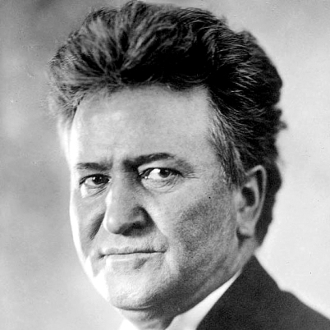
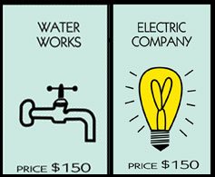
Fighting Bob
Spurred by progressive governors, many states passed laws to regulate railroads, mines, mills, telephone companies, and other large businesses.
Wisconsin Governor, Robert M. La Follette, led the way in driving big businesses out of politics. Wisconsin became known as the “laboratory of democracy”

Slide 8
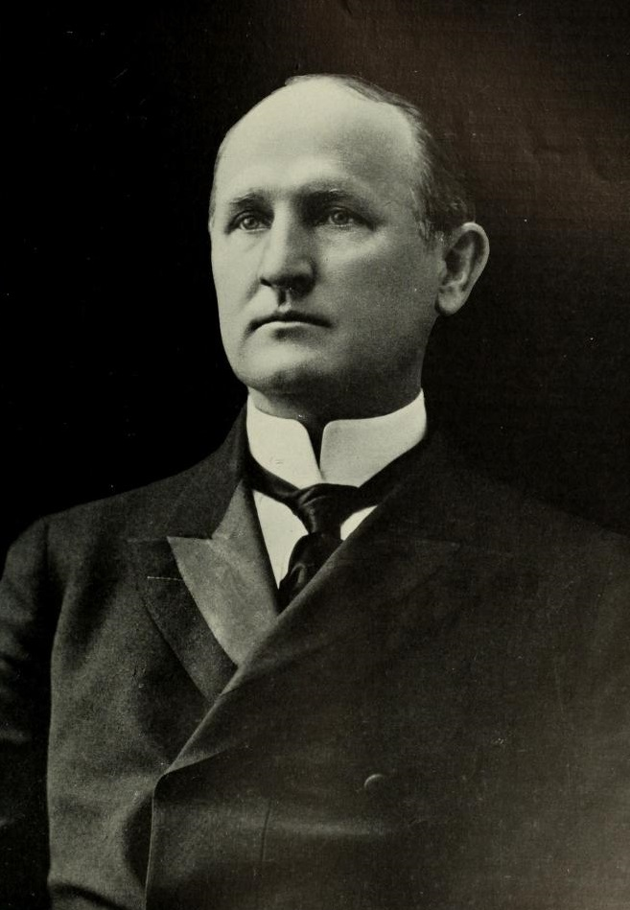
Encouraging political Efficiency-State Level Political Reform
Other Progressive governors introduced reform initiatives in their state:
Woodrow Wilson (D) (1911-1913), governor of New Jersey introduced workmen’s compensation and anti-trust legislation
Theodore Roosevelt (R) (1899-1901), won the passage of new factory-inspection and tenement-house laws.
Charles Evans Hughes (R)(1907-1910) created a state-wide commission as governor of New York to regulate public utilities
California Governor, Hiram Johnson (R) (1911-1917) limited the power of the railroad industry.
North Carolina Governor Charles B. Aycock (D) (1901-1905) was noted as the “education governor”

Slide 9
Progressive Presidents

Slide 10
A&E-Theodore Roosevelt
While watching the documentary take notes on Theodore Roosevelt’s presidency using the graphic organizer provided.

Slide 11
Progressive Presidents
How did each presidency successfully address the goals of progressivism?
social justice
moral reform
economic reform
political efficiency

Slide 12
Progressive Presidents
1901-1909
Theodore Roosevelt, Republican
1st “Modern” President-Use of the Bully Pulpit
“Square Deal” (control corporations, consumer protection, conservation of natural resources)
Trustbuster (“Good trusts” and “Bad Trusts”)

Slide 13
Progressive Presidents- Theodore Roosevelt
1901-1909
Coal Strike of 1902
a strike by the United Mine Workers of America in the anthracite coal fields of Pennsylvania.
Miners were on strike asking for higher wages, shorter workdays and the recognition of their union; Roosevelt sided with the workers

Slide 14
Progressive Presidents- Theodore Roosevelt (R)
1901-1909
Northern Securities case, 1902
Roosevelt urged case to Supreme Court which ruled against the stockholders of the Great Northern and Northern Pacific railroad companies, who had essentially formed a monopoly
Dissolved J.P. Morgan’s Northern Securities Company

Slide 15
Progressive Presidents
1901-1909
1903 Elkins Act
Interstate Commerce Commission (ICC) granted greater authority to stop railroad companies from giving rebates to favored customers
1906 Hepburn Act
Expanded the powers of the Elkins Act; gave ICC rulings the force of law
ICC could set maximum rates for railroad companies
Railroads were required to submit annual reports to the ICC

Slide 16
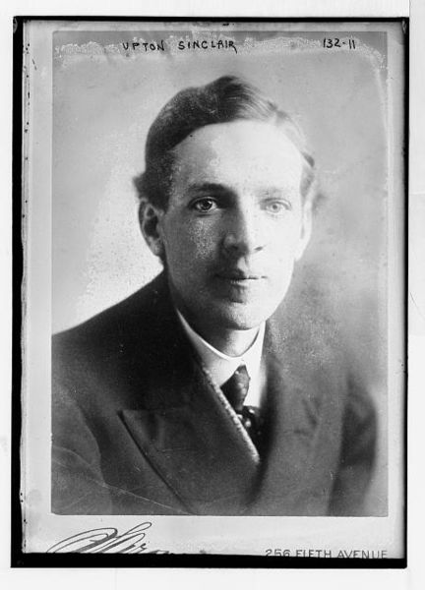
Muckrakers
Upton Sinclair
The Jungle, 1906

Slide 17
Progressive Presidents
1901-1909
Meat Inspection Act, 1906
Beginning of federal regulation of the nation’s meat, poultry, and egg products supply.
Pure Food and Drug Act, 1906
led to the creation of the Food and Drug Administration (FDA), which would test all foods and drugs made for human consumption; made it a requirement for prescriptions from licensed physicians before a patient could purchase certain drugs; led to “truth in labeling” laws

Slide 18
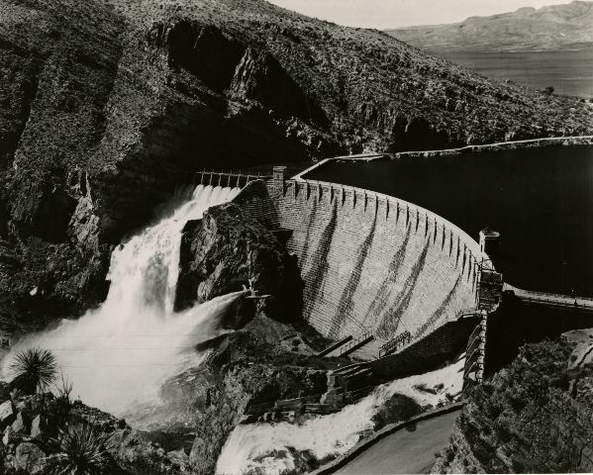
Progressive Presidents- Theodore Roosevelt (R)
1901-1909
1902 Newlands Reclamation Act
authorized the federal government to commission water diversion, retention and transmission projects in arid lands, particularly in the far west
Led to the creation of dams, canals, reservoirs that would irrigate 20 states
Theodore Roosevelt Dam, Salt River, Arizona

Slide 19
Progressive Presidents
1901-1909
American Antiquities Act 1906
first U.S. law to provide general legal protection of cultural and natural resources of historic or scientific interest on Federal land
authorizes the President to protect landmarks, structures, and objects of historic or scientific interest by designating them as National Monuments
President Roosevelt used the Antiquities Act eighteen times to establish national monuments. Those first monuments included what are now known as Grand Canyon National Park, Petrified Forest National Park and Olympic National Park.

Slide 20
Progressive Presidents
1901-1909
Roosevelt used his authority to protect wildlife and public lands by creating the U.S. Forest Service under the Department of Agriculture
Gifford Pinchot was chosen to head the new department
Agency established 150 National Forests, 5 National Parks; protected approximately 230,000,000 acres of public land.
Expanded existing national parks (i.e. Yellowstone in Wyoming and Yosemite in California)

Slide 21
Progressive Presidents
William Howard Taft, Republican, 1909-1913
the son of a distinguished judge, he graduated from Yale, and returned to Cincinnati to study and practice law
appointed a Federal circuit judge at 34
His route to the White House was via administrative posts. President McKinley sent him to the Philippines in 1900 as chief civil administrator.
President Roosevelt made him Secretary of War, and by 1907 had decided that Taft should be his successor.
lifelong ambition was to serve as Chief Justice of the United States, to which he was appointed after leaving the presidency.
He remains the only man in American history to have gained the highest executive and judicial positions

Slide 22
Progressive Presidents
Trustbuster-Filed ninety lawsuits against monopolistic trusts in just four years—more than twice as many as Roosevelt had filed in a little less than eight years.
In 1911, the Supreme Court finally used the Sherman Anti-Trust Act to dissolve John D. Rockefeller’s Standard Oil Company for “unreasonably” stifling its competition.
Later that year, Taft famously filed a lawsuit against J.P. Morgan’s U.S. Steel Corporation.
1909-1913

Slide 23
Progressive Presidents
1910 Mann-Elkins Act
Extended the power of the ICC to set new railroad rates
Gave the ICC power to regulate telecommunications industry: telephone, telegraph, and cable companies
16th Amendment
To offset loss of revenue with reduced tariff, this authorized the U.S. government to collect an income tax
1909-1913

Slide 24
Progressive Presidents
Republican Party begins to split between progressive and conservative factions
Payne-Aldrich Tariff
Pinchot-Ballinger Controversy
1909-1913

Slide 25
Progressive Presidents
Taft tried to lower tariff rates as a progressive tactic
But, Conservatives within the Republican party passed the Payne-Aldrich Tariff which kept tariffs high on certain products.
In 1909, Taft signed the bill anyway
Progressives denounced the tariff and called Taft a traitor.
1909-1913

Slide 26
Progressive Presidents
Ballinger-Pinchot Affair
Taft fired Gifford Pinchot, the head of the U.S. Forest Service for insubordination.
Pinchot, a progressive, a personal friend of Roosevelt, and a popular conservationist, had angered Taft when he opposed Secretary of the Interior Richard Ballinger
Ballinger had agreed to sell public wilderness lands in Alaska and the Rocky Mountains to corporate developers.
1909-1913

Slide 27
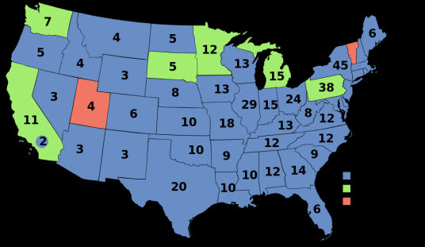
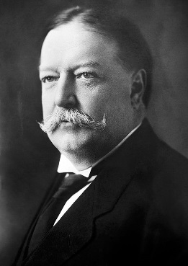
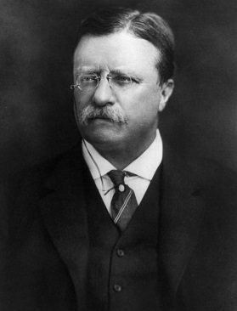
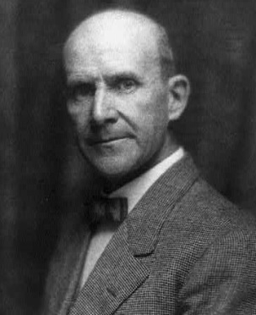
Election of 1912
Woodrow Wilson, Democratic Party
435 Electoral Votes, 6,296,284 Popular Votes
Theodore Roosevelt, Progressive “Bull Moose” Party
88 Electoral Votes, 4,122,721 Popular Votes
William H. Taft, Republican Party
8 Electoral Votes, 3,486,242 Popular Votes
Eugene V. Debs, Socialist Party
0 Electoral Votes, 901,551 Popular Votes
last election in which a candidate who was not a Republican or Democrat came in second in either the popular vote or the Electoral College
the first election in which all 48 states of the contiguous United States participated.

Slide 28
Republican Party Platform
High import tariffs.
Put limitations on female and child labor.
Workman’s Compensation Laws.
Against initiative, referendum, and recall.
Against “bad” trusts.
Creation of a Federal Trade Commission.
Stay on the gold standard.
Conservation of natural resources because they are finite.

Slide 29
Progressive Party Platform
Women’s suffrage.
Graduated income tax.
Inheritance tax for the rich.
Lower tariffs.
Limits on campaign spending.
Currency reform.
Minimum wage laws.
Social insurance.
Abolition of child labor.
Workmen’s compensation.
N e w N a t i o n a l i s m

Slide 30
Socialist Party Platform
Government ownership of railroads and utilities.
Guaranteed income tax.
No tariffs.
8-hour work day.
Better housing.
Government inspection of factories.
Women’s suffrage.

Slide 31
Democratic Party Platform
Government control of the monopolies → trusts in general were bad → eliminate them!!
Tariff reduction.
One-term President.
Direct election of Senators.
Create a Department of Labor.
Strengthen the Sherman Anti-Trust Act.
Did NOT support women’s suffrage.
Opposed to a central bank.
Ne w F r e e d o m

Slide 32
Progressive Presidents
1913-1921
Woodrow Wilson, Democrat (1913-1921)
Grew up in Virginia during the Civil War. Only second Democrat to occupy White House since Civil War
First southerner since Zachary Taylor (1849)
Idealistic, intellectual, righteous, inflexible
graduated from Princeton (then the College of New Jersey) and the University of Virginia Law School,
earned his doctorate at Johns Hopkins University and entered upon an academic career.
professor of political science who became president of Princeton in 1902
Ran for Governor of New Jersey in 1910.
Won passage of anti-trust legislation, workmen’s compensation, restriction of child labor, direct primaries

Slide 33
Progressive Presidents
1913-1921
1912 platform for change was called the “New Freedom”.
New Freedom program attacked what Wilson called the TRIPLE WALL OF PRIVILEGE — the tariff, the banks, and the trusts.
Goal was to bring back conditions of free and fair competition in the economy

Slide 34
Progressive Presidents
1913-1921
Underwood Tariff Act-1913
Wilson felt that tariffs protected the large industrialists at the expense of small farmers.
On his first day of the presidency he called for a special session on congress to lower the tariff.
By speaking directly to congress he broke long standing tradition of Presidents making written requests to congress
Wilson’s argument was to bring consumer prices down by lowering the tariff.
Lowered tariffs for the first time in 51 years
To compensate for the loss in revenue, a graduated income tax with rates from 1-6% was passed

Slide 35
Progressive Presidents
1913-1921
Federal Reserve Act-1914
Wilson felt that the gold standard was inflexible and that banks were too influenced by stock speculation on Wall Street
President spoke directly to congress again, to propose a plan for a national banking system that would serve the public interests
Act created a decentralized national bank composed of twelve regional branches.
Collectively, all the private banks in each region received their money from their respective region’s branch.
Private banks would issue Federal Reserve Notes (dollar bills) to regional banks for consumer purchases
A new Federal Reserve Board had the final say in decisions affecting all branches, including setting interest rates and issuing currency.

Slide 36
Progressive Presidents
1913-1921
Clayton Anti-Trust Act of 1914
addressed specific practices that the Sherman Act does not clearly prohibit, such as mergers and interlocking directorates (that is, the same person making business decisions for competing companies).
legalized labor unions and their right to strike peacefully. Unions could no longer be prosecuted as trusts
act would be enforced by the newly created Federal Trade Commission (FTC)

Slide 37
Progressive Presidents
1913-1921
Federal Trade Commission Act-1914
bans "unfair methods of competition" and "unfair or deceptive acts or practices.
Empowers the Federal Trade Commission to investigate and take action against any “unfair trade practice” in every industry except banking and transportation
“watchdog agency”-works to protect the interests of consumers and businesses on behalf of competition
Workmen’s Compensation Act 1916
helped support temporarily disabled federal employees
Child Labor Act-1916
Prohibited the shipment in interstate commerce of products manufactured by children under 14 years of age

Slide 38
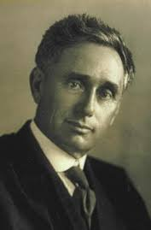
Progressive Presidents
1913-1921
Appointed Louis Brandeis to the Supreme Court
First Jew to have ever been nominated
As a lawyer, his early cases were actions fighting railroad monopolies, defending workplace and labor laws, helping create the Federal Reserve System, and presenting ideas for the new Federal Trade Commission.
He achieved recognition by submitting a case brief, later called the "Brandeis Brief", which relied on expert testimony from people in other professions to support his case, thereby setting a new precedent in evidence presentation
As an associate justice from 1916-1939, he was a long-time advocate for protection of civil liberties
Believed in public's right to privacy, and upheld laws that supported freedom of expression

