Slide 1
Progressivism
Progressive Presidents

Slide 2
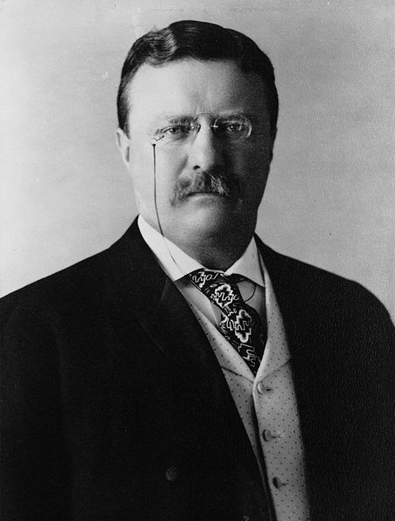
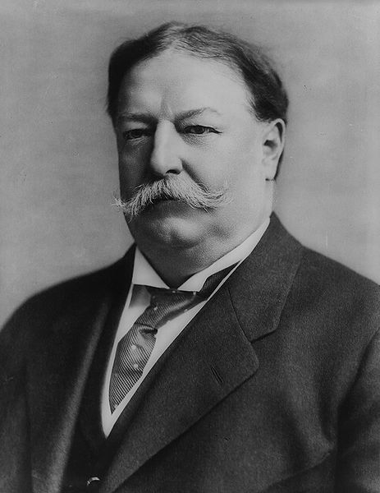
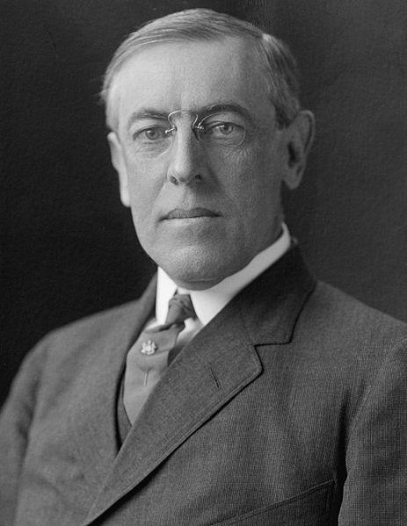
Progressive Presidents

Slide 3
Theodore Roosevelt
How and why did Teddy Roosevelt emerge as a Progressive politician?
Which goal of progressivism do you feel his presidency best exemplified?
social justice
moral reform
economic reform
political efficiency

Slide 4
Theodore Roosevelt
American Experience: Complete the graphic organizer while watching the documentary on Theodore Roosevelt
Essential Question: How and why did Theodore Roosevelt emerge as a progressive president?

Slide 5
Progressive Presidents
1901-1909
Theodore Roosevelt, Republican
1st “Modern” President-Use of the Bully Pulpit
“Square Deal” (control corporations, consumer protection, conservation of natural resources)
Trustbuster (“Good trusts” and “Bad Trusts”)

Slide 6
Progressive Presidents- Theodore Roosevelt
1901-1909
Coal Strike of 1902
a strike by the United Mine Workers of America in the anthracite coal fields of Pennsylvania.
Miners were on strike asking for higher wages, shorter workdays and the recognition of their union; Roosevelt sided with the workers

Slide 7
Progressive Presidents- Theodore Roosevelt (R)
1901-1909
Northern Securities case, 1902
Roosevelt urged case to Supreme Court which ruled against the stockholders of the Great Northern and Northern Pacific railroad companies, who had essentially formed a monopoly
Dissolved J.P. Morgan’s Northern Securities Company

Slide 8
Progressive Presidents
1901-1909
1903 Elkins Act
Gave the ICC greater authority to stop railroads from granting rebates to favored customers
1906 Hepburn Act
ICC could fix “just and reasonable” rates for railroads

Slide 9
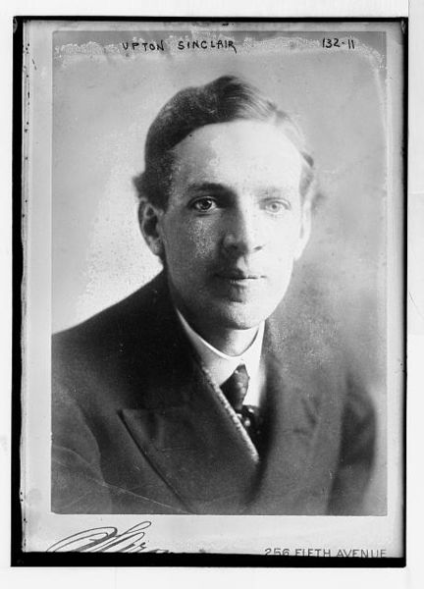
Muckrakers
Upton Sinclair
The Jungle, 1906

Slide 10
Progressive Presidents
1901-1909
Meat Inspection Act, 1906
Beginning of federal regulation of the nation’s meat, poultry, and egg products supply.
Pure Food and Drug Act, 1906
led to the creation of the Food and Drug Administration (FDA), which would test all foods and drugs made for human consumption; made it a requirement for prescriptions from licensed physicians before a patient could purchase certain drugs; led to “truth in labeling” laws

Slide 11
Progressive Presidents- Theodore Roosevelt (R)
1901-1909
1902 Newlands Reclamation Act
Provided money for the sale of public land for irrigation projects in western states (dams, canals, reservoirs)

Slide 12
Progressive Presidents
1901-1909
American Antiquities Act 1906
Roosevelt used his authority to protect wildlife and public lands by creating the U.S. Forest Service and establishing 150 National Forests, 5 National Parks; protected approximately 230,000,000 acres of public land.
Expanded existing national parks (i.e. Yellowstone in Wyoming and Yosemite in California)

Slide 13
Theodore Roosevelt
American Experience: Complete the graphic organizer while watching the documentary on Theodore Roosevelt
Essential Question: How and why did Theodore Roosevelt emerge as a progressive president?

Slide 14
Progressive Presidents
1909-1913
William Howard Taft
Republican
Trustbuster-Filed ninety lawsuits against monopolistic trusts in just four years—more than had filed in a littwice as many as Roosevelt tle less than eight years.

Slide 15
Progressive Presidents
In 1911, the Supreme Court finally used the Sherman Anti-Trust Act to dissolve John D. Rockefeller’s Standard Oil Company for “unreasonably” stifling its competition.
Later that year, Taft famously filed a lawsuit against J.P. Morgan’s U.S. Steel Corporation.
1909-1913

Slide 16
Progressive Presidents
1910 Mann-Elkins Act
Gave power to ICC to suspend new railroad rates and oversee telephone, telegraph, and cable companies
16th Amendment
To offset loss of revenue with reduced tariff, this authorized the U.S. government to collect an income tax
1909-1913

Slide 17
Progressive Presidents
Republican Party begins to split between progressive and conservative factions
Payne-Aldrich Tariff
Pinchot-Ballinger Controversy
1909-1913

Slide 18
Progressive Presidents
Taft tried to lower tariff rates as a progressive tactic
But, Conservatives within the Republican party passed the Payne-Aldrich Tariff which kept tariffs high on certain products.
In 1909, Taft signed the bill anyway
Progressives denounced the tariff and called Taft a traitor.
1909-1913

Slide 19
Progressive Presidents
Ballinger-Pinchot Affair
Taft fired Gifford Pinchot, the head of the forestry division in the Department of Agriculture, for insubordination.
Pinchot, a progressive, a personal friend of Roosevelt, and a popular conservationist, had angered Taft by opposing Secretary of the Interior Richard Ballinger’s decision to sell public wilderness lands in Alaska and the Rocky Mountains to corporate developers.
1909-1913

Slide 20
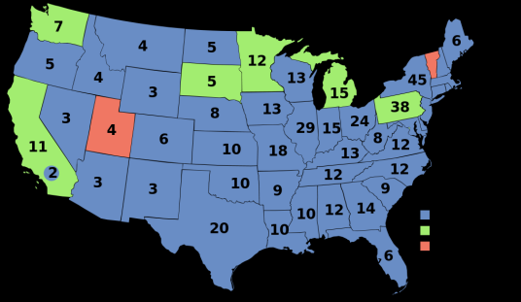
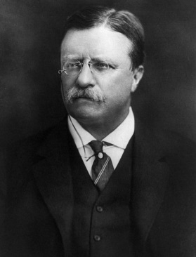
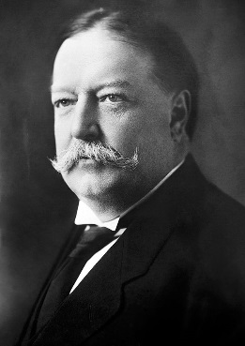
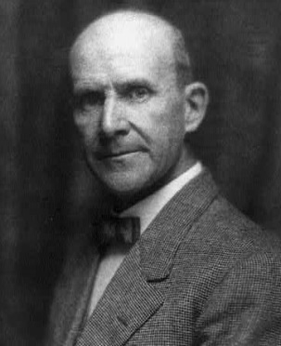
Election of 1912
Woodrow Wilson, Democratic Party
435 Electoral Votes, 6,296,284 Popular Votes
Theodore Roosevelt, Progressive “Bull Moose” Party
88 Electoral Votes, 4,122,721 Popular Votes
William H. Taft, Republican Party
8 Electoral Votes, 3,486,242 Popular Votes
Eugene V. Debs, Socialist Party
0 Electoral Votes, 901,551 Popular Votes
last election in which a candidate who was not a Republican or Democrat came in second in either the popular vote or the Electoral College
the first election in which all 48 states of the contiguous United States participated.

Slide 21
Republican Party Platform
High import tariffs.
Put limitations on female and child labor.
Workman’s Compensation Laws.
Against initiative, referendum, and recall.
Against “bad” trusts.
Creation of a Federal Trade Commission.
Stay on the gold standard.
Conservation of natural resources because they are finite.

Slide 22
Progressive Party Platform
Women’s suffrage.
Graduated income tax.
Inheritance tax for the rich.
Lower tariffs.
Limits on campaign spending.
Currency reform.
Minimum wage laws.
Social insurance.
Abolition of child labor.
Workmen’s compensation.
N e w N a t i o n a l i s m

Slide 23
Socialist Party Platform
Government ownership of railroads and utilities.
Guaranteed income tax.
No tariffs.
8-hour work day.
Better housing.
Government inspection of factories.
Women’s suffrage.

Slide 24
Democratic Party Platform
Government control of the monopolies → trusts in general were bad → eliminate them!!
Tariff reduction.
One-term President.
Direct election of Senators.
Create a Department of Labor.
Strengthen the Sherman Anti-Trust Act.
Did NOT support women’s suffrage.
Opposed to a central bank.
Ne w F r e e d o m

Slide 25
Progressive Presidents
Woodrow Wilson, Democrat
Only second Democrat to occupy White House since Civil War
First southerner since Zachary Taylor (1849)
1912 platform for change was called the “New Freedom”.
New Freedom program attacked what Wilson called the TRIPLE WALL OF PRIVILEGE — the tariff, the banks, and the trusts.
Goal was to bring back conditions of free and fair competition in the economy
1913-1921

Slide 26
Progressive Presidents
Underwood Tariff Act-1913
Wilson felt that tariffs protected the large industrialists at the expense of small farmers. This act reduced tariff rates.
Clayton Anti-Trust Act of 1914
Act clarified the Sherman Act by specifically naming certain business tactics illegal. Act also legalized labor unions and their right to strike peacefully.
1913-1921

Slide 27
Progressive Presidents
Federal Reserve Act-1913
Act created a decentralized national bank comprising twelve regional branches.
Collectively, all the private banks in each region owned and operated that respective region’s branch.
But the new Federal Reserve Board had the final say in decisions affecting all branches, including setting interest rates and issuing currency.
1913-1921

Slide 28
Progressive Presidents
Federal Trade Commission Act-1914
Empowered to investigate and take action against any “unfair trade practice” in every industry except banking and transportation
Workmen’s Compensation Act 1916
helped support temporarily disabled federal employees
Child Labor Act-1916
Prohibited the shipment in interstate commerce of products manufactured by children under 14 years of age
1913-1921

Slide 29
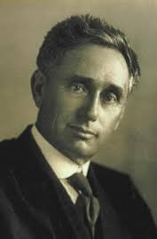
Progressive Presidents
Appointed Louis Brandeis to the Supreme Court
First Jew to have ever been nominated
Long time advocate for protection of civil liberties
Believed in public's right to privacy, and upheld laws that supported freedom of expression
1913-1921

