Slide 1
Presidents of the 1920s
Politics and Economics of the Roaring Twenties

Slide 2
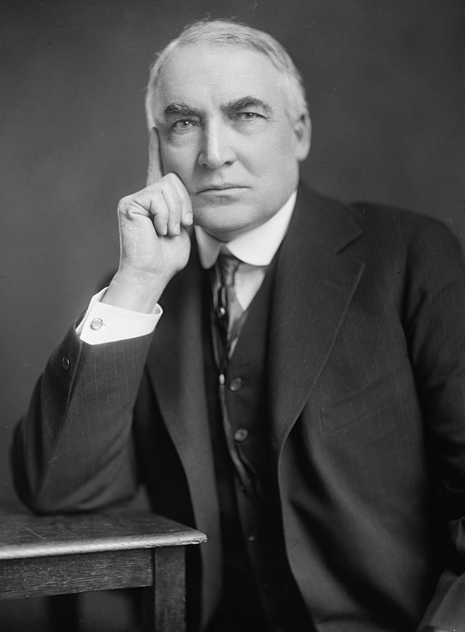
Warren G. Harding (1921-1923)
Republican from Ohio
Conservative (rejected progressive reforms)
“Laissez Faire”
Isolationist (rejected Woodrow Wilson’s idealism in foreign affairs)
Elected in 1920; won in a landslide along with Republicans winning control of Congress
“America’s present need is not heroics, but healing; not nostrums, but normalcy; not revolution, but restoration; not the dramatic, but the dispassionate…”

Slide 3
Warren G. Harding (1921-1923)
By the time of his election, U.S. was an economic giant
U.S. had become world’s largest creditor nation; N.Y. became new financial capital of the world
U.S. outpaced Allied nations, like France and Great Britain; both of which demanded American goods
Europeans borrowed money from American banks to pay for the goods

Slide 4
Warren G. Harding (1921-1923)
Cabinet:
Charles Evans Hughes became a distinguished Secretary of State.
Herbert Hoover in the Commerce Department,
Andrew Mellon in the Treasury Department
Henry Wallace in the Agricultural Department

Slide 5
Warren G. Harding (1921-1923)
The Harding administration set out to undo the social and economic components of progressivism
Established pro business practices.
To sustain economic growth, Secretary of the Treasury Mellon instituted a Republican policy of reduced government spending and lower taxes (especially on the wealthy)
Mellon favored a policy of high tariffs to protect innovations in industries like chemicals and metals

Slide 6
Warren G. Harding (1921-1923)
Not the most intelligent president; entrusted advisors to help him make decisions
Administration was noted for scandal
Many lesser offices went to members of his “Ohio Gang”, a group with which Harding met in a “Little House on K Street” ; played poker with; corrupt
Charles Forbes, head of the Veterans Bureau wasted hundreds of millions of taxpayer’s dollars
Attorney General Harry Daugherty accepted money from criminals

Slide 7
Warren G. Harding (1921-1923)
Teapot Dome Scandal was the biggest scandal for a climate of corruption.
Teapot Dome, Wyoming had been set aside as a naval oil reserve administered by the Interior Department under Albert B. Fall.
Fall signed contracts letting private interest take the oil deposits
Suspicion grew when Fall’s personal standard of living suddenly rose.
It turned out that he had taken loans of about $400,000 from the companies he illegally leased the land to.
My damn friends, they’re the ones that keep me walking the floor nights!”

Slide 8
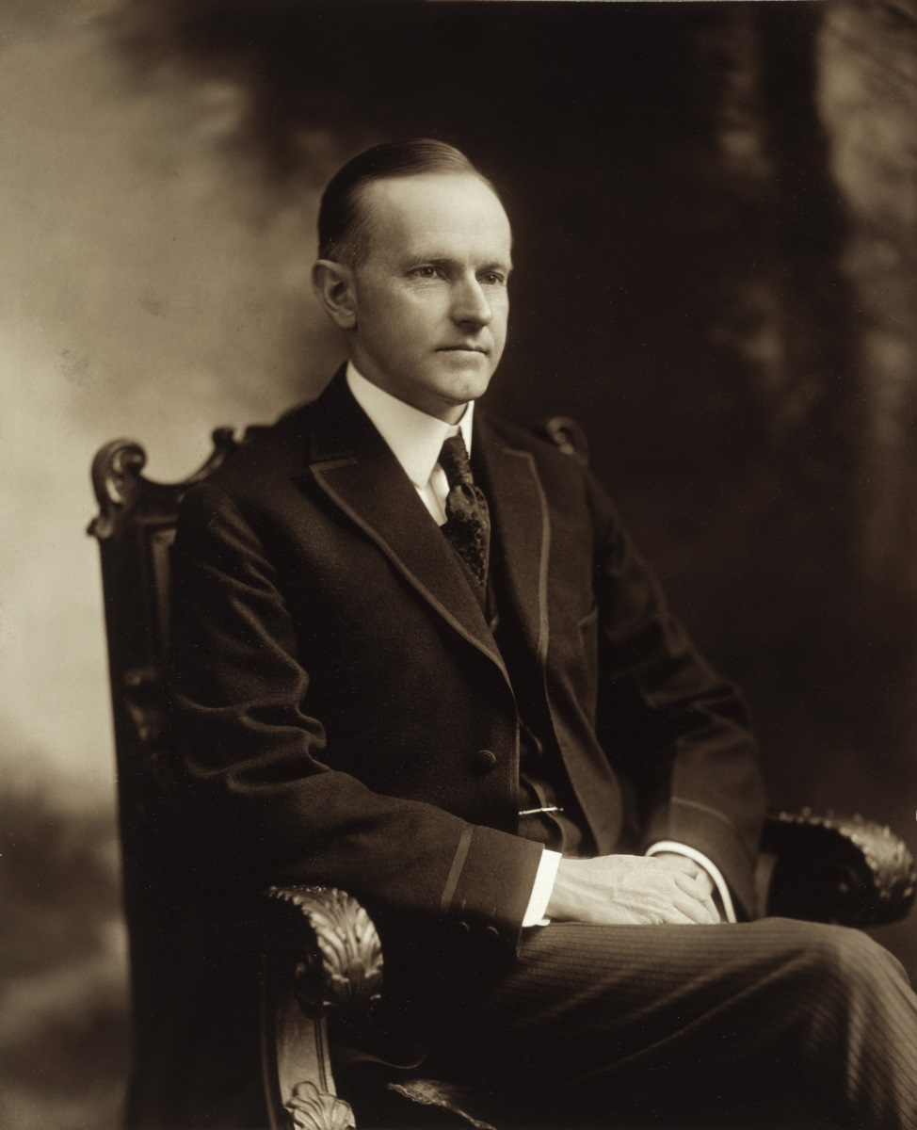
Calvin Coolidge (1923-1929)
Harding died of food poisoning in San Francisco
His death came when VP Calvin Coolidge was visiting his father in Plymouth, Vermont, his birthplace.
There at 2:47 on the morning of August 3, 1923, by the light of a kerosene lamp, Colonel John Coolidge administered the oath of office to his son.
Republican
“Silent Cal”
Honest, frugal

Slide 9
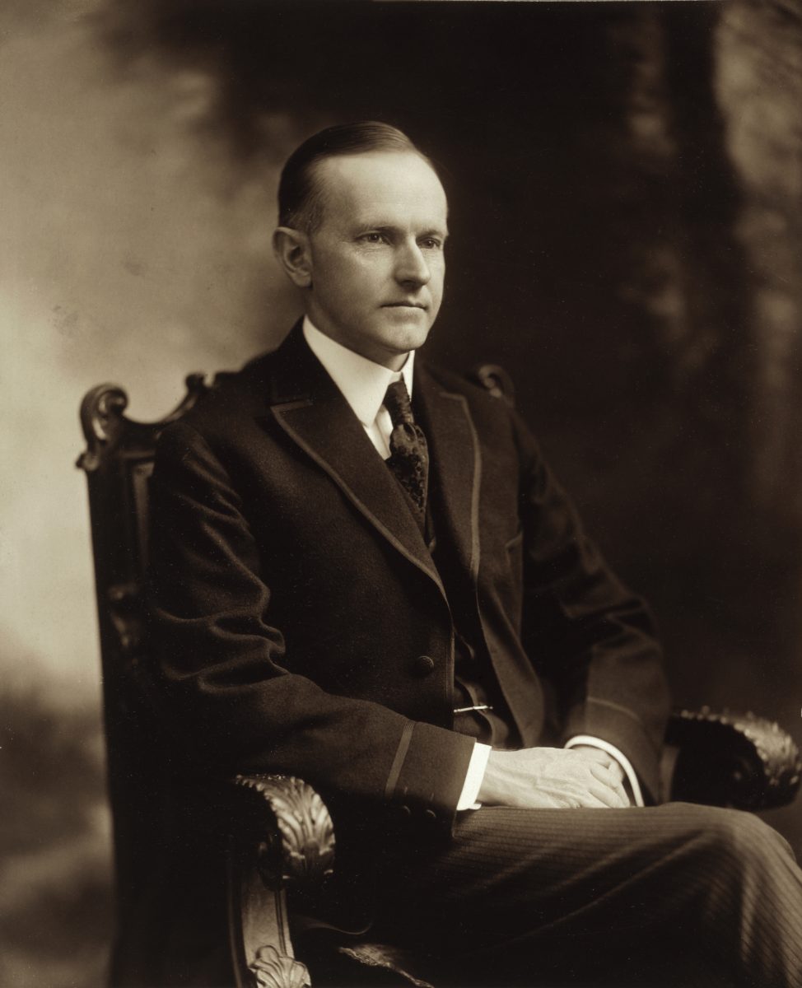
Calvin Coolidge (1923-1929)
Isolationist
Kellogg-Briand Pact of 1928; treaty “outlawed” war; signed by 62 nations
Washington Naval Conference nations agreed to limit construction of large warships
Dawes Plan of 1924; insisted that France and Great Britain repay its debts to the U.S.; plan arranged U.S. loans to Germany so that Germany could make reparation payments to Great Britain and France; Then these Allied countries would use the money to repay loans to the U.S. (U.S. was loaning money to itself)

Slide 10
Calvin Coolidge (1923-1929)
“The chief business of the American people is business…The man who builds a factory builds a temple. The man who works there worships there.”
He sought to unleash the free-enterprise system and, even more than Harding, he desired an end to government regulation of business and industry and reduce taxes as well as the national debt

Slide 11
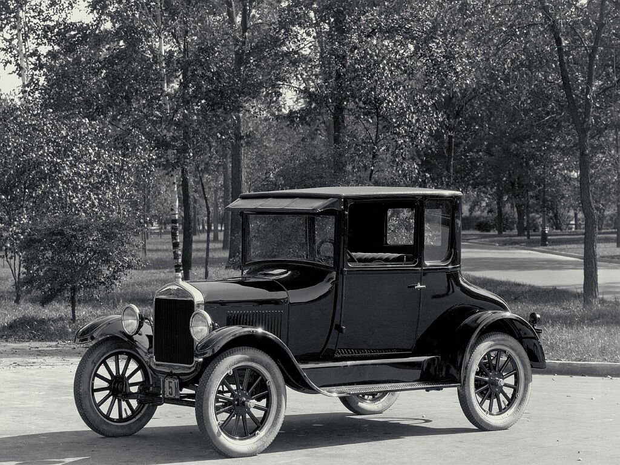
Calvin Coolidge (1923-1929)
1920s were a time of tremendous economic growth
Automobile and Henry Ford had a lot to do with the growth
Ford Motor Company in 1903 revolutionized the industry. Ford’s reliable Model T (“tin lizzie”) came out in 1908 at a price of $850.
Ford perfected mass production techniques using scientific management
Ford vowed to “democratize the automobile. When I’m through everybody will be able to afford one.”
He was right. In 1916 the total number of cars manufactured passed 1 million; by 1920 more than 8 million were registered, and in 1929 more than 23 million.
Used moving assembly lines to increase efficiency and lower price; by 1927 the Model T price had dropped to $290

Slide 12
Calvin Coolidge (1923-1929)
Ford revolutionized the work day
Ford raised worker’s salaries to $5 a day; reduced workday to 8 hours
By 1926, he became the first industrialist to give his workers Saturday and Sunday off
Realized that workers who had more money and more time would buy his cars as consumers
The production of automobiles stimulated growth in other industries
consumed large amounts of the nation’s steel, rubber, glass, oil, and textile output.
Creation of service stations, diners and hotels
New sense of freedom and prosperity
Created suburbs

Slide 13
Calvin Coolidge (1923-1929)
1920s Mass Consumerism
Consumer revolution of 1920s best defined by use of electricity
Moderately priced comforts such as hand cameras, wristwatches, cigarette lighters, vacuum cleaners, washing machines, and linoleum, became increasingly available.
Inventions in communications and transportation, such as motion pictures, radio, telephones, and automobiles, not only fueled the boom but also brought transformations in society.
The first movie with sound appeared in 1926, but the success of talking pictures was established by The Jazz Singer (1927), starring Al Jolson
Calvin Coolidge became the first president to address the nation by radio
New ways of buying fueled consumer revolution
Installment plan-people did not have to pay the entire price of good up front; could make a small down payment and then pay off the rest of the debt with regular monthly payments
Stock Market also benefited-Bull market during 1920s; people purchased stocks by buying on margin (buying on credit)

Slide 14
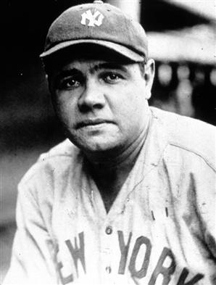
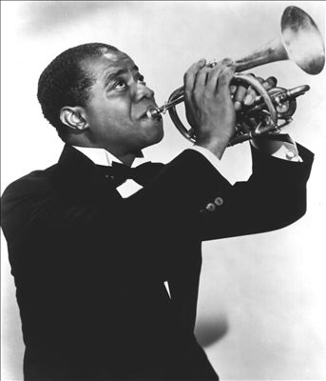
Calvin Coolidge (1923-1929)
1920s Popular Culture
Technology, like the radio, was beginning to break down cultural barriers
New Culture glorified the individual-Common heroes-Jim Thorpe, Red Grange, Bobby Jones, Jack Dempsey, Helen Wills, Charles Lindbergh
Growth of cities change leisure patterns; average workweek dropped to 45 hours a week by 1929
Salaries increased as amount of work time dropped to 5-6 days a week
Opportunity to enjoy a game of baseball and its greatest hero of the 1920s-Babe Ruth
Opportunity to enjoy jazz music-at home on the radio, at a speakeasy; its greatest hero-Louis Armstrong

Slide 15
Journal Prompt
“There are only three things that America will be remembered for 2000 years from now when they study this civilization: The Constitution, Jazz music, and Baseball. These are the 3 most beautiful things this culture's ever created.” Gerald Early, essayist
Based upon your knowledge of American history and your understanding of the 1920s, do you agree with this assessment? Why or why not?
Step 1—As you are watching clips from the documentaries on baseball and jazz take notes using the graphic organizer with this question in mind.
Step 2—Answer the question using your notes and your knowledge of American history. Use the Rubric for Reflective Journal Entry to guide your answer.

