Slide 1
Road to War
Pearl Harbor, December 7, 1941

Slide 2
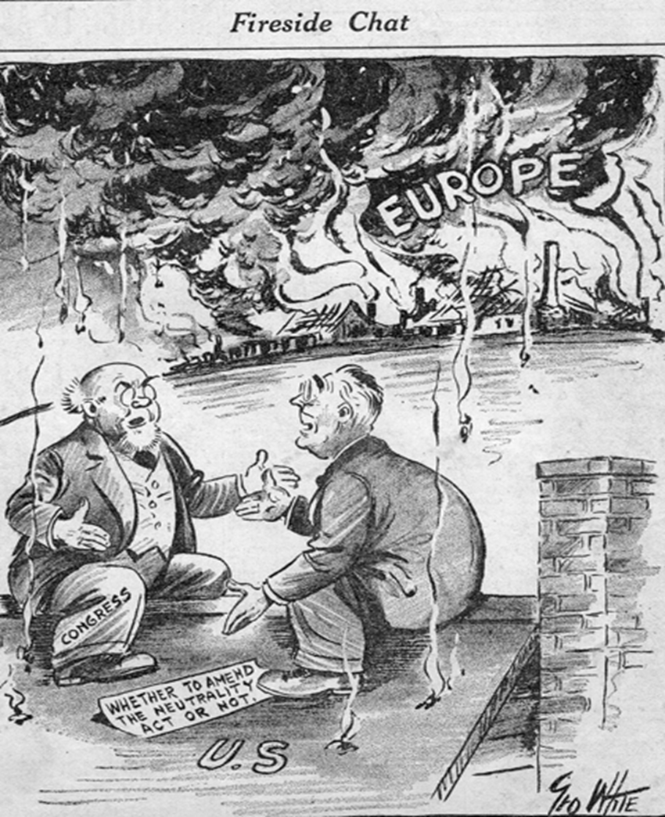
Neutrality Acts
In an effort to keep the U.S. out of war, Congress beginning in 1935 passed a series of Neutrality Acts
The first two acts outlawed arms sales or loans to nations at war
The third act was passed in response to fighting in Spain; this act extended the ban on arms sales and loans to nations engaged in civil wars

Slide 3
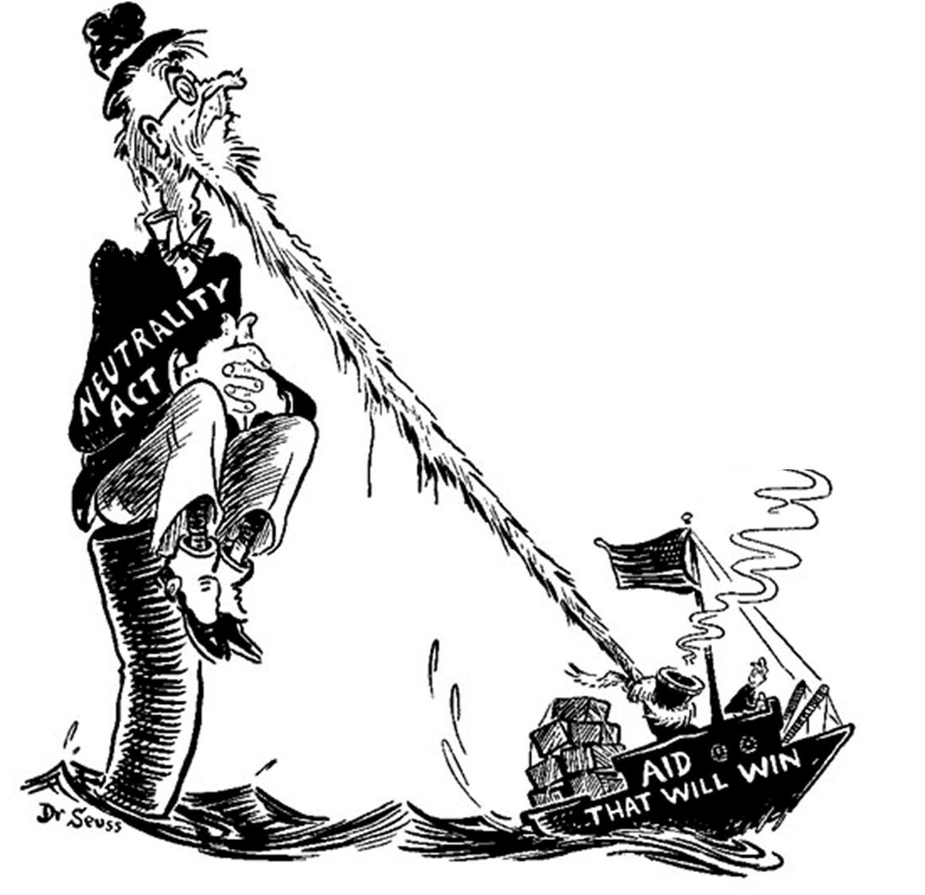
Neutrality Acts
Roosevelt found it impossible to stay neutral and began finding ways around the acts
When Japan attacked China again in 1937, FDR claimed there was no need to enforce the Neutrality Acts since Japan had not formally declared war against China; So U.S. continued sending arms and supplies to China
A few months later, October 5, 1937 FDR issued the “Quarantine Speech”

Slide 4
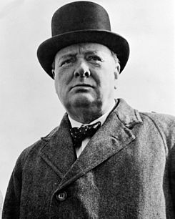
Timeline of Early Aggression in Asia and Europe
1936-1939 Fascists victorious in the Spanish Civil War; Nationalists had rebelled against Spanish Democratic-republican government; both Hitler and Mussolini used the war as a staging ground for their military; France, Great Britain and the U.S. failed to provide support to the Republican government
Spring 1938-Austrian Anschluss
Fall 1938-Sudetenland, western portion of Czechoslovakia fell to Germany; resulted in Munich Pact with British Prime Minister Neville Chamberlain “Peace for our time”; policy of appeasement
“You were given the choice between war and dishonor. You chose dishonor, and you will have war.”…Winston Churchill

Slide 5
German offensive begins
March 15, 1939 German troops poured into what remained of Czechoslovakia; Hitler bragged that “Czechoslovakia has ceased to exist”
Turned to Poland for an invasion; country had a large German speaking population; Hitler claimed that German speaking people were being mistreated by the Poles
Problem with the location of Soviet Union; August 23, 1939 Hitler and Stalin signed Nazi-Soviet Non-Aggression Pact
Signed secret agreement to divide Poland when attacked by Germany
German invasion of Poland began on September 1, 1939; introduction of German blitzkrieg (lightning warfare)
September 3, Britain and France declared war on Germany

Slide 6
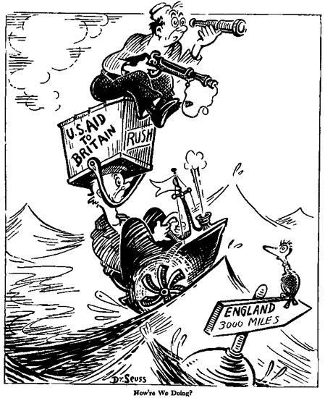
“Cash-and-Carry”
September 1939 FDR persuaded Congress to pass a “cash-and-carry” provision that allowed warring nations to buy U.S. arms as long as they paid cash and transported them on their own ships
Providing the arms, he argued, would help France and Britain defeat Hitler and keep the U.S. out of the war
Neutrality Act of 1939 put the policy into effect despite protests by Isolationist politicians

Slide 7
Axis Threat
By summer 1940, France had fallen and Britain was under siege; By June, U.S. had sent Britain over 500,000 rifles and 80,000 machine guns
By September, Germany, Italy, and Japan had signed a mutual defense treaty, the Tripartite Pact=Axis Powers (aimed at keeping the U.S. out of the war)
1940 Congress increased U.S. defense spending; first peacetime draft was passed-Selective Training and Service Act
1940 FDR broke the tradition of the two term presidency and was reelected for a third term; ran on the campaign that he would keep the nation out of war

Slide 8
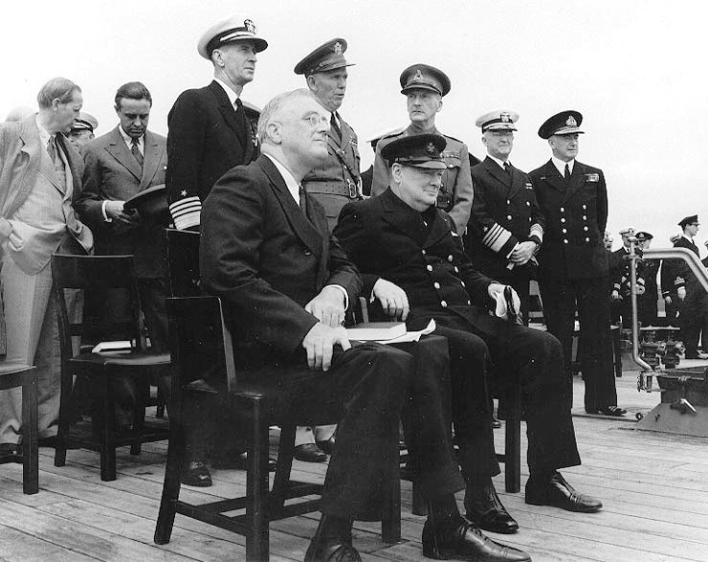
The Atlantic Charter
Secret meeting between FDR and Winston Churchill aboard the battleship USS Augusta off of Newfoundland
Agreed to and issued a joint declaration of war aims, called the Atlantic Charter- August 14, 1940
Both countries promised the following: collective security, disarmament, self-determination, economic cooperation, and freedom of the seas
FDR said that he could not yet ask Congress for a declaration of war against Germany, but “he would wage war” and do “everything” to force an incident.
Charter became the basis for the signing of “A Declaration of United Nations”; 26 nations that would form the Allies

Slide 9
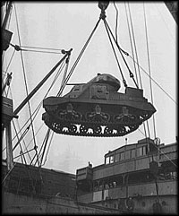
“The Great Arsenal of Democracy”
FDR proposed a replacement of Cash-carry policy, because Britain ran out of money
Lend-Lease Act was passed in March 1941; under the plan, the U.S. would lend or lease arms and other supplies to “any country whose defense was vital to the United States”
FDR compared his plan to lending a garden hose to a neighbor whose house was on fire. Only sensible thing to do to keep the fire from spreading to your house.
Isolationist politicians were opposed to it, but most Americans favored
Germany and Hitler responded with U-boat attacks (Wolf packs) that were responsible for sinking up to 350,000 tons of supplies within a month
September 1941-FDR granted permission for U.S. warships to attack German U-boats in self-defense.
The "Four Freedoms" Franklin D. Roosevelt's Address to Congress January 6, 1941

Slide 10
Growing tensions between Japan and the U.S.
By 1938, American businesses had supplied Japan with two-thirds of its oil and 9/10 of its scrap metal
Japan's 1937 invasion of China and its occupation of French Indochina in 1940 and 1941 led President Roosevelt to embargo scrap metal and oil shipments to Japan
Japanese assets were frozen in the United States.
The Japanese resented oil embargo because it had no oil of its own and had limited stockpiles.
Without oil, the Japanese would have to withdraw from China.
Japan was determined to seize this opportunity to expand (into British, French, Dutch, and U.S. territory) even if that meant war with the United States.

Slide 11
Japanese plans in the Pacific
The Japanese envisioned taking U.S. and European possessions in the Far East (Guam and the Philippines) forcing the U.S. Navy to fight its way across the Pacific to relieve them.
The Japanese thought that somewhere in the Far East, a great naval battle would occur to decide who would control the Pacific
The Japanese believed that a preemptive strike against the U.S. fleet, which Roosevelt had shifted from San Diego to Pearl Harbor on the island of Oahu would buy time for Japan to build a defensive ring of islands in the Pacific to prepare for such a battle
The Japanese thought Americans would be demoralized and that the U.S. would negotiate a settlement that would give Japan control of the western Pacific

Slide 12
Japan plans for Pearl Harbor
The Japanese fitted their torpedoes with fins so that they could be dropped from aircraft in the shallow water of Pearl Harbor
They also planned to use large armor-piercing shells to be dropped as bombs from high-flying aircraft. No deck armor would be able to withstand them.
Surprise was essential; Japanese maintained radio silence, and Washington knew only that the Japanese fleet had sailed.
A "war warning" had been issued to military commanders in the Pacific, but few American leaders thought the Japanese would attack Pearl Harbor

Slide 13
Roosevelt’s critics
The U.S. had broken the codes that the Japanese used in transmitting military and diplomatic messages
Critics of FDR argued that the president knew of the attacks and did nothing to prevent them so that he could break the isolationist mood at home
Evidence suggests otherwise: The intercepted Japanese messages did not specifically identify a target; most people assumed the attack would take place in the Philippines

Slide 14
The attack
At 7:50 a.m., the first wave of Japanese aircraft began its attack on the ships at Pearl Harbor and air stations at Ford Island, Hickam, and Wheeler.
Most U.S. planes were destroyed on the ground.
The attack achieved great success. Over some 140 minutes, the Japanese sank 4 of the 8 U.S. battleships in the Pacific and badly damaged the rest.
Seven smaller ships were also sunk, and 4 were badly damaged.
A total of 188 U.S. aircraft were destroyed, and 63 were badly damaged.
American aircraft carriers happened to be away at sea
The attack killed 2,403people and wounded 1,178. The attack cost the Japanese only 29 aircraft and fewer than 100 aircrew dead.
1,177 of the dead perished when a single bomb struck the battleship Arizona

Slide 15
The address
In an address before a joint-session of Congress that was broadcast to millions across the country, President Roosevelt denounced the attack
Calling December 7, 1941, “a day which will live in infamy”
Congress, with one dissenting vote, enacted a declaration of war against Japan.
On December 11, Hitler and Mussolini declared war on the United States

Slide 16
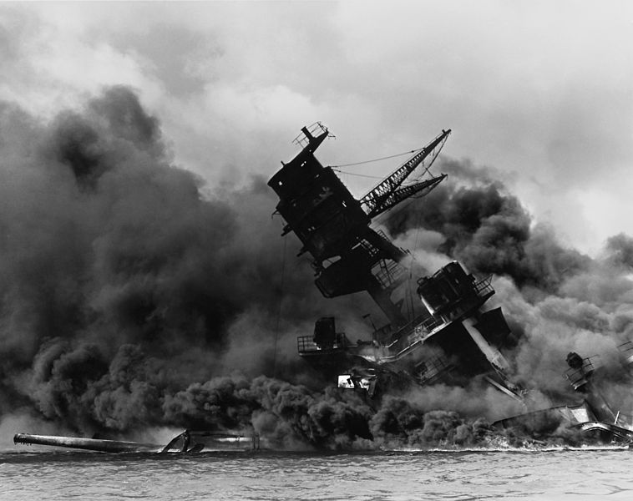

Slide 17
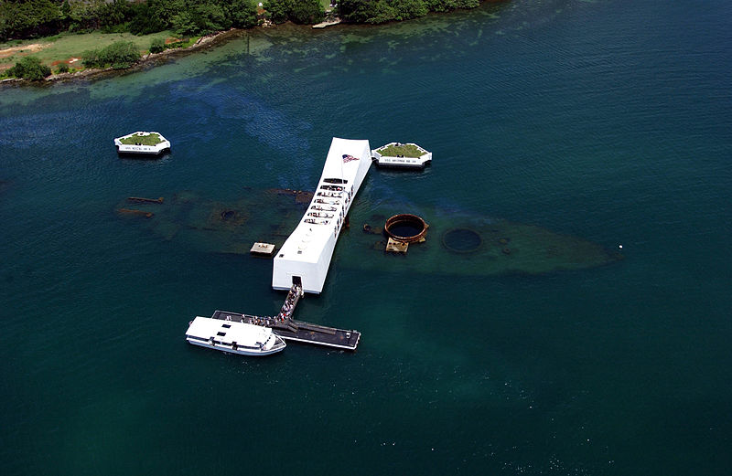

Slide 18
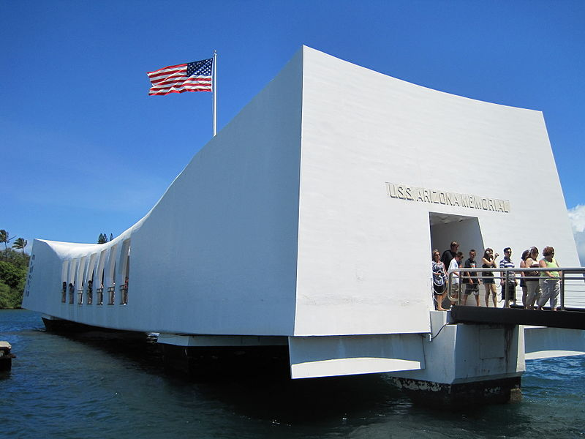

Slide 19
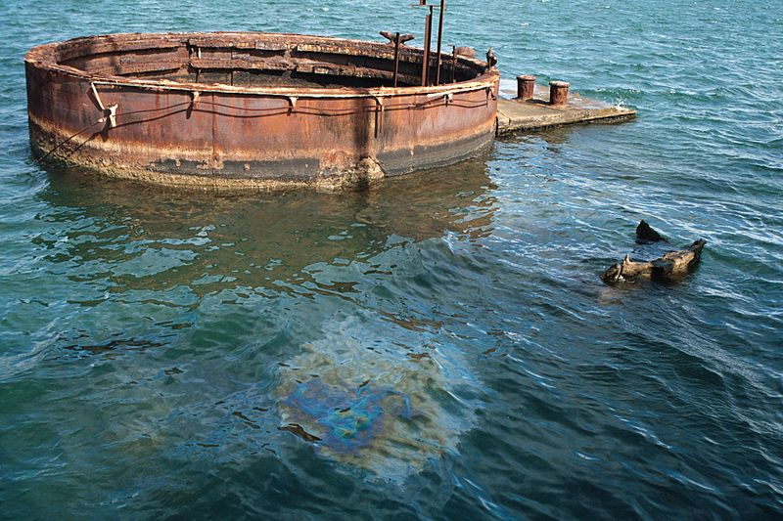

Slide 20
