Slide 1
WWII The Pacific Theater of War

Slide 2
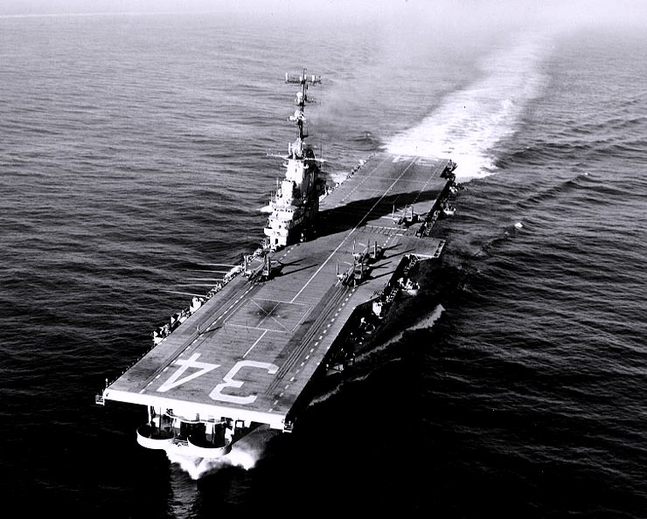
What about the Pacific War?
The US (mostly) fought the Japanese.
December 7, 1941
“Day that will live in Infamy”
Japan bombed Pearl Harbor in Hawaii to sink US ships there.
Two hours = most US navy destroyed and 2,000+ sailors killed

Slide 3
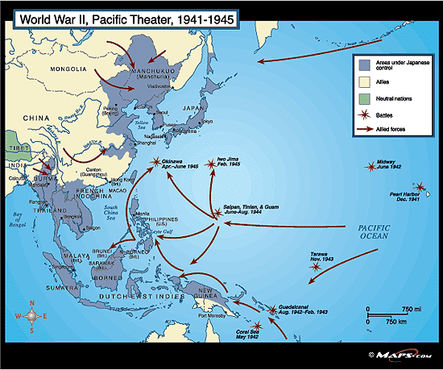

Slide 4
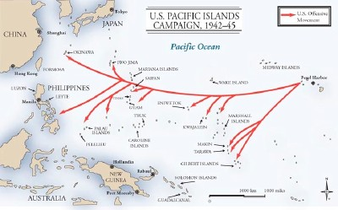
“Island-hopping”
US forces elected to focus on capturing only certain strategic islands in the Pacific – ones that would allow US bombers to get within striking range of Japan and create a safe route for troop and supply movement

Slide 5
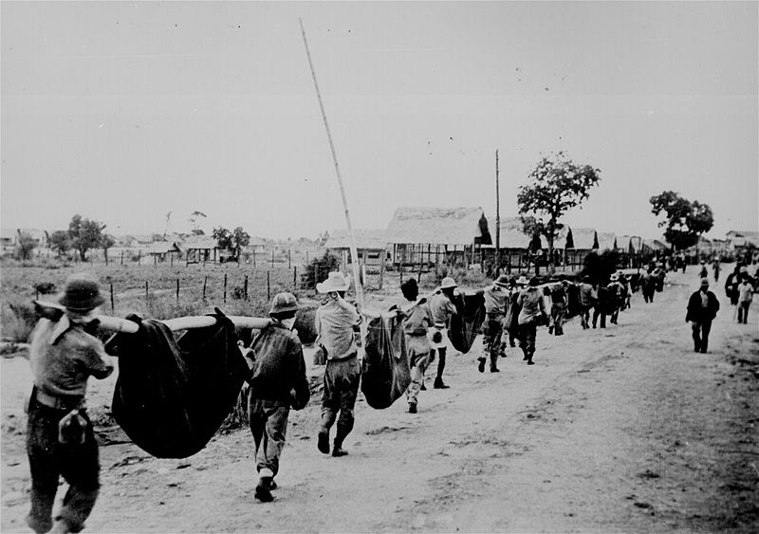
Bataan Death March
April 1942 after 3 month Battle of Bataan
“I shall return”: Douglas MacArthur
75000 Americans and Filipino troops surrendered after 3 month battle of Philippines
9 day walked 90 mile trip from Bataan to Camp O’Donnell
650 American deaths; up to 10,000 Filipino deaths

Slide 6
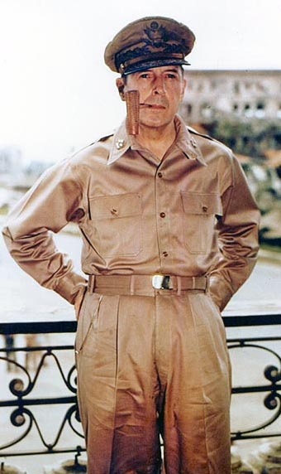
Douglas MacArthur
Seasoned veteran of WWI, highly decorated soldier who had won the Medal of Honor
Had vowed to return to the Philippines when forced to evacuate in 1942
Led US effort to retake the Philippines and proclaimed “I have returned” when he finally landed in Oct. 1944
Later was US commander of occupied Japan after WWII and led UN forces in the Korean War

Slide 7
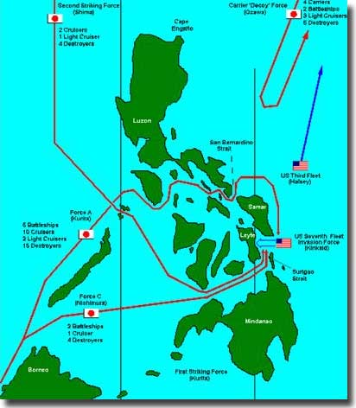
The Philippines
US forces landed at Leyte Gulf in Oct. 1944 to begin the retaking of the Philippines, but relied entirely on the US Navy for air cover for protection
Japanese navy counterattacked, drawing the US Navy into a major naval battle that left MacArthur’s forces unprotected and nearly led to disaster
US forces would not gain full control of the Philippines until July 1945, just weeks before the war ended

Slide 8
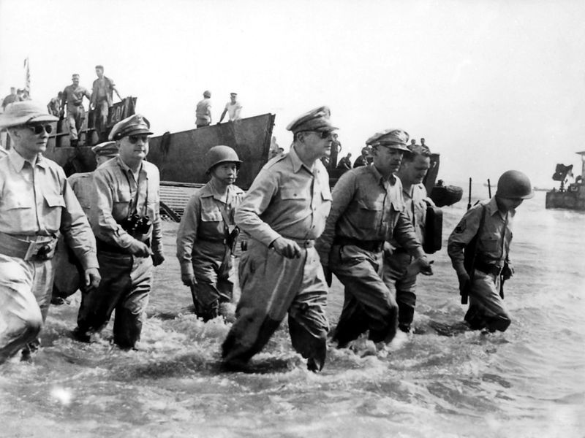

Slide 9
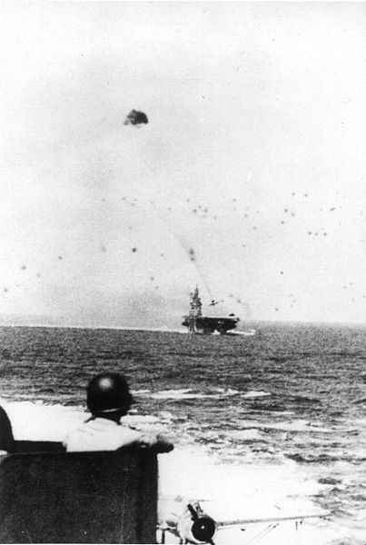
Kamikaze Attacks
The Battle of Leyte Gulf marked the first coordinated use of suicide attacks by Japanese pilots known as kamikaze (“divine wind”)
Japanese high command was now resorting to desperate tactics as Japan ran out of experienced pilots and the industrial capacity to continue making new weaponry

Slide 10
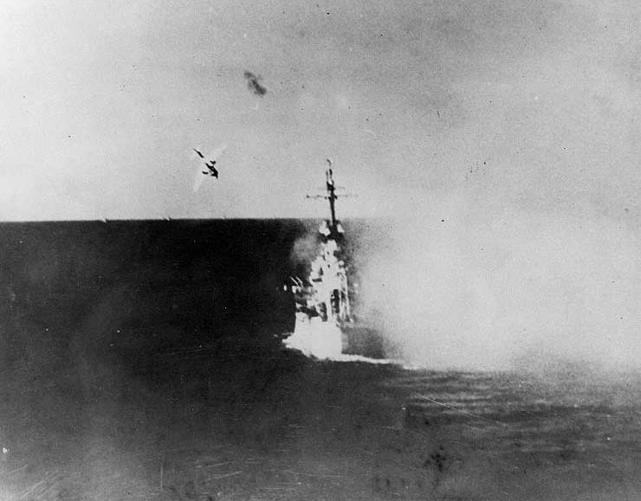

Slide 11
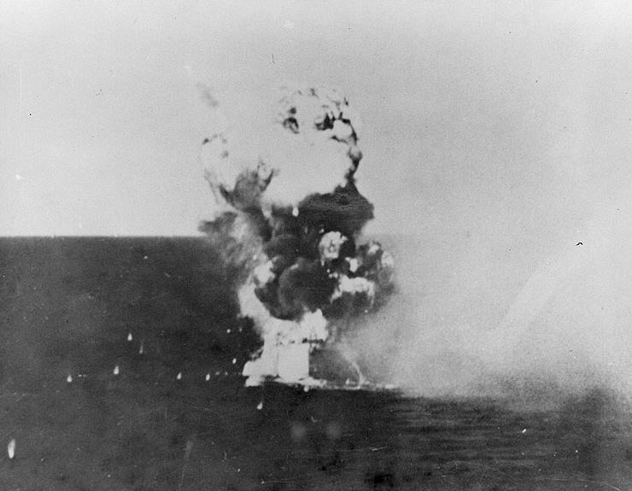

Slide 12
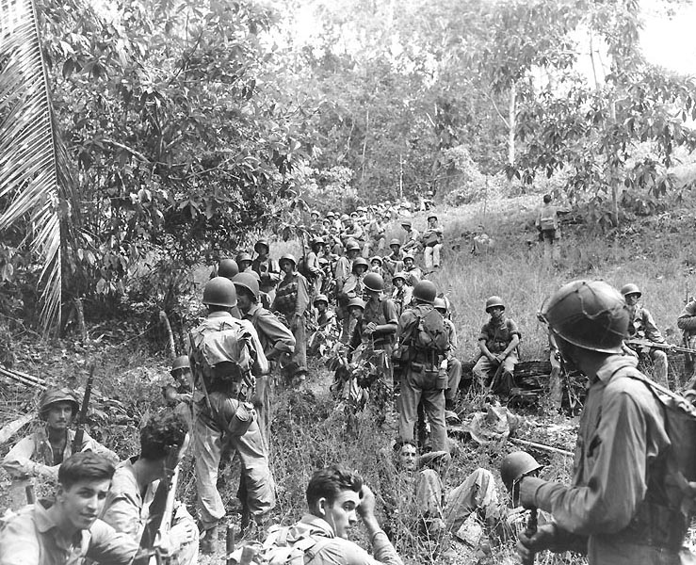
Battle of Guadalcanal
Aug. 1942 – Feb. 1943
U.S. amphibious attack on Japanese fortifications
1st land battle in Pacific Theater
Eventually 31,000 of the 36,000 Japanese on the island were killed
Japanese lost chance for offensive further South

Slide 13
Battle of the Coral Sea
Prior to this battle, the Japanese were winning every battle and taking over the Pacific
May 1942 - U.S. and Australia stopped Japan from invading Australia
Japan won the actual battle, but the allies were able to stop Japan invasion for the first time; Japan was forced to retreat
U.S. was beginning to use the Island Hopping technique to weaken Japan’s forces

Slide 14
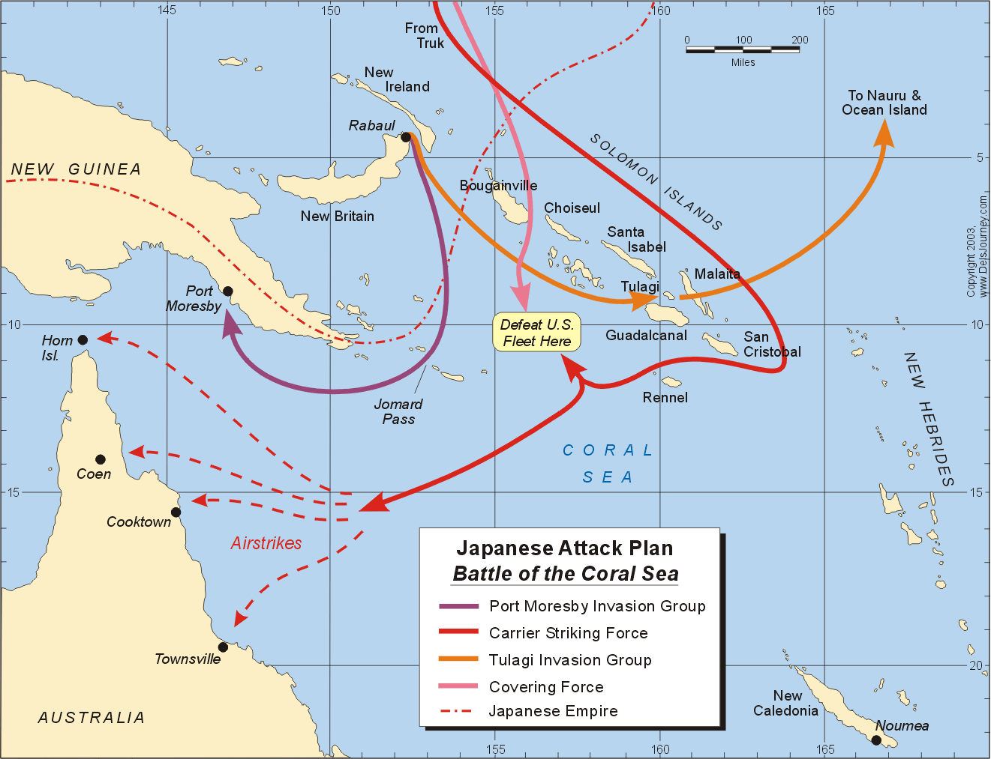

Slide 15
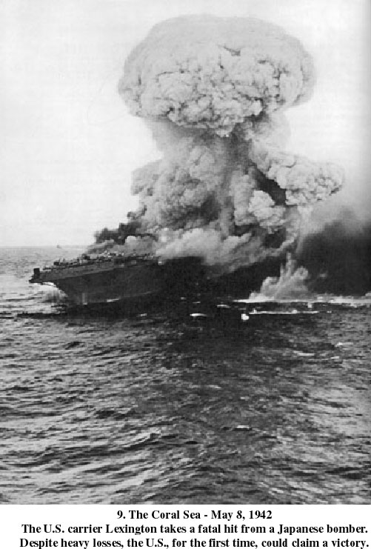

Slide 16
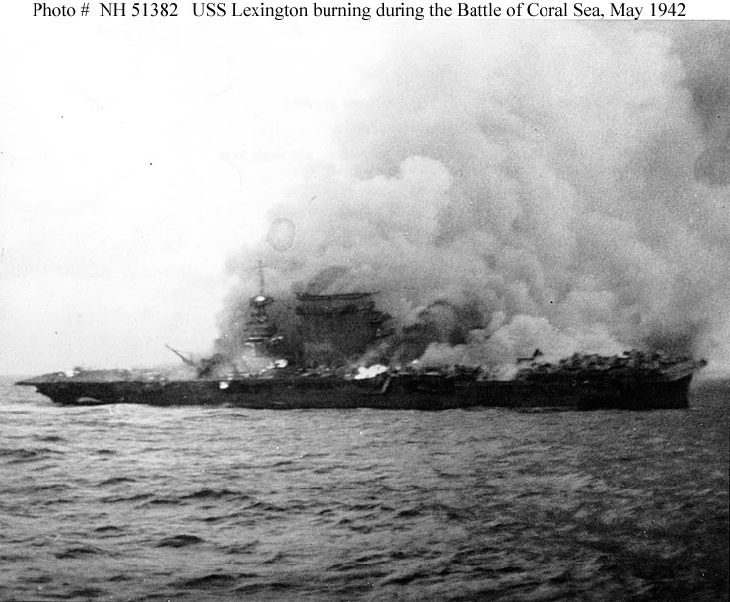

Slide 17
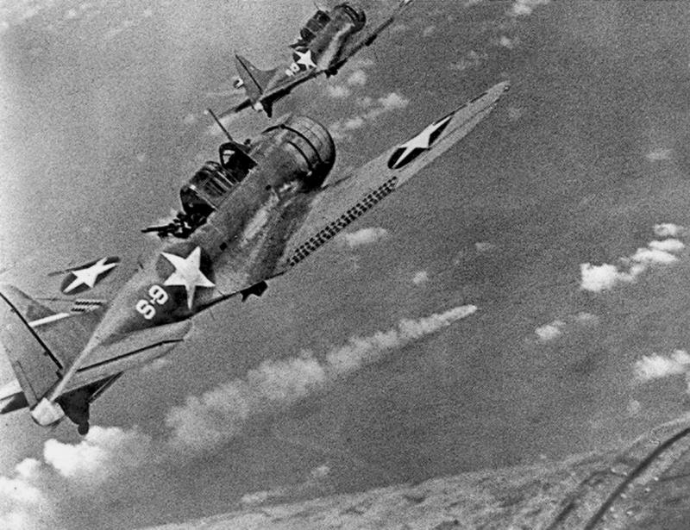
Battle of Midway
June 1942
Admiral Chester Nimitz intercepted Japanese code
U.S. launched successful surprise attack on Japan at Pacific island called Midway

Slide 18
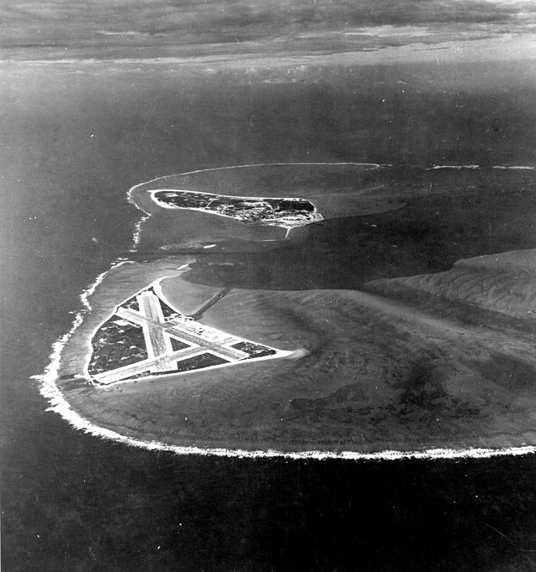
Battle of Midway
The Japanese lost 4 carriers, a heavy cruiser, 3 destroyers, some 275 planes, at least 4,800 men, and suffered heavy damage among the remaining vessels of their fleet.
American losses included 1 carrier, the Yorktown, a destroyer, about 150 planes, and 307 men
“Revenge of Pearl Harbor”

Slide 19
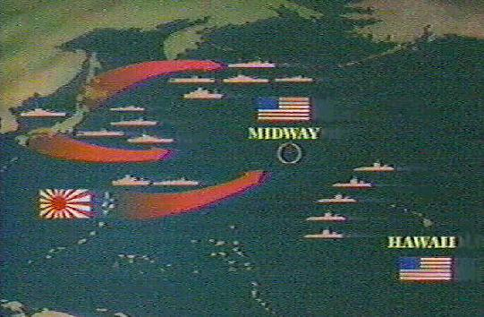
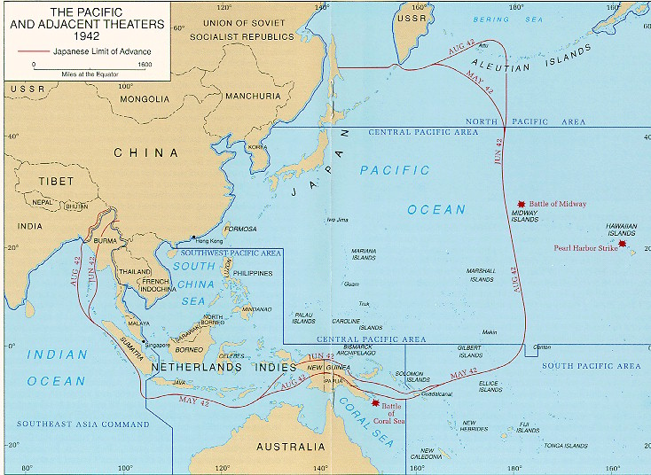

Slide 20
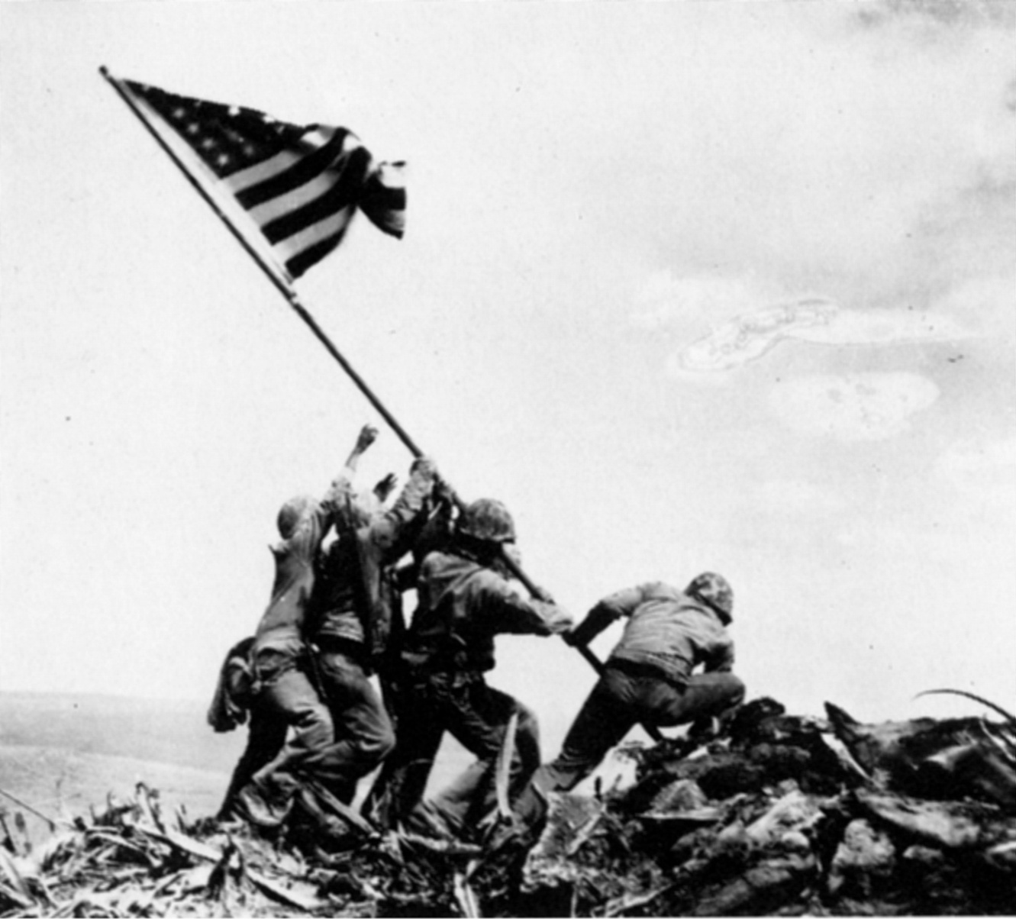
Iwo Jima
Feb./Mar. 1945
First Japanese “home-island” captured by the US
20,700 of the 22,000 Japanese soldiers on the island were killed; about 6800 of the 60,000 US Marines who landed on Iwo Jima were killed
Badly damaged Japanese morale; placed Japan within easy bombing range for US bombers

Slide 21
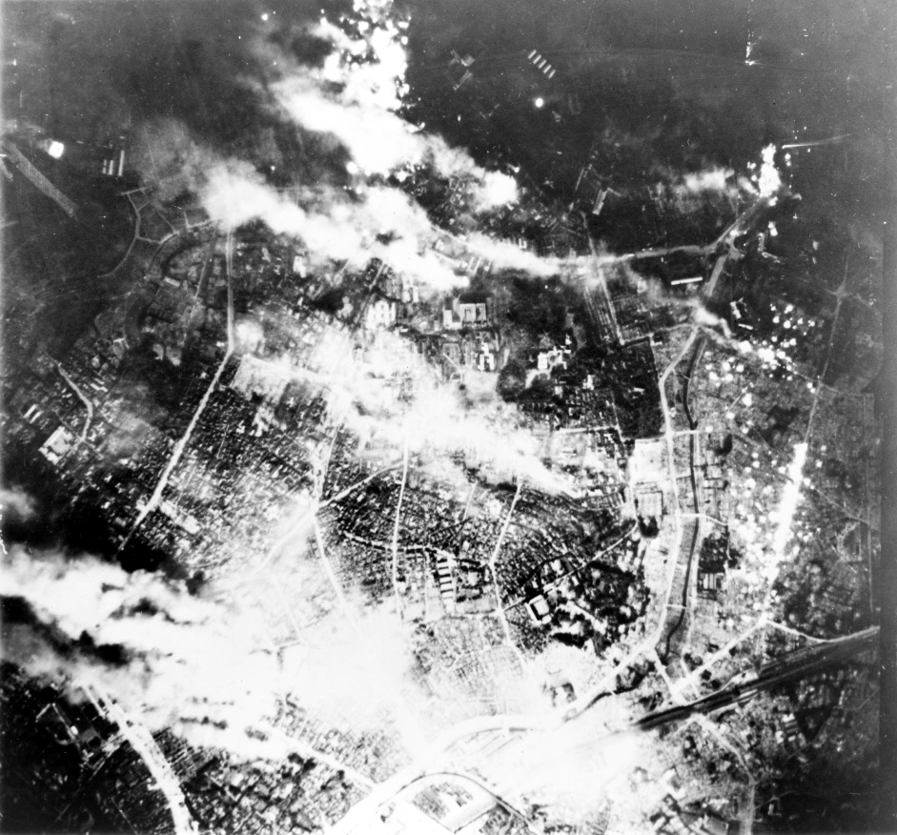
Firebombing of Japan
Mar. 9, 1945: firebombing of Tokyo killed over 80,000; by the war’s end, 67 Japanese cities had been destroyed using napalm
Gen. Curtis LeMay ordered the use of napalm (jellied gasoline) bombs on Japanese cities because his bombers were having trouble hitting their targets
The napalm was designed to start massive fires, which would ensure the destruction of the desired military targets, but would also lead to heavy losses of civilian life

Slide 22
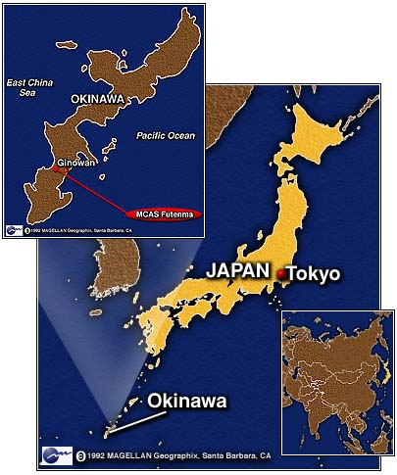
Battle of Okinawa
Apr.-June 1945
Most brutal battle of the Pacific war: about 125,000 Japanese killed and 12,500 Americans
Nearly 700,000 men fought in this battle (550,000 Americans)
Okinawa was needed to set up a base of operations for an invasion of Japan itself

Slide 23
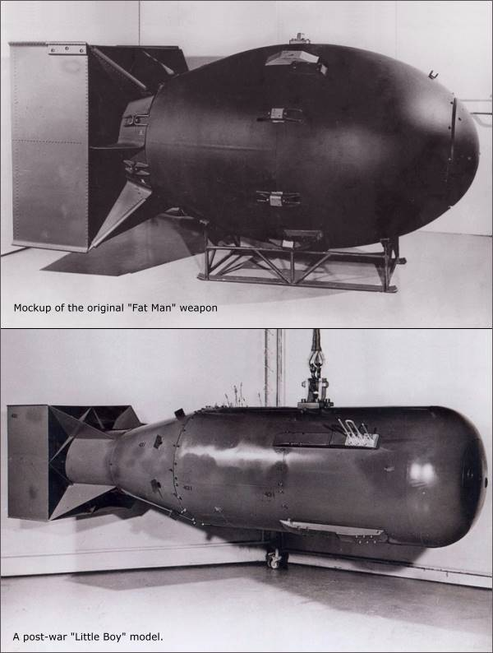
The Manhattan Project
US effort to build a new type of weapon that would unleash tremendous destructive energy by splitting uranium atoms – an “atomic bomb”
Led by Gen. Leslie Groves and researcher J. Robert Oppenheimer, the team produced 3 bombs
1 bomb was tested in the New Mexico desert (Los Alamos), leaving just 2 bombs for military use
Bombs were code-named “Fat Man” and “Little Boy”

Slide 24
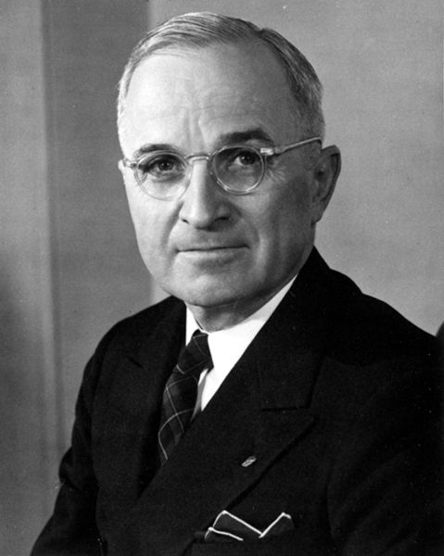
Harry S. Truman
1945 - 1953 (Pres.)
Became president upon FDR’s death
Truman now had to decide how to end the war – should the US mount an invasion of Japan, which would cost an estimated 1 million American lives or should it use the new atomic bomb, which would kill an unknown number of Japanese civilians and whose after-effects were still unknown?

Slide 25
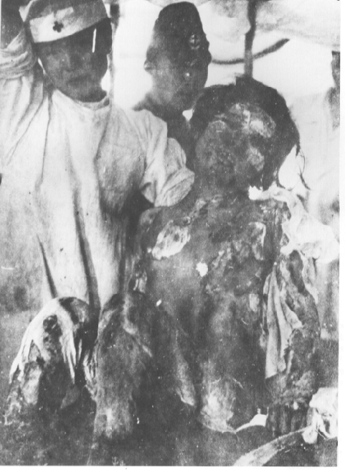
Hiroshima
Japan was warned that unless they surrendered immediately and without conditions, they faced “prompt and utter destruction”
When the Japanese did not reply, orders were given to destroy the industrial city of Hiroshima
August 6, 1945: The B-29 Enola Gay dropped “Little Boy” on the city, destroying 76,000 buildings and killing over 120,000 people

Slide 26
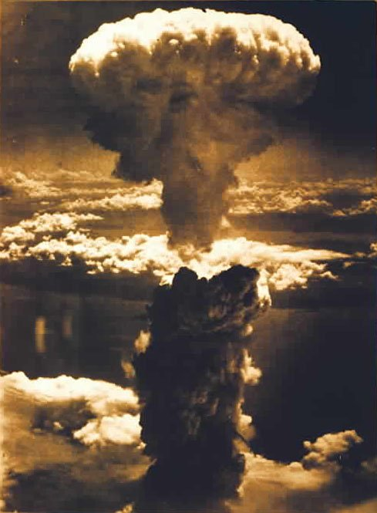
Nagasaki
When the Japanese still did not surrender, a B-29 bomber dropped “Fat Man” on the port of Nagasaki, killing over 50,000 on August 9, 1945
On the same day, the Soviets declared war on Japan and began to prepare to enter the war in the Pacific

Slide 27
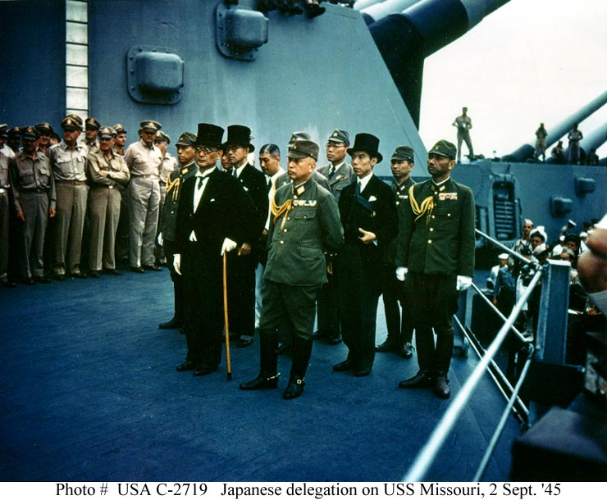
Japan Surrenders
Faced with destruction on an unforeseen scale (and unaware that the US had no more atomic bombs to use), Emperor Hirohito ordered his government to surrender unconditionally
Fighting stopped August 15, 1945 (“V-J Day”)
Formal surrender took place on September 2, 1945
As part of the terms of surrender, Japan was occupied by U.S. forces until Apr. 1952

