Slide 1
World War II
The Pacific Theater of War

Slide 2
Interpretive Commentary Activity
How did American entry into World War II impact the American home front?

Slide 3
Values Walk
Pro/Con Seattle Times article
Do you feel President Truman was justified in using the weapon to end World War II? Why or why not?

Slide 4
SAQ
Answer the following SAQ using the ACE strategy:
What do you think were the major factors influencing President Truman’s decision to use the atomic bomb effectively ending World War II?
Given the pros and cons of using the atomic bomb, and the options available to Truman do you feel he was justified in using the weapon to end World War II? Why or why not?
How will the use of the bomb potentially impact the development of the United States?

Slide 5
SAQ Assignment
Using the following resources as evidence to draw some conclusions.
National Park Service Website https://www.nps.gov/articles/trumanatomicbomb.htm
Pro/Con Seattle Times article
Google My Map Pacific Theater Battles Research

Slide 6
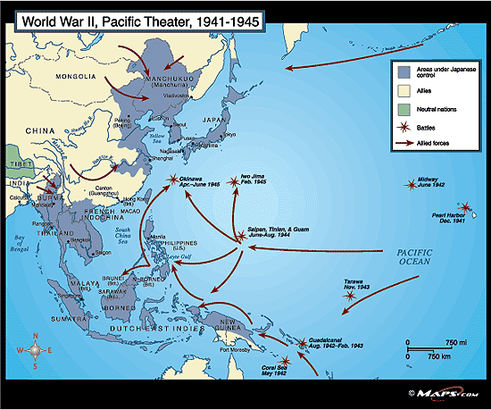

Slide 7
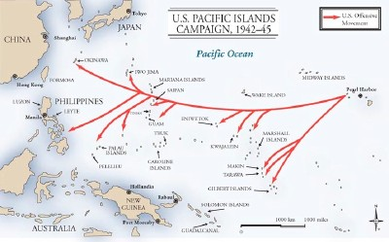
“Island-hopping”
US forces elected to focus on capturing only certain strategic islands in the Pacific – ones that would allow US bombers to get within striking range of Japan and create a safe route for troop and supply movement

Slide 8
Japanese occupation of the Philippines
The invasion of the Philippines started on December 8, 1941, ten hours after the attack on Pearl Harbor.
As at Pearl Harbor, American aircraft were severely damaged in the initial Japanese attack. Lacking air cover, the American Fleet in the Philippines withdrew on December 12, 1941.
General Douglas MacArthur was ordered out, leaving his men at Corregidor on the night of 11 March 1942 for Australia,
The 76,000 starving and sick American and Filipino defenders on Bataan surrendered on 9 April 1942, and were forced to endure the infamous Bataan Death March on which 7,000–10,000 died or were murdered.
Japan occupied the Philippines for over three years, until the surrender of Japan

Slide 9
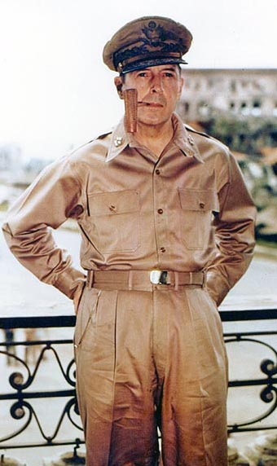
Douglas MacArthur
Supreme Allied Commander of the Pacific Theater
Seasoned veteran of WWI, highly decorated soldier who had won the Medal of Honor
Had vowed to return to the Philippines when forced to evacuate in 1942
Led US effort to retake the Philippines and proclaimed “I have returned” when he finally landed in Oct. 1944
Later was US commander of occupied Japan after WWII and led UN forces in the Korean War

Slide 10
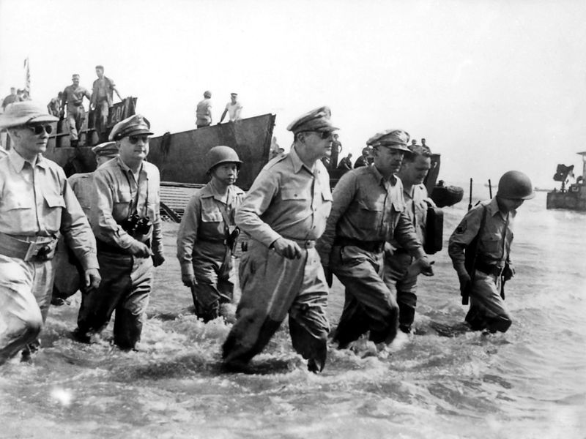

Slide 11
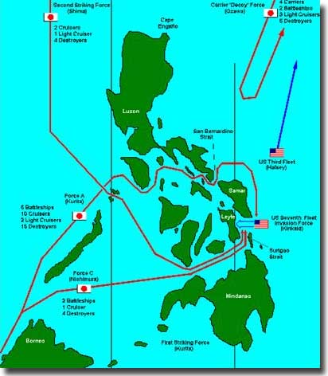
The Philippines
US forces landed at Leyte Gulf in Oct. 1944 to begin the retaking of the Philippines, but relied entirely on the US Navy for air cover for protection
Japanese navy counterattacked, drawing the US Navy into a major naval battle that left MacArthur’s forces unprotected and nearly led to disaster
US forces would not gain full control of the Philippines until July 1945, just weeks before the war ended

Slide 12
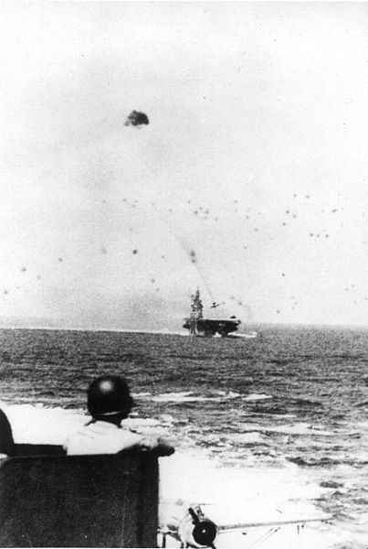
The Battle of Leyte Gulf
marked the first coordinated use of suicide attacks by Japanese pilots known as kamikaze (“divine wind”)
Japanese high command was now resorting to desperate tactics as Japan ran out of experienced pilots and the industrial capacity to continue making new weaponry

Slide 13
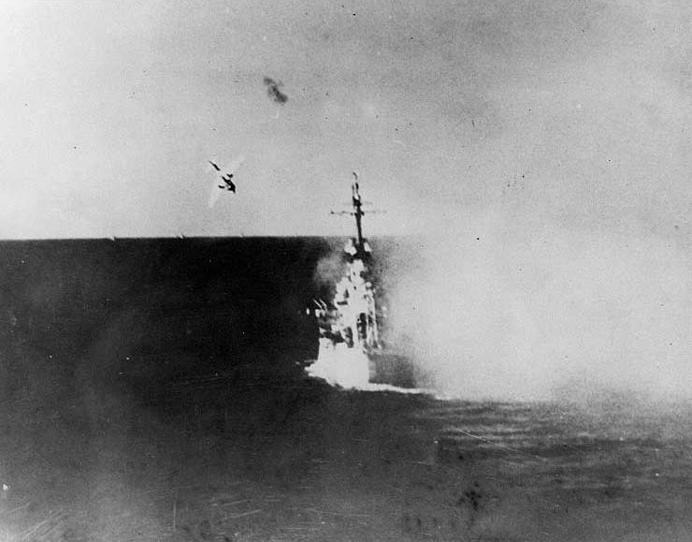

Slide 14
Battle of the Coral Sea
Prior to this battle, the Japanese were winning the battle for the Pacific
May 1942 - U.S. and Australia stopped Japan from invading Australia
Japan won the actual battle, but the allies were able to stop Japan invasion for the first time; Japan was forced to retreat
U.S. was beginning to use the Island Hopping technique to weaken Japan’s forces

Slide 15
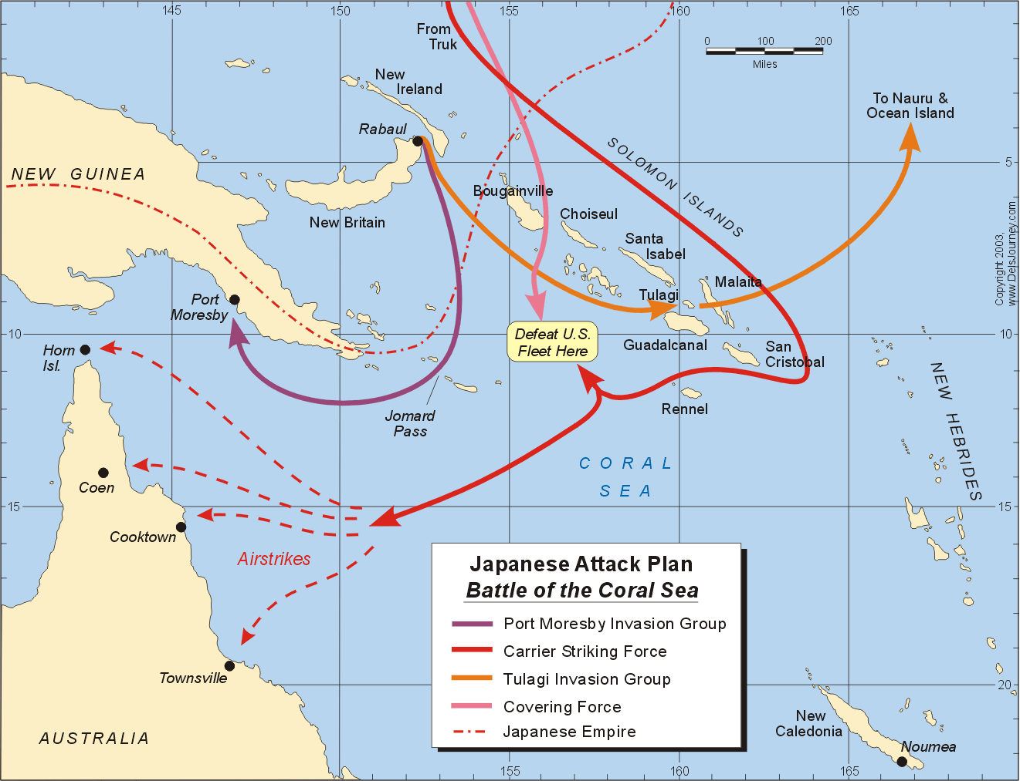

Slide 16
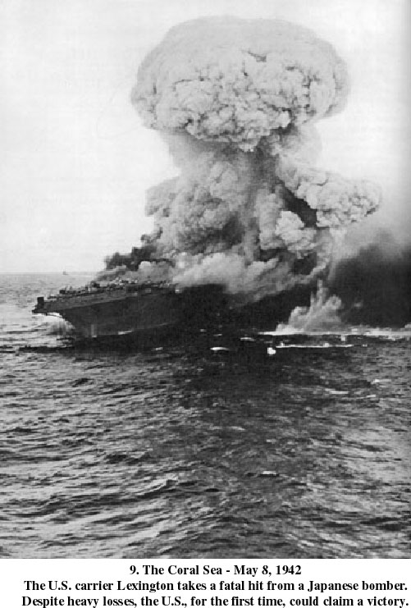

Slide 17
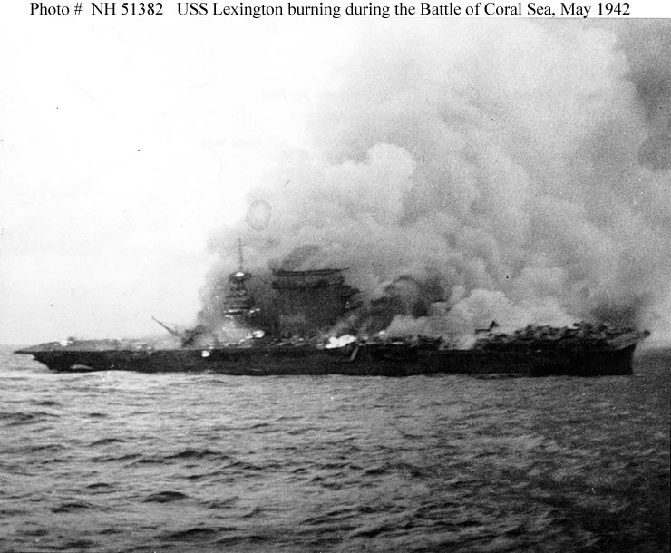

Slide 18
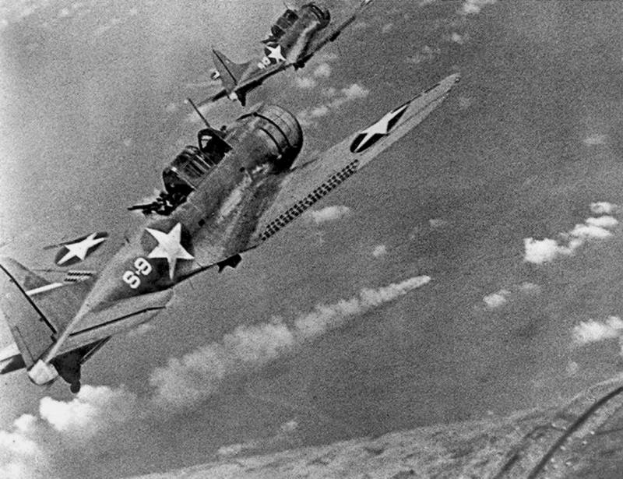
Battle of Midway
June 1942
Admiral Chester Nimitz intercepted Japanese codes
U.S. launched successful surprise attack on Japan at Pacific island called Midway

Slide 19
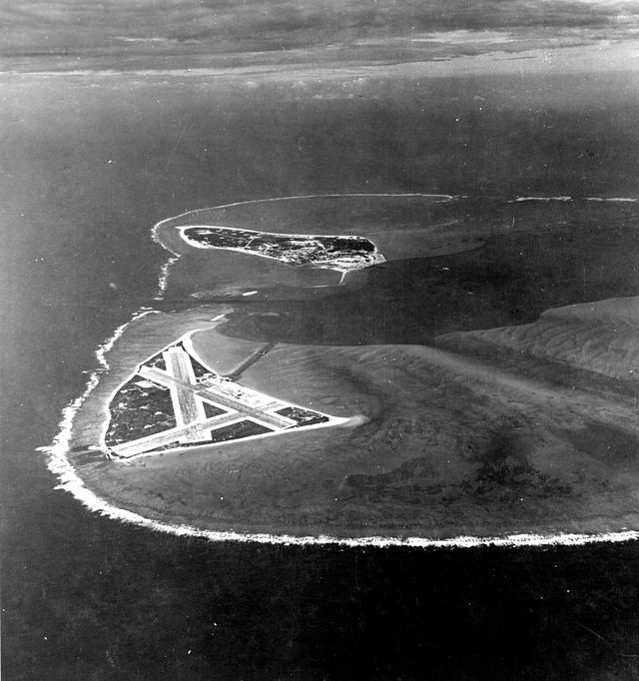
Battle of Midway
The Japanese fleet suffered heavy damage: lost 4 carriers, a heavy cruiser, 3 destroyers, some 275 planes, at least 4,800 men
American losses included 1 carrier, the Yorktown, a destroyer, about 150 planes, and 307 men
“Revenge of Pearl Harbor”

Slide 20
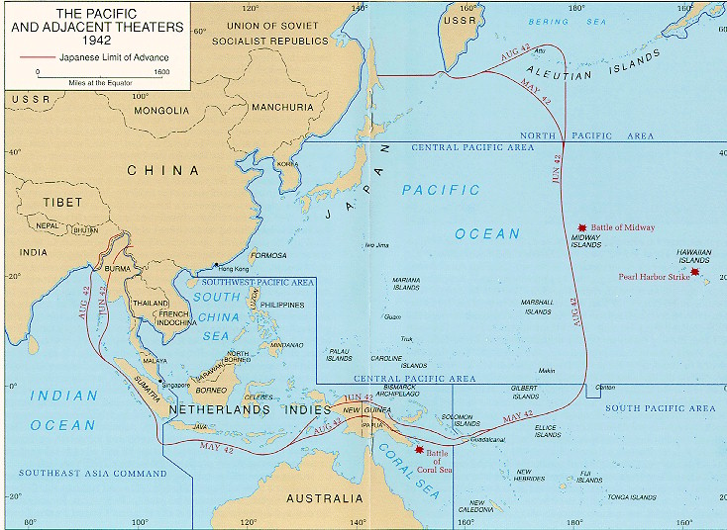

Slide 21
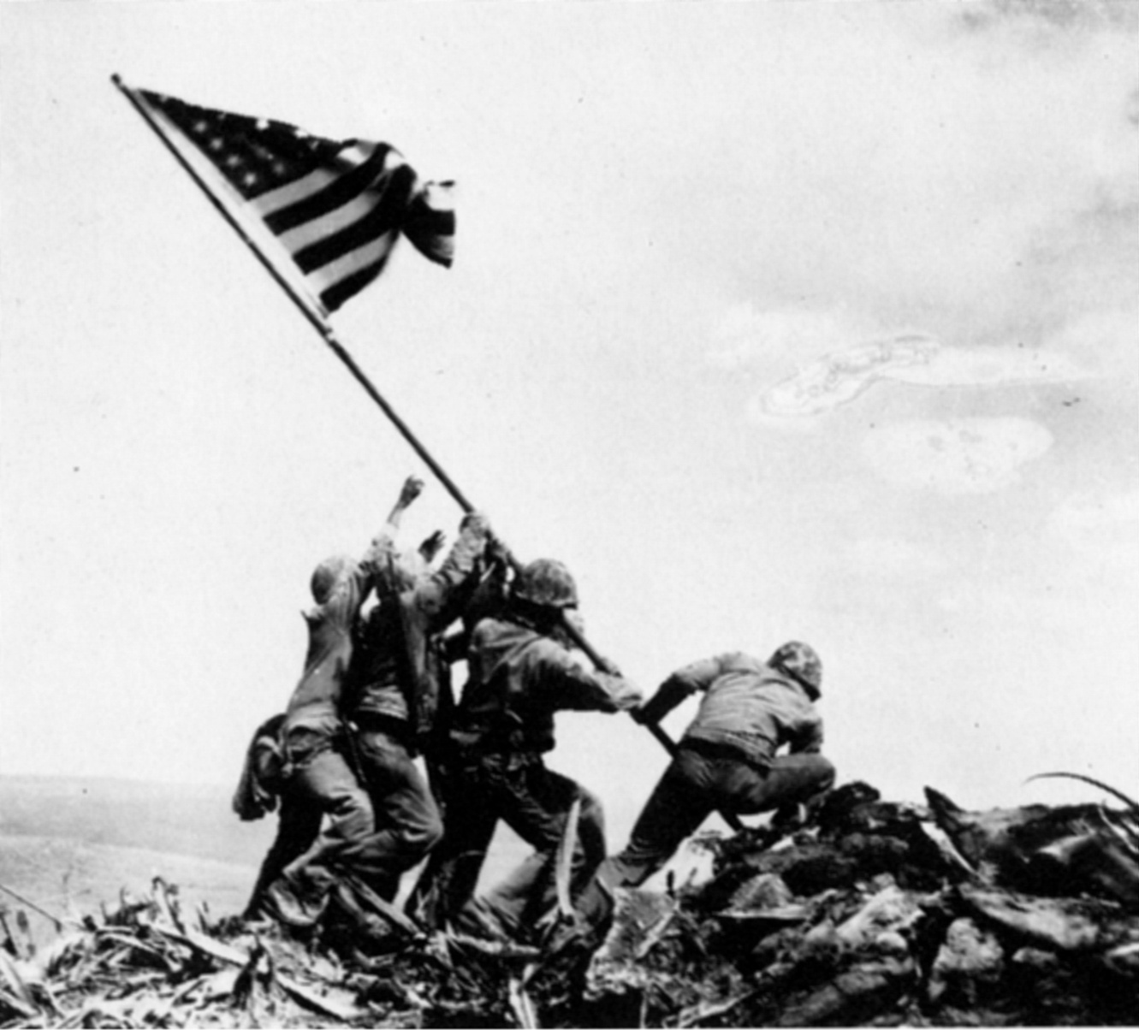
Iwo Jima
Feb./Mar. 1945
First Japanese “home-island” captured by the US
20,700 of the 22,000 Japanese soldiers on the island were killed; about 6800 of the 60,000 US Marines who landed on Iwo Jima were killed
Badly damaged Japanese morale; placed Japan within easy bombing range for US bombers

Slide 22
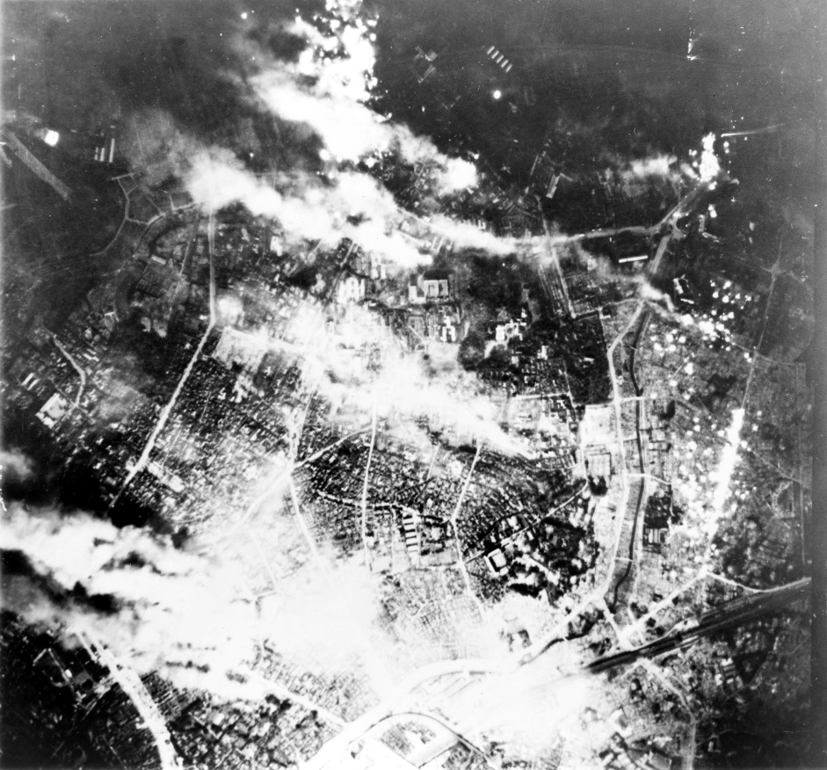
Firebombing of Japan
Mar. 9, 1945: firebombing of Tokyo killed over 80,000; by the war’s end, 67 Japanese cities had been destroyed using napalm
Gen. Curtis LeMay ordered the use of napalm (jellied gasoline) bombs on Japanese cities because his bombers were having trouble hitting their targets
The napalm was designed to start massive fires, which would ensure the destruction of the desired military targets, but would also lead to heavy losses of civilian life

Slide 23
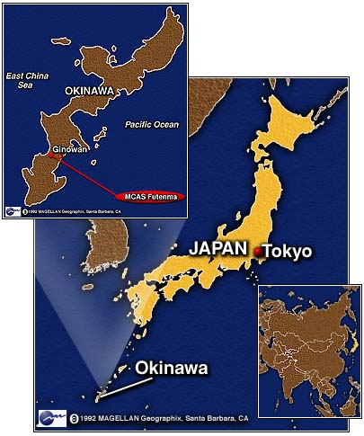
Battle of Okinawa
Apr.-June 1945
Most brutal battle of the Pacific war: about 125,000 Japanese killed and 12,500 Americans
Nearly 700,000 men fought in this battle (550,000 Americans)
Okinawa was needed to set up a base of operations for an invasion of Japan itself

Slide 24
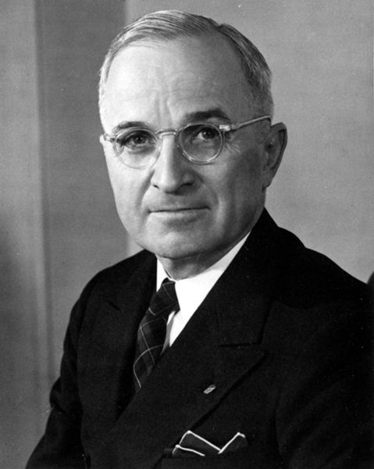
Harry S. Truman
1945 - 1953 (D)
Became president upon FDR’s death on April 12, 1945
VE Day-May 8, 1945
Truman now had to decide how to end the war – should the US mount an invasion of Japan, which would cost an estimated 1 million American lives or should it use the new atomic bomb, which would kill an unknown number of Japanese civilians and whose after-effects were still unknown?

Slide 25
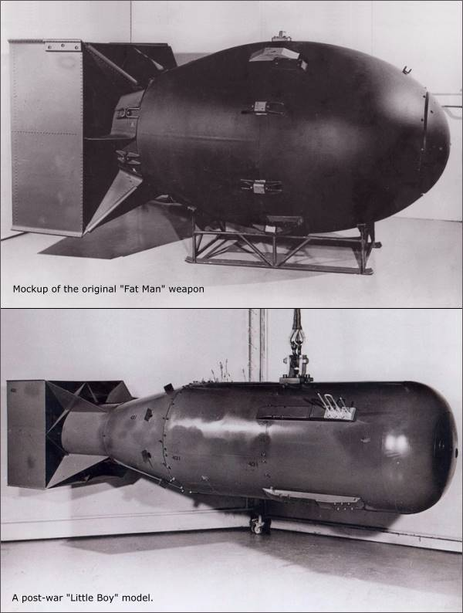
The Manhattan Project
US effort to build a new type of weapon that would unleash tremendous destructive energy by splitting uranium atoms – an “atomic bomb”
Led by Gen. Leslie Groves and researcher J. Robert Oppenheimer, the team produced 3 bombs
1 bomb was tested in the New Mexico desert (Los Alamos), leaving just 2 bombs for military use
Bombs were code-named “Fat Man” and “Little Boy”

Slide 26
Truman’s Options
continue conventional bombing of Japanese cities
invade Japan
demonstrate the bomb on an unpopulated island
drop the bomb on an inhabited Japanese city

Slide 27
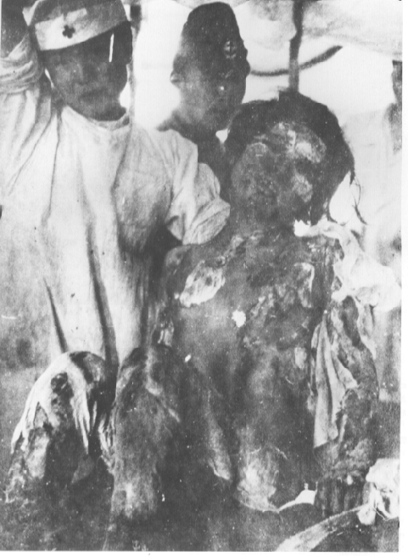
Hiroshima
Japan was warned that unless they surrendered immediately and without conditions, they faced “prompt and utter destruction”
When the Japanese did not reply, orders were given to destroy the industrial city of Hiroshima
August 6, 1945: The B-29 Enola Gay dropped “Little Boy” on the city, destroying 76,000 buildings and killing over 120,000 people

Slide 28
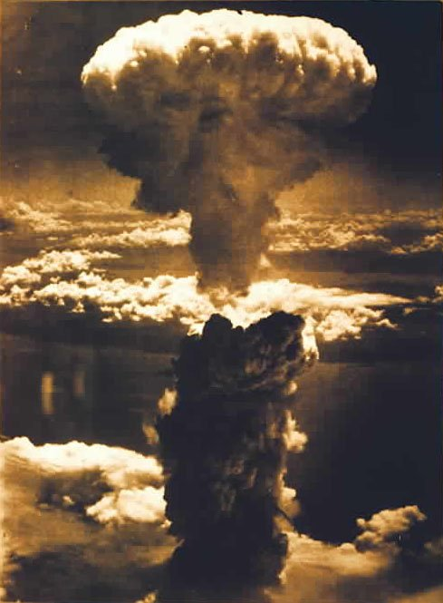
Nagasaki
When the Japanese still did not surrender, a B-29 bomber dropped “Fat Man” on the port of Nagasaki, killing over 50,000 on August 9, 1945
On the same day, the Soviets declared war on Japan and began to prepare to enter the war in the Pacific

Slide 29
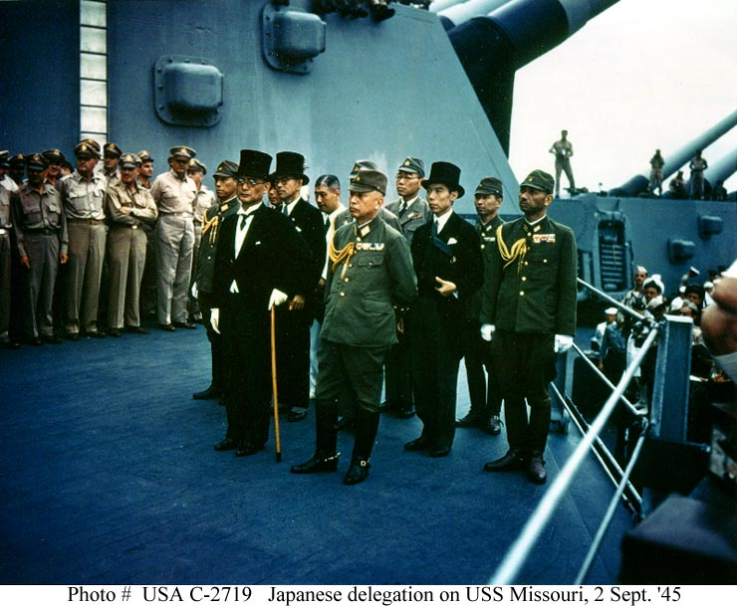
Japan Surrenders
Faced with destruction on an unforeseen scale (and unaware that the US had no more atomic bombs to use), Emperor Hirohito ordered his government to surrender unconditionally
Fighting stopped August 15, 1945 (“V-J Day”)
Formal surrender took place on September 2, 1945
As part of the terms of surrender, Japan was occupied by U.S. forces until Apr. 1952

Slide 30
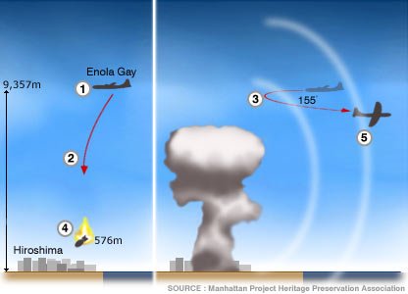
Notes:
http://newsimg.bbc.co.uk/media/images/40661000/jpg/_40661252_hirosh2_bmbdrp_inf416.jpg
0812 local time, 6 August 1945: 1. American B-29 bomber 'Enola Gay' approaches Hiroshima at an altitude of about 9,357 metres, and begins its bombing run 2. At 0815 it releases the atomic bomb 'Little Boy' 3. The aircraft then performs a sharp, 155 degree right turn and dives an estimated 518 metres 4. The bomb explodes with a force of 13 kilotons at a height of approximately 576 metres above the city 5. About a minute later the first shock wave, travelling at about 335 metres per second, hits the aircraft

Slide 31
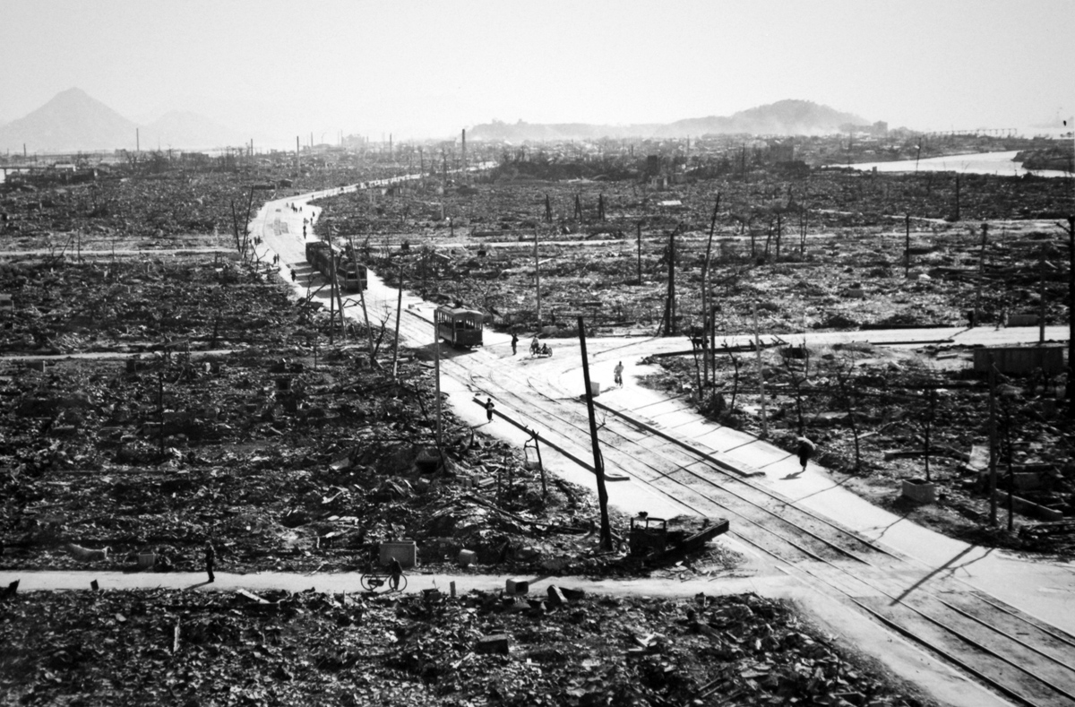

Slide 32
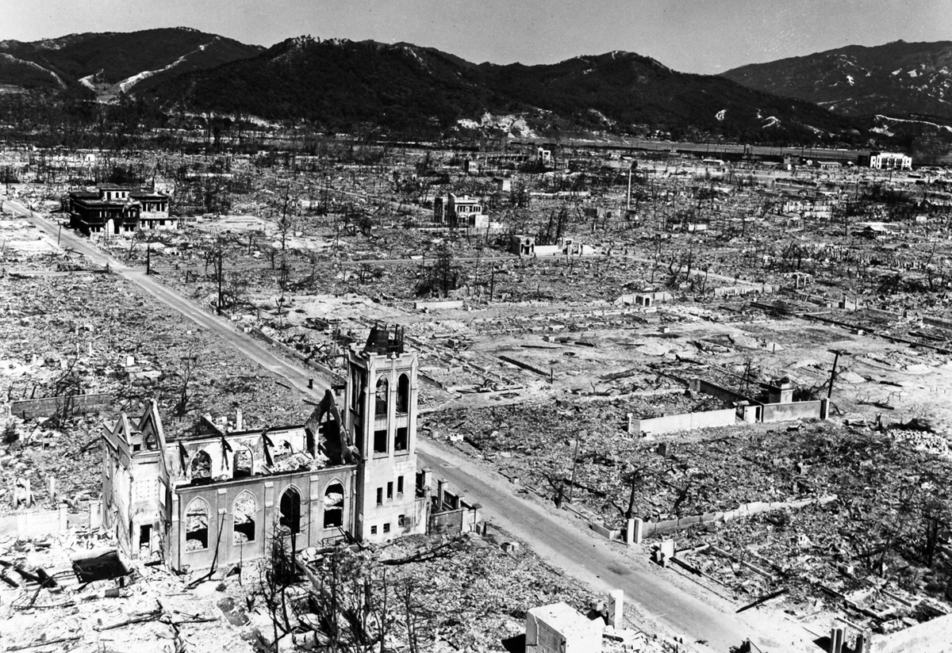

Slide 33
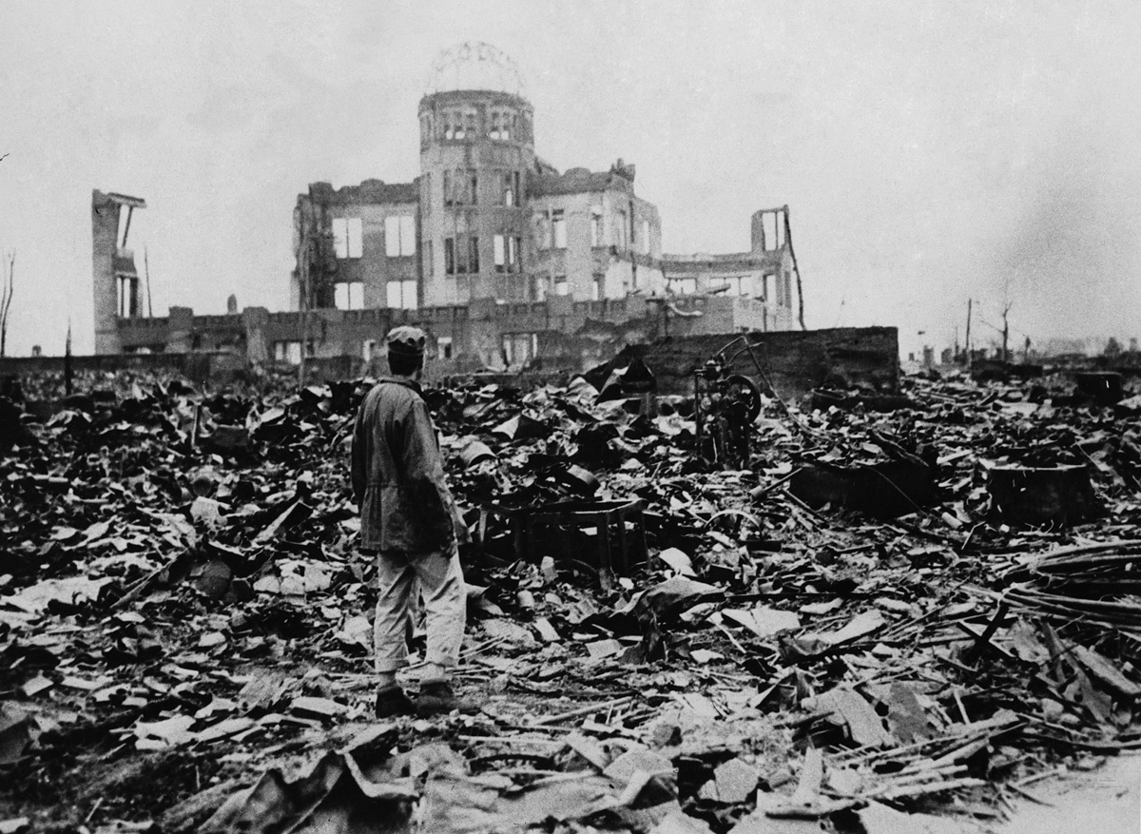

Slide 34
Research Assignment
Using the essential question as a guide review the following evidence to draw some conclusions.
National Park Service Website https://www.nps.gov/articles/trumanatomicbomb.htm
Pro/Con Seattle Times article
Google My Map Pacific Theater Battles Research

Slide 35
SAQ
Answer the following SAQ using the ACE strategy:
What do you think were the major factors influencing President Truman’s decision to use the atomic bomb effectively ending World War II?
Given the pros and cons of using the atomic bomb, and the options available to Truman do you feel he was justified in using the weapon to end World War II? Why or why not?
How will the use of the bomb potentially impact the development of the United States?

