Slide 1
The Frontier in America
Migration & Settlement of the West, 1865-1898

Slide 2
Bell Ringer-Frederick Jackson Turner
Historian Frederick Jackson Turner wrote an essay entitled “The Significance of the Frontier in American History” that was read at the World’s Columbian Exposition of 1893
Read the excerpted essay and answer the questions that follow.

Slide 3
Key Concept 6.2 The migrations that accompanied industrialization transformed both urban and rural areas of the United States and caused dramatic social and cultural change
Larger numbers of migrants moved to the West in search of land and economic opportunity, frequently provoking competition and violent conflict.
The building of transcontinental railroads, the discovery of mineral resources, and government policies promoted economic growth and created new communities and centers of commercial activity.
In hopes of achieving ideals of self-sufficiency and independence, migrants moved to both rural and boomtown areas of the West for opportunities, such as building the railroads, mining, farming, and ranching.
As migrant populations increased in number and the American bison population was decimated, competition for land and resources in the West among white settlers, American Indians, and Mexican Americans led to an increase in violent conflict.
The U.S. government violated treaties with American Indians and responded to resistance with military force, eventually confining American Indians to reservations and denying tribal sovereignty.
Many American Indians preserved their cultures and tribal identities despite government policies promoting assimilation, and they attempted to develop self-sustaining economic practices

Slide 4
Key Western Tensions
Vs.
- Buffalo Hunters - Railroads - U. S. Government
Native Americans
Vs.
Cattlemen
Sheep Herders
Vs.
Farmers
Ranchers
Ethnic Minorities
Vs.
Nativists
- Big Business Interests [mining, timber] - Local Govt. Officials - Farmers - Buffalo Hunters
Vs.
Environmentalists
Lawlessness of the Frontier
Vs.
“Civilizing” Forces

Slide 5
Settlement of the West Historical Perspective
Perspective #1
“…the settlement of the West beyond the Mississippi River constitutes a colorful drama of determined pioneers and two-fisted gunslingers overcoming all obstacles to secure their visions of freedom and opportunity amid the region’s awesome vastness.”
Perspective #2
“…the colonization of the Far West was a tragedy of shortsighted greed and irresponsible behavior, a story of reckless exploitation that scarred the land, decimated its wildlife, and nearly exterminated the culture of Native Americans”.
Tindall, George B. & Shi, David E., America-A Narrative History, 2004

Slide 6
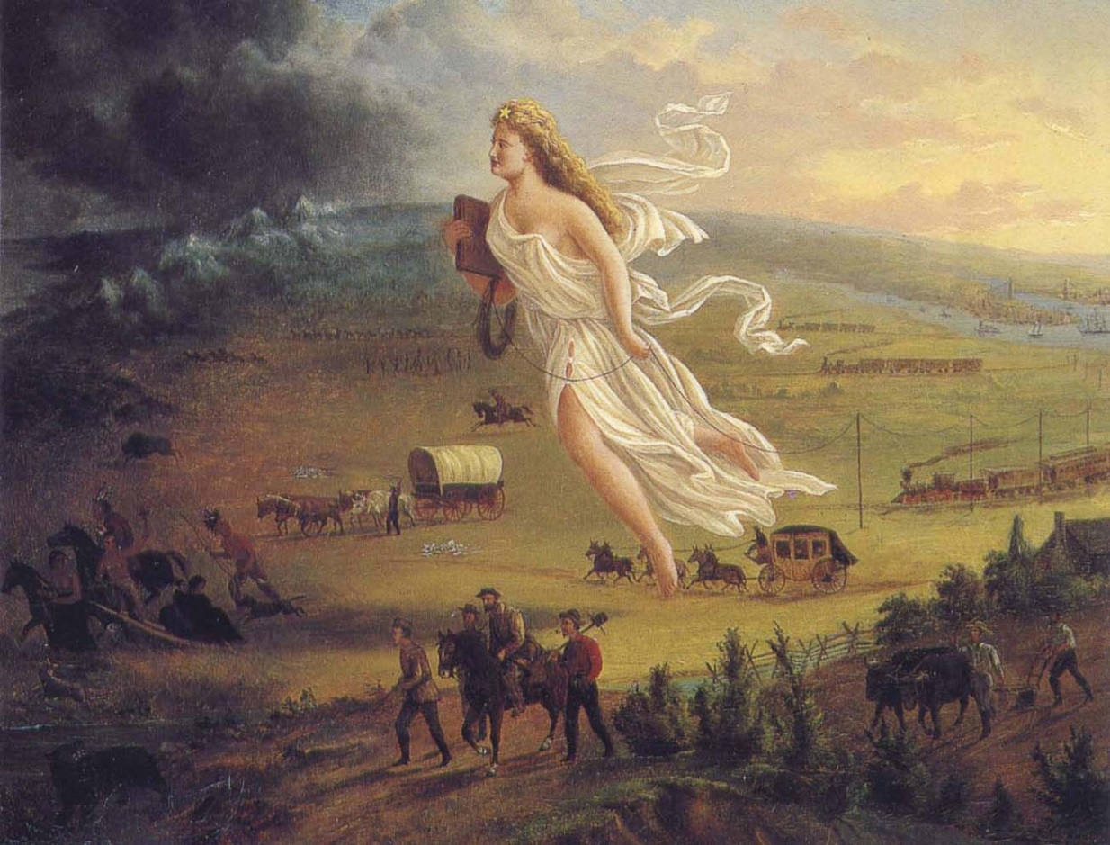
Western Frontier
It took 250 years (from the settlement of Jamestown until 1870) to turn 400 million acres of forests and prairies into farms.
Settling the second 400 million acres took only 30 years (from 1870-1900)
Why?
Mining of Gold and Silver
New technology and industry
Federal Land policy

Slide 7
A. Mining of Gold and Silver
Miners hoped to strike it rich; others sought fortune by supplying the needs of miners (food, clothing, tools)
Effects of gold or silver discovery
As word spread, people poured into a mining area (Pikes Peak in Colorado, Carson River Valley in Nevada)
Mining camps could be replaced by more permanent communities
Some of these communities were “boomtowns” (Leadville, Colorado and Nevada City, Montana)
Other cities (Denver, Colorado; Boise, Idaho) diversified economically and grew
Lawless societies that had to find means of control (vigilantes, marshals, sheriffs)

Slide 8
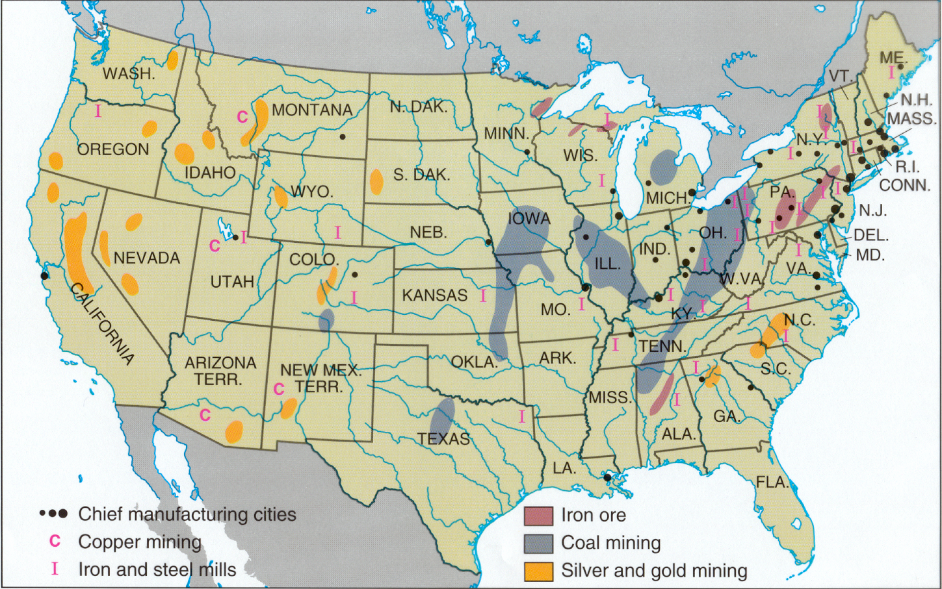
Mining Centers: 1900

Slide 9
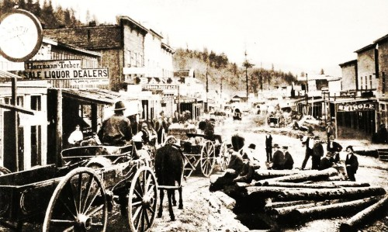
Deadwood, SD
Gold mining town on former Sioux land

Slide 10
A. Mining of Gold and Silver
What were the two phases of mining?
Individuals extracting minerals from surface soil and streambeds
Big companies who had the capital to build mine shafts and extract minerals below the earth’s surface (use of pressurized water to help separate minerals from silt)
Led to political and environmental issues on the use of water (a limited resource) out west; demonstrated federal government’s support for large companies (selling inexpensive land to mining companies and granting of patents for new inventions)

Slide 11
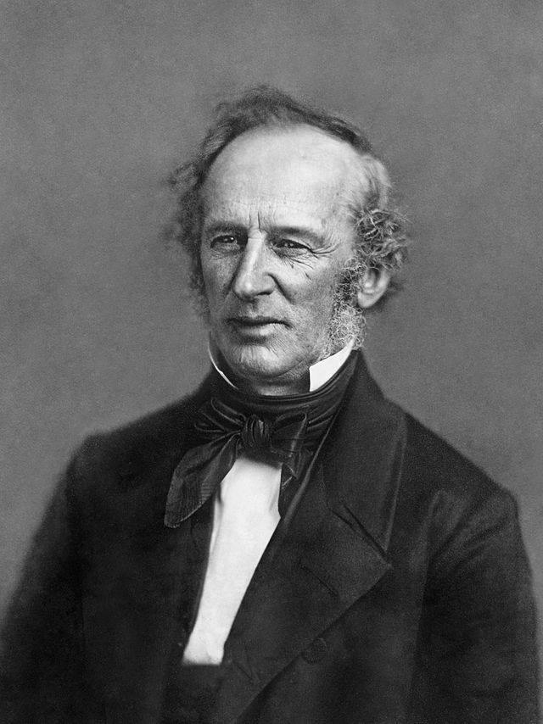
B. New Technology and Industry 1. Railroads open the West
Railroads were the nation’s first big business
It was the first to attract market investment
It was the first industry to develop a large scale management bureaucracy
Railroads connected raw materials to factories and markets, creating a national market for the nation’s goods and produce.
Railroads themselves were gigantic markets for iron, steel, lumber and other capital
Cornelius Vanderbilt, “The Commodore”

Slide 12
B. New Technology and Industry 1. Railroads open the West
From 1850 to 1871, the federal government made huge land grants to the railroads—170 million acres, worth half a billion dollars—for laying track in the West
Pacific Railway Act of 1862--authorized a north-central line to be built jointly by the Union Pacific westward from Omaha and the Central Pacific eastward from Sacramento.
The Union Pacific and Central Pacific railroad companies received 10 square miles of public land for every mile of track laid in a state; and 20 square miles in a territory

Slide 13
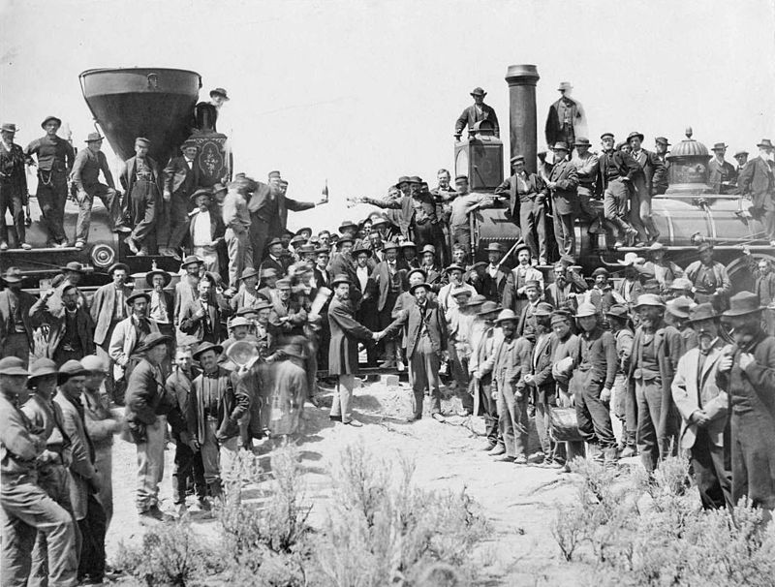
Both companies reached Promontory Point, Utah by the Spring of 1869; On May 10, 1869 Leland Stanford, governor of California and one of the organizers of the Central Pacific, drove a gold spike to symbolize the completion of the first transcontinental railroad.
Notes:
The ceremony for the driving of the golden spike at Promontory Summit, Utah on May 10, 1869; completion of the First Transcontinental Railroad. At center left, Samuel S. Montague, Central Pacific Railroad, shakes hands with Grenville M. Dodge, Union Pacific Railroad (center right).

Slide 14
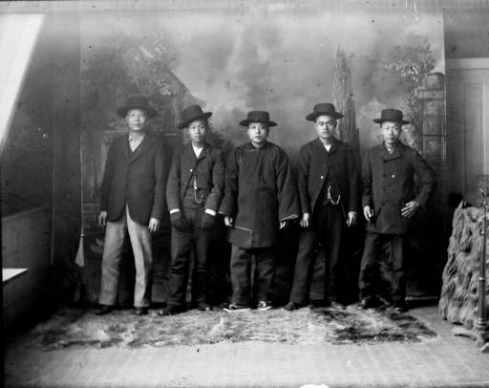
B. New Technology and Industry 1. Railroads open the West
Workers included Civil War Veterans, Irish and Chinese Immigrants, African Americans and Mexican Americans
Work crews had to cope with brutal weather, bad roads, water shortages and Indian attacks
1000s of Chinese men migrated raising numbers in U.S. from 7500 in 1850 to 105,000 in 1880. By 1867 Chinese laborers represented 90% of Union Pacific workforce

Slide 15
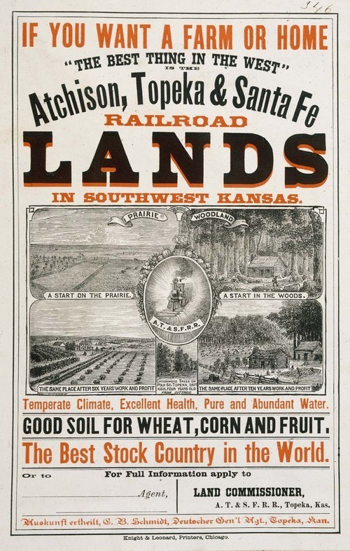
B. New Technology and Industry 1. Railroads open the West
Railroad companies sold off land to farmers for 2-10 dollars an acre
Railroad companies sent agents to Europe to recruit buyers: By 1880, 44% of settlers in Nebraska and 70% in Minnesota and Wisconsin were immigrants
Farms, ranches and towns sprouted up along rail lines

Slide 16
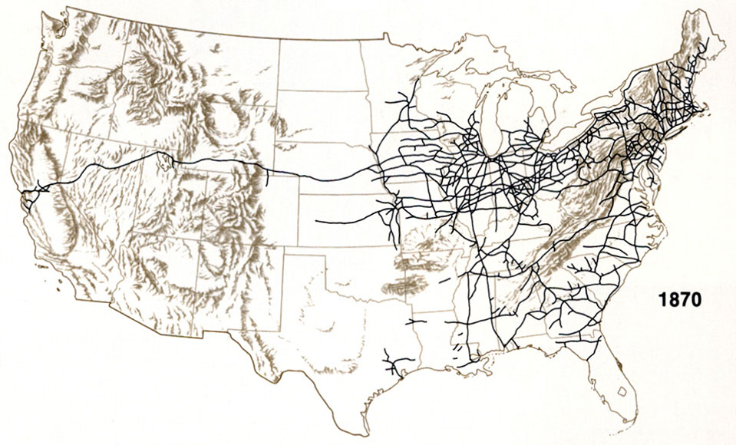
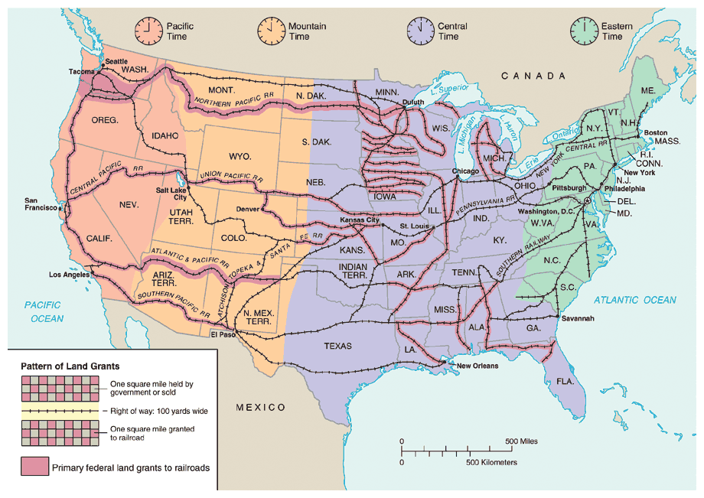
Railroad Construction

Slide 17
Activity: The Pacific Railroad Question, 1867
Using your device access the following primary source on the Unit 6 Resource page: The Pacific Railroad Question, 1867
You will be assigned one of the following speeches on the transcontinental railroad:
Senator Cameron of Pennsylvania
Senator Trumbull of Illinois
Senator C.D. Hubbard of West Virginia
Senator John Creswell of Maryland
Senator G.S. Orth of Indiana
Senator Chandler of Michigan
Senator Yates of Illinois
Read your assigned speech and answer the following questions as you read:
What is the main idea of the speech? What evidence used by the Senator best supports this idea?
How does the transcontinental railroad offer a chance for the nation to “move on” from the devastation of the Civil War?
How does the senator use the growth of the railroad industry to define American progress?

Slide 18
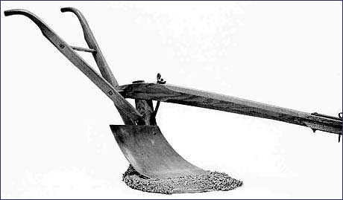
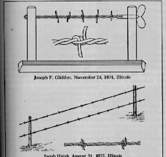
B. New Technologies and Industry 2. Inventions opened the West to settlement
1837, John Deere invented the steel plow
1847, Cyrus McCormick began the mass production of a reaping machine.
1874-Joseph Glidden’s Barbed Wire fenced in the land
1880 – Gustavus Swift-First effective Refrigerated Train Car in operation
Effects-
Mass market developed by 1880s, as farmers began to settle the Great Plains
By 1890 there were more than 900 manufacturers of farm equipment
In 1830 producing a bushel of grain took about 180 minutes; by 1900 it took only 10 minutes; grain could now be made available to wider markets

Slide 19
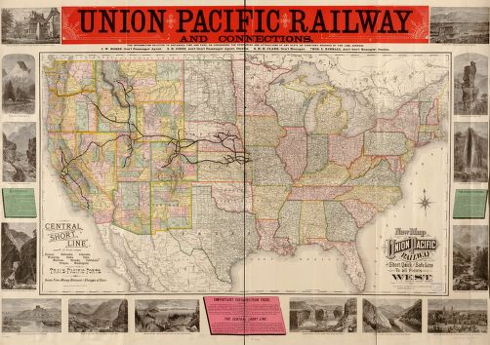
C. Federal Land Policy 1. Pacific Railway Act of 1862
From 1850 to 1871, the federal government made huge land grants to the railroads—170 million acres, worth half a billion dollars—for laying track in the West
Pacific Railway Act of 1862--authorized a north-central line to be built jointly by the Union Pacific westward from Omaha and the Central Pacific eastward from Sacramento.
The Union Pacific and Central Pacific railroad companies received 10 square miles of public land for every mile of track laid in a state; and 20 square miles in a territory

Slide 20
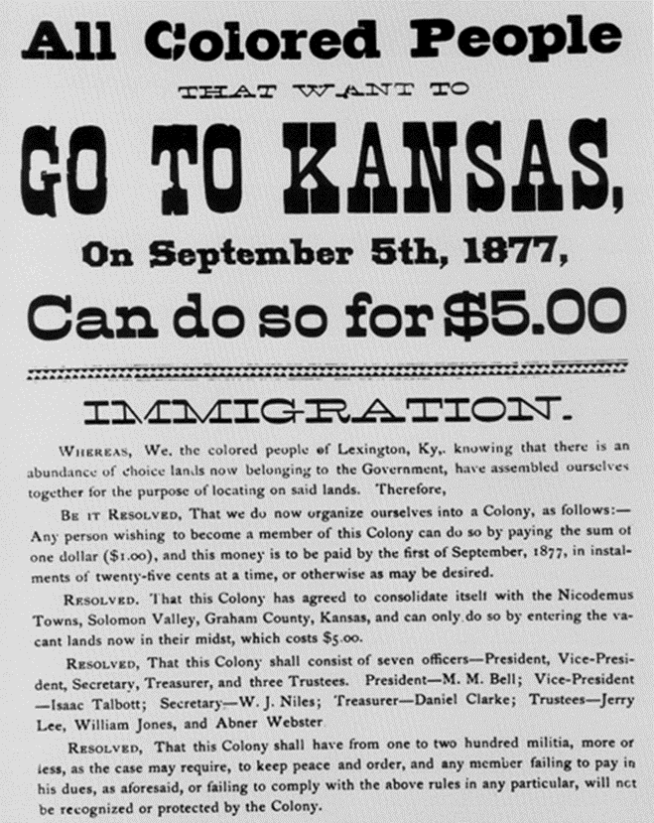
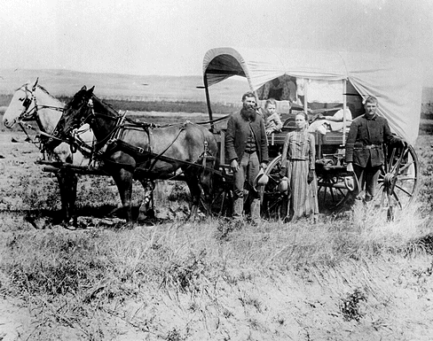
C. Federal Land Policy 2. Homestead Act of 1862
1862- Congress passed the Homestead Act; offered 160 acres of land free to any citizen or intended citizen who was head of the household
From 1862-1900, up to 600,000 families took advantage of this policy
After passage of the Homestead Act a former slave named Benjamin “Pap” Singleton began urging blacks to form their own independent communities in the West.
Several thousand of these “Exodusters” moved from post Reconstruction South to Kansas

Slide 21
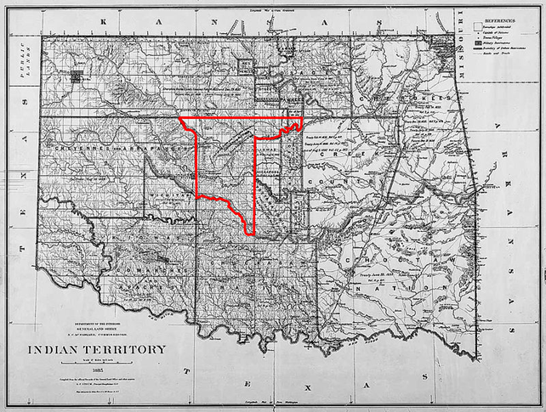
C. Federal Land Policy 2. Homestead Act of 1862
1889-major land giveaway in Oklahoma territory attracted thousands. In less than one day land hungry settlers claimed 2 million acres of land. Some took possession of the land before it was officially declared open by the government (Sooners)

Slide 22
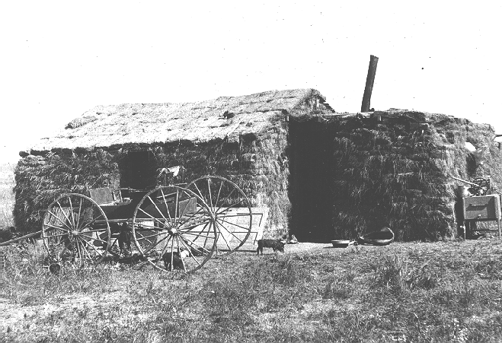
C. Federal Land Policy 2. Homestead Act of 1862
Homesteaders: frontier people who settled on free land
Faced extreme hardships-droughts, floods, fires, blizzards, locust plagues and raids by outlaws and Native Americans
However number of people living west of the Mississippi River grew from 1 percent of the nation’s population in 1850 to 30% by 1900.

Slide 23
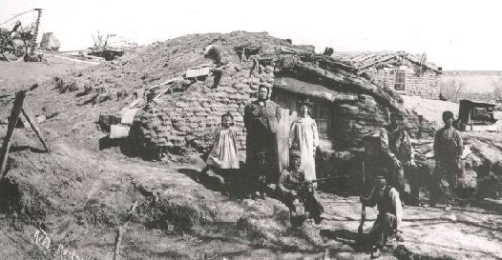
Settlers had to provide shelter for themselves before they could even begin to prepare their land for farming.

Slide 24
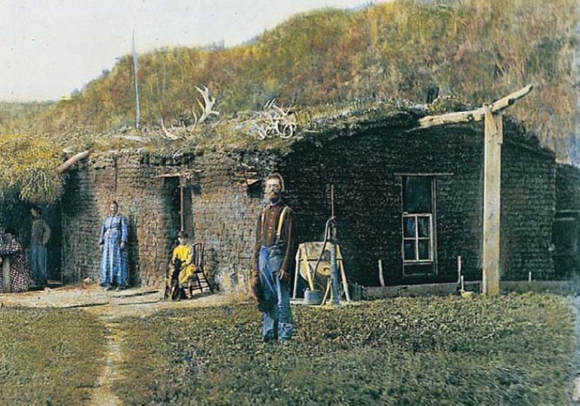

Slide 25
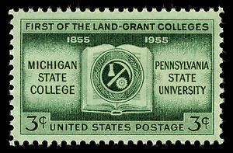
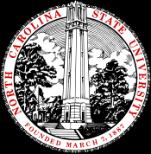
C. Federal Land Policy 3. Morrill Act of 1862
Federal government supported farmers in the west and south by financing agricultural education
Morrill Act of 1862 gave federal land to states to help finance agricultural colleges;
agricultural researchers developed grains for arid soil and techniques for dry farming, which helped the land to retain moisture. Innovations helped the dry eastern plains to become “the breadbasket of the nation”.

Slide 26
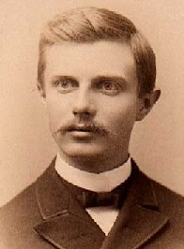
Closing of the Frontier
By 1890 individuals had purchased nearly 19 million acres of government owned land
The census that year declared that the frontier no longer existed.
1893 essay by historian Frederick Jackson Turner, “The Significance of the Frontier in American History”

