Slide 1
New Frontiers in America
Migration & Settlement of the West, 1865-1900

Slide 2
KWL Homework
What do you know about the West and westward migration in American history?
What would you like or want to know about the West and westward migration in American History?
Know | Want | Learned

Slide 3
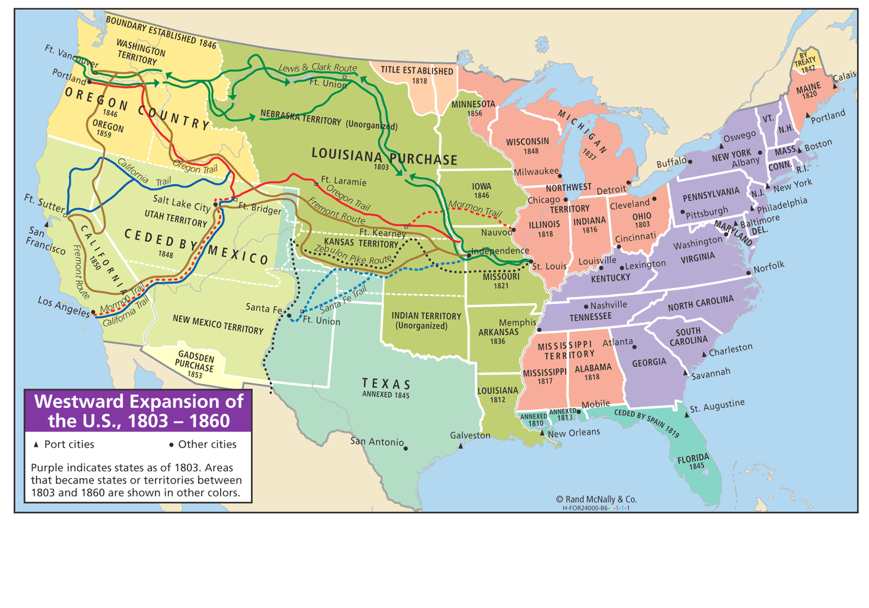
What caused individuals or groups to migrate westward before the Civil War?

Slide 4
Unit 1 Big Ideas
Students will understand that
A variety of economic, cultural, and political factors motivated people to migrate westward during the latter part of the 19th Century.
Essential Question:
What caused individuals or groups to migrate westward between 1865 and 1900?

Slide 5
Settlement of the West Historical Perspective
Perspective #1
“…the settlement of the West beyond the Mississippi River constitutes a colorful drama of determined pioneers and two-fisted gunslingers overcoming all obstacles to secure their visions of freedom and opportunity amid the region’s awesome vastness.”
Perspective #2
“…the colonization of the Far West was a tragedy of shortsighted greed and irresponsible behavior, a story of reckless exploitation that scarred the land, decimated its wildlife, and nearly exterminated the culture of Native Americans”.
Tindall, George B. & Shi, David E., America-A Narrative History, 2004

Slide 6
Perspective Activity
Which perspective do you think best represents the causes and effects of Westward Migration? Why?

Slide 7
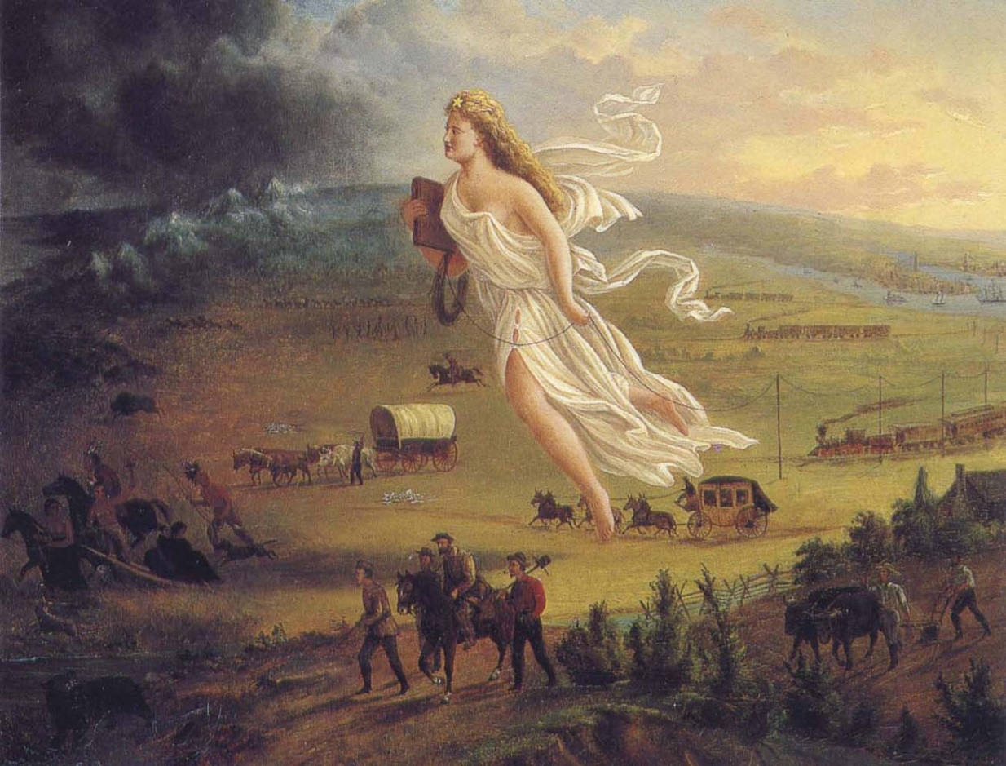
Western Frontier
It took 250 years (from the settlement of Jamestown until 1870) to turn 400 million acres of forests and prairies into farms.
Settling the second 400 million acres took only 30 years (from 1870-1900)
Why?
New technology and industry encouraged westward migration
Federal Land policy encouraged westward migration

Slide 8
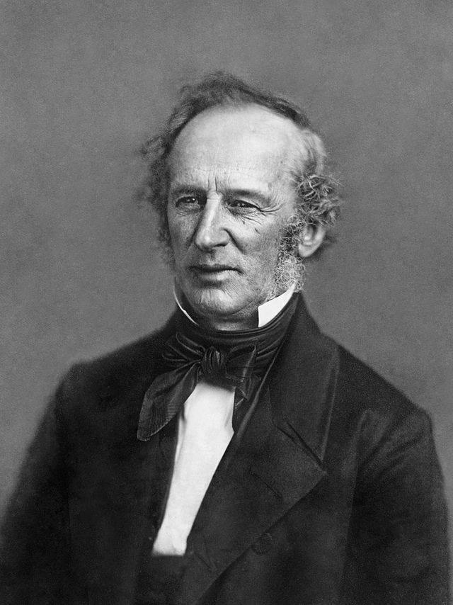
A. New Technology and Industry 1. Railroads open the West
Railroads were the nation’s first big business, the first magnet for great financial market investment, and the first industry to develop a large scale management bureaucracy
Railroads opened the west, connected raw materials to factories and markets, creating a national market for the nation’s goods and produce.
Railroads themselves were gigantic markets for iron, steel, lumber and other capital
Cornelius Vanderbilt, “The Commodore”

Slide 9
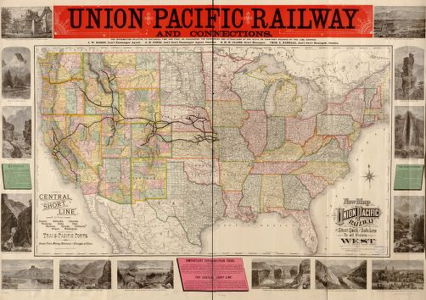
A. New Technology and Industry 1. Railroads open the West
From 1850 to 1871, the federal government made huge land grants to the railroads—170 million acres, worth half a billion dollars—for laying track in the West
Pacific Railway Act of 1862--authorized a north-central line to be built jointly by the Union Pacific westward from Omaha and the Central Pacific eastward from Sacramento.
The Union Pacific and Central Pacific railroad companies received 10 square miles of public land for every mile of track laid in a state; and 20 square miles in a territory

Slide 10
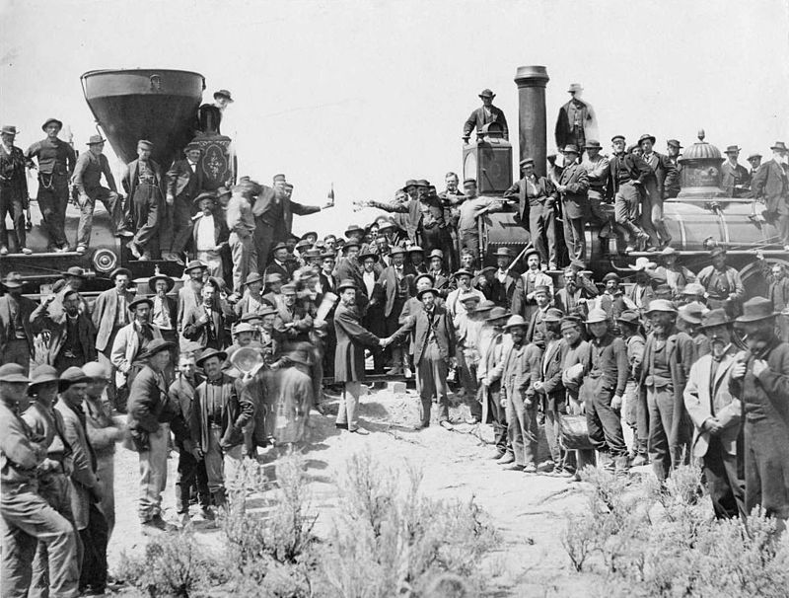
Both companies reached Promontory Point, Utah by the Spring of 1869; On May 10, 1869 Leland Stanford, governor of California and one of the organizers of the Central Pacific, drove a gold spike to symbolize the completion of the first transcontinental railroad.
Notes:
The ceremony for the driving of the golden spike at Promontory Summit, Utah on May 10, 1869; completion of the First Transcontinental Railroad. At center left, Samuel S. Montague, Central Pacific Railroad, shakes hands with Grenville M. Dodge, Union Pacific Railroad (center right).

Slide 11
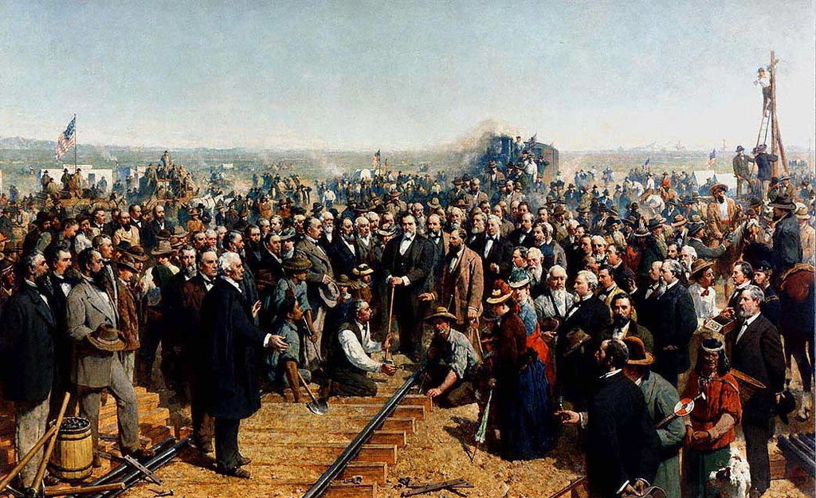
Notes:
"The Last Spike" by Thomas Hill (1881) depicting the ceremony of the driving of the "Last Spike" at Promontory Summit, UT, on May 10, 1869, joining the rails of the Central Pacific Railroad and the Union Pacific Railroad. This is an image of a painting by Thomas Hilldated 1881 which is in the public domain. Slavish images of public domain items, such as 19th century paintings, cannot be copyrighted. See The Bridgeman Art Library, LTD. Plaintiff, v. Corel Corporation, et ano, Defendents.

Slide 12
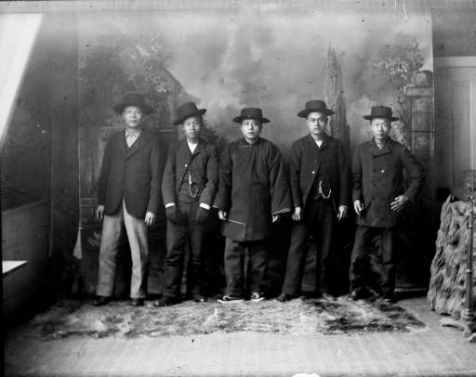
A. New Technology and Industry 1. Railroads open the West
Workers included Civil War Veterans, Irish and Chinese Immigrants, African Americans and Mexican Americans
Work crews had to cope with brutal weather, bad roads, water shortages and Indian attacks
1000s of Chinese men migrated raising numbers in U.S. from 7500 in 1850 to 105,000 in 1880. By 1867 Chinese laborers represented 90% of Union Pacific workforce

Slide 13
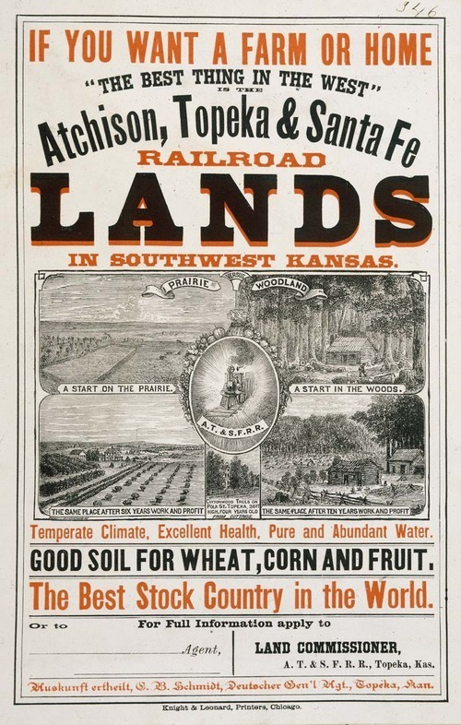
A. New Technology and Industry 1. Railroads open the West
Railroad companies sold off land to farmers for 2-10 dollars an acre
Railroad companies sent agents to Europe to recruit buyers: By 1880, 44% of settlers in Nebraska and 70% in Minnesota and Wisconsin were immigrants
Farms, ranches and towns sprouted up along rail lines

Slide 14
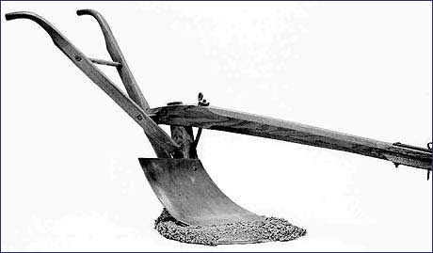
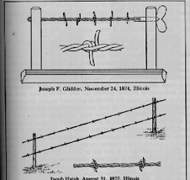
A. New Technologies and Industry 2. Inventions opened the West to settlement
1837, John Deere invented the steel plow
1847, Cyrus McCormick began the mass production of a reaping machine.
Mass market didn’t develop until 1880s, as farmers began to settle the Great Plains
Other inventions—Barbed Wire (1874) fenced in the land; Corn binder (1878)
Effects-By 1890 there were more than 900 manufacturers of farm equipment
In 1830 producing a bushel of grain took about 180 minutes; by 1900 it took only 10 minutes; grain could now be made available to wider markets

Slide 15
B. Federal Land Policy 1. Pacific Railway Act of 1862
From 1850 to 1871, the federal government made huge land grants to the railroads—170 million acres, worth half a billion dollars—for laying track in the West
Pacific Railway Act of 1862--authorized a north-central line to be built jointly by the Union Pacific westward from Omaha and the Central Pacific eastward from Sacramento.
The Union Pacific and Central Pacific railroad companies received 10 square miles of public land for every mile of track laid in a state; and 20 square miles in a territory

Slide 16
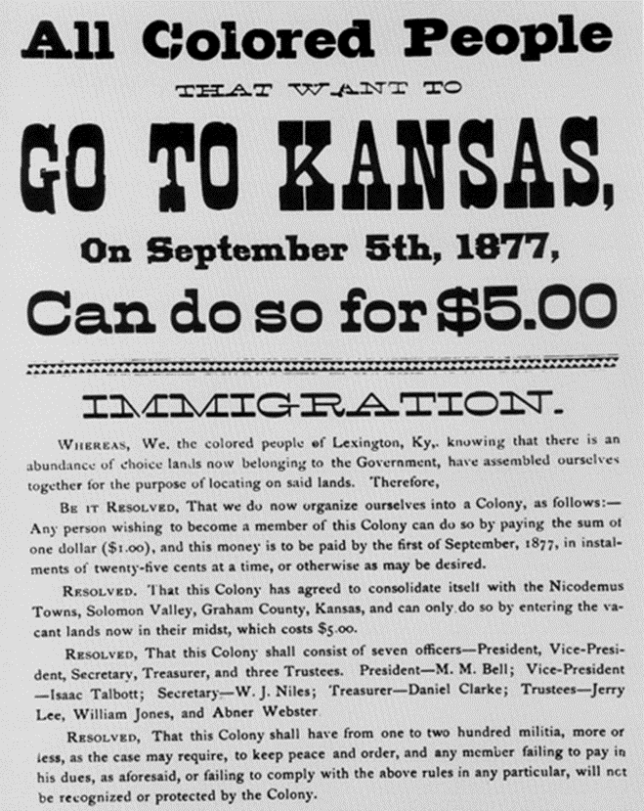
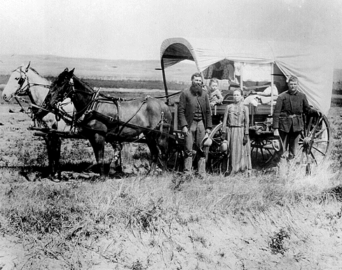
B. Federal Land Policy 2. Homestead Act of 1862
1862- Congress passed the Homestead Act; offered 160 acres of land free to any citizen or intended citizen who was head of the household
From 1862-1900, up to 600,000 families took advantage of this policy
After passage of the Homestead Act a former slave named Benjamin “Pap” Singleton began urging blacks to form their own independent communities in the West.
Several thousand of these “Exodusters” moved from post Reconstruction South to Kansas

Slide 17
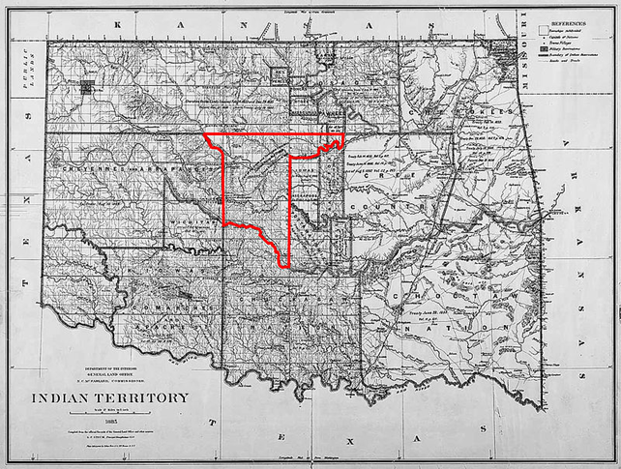
B. Federal Land Policy 2. Homestead Act of 1862
1889-major land giveaway in Oklahoma territory attracted thousands. In less than one day land hungry settlers claimed 2 million acres of land. Some took possession of the land before it was officially declared open by the government (Sooners)

Slide 18
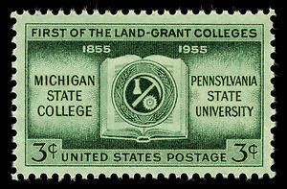
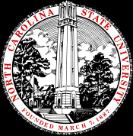
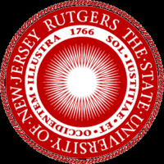
B. Federal Land Policy 3. Morrill Act of 1862
Federal government supported farmers in the west and south by financing agricultural education
Morrill Act of 1862 gave federal land to states to help finance agricultural colleges;
agricultural researchers developed grains for arid soil and techniques for dry farming, which helped the land to retain moisture. Innovations helped the dry eastern plains to become “the breadbasket of the nation”.

Slide 19
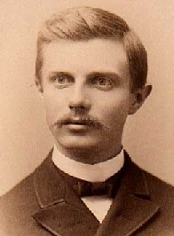
Closing of the Frontier
By 1890 individuals had purchased nearly 19 million acres of government owned land
The census that year declared that the frontier no longer existed.
1893 essay by historian Frederick Jackson Turner, “The Significance of the Frontier in American History”

Slide 20
The Pacific Railroad Question, 1867
Read your assigned speech.
Answer the following questions as you read:
What is the main idea of the speech? What evidence used by the Senator best supports this idea?
How does the transcontinental railroad offer a chance for the nation to “move on” from the devastation of the Civil War?
How does the senator use the growth of the railroad industry to define American progress?

Slide 21
Identifications
There is a specific way that you need to define terms in American History II. These definitions would be part of your homework’s guided reading assignments or on a major assessment such as a quiz or unit test.
Use the rubric provided as a guideline to define, or identify, the following term that should be familiar to you from American History I:
Manifest Destiny

Slide 22
Manifest Destiny
A newspaper editor, John L. O’Sullivan first coined the phrase “Manifest Destiny” in an 1845 issue of the Democratic publication, The North American Review. In the paper, O’Sullivan attempted to rationalize the necessity of expanding westward by stating that Providence, or God, had blessed the development of our nation since the movement to colonize the original 13 British colonies; That only divine intervention could have granted Americans the ability to gain their independence and establish a government based upon the ideals of popular sovereignty, natural rights and individual freedoms. God wanted such a nation to continue to prosper.
Many individuals and groups had exhibited their belief in Manifest Destiny, by moving westward before the onset of the Civil War. Christian missionaries, such as Marcus and Narcissa Whitman used the Oregon trail to migrate with the purpose of converting Native Americans. Brigham Young led a great Mormon movement to the Great Salt Lake in order to avoid religious persecution. Gold hungry 49ers settled in California for an opportunity to strike it rich. Politicians, especially Democrats, used Manifest Destiny to justify the onset of the Mexican War. James K. Polk had a firm belief that in order for the nation to prosper economically and politically, Americans must be prepared to take Mexican territory.
Because of the possibility of war, the exploitation of Native Americans, and the expansion of slavery westward, Manifest Destiny created much debate leading up to the Civil War. The settlement of the 49th parallel as the northern border of the U.S. along with the Treaty of Guadalupe Hidalgo in 1848 and the Gadsden Purchase of 1853 would fulfill the continental Manifest Destiny of the U.S.
After the Civil War, government land policy and the development of new technology and industry such as the railroad would help settle the western frontier. By the end of the nineteenth century, Manifest Destiny would come to encompass even more.

