Slide 1
13 English Colonies
1607-1754

Slide 2
Key Concept 2.1: Europeans developed a variety of colonization and migration patterns, influenced by different imperial goals, cultures, and the varied North American environments where they settled, and they competed with each other and American Indians for resources.
II. In the 17th Century, early British colonies developed along the Atlantic coast, with regional differences that reflected various environmental, economic, cltral and demographic factors.
B. The New England colonies, initially settled by Puritans, developed around small towns with family farms and achieved a thriving mixed economy of agriculture and commerce

Slide 3
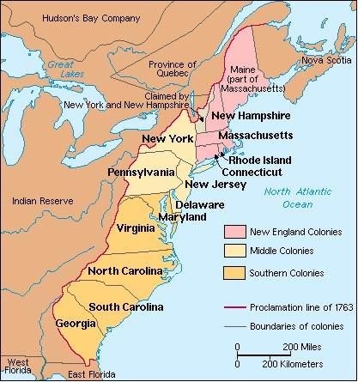

Slide 4
The New England Colonies
1607-1754

Slide 5
New England Colonies
No indentured servants as in the Chesapeake; mostly middle class families that could pay their own way across the Atlantic
Small farmers, merchants, seamen, fishermen
Attracted more women than the southern colonies
Soil less fertile than Chesapeake and growing season shorter
Healthier place to live; colder climate; settlers avoided infectious diseases that plagued southern colonies
Attracted 21,000 colonists in 17th Century compared with 120,000 Chesapeake Bay colonists; by 1700 New England had larger white population than Virginia and Maryland

Slide 6
New England
Originally intended to be self-governing religious utopias based on teachings of John Calvin; Pilgrims and Puritans who arrived in Massachusetts in the 1620s were on a divine mission to create a model Christian society
Puritans wanted to “purify” their churches of all Catholic and Anglican rituals and pass a code of laws and a government structure based upon biblical principles
Puritans wanted to limit church membership to saints (chosen by God for salvation), unlike Anglican church who allowed sinners
Sought to rid society of gambling, swearing, and breaking the Sabbath.
Wanted to be a model for England to emulate

Slide 7
Massachusetts
The earliest New England settlements-Plymouth and Massachusetts Bay-became one colony in 1691.

Slide 8
Plymouth
Settled by Pilgrims in 1620
Pilgrims were Separatists who left England because they thought that the Anglican Church (Church of England) had too many Catholic influences
Separatists demanded that each congregation govern itself rather than be ruled by bureaucracy of bishops and archbishops
Sailed for Virginia on the Mayflower but ship was blown off course to Cape Cod, just south of what became Boston
Before landing all 100 passengers agreed to the Mayflower Compact, which formed a church and bound them all to obey the decisions of the majority
Signers of the compact met at the General Court of Plymouth plantation
Led by Governor William Bradford
Like Jamestown, had to endure “starving time” of the first winter when half of the Pilgrims died
First Thanksgiving feast held in 1621 with the Wampanoag tribe

Slide 9
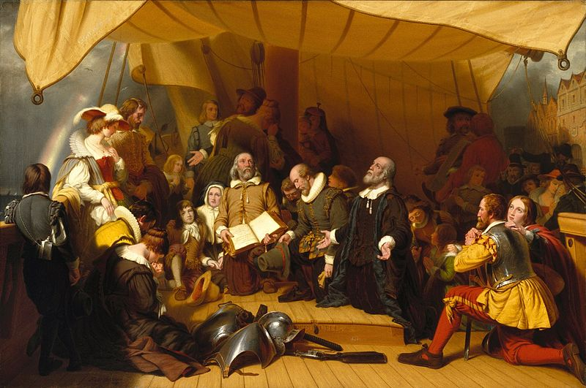
Plymouth
Robert Walter Weir, Embarkation of the Pilgrims, 1857

Slide 10
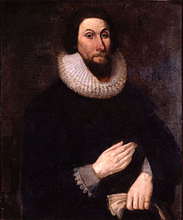
Massachusetts Bay
1629 several English Puritans led by John Winthrop received a royal charter for the Massachusetts Bay company
Charter did not say where the colony had to locate
Instead of organizing a business with the charter, Winthrop used it as a constitution to start a government

Slide 11
Massachusetts Bay
Company founded Salem, Boston, Charlestown and Cambridge
Towns organized around church congregations
Organized politics around the town meeting
About 13,000 settlers came to New England by 1641, most as families, which was unique

Slide 12
Massachusetts Bay
Winthrop wanted the colony to be a haven for Puritans who wanted to “purify” the church of England from within, not separate from it.
Hoped to create a “city upon a hill” to inspire
Colonial charter did not require that the joint-stock company maintain office in England, so the royal charter allowed government authority to be transferred to Massachusetts.
Puritan leaders controlled the government, church, and land in Massachusetts. They expelled anyone who disagreed (Baptists, Catholics, Quakers, Anglicans)

Slide 13
Puritans
Rhode Island grew from settlements founded in the 1630s by outspoken Puritans, Roger Williams and Anne Hutchinson. Their colony accepted religious freedom and separation of church and state
Connecticut grew from a settlement started by Thomas Hooker.

Slide 14
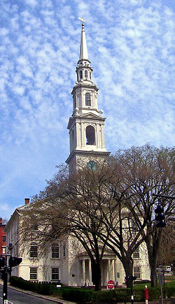
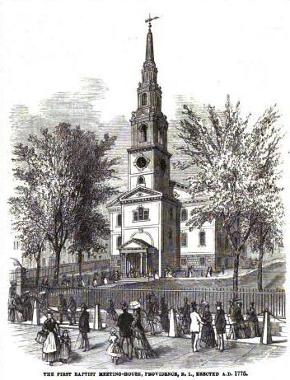
Roger Williams

Slide 15
New England
Had to trade to prosper; soil was to rocky to grow large crops
New England Colonies traded lumber, furs, and fish for English goods. During the 1700s, the trade routes of some merchants looked like triangles.
As trade and towns grew, the Puritan life gave way to an interest in making money.

Slide 16
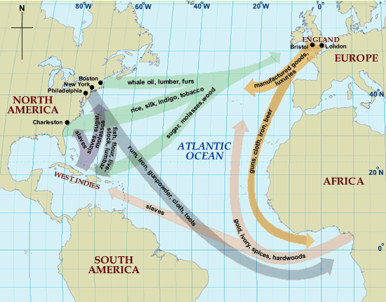

Slide 17
Triangular Trade
In this triangular trade, ships loaded with rum sailed to West Africa. Traders there bought the rum and sold enslaved African people.
The ships then sailed to the West Indies, where landowners bought enslaved Africans.
The ships returned to New England with unsold Africans and with sugarcane and molasses to make rum.
The voyage by Africans across the Atlantic was known as the Middle Passage

Slide 18
Works Cited
John M. Murrin, Liberty, Equality, Power: A History of the American People, Concise Edition, 6th Edition
George Brown Tindal & David Emory Shi. America-A Narrative History, W.W. Norton & Company, New York: 2016.

