Slide 1
Warm Up-The Monroe Doctrine
Complete an APPARTS sheet on the Monroe Doctrine
Significance: How did the Monroe Doctrine enable nationalism during the Era of Good Feelings?

Slide 2
Nationalism and “the era of good feelings”
Nationalism exerted a strong influence in the courts, foreign affairs, and westward expansion in the early 1800s.

Slide 3
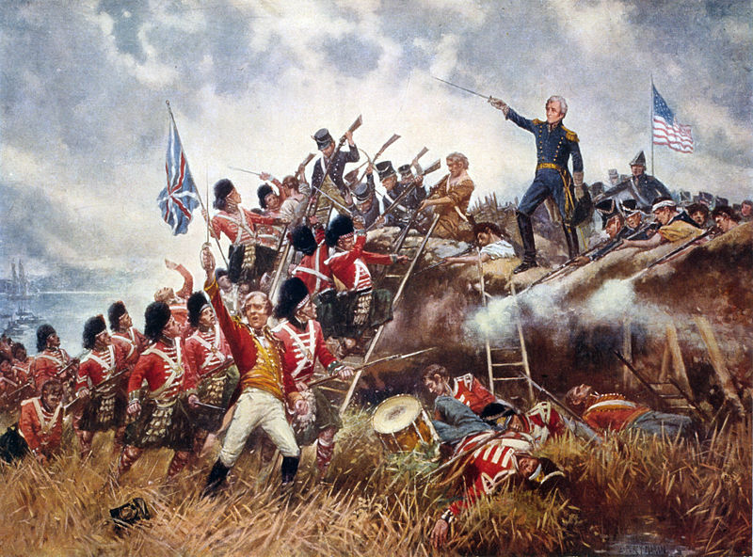
The War of 1812
Nationalism exerted a strong influence in the courts, foreign affairs, and westward expansion in the early 1800s.

Slide 4
Nationalism
Nationalism exerted a strong influence in the courts, foreign affairs, and westward expansion in the early 1800s.
The War of 1812 encouraged Nationalism.
The territorial boundaries of the United States were secure—defeat of Native Americans and the British.
Peace between the United States and Great Britain—beginning of a long partnership.
End of the Federalist Party—they had supported peace in December 1814 at the Hartford Convention.
America had survived “the second American revolution”—The U.S. Constitution and the federal government survived.
a new national identity—symbolism—“Star Spangled Banner”, “Uncle Sam”
new American hero—Andrew Jackson

Slide 5
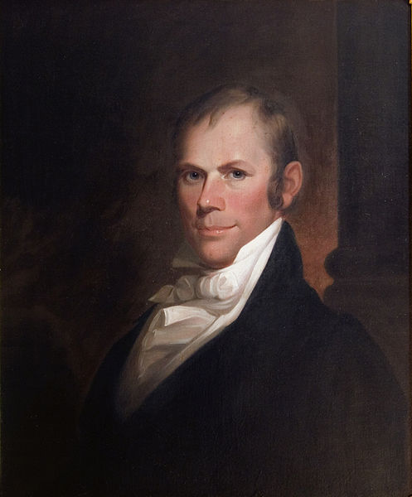
American System
As the North and South developed different economies politicians rallied behind an economic plan to unify the nation.
Speaker of the House, Henry Clay, promoted President James Madison’s plan to unify the nation as the American System
Develop transportation systems and other internal improvements
Establish a protective tariff
Establish a second national bank
The plan would allow an increasingly industrial North to produce manufactured goods that farmers in the South and West could buy
While the South and West would produce most of the grain, meat and cotton needed in the North
By sustaining each other, we could be economically independent from Britain and the rest of Europe

Slide 6
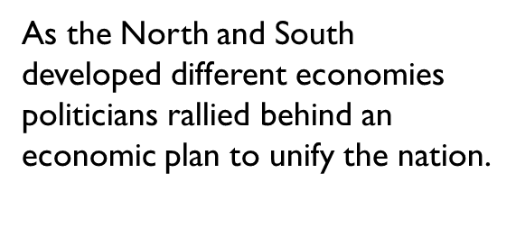
National Road
After the War of 1812, Americans went on a road building frenzy
Private investors, states and the federal government built private roads called turnpikes; charged tolls to offset costs of maintenance
By 1815, New York had chartered 300 companies to build 5,000 miles of gravel roads
By 1818 U.S. government opened the “National Road” connecting the Potomac River at Cumberland Maryland with Wheeling (West) Virginia on the Ohio River
Road was best technology could offer, but fell into poor condition because of heavy traffic

Slide 7
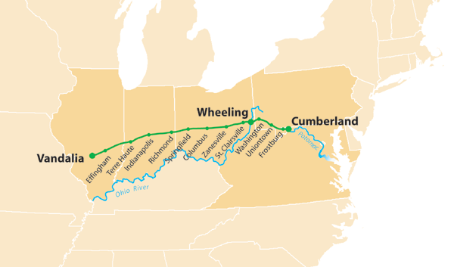

Slide 8
Erie Canal
In 1817 Governor DeWitt Clinton talked the NY state legislature into building a canal linking the Hudson River with Lake Erie
Would open a continuous water route between the Northwest and New York City
Built with the hands, backs and shovels of self-taught engineers and gangs of Irish immigrants, local farm boys and convict labor
Known as “Clinton’s Ditch”; it stretched 364 miles from Albany to Buffalo; Canal was 4 feet deep and 40 feet wide
Required a system of 83 locks and it passed over 18 rivers on stone aqueducts; enabled boats to travel 675 feet up and down from one end to the other
Construction began in 1819 and reached Buffalo by 1825
Clinton in a ceremony poured water from Lake Erie into the Atlantic Ocean when completed

Slide 9
Erie Canal
Once opened, traffic on the canal expanded quickly; western agricultural products moved eastward while manufactured goods and immigrants traveled westward
By replacing rough roads, transportation costs dropped drastically
Biggest impact on western NY: cities of Syracuse, Rochester and Buffalo grew out of farmland; New York City would become the greatest city in the nation
By 1834 9 boats passed through the locks of the canal each minute
NY gained $500,000 a year from tolls; by 1882 it had produced revenues of up to $121 million
More than 40,000 passengers traveled on the new waterway a year; settlers, tourists, salesmen and evangelical ministers
Started a canal boom lasting 20 years; Ohio and Pennsylvania led the nation in canal building
When construction began on Erie Canal there were fewer than 100 miles of canal in the U.S.; by 1840 there were 3,300 miles most of which were in the Northeast and Northwest

Slide 10
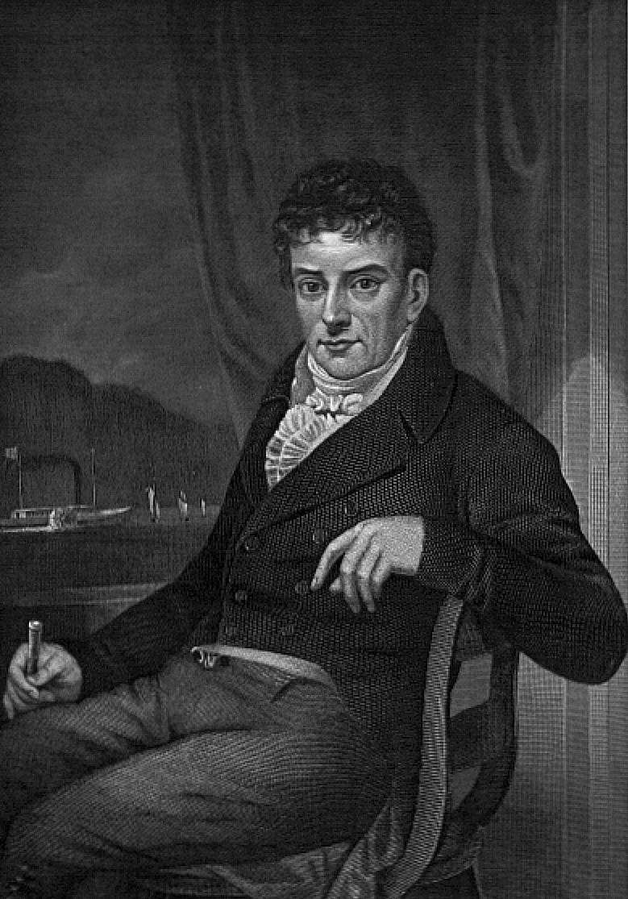
Steamboats
Canals reached only a limited part of the continent; rivers offered faster and cheaper travel; especially the Mississippi, Ohio and Missouri Rivers
But those who wanted to transport goods northward had to push boats against the current; sometimes with poles, sometimes with ropes held by crew that dragged the boats upstream; process took 3 or 4 months
Others sold craft for scrap and walked back home
Robert Fulton had developed steamboats in the Northeast in 1807 beginning with the Clermont; built one for the Mississippi by 1811
War of 1812 had slowed development of the steamboat because steam engines had to be shipped from England
By 1815 production resumed

Slide 11
Time and Money
Transportation revolution brought reduction in time and money it took to move heavy goods
Turnpikes cut cost of wagon transport in half from 1816-1860 (30 cents per ton/mile to 15 cents)
Erie Canal and Ohio canals reduced distance between East and West and carried goods at 1 cent per ton/mile
Overland route from Cincinnati to New York in 1815 took 52 days minimum; by the 1840s an all water route from Cincinnati to New York City would be 18 days.
In 1817 the journey from New Orleans to Louisville by steamboat took 25 days; by 1819 it took 14 days

Slide 12
Erie Canal Video
Erie Canal
Guided Questions
How did DeWitt Clinton get the Erie Canal built?
Historian Peter Bernstein said that “the Erie Canal was the marvel of its age”. What made it such a marvel?

Slide 13
The American System
STEP 2: A tariff (a tax on imported goods)
Made European goods more expensive
Encouraged Americans to buy cheaper products made in America
Made the country money, used for national improvements
Developments include…
1816- President James Madison proposes a tariff that would tax all imported foreign goods.
The proposed tariff would help the American manufacturing economy become more competitive with the foreign markets,
The north encouraged the tariff because it would improve their economy and increase total profits.
The south and west discouraged the tariff because they would have to pay more for the same products.

Slide 14
Step 3: A National Bank
Stabilize/ strengthen the currency and control risky banks
Developments include…
1816- The Second Bank of the United States (BUS) was approved for a 20-year term by the Congress.
The bank charter would establish a national, guaranteed currency, that would improve national and regional trading of goods and services.
The national bank idea had been revived from the presidency of George Washington, and had become vastly popular among all regions of the country.
1816- James Monroe (VA) is elected US President.
Begins a new presidency, “Era of Good Feelings!”

Slide 15
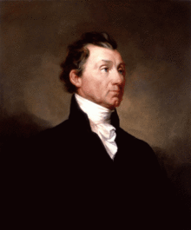
James Monroe (Republican) 1817-1825
Last president from the generation of founding fathers
Last president of the Virginia dynasty
Had negotiated the Louisiana Purchase as a minister to France
Had served as president Madison’s Secretary of State and Secretary of War during the War of 1812
Grounded in Republican ideas: Jefferson said “his soul, if turned inside out, would be spotless”

Slide 16
James Monroe (Republican) 1817-1825
Surrounded himself as president with good people: John Quincy Adams was his Secretary of State; William Crawford of Georgia was Secretary of the Treasury; John C. Calhoun was Secretary of War
Soon after his inauguration, Monroe began a goodwill tour of New England
Federalist paper commented that it was a new “Era of Good Feelings”
Federalist party was fading away
Monroe’s Republican party would soon follow

Slide 17
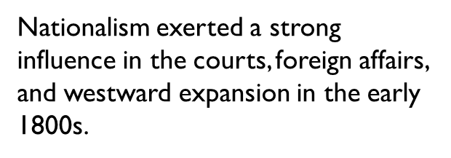
Foreign Affairs
Transcontinental Treaty (Adams/Onis Treaty) 1819
There were problems with Spanish control of Florida
Seminole Indians kept attacking U.S. citizens in Georgia and then retreating into Florida
African slaves who escaped across the border into Florida could not be recovered
General Andrew Jackson was sent by President Monroe into Florida to stop the Seminole attacks; He crossed into Florida and seized two Spanish forts
Spanish realized they couldn’t control American expansion into Florida so they were ready to surrender Florida if they could agree to terms with U.S. on the boundary of the Louisiana Territory
Spain wanted a boundary as far east of the Rio Grande as possible; but the Spanish minister in Washington, Luis de Onis gave in to the demands of Secretary of State John Quincy Adams
Agreed to give up Florida for $5 million and the Louisiana line was drawn through present day Texas to the Rocky Mountains; Spain would also give up claims north of the 42nd Parallel (Oregon Territory)

Slide 18
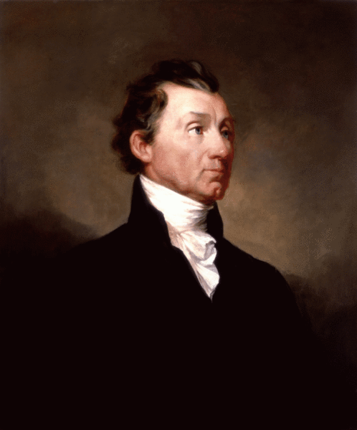
Foreign Affairs
Nationalism exerted a strong influence in the courts, foreign affairs, and westward expansion in the early 1800s.
In his 1823 message to Congress, President Monroe warned all outside powers not to interfere with the affairs of the Western Hemisphere=Monroe Doctrine
Reasons for the Monroe Doctrine centered around an attempt to end quarreling with foreign powers that might distract America from building and strengthening our nation

Slide 19
Foreign Affairs
The first foreign threat in the western hemisphere was from Russia. Beginning with the explorations of Vitus Bering in 1741, the Russians had kept an interest in fishing and fur trading along the northwest coast of North America, from Alaska to the Oregon country.
The second foreign threat in the western hemisphere came from European monarchs in Latin America. Between 1817 and 1822 practically all of Latin America had won its independence from Spain. Spain was too weak to win it back by force, but Austria, Prussia, France, and Russia all had interest in helping Spain regain the territory
In 1823, the British foreign minister suggested that the United States and Great Britain issue a joint statement opposing any French interference in South America
The United States refused to issue such a statement with the British, and instead issued a separate statement which became the Monroe Doctrine

Slide 20
Foreign Affairs
The Monroe Doctrine warned that European powers should not attempt to create new colonies or try to overthrow new independent republics in the hemisphere
The U.S. would consider such action “dangerous to our peace and safety”
In addition, the U.S. would not involve itself in European affairs
Monroe’s Doctrine was a public announcement that the sovereign United States had completed its independence and wanted to be left alone to concentrate on its own development.

Slide 21
Warm up
Review Power Point questions from yesterday’s presentation
Review Supreme Court cases from the Marshall Court: How did these cases enable nationalism during the “Era of Good Feelings”?
What was the Missouri Compromise? How did it enable nationalism during the “Era of Good Feelings”?

Slide 22
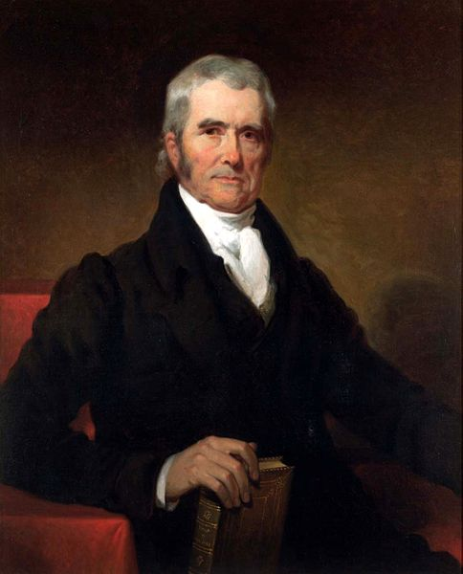
Supreme Court
Nationalism exerted a strong influence in the courts, foreign affairs, and westward expansion in the early 1800s.
The Supreme Court under John Marshall’s leadership made decisions that strengthened the federal government and encouraged the growth of business.

Slide 23
Supreme Court
Nationalism exerted a strong influence in the courts, foreign affairs, and westward expansion in the early 1800s.
McCulloch v. Maryland (1819)
Dartmouth College v. Woodward (1819)
Gibbons v. Ogden (1824)

Slide 24
I. Supreme Court Case Activity
http://www.streetlaw.org/en/landmark/home
https://www.oyez.org/cases/2015
Textbook, Chapter 7 Section 3
Directions:
Use the links above to access information about three of John Marshall’s cases during the “Era of Good Feelings”.
Complete the graphic organizer provided for each of the cases
Be prepared to share your findings to the class

Slide 25
II. Missouri Compromise Activity
A. Map Activity-Missouri Compromise
Follow the directions to label the map and answer the questions that follow.
B. Jefferson Letter-Missouri Compromise
Why does Jefferson describe the Missouri Compromise as the “knell of the Union”?
What will it take to end slavery in the United States, according to Jefferson, and is he hopeful or doubtful that it will be accomplished?
Why does Jefferson fear the “passions” of the younger generation of Americans?

Slide 26
Nationalism (1816-1823)
Supreme Court Cases
Foreign Affairs
McCulloch V. Maryland
Dartmouth College v. Woodward
Adams-Onis Treaty
Gibbons v. Ogden
Monroe Doctrine
Westward Expansion
Missouri Compromise

Slide 27
Westward Expansion Missouri Compromise
In 1819, when Missouri petitioned for statehood, conflict arose.
Government had admitted Illinois as eleventh free state. Politicians assumed Missouri would enter the union as a slave state.
N.Y. Congressmen amended the Missouri statehood bill to require the state to gradually free its slaves. Southerners blocked passage of the bill
During the debates, Alabama was admitted as the 11th slave state
Missouri’s status became crucial to the balance

Slide 28
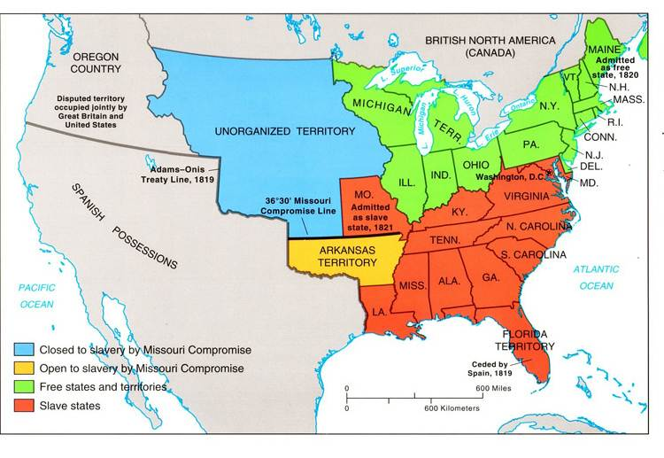
Westward Expansion-Missouri Compromise

Slide 29
Westward Expansion-Missouri Compromise
Maine was admitted as a free state and Missouri as a slave state
Rest of Louisiana territory was split into two spheres of interest, one for slaveholders and one for free states.
The dividing line was set at 36.30’ north latitude. South of the line slavery was legal. North of the line, with the exception of Missouri, slavery was banned.

Slide 30
Thomas Jefferson to John Holmes, April 22, 1820
Why does Jefferson describe the Missouri Compromise as the “knell of the Union”?
What will it take to end slavery in the United States, according to Jefferson, and is he hopeful or doubtful that it will be accomplished?
Why does Jefferson fear the “passions” of the younger generation of Americans?

Slide 31
Thomas Jefferson to John Holmes, April 22, 1820
Why does Jefferson describe the Missouri Compromise as the “knell of the Union”?
What will it take to end slavery in the United States, according to Jefferson, and is he hopeful or doubtful that it will be accomplished?
Why does Jefferson fear the “passions” of the younger generation of Americans?

Slide 32
James Monroe-Review
James Monroe Presidency

Slide 33
Assignment
The year is 1828. You are a senator from a Southern state. Congress has just passed a high tax on imported cloth and iron in order to protect Northern industry. The tax will raise the cost of these goods in the South and will cause Britain to buy less cotton. Southern states hope to nullify, or cancel, such federal laws that they consider unfair.
Would you support the federal or state government?

