Slide 1
The Middle Colonies
1607-1754

Slide 2
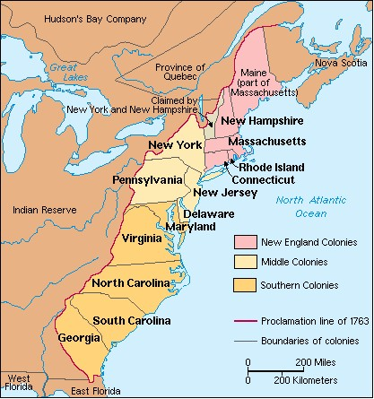

Slide 3
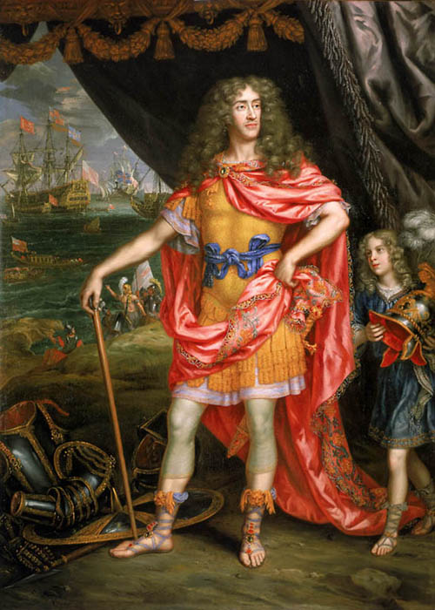
New York
Charles II gave his brother James, the Duke of York, the territory between the Connecticut and Delaware Rivers including the Hudson Valley and Long Island
This land would become the states of New Jersey and New York
In 1644, James sent commissioners and a fleet to establish power over the Dutch colony already there
Fleet arrived and Dutch Governor Peter Stuyvesant surrendered
Dutch colony of New Netherland, would become New York; New Amsterdam became New York City

Slide 4
New York
Friction developed between the Dutch that remained and the English that now had control
Originally ruled by a military governor, Sir Edmund Andros, who set up all of the rules of law
To attract new settlers and please English merchants, the Duke had to give in and allow the creation of a general assembly that was elected
Within months of receiving proprietary grant, James gave the land that would become New Jersey to two followers: Sir George Carteret and John Berkeley
Much of New Jersey’s colonial history was over land claim fights

Slide 5
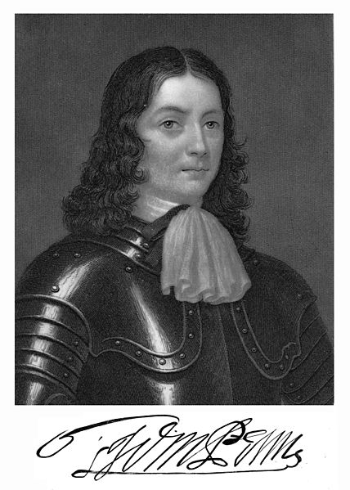
Pennsylvania
Designed as a “holy experiment” for Quakers by William Penn
Penn took an old debt owed to his father by Charles II and received a charter from the king for a proprietary colony named for his father
It was the best planned colony; Penn’s First Frame of Government was written in 1682; a council of 72 men was to be elected; as sole proprietor, Penn could work with the council to propose laws that an assembly could approve or reject; create courts and appoint judges, manage the treasury

Slide 6
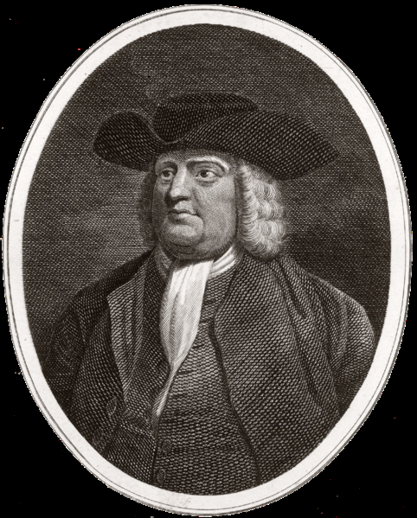
Pennsylvania
Quakers entered Pennsylvania unarmed; friendly relations with local Indians were important
Capital punishment banned except for murder; granted religious freedom, trial by jury and habeas corpus

Slide 7
Quakers
Made other Christians angry because of their beliefs
Believed that God, in the form of the Inner Light, is present in all people. People could become good by letting their light shine through.
Believed in pacifism. This angered Catholics and other Protestants who had found ways to justify war
Slavery made them uncomfortable, and they would later become abolitionists

Slide 8
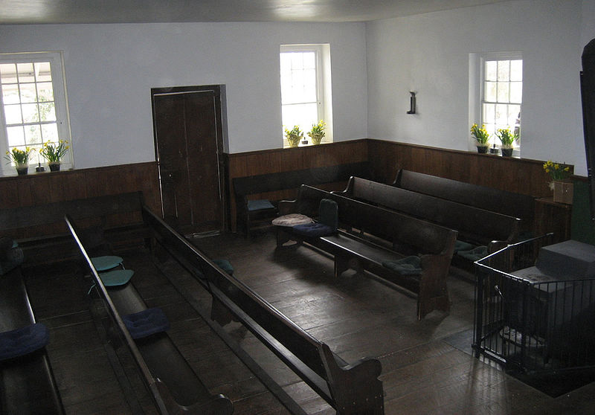
Quakers
They began “the Lamb’s war” against human pride. Refused to doff their hats to social superiors
Saw no need for priests or ceremonies or religious artifacts
Held weekly meetings with no clergy; people spoke when the Light inspired them.
Despised rank and outward show-dressed in plain clothes
Refused to accept or give titles; referred to everyone as “thee” or “thou”
Women enjoyed almost full equality
Treated their children with affection

Slide 9
Pennsylvania
Quakers and non-Quakers could live together with complete freedom to worship God as they chose
Penn advertised throughout Europe that he offered religious freedom and rich farmland (5o acres to every master who paid for a servant to come and 50 acres to every servant when their contract expired)
Population included Swedes, Finns, Dutchmen, Germans, English, Welsh, and Irish settlers
His city, Philadelphia, grew quickly. It was the largest city in America by 1775 with 32,000

Slide 10
Middle Colonies
Location, plus rich resources, helped the Middle Colonies to have the most prosperous family farms
The most diverse colonies from the beginning and after 1720 became more diverse with new immigrants from Ireland and Germany
Many immigrant families arrived as indentured servants
By 1760 had the two largest cities in America, Philadelphia and New York

