Slide 1
Bell Ringer: Colony of Pennsylvania Analysis
Think about how you would answer the following question using your prior knowledge: To what extent did environmental, economic, cultural and demographic factors make Pennsylvania a different or unique colony in the 17th and early 18th Centuries? Write this question at the top of your HIPP analysis sheet.
Write a one-two statement response to the question somewhere on the HIPP analysis sheet. Your response should answer the question, take a position and include categories of potential analysis.
Analyze each of the following documents using the HIPP analysis sheet. Use the documents and your analysis as evidence to support your answer to this question.
This will be a timed activity. You will only have 5 minutes for each document. You only need to find one category of HIPP for each of the documents (Thus, one completed HIPP would derive from all of the documents)
Google Classroom:
Document A: Digital History, William Penn Document B: History Matters, Gottleib Mittleberger Document C: National Humanities Center, Robert Parke Document D: National Humanities Center, Thomas Makin

Slide 2
The Middle Colonies
1607-1754

Slide 3
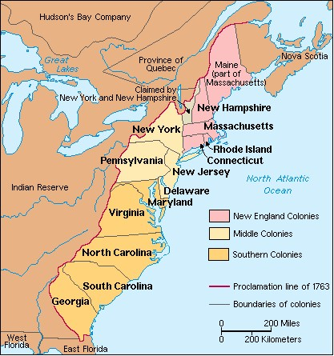

Slide 4
Brinkley: The Restoration Colonies
What were the origins and outcome of the English Civil War? How did it impact English colonization?
1629-Charles I, son of James I dissolved Parliament and ruled as an absolute monarch favoring Roman Catholicism
1642-Parliament organized military challenge; Cavaliers were supporters of the King; Roundheads were supporters of Parliament; lasted seven years
1649-Roundheads won; Charles I beheaded; Oliver Cromwell ruled as militant Protestant
1660-Charles II reclaimed throne after Cromwell’s death; supported colonization; ruled 25 years
Carolina, New York, New Jersey and Pennsylvania were proprietary colonies

Slide 5
Brinkley: The Carolinas
What were the incentives for settling Carolina?
Incentives: proprietors promised political freedom; religious freedom; but people would not move there until the efforts of Anthony Ashley Cooper who convinced wealthy donors to finance voyages from England to Carolina; founded Charles Town in 1690; supposed to be planned and thought out; Fundamental Constitution for Carolina
How and why did Carolina separate?
Northern and southern regions were socially and economically distinct; northerners were backwoods farmers and southerners were more aristocratic and imported slave labor from Barbados; southern plantations were larger and grew rice and indigo
1719-King divided region

Slide 6
Brinkley: New Netherland, New York and New Jersey
How did the Dutch presence in America provide a problem for the English?
Part of a larger commercial rivalry
Separated England’s northern and southern colonies
Provided bases for Dutch smuggling past English customs laws
How was the conflict settled?
1664, English fleet forced Dutch governor Peter Stuyvesant to agree to Articles of Capitulation with agreement that Dutch would not have to leave
Charles II had given his brother James, the Duke of York, the territory between the Connecticut and Delaware Rivers including the Hudson Valley and Long Island
Dutch colony of New Netherland, would become New York; New Amsterdam became New York City

Slide 7
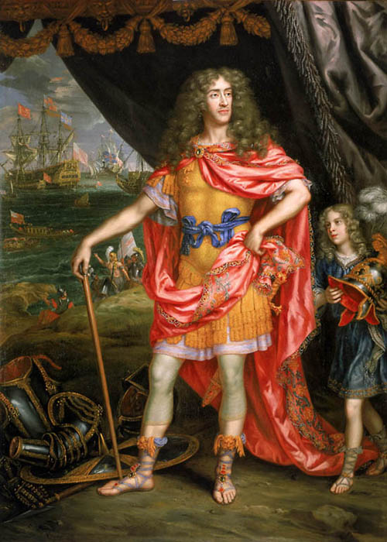
New York
Charles II gave his brother James, the Duke of York, the territory between the Connecticut and Delaware Rivers including the Hudson Valley and Long Island
This land would become the states of New Jersey and New York
In 1644, James sent commissioners and a fleet to establish power over the Dutch colony already there
Fleet arrived and Dutch Governor Peter Stuyvesant surrendered
Dutch colony of New Netherland, would become New York; New Amsterdam became New York City

Slide 8
New York
Friction developed between the Dutch that remained and the English that now had control
Originally ruled by a military governor, Sir Edmund Andros, who set up all of the rules of law
To attract new settlers and please English merchants, the Duke had to give in and allow the creation of a general assembly that was elected
Within months of receiving proprietary grant, James gave the land that would become New Jersey to two followers: Sir George Carteret and John Berkeley

Slide 9
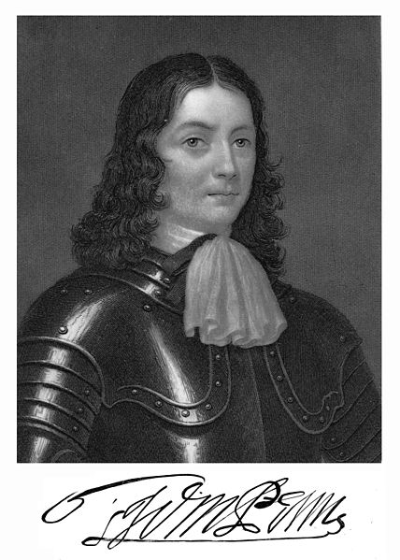
Pennsylvania
Designed as a “holy experiment” for Quakers by William Penn
Penn took an old debt owed to his father by Charles II and received a charter from the king for a proprietary colony named for his father
It was the best planned colony; Penn’s First Frame of Government was written in 1682; a council of 72 men was to be elected;
as sole proprietor, Penn could work with the council to propose laws that an assembly could approve or reject; create courts and appoint judges, manage the treasury

Slide 10
Pennsylvania’s Legal Legacy
All free men were allowed to vote, regardless of property holdings
Fair and open trials of persons accused of a crime; and rules for the fair treatment of prisoners
Colony was open to all religious faiths without fear of persecution; this “Holy Experiment” encouraged a diversity of cultures

Slide 11
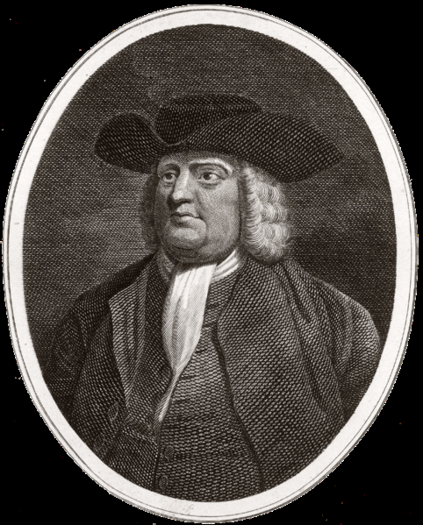
Pennsylvania and Quakers
George Fox established the Religious Society of Friends in mid-1600s in England; “tremble at the name of the Lord”
Quakers entered Pennsylvania unarmed; friendly relations with local Indians were important
Capital punishment banned except for murder; granted religious freedom, trial by jury and habeas corpus

Slide 12
Quakers
Made other Christians angry because of their beliefs
Believed that God, in the form of the Inner Light, is present in all people. People could become good by letting their light shine through.
Believed in pacifism. This angered Catholics and other Protestants who had found ways to justify war
Slavery made them uncomfortable, and they would later become abolitionists

Slide 13
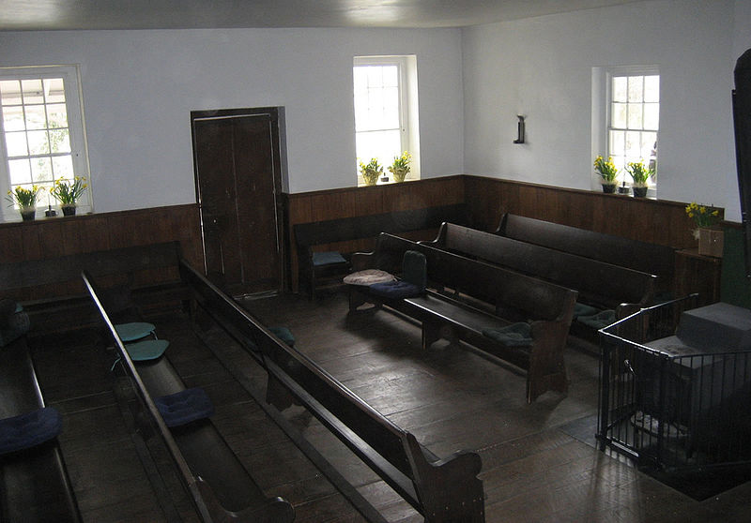
Quakers
They began “the Lamb’s war” against human pride. Refused to doff their hats to social superiors
Saw no need for priests or ceremonies or religious artifacts
Held weekly meetings with no clergy; people spoke when the Light inspired them.
Despised rank and outward show-dressed in plain clothes
Refused to accept or give titles; referred to everyone as “thee” or “thou” (as if addressing servants)
Women enjoyed almost full equality (Margaret Fell)
Treated their children with affection

Slide 14
Pennsylvania
Prospered from the beginning; Penn successfully recruited; planned out the city of Philadelphia; paid Natives for their land and had no major conflicts with Natives
Quakers and non-Quakers could live together with complete freedom to worship God as they chose
Penn advertised throughout Europe that he offered religious freedom and rich farmland (5o acres to every master who paid for a servant to come and 50 acres to every servant when their contract expired)
Population included Swedes, Finns, Dutchmen, Germans, English, Welsh, and Irish settlers

Slide 15
Middle Colonies
Location, plus rich resources, helped the Middle Colonies to have the most prosperous family farms
The most diverse colonies from the beginning and after 1720 became more diverse with new immigrants from Ireland and Germany
Many immigrant families arrived as indentured servants
Penn’s city, Philadelphia, grew quickly. It was the largest city in America by 1775 with 32,000

Slide 16
Debrief
Would you change your response to your original answer to this question given any new evidence?
To what extent did environmental, economic, cultural and demographic factors make Pennsylvania a different or unique colony in the 17th and early 18th Centuries?

Slide 17
Colonial Brochure
Continue researching your colonial brochure.
Please ask any questions related to your research and presentation.

