Slide 1
Abraham Lincoln’s Second inaugural Address
March 5, 1865

Slide 2
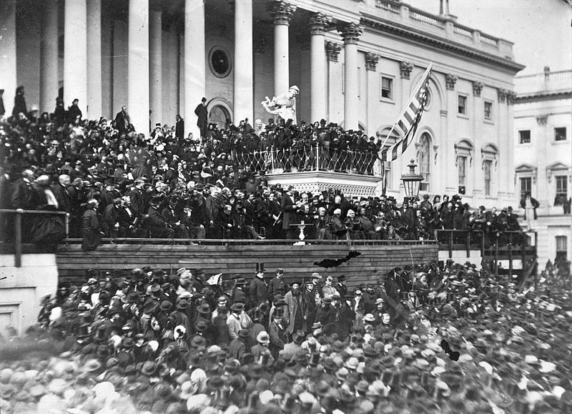

Slide 3
Group Activity
Your group will examine the following primary resources to determine the context in which President Lincoln gave his second inaugural address:
"Grant Takes Command" (1864/1865)
Charles Sumner, "Letter to John Bright" (March 13, 1865)
Jefferson Davis, "African Church Speech" (February 6, 1865)
As a group answer the questions that follow for each of the documents

Slide 4
Document questions
"Grant Takes Command" (1864/1865)
What evidence do you find in this article that the Union is winning in late 1864 and early 1865, and that the South is collapsing?
Charles Sumner, "Letter to John Bright" (March 13, 1865)
What does Sumner propose should be done with the land of former slave-owners in the South?
What reasons does Sumner give for securing "suffrage" or the vote to the freedmen? What ultimate benefit does this bestow upon the United States?
What other proposals that Sumner offers in his letter would be seen as hostile by white southerners?
Describe the attitude Sumner has toward "the rebel states" and provide evidence for your answer.
Jefferson Davis, "African Church Speech" (February 6, 1865)
Is Jefferson Davis hopeful or pessimistic about the Confederate war effort? Give evidence for your answer.
What does Davis believe is required for the Confederate cause to succeed at this stage of the conflict? What does he call upon the citizens of the Confederacy to do?
What can you infer from the "African Church Speech" about the status or morale of the Confederate military? Cite an example or two in support of your answer.
Is Davis open to having the Confederate states rejoin the American union? Explain.
Describe the attitude Davis has towards "the enemy" and provide evidence for your answer

Slide 5
Write your own inaugural Address
You are Abraham Lincoln and you are tasked with writing an inaugural address for your second term in office. Consider the following when writing your address:
what you know to be true about the nation in 1865
your thoughts on the cause of the war
a way to put the nation's conflict into perspective
how you will deal with a nation whose sections are hostile to each other
where you will lead the country over the next four years
your goals and vision for the nation

Slide 6
Lincoln’s Second Inaugural Address
In the second paragraph, what does Lincoln say that Americans (North and South) believed about the "impending civil-war"? Why does he not identify the South as responsible for starting the war?
What connection does Lincoln make between slavery and the Civil War?
What two or three things about the Civil War does Lincoln say the American people did not expect?
What does Lincoln "suppose" God may be accomplishing with the Civil War?
How does Lincoln's interpretation of the war humble both victorious Northerners and defeated Southerners? Why is this useful given the historical context in March 1865?
In terms of both the war and slavery, how do Lincoln's references to the Bible help him to explain what has happened to the country since his first presidential inauguration?

