Slide 1
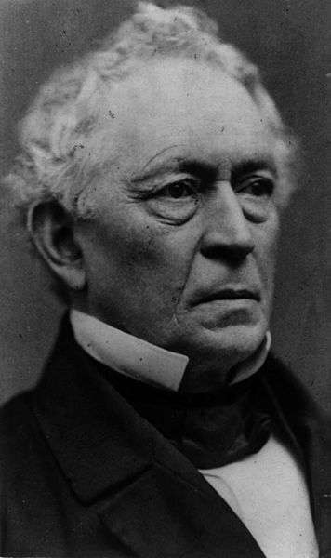
Edward Everett

Slide 2
Start up Assignment: Lincoln’s Gettysburg Address
Why does Lincoln begin his eulogy to the soldiers buried at Gettysburg with a reference to “Four Score and seven years ago”?
Why does Lincoln at Gettysburg call human equality a “proposition”?
What does Lincoln mean by calling the Civil War a test of the ability of the nation to “long endure”?
What does Lincoln say is the best way for the living to honor the dead at Gettysburg?
What is “the new birth of freedom” Lincoln calls for, and how does it differ from the nation’s original birth?
Why do you think Lincoln uses “nation” repeatedly, and not the word “union” at all?
Lincoln never mentions slavery in his Gettysburg Address. Why not?

Slide 3
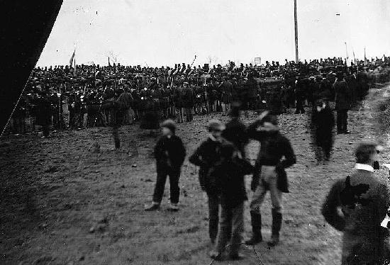

Slide 4
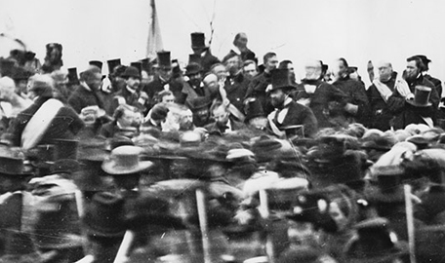

Slide 5
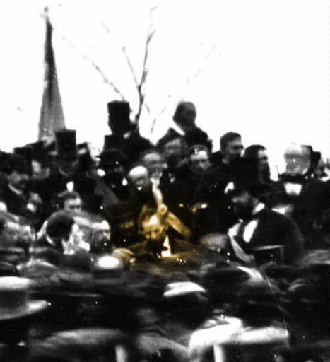
Notes:
Lincoln at Gettysburg

Slide 6
