Slide 1
LEGISLATIVE BRANCH
Article I

Slide 2
How is Congress organized?
Bicameral Legislature
Two Houses
House of Representatives
Senate

Slide 3
How is the House of Representative organized?
435 members
Representation based on state population
Requirements:
25 yrs. Old
U.S. citizen 7 yrs
Live in district representing
Leadership:
Speaker of the House (Paul Ryan)

Slide 4
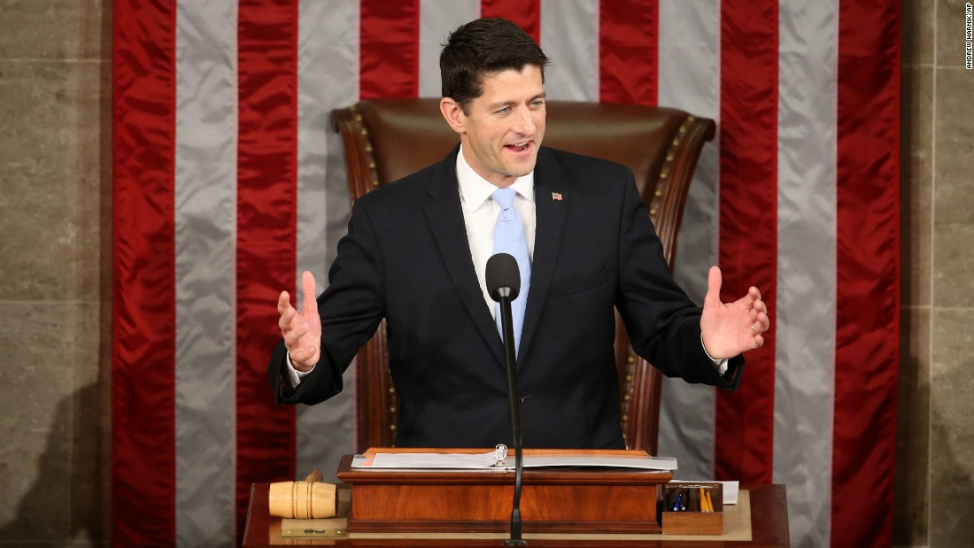

Slide 5
How is representation for each state determined in the House?
Population in each state determines the number of seats in the House
Census
Population count every 10 years
Based on the census apportionment (division of seats) is determined

Slide 6
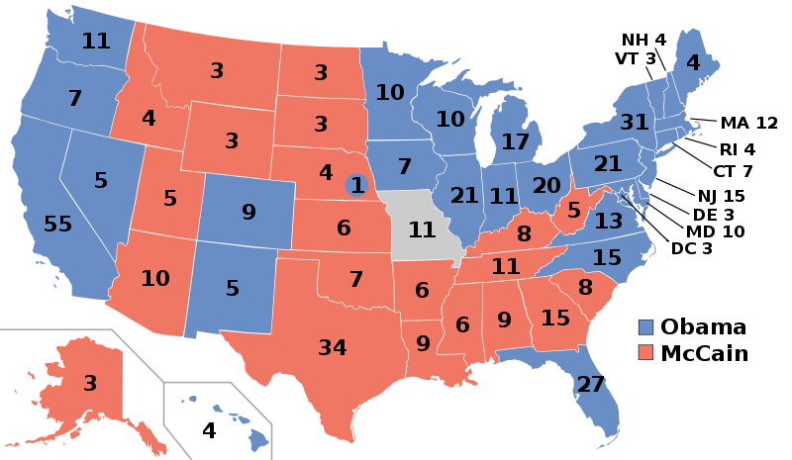

Slide 7
How is the Senate organized?
100 members
Equal Representation, 2 from each state
Requirements:
30 yrs old
U.S. citizen 9 yrs
Live in state representing
Leadership:
Vice President
President Pro Tempore- leader when VP not available (Orrin Hatch)

Slide 8
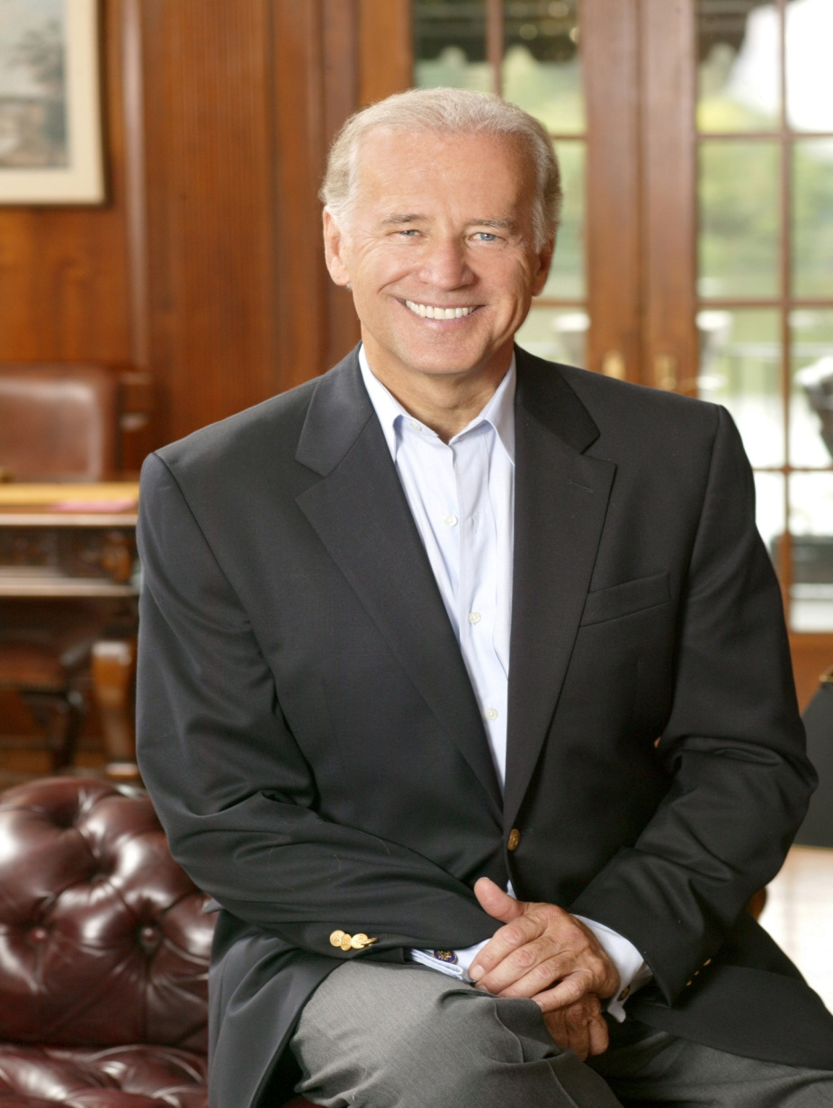

Slide 9
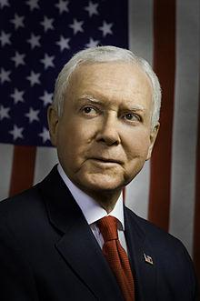

Slide 10
What is the term for Representatives and Senators?
Representatives
2 yr terms
Senate
6 yr terms

Slide 11
Who are the party leaders in Congress?
Majority Leader
Leader from the political party in each house that more than half the members belong
Rep. Kevin McCarthy
Minority Leader
Leader from the political party in each house that less than half the members belong
Dem. Nancy Pelosi
Party Whips
Party member who helps the floor leader by making sure representatives are present for key votes
Rep. Steve Scalise
Dem. Steny Hoyer

Slide 12
How does a bill become a law?
Bill introduced in House or Senate
Bill debated in Standing Committee
Rules Committee sets rules for debate
House and Senate Debate Bill
House and Senate Vote
Conference Committee works out differences
Final Vote in each house
President Signs or Vetoes Bill

Slide 13
How is the committee system organized?
Standing Committees
Permanent committees in both the House and Senate
Ex: Agriculture, Education, Government Reform
Joint Committees
Committee with members from both houses
Ex: Economics, Taxation
Select and Special Committees
Committees formed for specific reasons for a limited amount of time
Seniority System
years in congress determines spot on committees

Slide 14
How is a filibuster and cloture related?
Filibuster
Talking a bill to death, Senator talk about a bill to delay the vote
Cloture
Process in Senate when 2/3 of the members vote to end a filibuster

Slide 15
What Legislative powers are granted to Congress in Article I?
Expressed Powers:
Powers give to Congress that are clearly listed in Article I
Ex: Make laws, Coin money
Implied Powers:
Powers give to congress not clearly listed in Article I
Ex: Create an air force

Slide 16
What Non-Legislative Powers does Congress have?
Impeachment
The power of Congress to bring formal charges against a government official
House: Accuses the official of misconduct
Senate: Holds trial to determine guilt or innocence
2 President Impeached
Andrew Johnson 1868- not guilty
Bill Clinton 1998- not guilty

