Slide 1
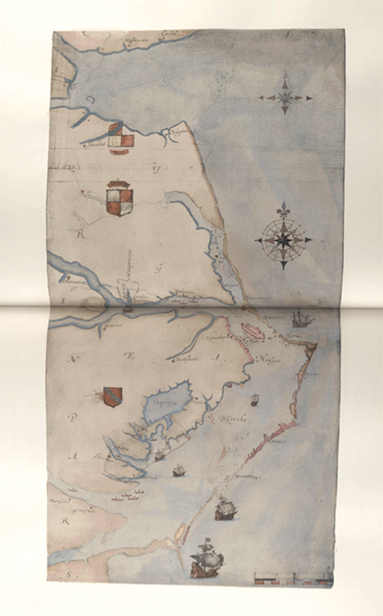
Bell Ringer: The New York Times Article, “The Lost Colony: Lost and Found?”
What happened to the Lost Colony?

Slide 2
Homework: 13 English Colonies Map
Complete the map of the original 13 English colonies
Use the directions provided

Slide 3
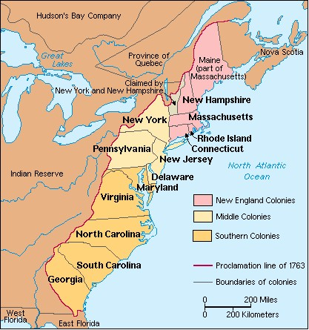

Slide 4
The English Southern Colonies
1607-1754

Slide 5
What were the environmental, cultural, demographic and economic factors that influenced the development of Jamestown?

Slide 6
Jamestown, Virginia 1607
Early Virginians:
Gave America its first representative assembly (Virginia House of Burgesses)
Gave England a new vice—tobacco
Helped establish slavery as a labor system in the New World
1st 10 years of Jamestown colony 75,000 British pounds spent to send 2000 settlers, but it was considered a disaster
Early accounts of Jamestown from Captain John Smith’s A Generall Historie of Virginia

Slide 7
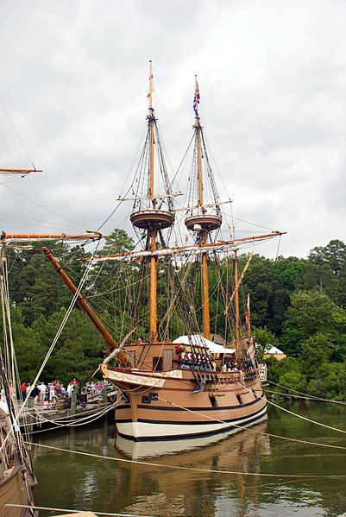
Jamestown/Virginia
1606 King James granted a charter to a group of London Merchants-
London company was a joint-stock company by which investors could pool their resources to support the expedition
Investors hoped to find gold or silver, or a northwest passage to Asia
But after 4 months at sea only 105 of original 144 settlers reached Chesapeake Bay in 1607

Slide 8
Jamestown, Virginia
By the end of the first summer 46 more people died; only 38 survived by end of the year.
Theories as to why the colony had failed:
Colony’s original system of government (council of 13 men) had failed
James River became contaminated every summer and produced dysentery, typhoid fever, malaria,
Native Powhatan were unfriendly
No one had planted enough corn (would rather negotiate or steal from natives)
Colony had too many gentlemen who considered farming beneath them

Slide 9
Jamestown, Virginia
Colony suffered a setback in the winter of 1610-”starving time” and an Indian war with the Powhatan
As the winter approached-hogs, hens, goats, sheep and horses were consumed
Turned to dogs, cats, rats
Some turned to boiling boot leather
On man killed, salted and ate parts of his wife
1617--New governor Samuel Argall arrived to find a “slum in the wilderness”
Argall noticed that the marketplace and the streets, and all the spare places were planted with tobacco.
Of the 2000 settlers sent since 1607 only 400 were alive

Slide 10
Jamestown, Virginia
1618-Sir Edwin Sandys was elected treasurer of the Virginia Company
To attract more settlers and investors he offered land
“old planters” who had arrived before the spring of 1616 were granted 100 acres of land
Every new share purchased in the company would mean 100 more acres of land
Would give additional land if investors would pay the ship passage of tenant laborers; 50 acres for each new tenant
Became known as “headright” system (private property came to Virginia)

Slide 11
Jamestown, Virginia
Sandys worked to make the colony a more pleasant place to live
Instructed new governor, George Yeardly to create an assembly with power to make laws (laws would be binding as long as the company approved)
Each new settlement could send 2 representatives or burgesses (Virginia House of Burgesses)
1st convened in 1619
No taxes required to pay for government officials salaries-paid in land
From 1619-1622, 3,570 settlers were sent as part of Sandy’s program, by only 700 people remained. Records show that these people died. Why?

Slide 12
Jamestown, Virginia
Why were people dying at a time of increased immigration?
Men were sent unprepared (arrived with no food and found inadequate housing)
Diseases such as typhoid fever and malaria
Colonists were not self-sufficient
Principle food=corn
Indians spent a few days out of the year to plant and harvest with huge surpluses; little effort needed
Virginians had to pass a law requiring Virginians to grow corn (John Smith enforced)

Slide 13
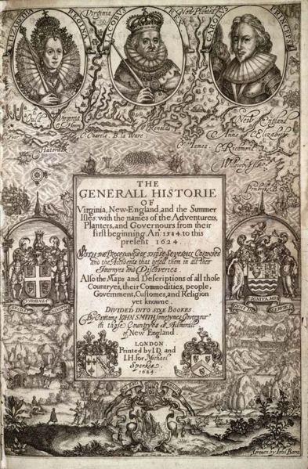
Jamestown/Virginia
1613-Colony offered first strand of “brown gold”-tobacco under the leadership of John Rolfe
Tobacco required more time to cultivate
1616-2,500 lbs shipped to England
1618-49,518 lbs shipped
Historian Edmund Morgan called Virginia “the first American boom town”

Slide 14
Jamestown, Virginia
Tobacco
One individual could grow 250-930 lbs a year
Developed labor system
Tenant-agreed to work land for certain time (4-7 years) and tenant could keep ½ of what was produced
Servant-paid only room and board and passage from England-gave master everything that was produced.
Apprentices-served 7 years and then another 7 as tenants (only cost was transportation and room)
Used as medium of exchange
Captain John Smith turned the colony around by concentrating on survival
Ingredients for African Slavery in place

Slide 15
Slavery in British Southern Colonies
1619 in Jamestown, 20 black indentured servants arrived aboard a Dutch ship
1661 Virginia legalized slavery; English king chartered Royal African Company to bring slaves to Jamestown, Hampton & Yorktown
By 1680s African slaves had become essential to Virginia’s economy
Slavery grew in the U.S. from 1650-1750. Why?
Native Americans unsuitable for labor intensive tobacco
Native susceptible to European disease
Natives able to escape
African slave cost $27; a European laborer was $.70 a day

Slide 16
Slavery in British Southern Colonies
From 1650-1750 10-12 million African slaves were taken from the West African coast
5% of potential slaves died in Africa on the way to the coast
13% died in transit to West Indies
30% died during the first 3 months of “seasoning”
Several committed suicide to avoid slavery
In the 1700s British Parliament opened slave trade to British merchants who carried on “triangular trade” from New England to Africa to Caribbean to New England; African slaves on the “middle passage”

Slide 17
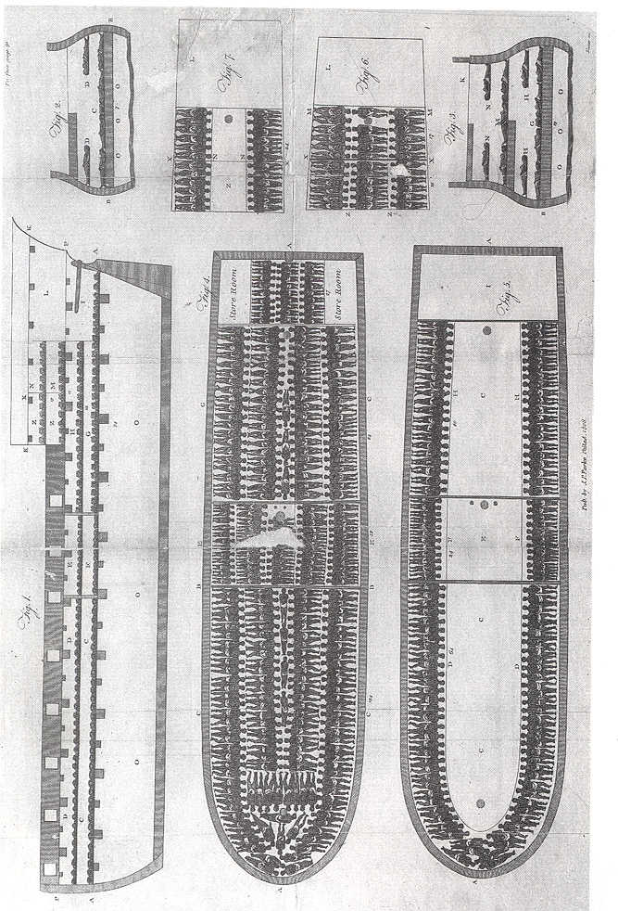

Slide 18
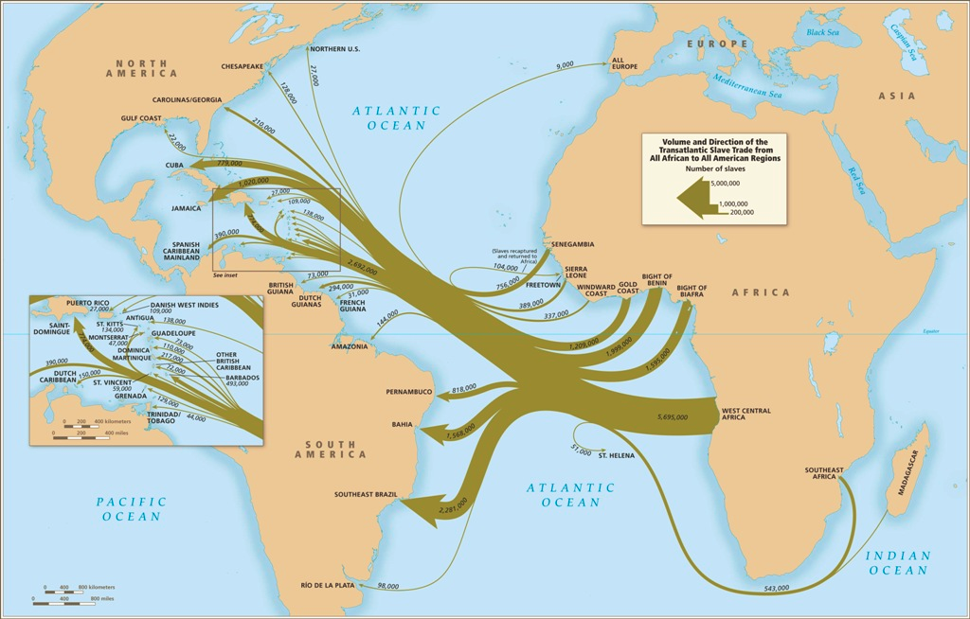
British Slave Trade
Only 6% of slaves transported across Atlantic wen to North America
Of these, most slaves lived on small and medium sized farms. Most whites did not own slaves
More than ½ of Chesapeake slave owners owned fewer than 5 slaves.
Jamestown-Story of Us

Slide 20
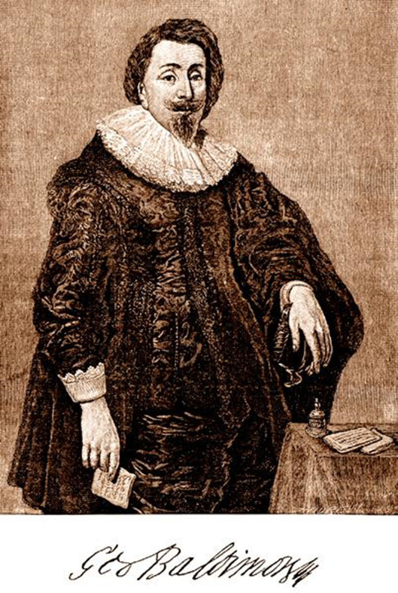
Maryland
In 1632, the English king gave George Calvert land north of Virginia. Calvert was a Roman Catholic who wanted a colony for people of his faith.
King made him baron Baltimore and “lord proprietor” of the colony
Lord Baltimore’s regime overthrown several times by Protestants
Approved Toleration Act of 1649 granting freedom of worship to all Christians

Slide 21
Southern Colonies
In Virginia and Maryland, large farms called plantations developed.
In other southern colonies like North Carolina, farms tended to be small.
Tobacco was the common crop. In South Carolina and Georgia, planters raised rice and indigo. By 1700 almost 100,000 lbs exported annually by 1776, rice exports from SC and GA were more than 65 million lbs annually
Tobacco, rice, indigo, forest products meant the Southern colonies could obtain manufactured goods in trade from England; Planters dealt with English factories which prevented a diversified economy
Also stunted the growth of urban centers
Plantation owners lived in great comfort. Enslaved Africans, however, endured poverty, violence and a lack of freedom.

Slide 22
Southern Colonies
Led isolated lives whether poor or plantation owners
Churches were few; by middle of 18th century Anglican church had been established in southern colonies
Most families lived in one-two room houses, “small dark, unpainted, and unadorned”
Chairs were rare; people sat on, slept and ate on benches
Women managed household; spinning and sewing; pickling and preserving, making butter and cheese; tended to farm animals
Children not subject to strict discipline; formal schooling was non existent; illiteracy rates high

Slide 23
Trouble in VA – Bacon’s Rebellion
More conflicts with Native Americans caused the Virginia royal governor to increase taxes and restricted expansion into Native territory
After defeating the Natives, Nathaniel Bacon led a group or poor indentured servants against leadership in Jamestown in September 1676
Significance
Colonists would not tolerate a corrupt government
The poor (both black and white) could unite
Increase in African slave trade

Slide 24
Works Cited
James West Davidson, “Serving Time in Virginia”. After the Fact, Chapter 1.
Eddie Becker, Chronology on the History of Slavery, Compiled by 1999 http://innercity.org/holt/slavechron.html
John M. Murrin, Liberty, Equality, Power: A History of the American People, Concise Edition, 6th Edition

Slide 25
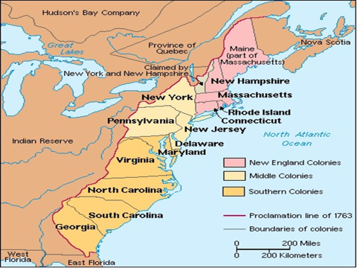
Honors Colonial Brochure Activity
Read the directions for the Colonial Brochure Activity and review the rubric that accompanies the directions
Be prepared to ask questions
Due date: 9/12
Quiz grade

