Slide 1
Election of 1824 Activity
Use the QR Code or Powerpoint link to access information on your candidate
Complete the graphic organizer provided for your candidate
Be prepared to share your research with 2 other classmates

Slide 2
Election of 1824 Activity
How similar are the candidates?
What matters most in a presidential election-issues or image?
How do you think either the issues or image of these candidates influenced the outcome of the election?

Slide 3
“Andrew Jackson, I am given to understand, was a patriot and a traitor. He was one of the greatest of generals, and wholly ignorant of the art of war. A writer brilliant, elegant, eloquent, without being able to compose a correct sentence, or spell words of four syllables. The first of statesmen, he never devised, he never framed a measure. He was the most candid of men, and was capable of the profoundest dissimulation. A most law-defying, law-obeying citizen. A stickler for discipline, he never hesitated to disobey his superior. A democratic autocrat. An urbane savage. An atrocious saint.“
James Parton, Jackson biographer

Slide 4
ANDREW JACKSON
The Age of Jackson

Slide 5
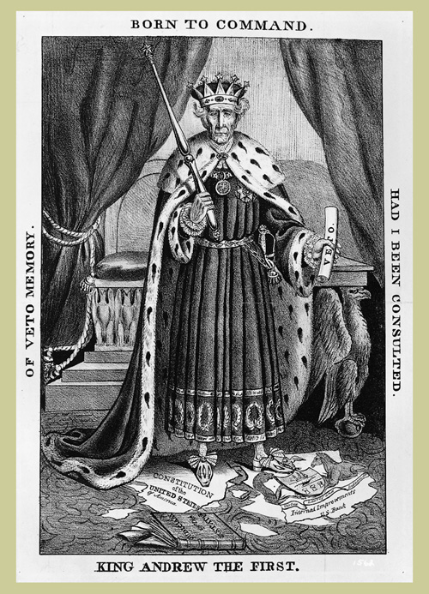
To what extent was Andrew Jackson a champion of the Common Man?

Slide 6
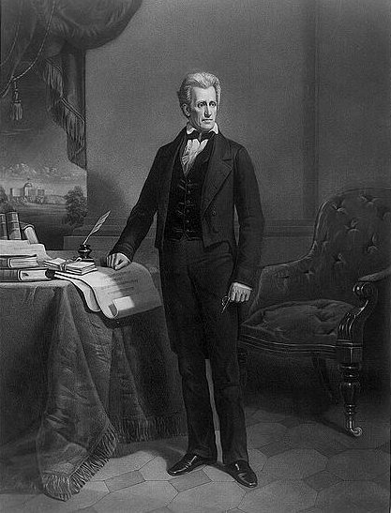
Election of 1824
All candidates were Republican
John Quincy Adams, son of a Federalist president, Secretary of State under Monroe; represented the interests of the Northeast
Henry Clay of Kentucky, Speaker of the House of Representatives
Andrew Jackson-a Senator from Tennessee and military hero from the Battle of New Orleans in the War of 1812, drew Western support away from Clay
William H. Crawford of Georgia was born in Virginia and hoped to continue the "Virginia Dynasty;” Secretary of the Treasury

Slide 7
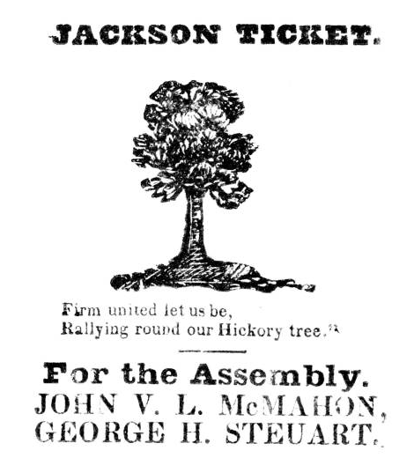

Slide 8
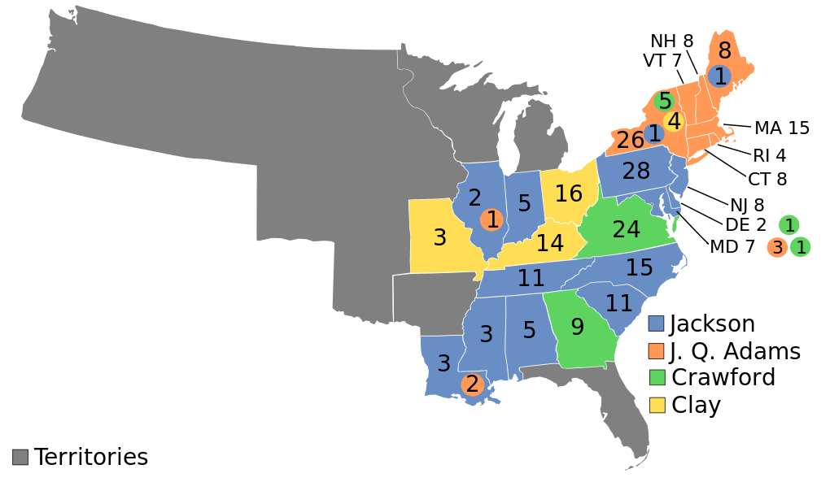

Slide 9
Election of 1824
Andrew Jackson-99 electoral votes/152,933 popular votes
John Quincy Adams-84 electoral votes/115,696 popular votes
Because nobody had received a majority of votes in the electoral college, the House of Representatives had to choose between the top two candidates.

Slide 10
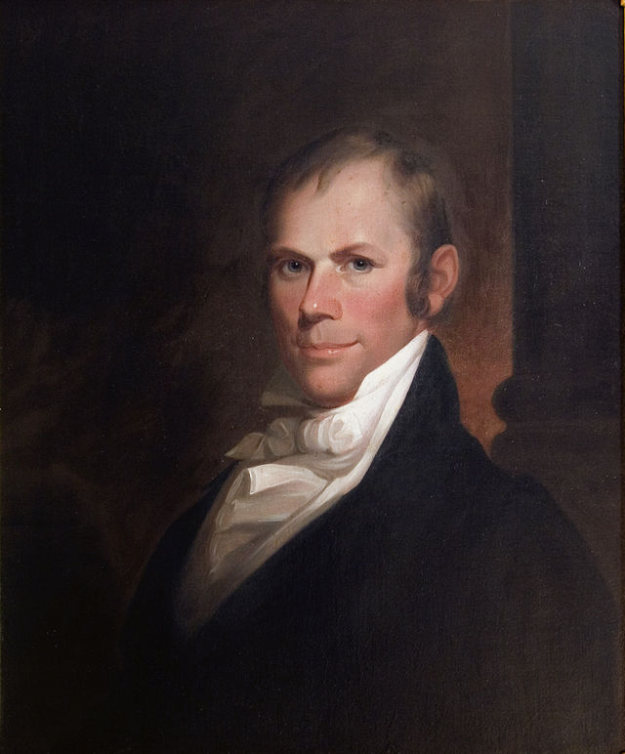
“Corrupt Bargain”
Henry Clay, the speaker of the House of Representatives
Clay forged an Ohio Valley-New England coalition by throwing his support to Adams
John Quincy Adams became President
Adams named Clay as his Secretary of State
Jackson and his supporters declared this a corrupt bargain; formed the Democratic Party

Slide 11
Election of 1828
.
Jackson’s campaign began almost immediately after the “corrupt bargain”. It was managed by Senator Martin Van Buren of NY
Created the Democratic Party from the remains of Jefferson’s old party
Support came from:
Northern farmers and artisans.
Southern slave owners.
Farmers with small land holdings.
Created a national committee that oversaw local and state party units.
Mass meetings, parades, picnics.

Slide 12
Election of 1828
.
One of the dirtiest campaigns in American history
Editor of Philadelphia Press documented Jackson’s alleged murders of twelve men in duels
Editor of Cincinnati Gazette reported on Jackson’s gambling and cursing
Others labeled Jackson’s mother a British prostitute who had married a black man by whom she had given birth to Jackson
Opponents called his wife an adulteress and accused Jackson of being a wife stealer
Jackson blamed Henry Clay for much of the slander

Slide 13
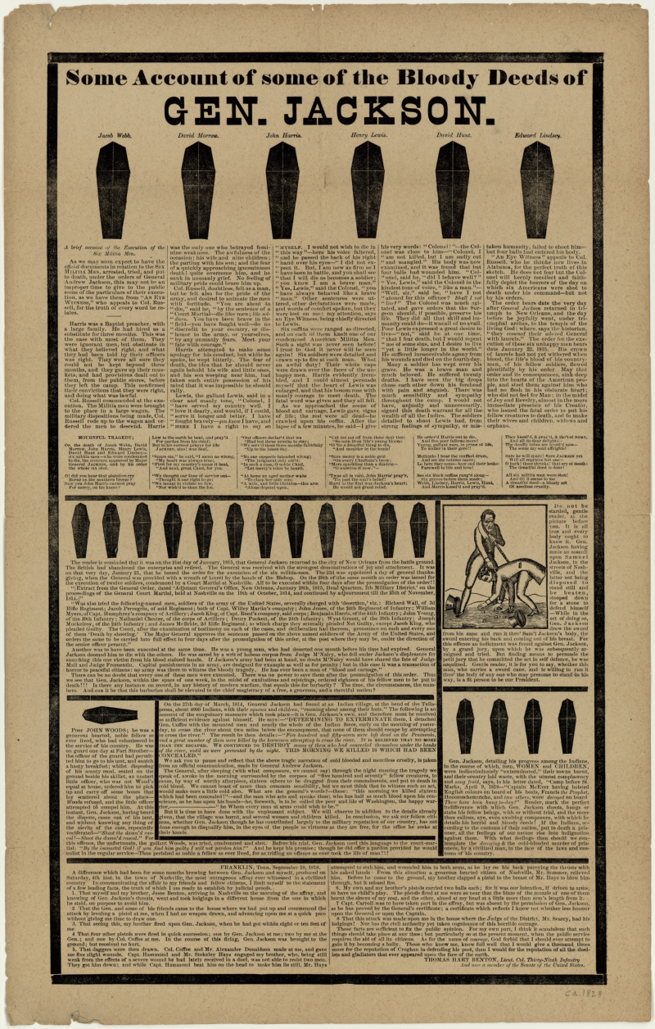

Slide 14
Election of 1828
.
Jackson: “Female character never should be introduced…I never war against females, and it is only the base or cowardly that do so.”
Rachel Jackson: “I had rather be a doorkeeper in the house of God than to live in that palace in Washington.”
Jackson defeated John Quincy Adams to become the seventh president of the U.S. Winning 178-83 in the Electoral College
800,000 more males voted in this election compared to the one in 1824. The “Old Hero” from frontier Tennessee had defeated the incumbent president, son of a previous office holder.
The elite were out and the people were in.

Slide 15
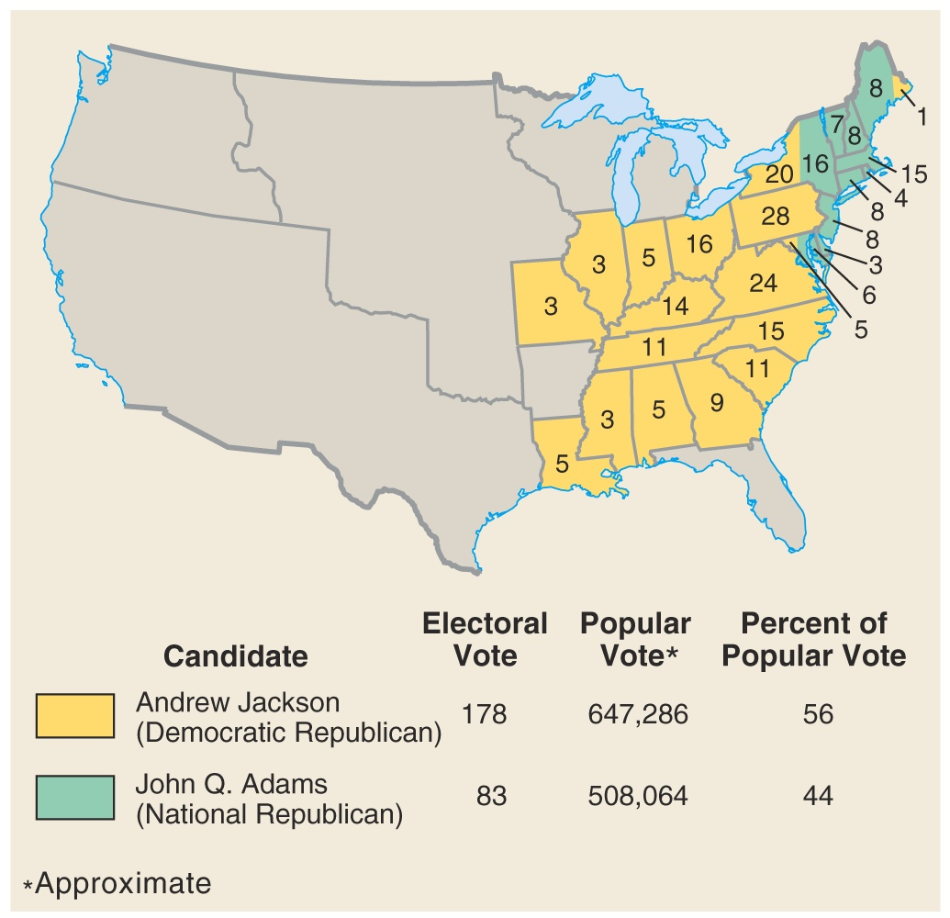

Slide 16
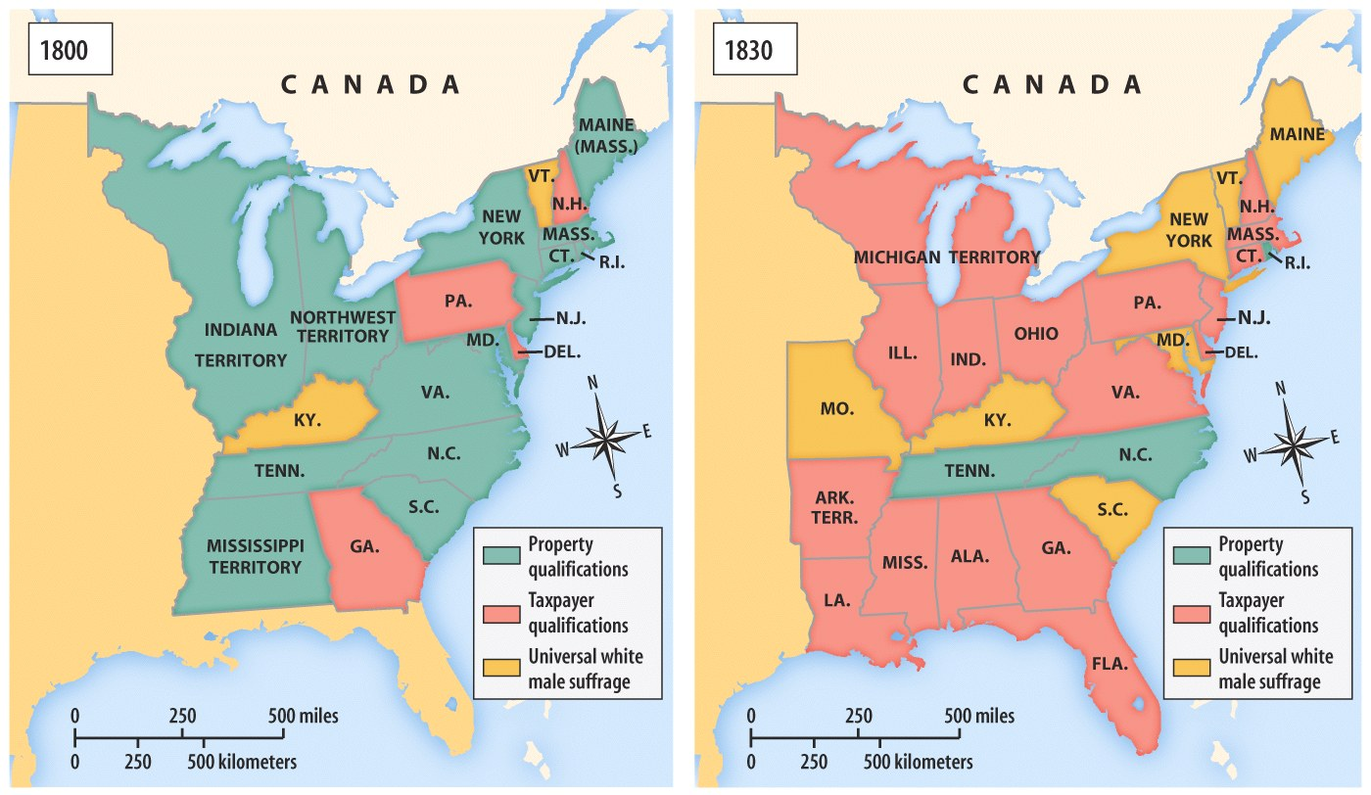
Voting Requirements in the Early 19c

Slide 17
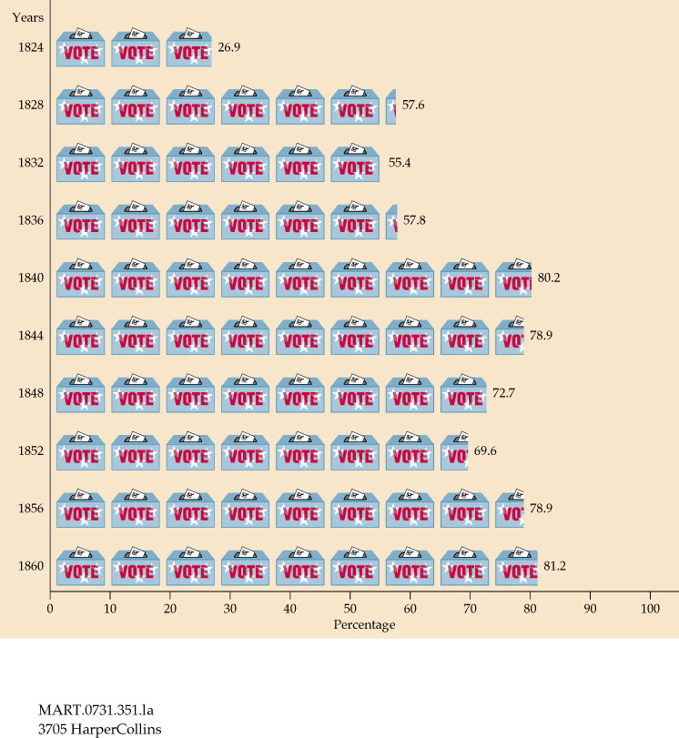
Voter Turnout: 1820 - 1860

Slide 18
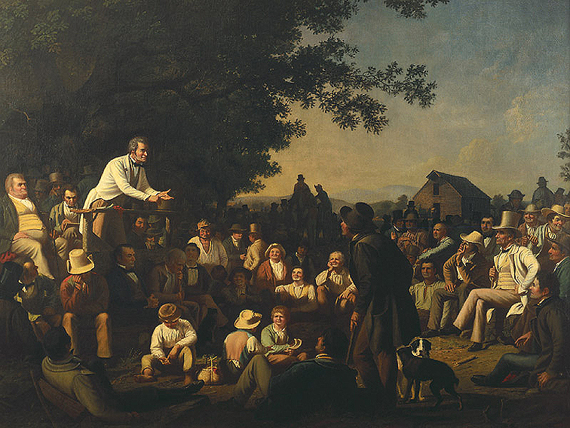
Campaigning “on the Stump”

Slide 19
The election signified that government was becoming more democratic.
White male suffrage increased; property qualifications for voting dropped in most states
Party nominating committees began
Voters chose their state’s slate of Presidential electors.
Spoils system/Rotation in Office.
Popular campaigning (parades, rallies, floats, etc.)
Two-party system returned in the 1832 election:
Dem-Reps → Natl. Reps.(1828) → Whigs (1832) → Republicans (1854)
Democrats (1828)

Slide 20
The Common Man/Jacksonian Democracy
Andrew Jackson and his supporters felt they had won a victory over major corruption in 1828
The “corrupt bargain” had demonstrated what was wrong with American society and politics: Corrupt elitists used the government for their own benefit at the expense of the common people
Jacksonians insisted that they would have honest government for the benefit of all

Slide 21
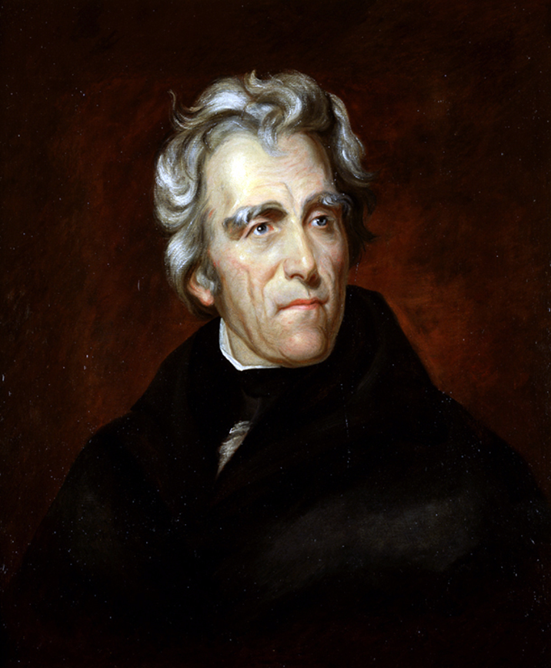
Inauguration
Took the oath of office on March 4, 1829 at the age of 61.
One of the most popular men ever elected president of the U.S.; record numbers of people, between 15,000 and 20,000, came to Washington to see “Old Hickory” inaugurated.

Slide 22
Inauguration
Jackson came in mourning; In December Rachel Jackson had gone shopping in Nashville and stopped to rest in a newspaper office.
She read for the first time accusations against her; she fainted and would eventually die of a heart attack
Jackson arrived in Washington wearing a black suit and black tie, a black armband and hatband that trailed down his neck in what was known as a weeper

Slide 23
Inauguration
Inaugural address was vague
Promised “proper respect” for states rights and a “spirit of compromise” over the tariff
Promised to reform civil service by replacing “unfaithful or incompetent” officers
He noted that he had “been elected by the choice of a free people”

Slide 24
Margaret Bayard Smith's account
But what a scene did we witness! The Majesty of the People had disappeared, and a rabble, a mob, of boys, negroes, women, children, scrambling fighting, romping. What a pity what a pity! No arrangements had been made no police officers placed on duty and the whole house had been inundated by the rabble mob…
The President, after having been literally nearly pressed to death and almost suffocated and torn to pieces by the people in their eagerness to shake hands with Old Hickory, had retreated through the back way or south front and had escaped to his lodgings at Gadsby's.
Cut glass and china to the amount of several thousand dollars had been broken in the struggle to get the refreshments, punch and other articles had been carried out in tubs and buckets…
Ladies fainted, men were seen with bloody noses and such a scene of confusion took place as is impossible to describe, - those who got in could not get out by the door again, but had to scramble out of windows. At one time, the President who had retreated and retreated until he was pressed against the wall, could only be secured by a number of gentleman forming around him and making a kind of barrier of their own bodies…

Slide 25
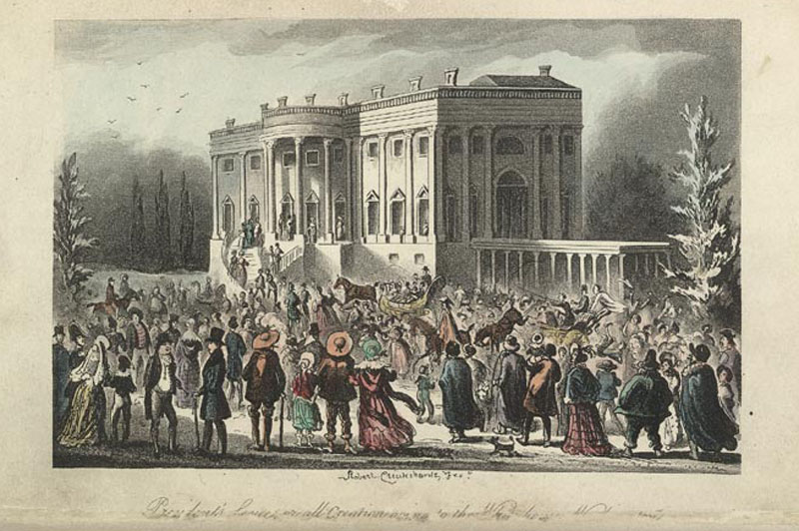
Robert Cruikshank, The President’s Levee
/All Creation Going to the White House

Slide 26
Jackson’s Presidency
Spoils System
Indian Removal
Nullification/
State’s Rights/Tariff
National Bank

Slide 27
Elect Andrew Jackson-The Common Man’s Man
Your task will be to elect Andrew Jackson by organizing a political campaign rally.
Your group (2-3) must create a campaign speech and two additional campaign products from the following list:
Campaign song/rap/poem
Campaign poster/broadside
Campaign buttons/flyers
Your campaign must creatively address all of the following issues:
Spoils system
States Rights/Nullification and the Tariff
The National Bank
Indian Removal

Slide 28
Research sites
www.thehermitage.com
http://www.whitehouse.gov/about/presidents/andrewjackson/

Slide 29
Works Cited
Marszalek, John F. “Andrew Jackson: Flamboyant Hero of the Common Man”, 1998.
Murrin, John, et al. Liberty, Equality & Power. 3rd Edition

