Slide 1
Bell Ringer: C-Span Assignment 2016 Presidential Issues
If you could vote, which issue would most impact who you would vote for? How and why would it impact your vote?
Which issue do you feel will drive the outcome of the election between Hillary Clinton (D) and Donald Trump (R)?
In what ways have issues taken a back seat to image during this presidential campaign?
How much should image matter in voting for a presidential candidate?

Slide 2
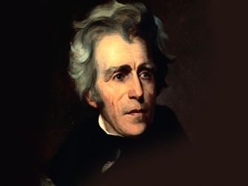

Slide 3
ANDREW JACKSON
The Age of Jackson

Slide 4
Rise of Andrew Jackson
1767-Jackson was born in Waxhaw district between NC and SC; Father had died before his mother, Elizabeth, gave him birth
1780-81- Andrew and brother participate in the Battle of Hanging Rock. Both are later captured by the British and jailed in Camden They contracted small pox. Mother secured their release through prisoner exchange, but Robert died
1781-Mother died of Cholera
1784-1787- Lived in Salisbury, N.C., and studied law.
1788- Jackson travels West as young lawyer to Jonesboro, in the territory that will later become the state of Tennessee
1788- Friend appoints Jackson prosecuting attorney for the district. He and Rachel Robards begin a courtship
1791-Marries Rachel

Slide 5
Rise of Andrew Jackson
1795- Jackson elected as a delegate to the Tennessee Constitutional Convention
1796- Jackson serves in the U.S. House of Representatives and then U.S. Senate
1802- Commissioned Major General of the Tennessee militia
1804- Moves to the Hermitage property near Nashville. He and Rachel Jackson will develop "the farm" into a cotton-growing plantation based on slave labor
1812-U.S. Declares War against Great Britain; Jackson leads troops against both Indians and the British; Earns nickname “Old Hickory”
1814-Repulses British advances at New Orleans; Hero at the battle
1818-Begins First Seminole War; Invades Spanish Florida.
1821-Assigned Governor of Florida Territory

Slide 6
Rise of Andrew Jackson
Fought duels, had a passion for horse racing
Fiery temper made him seem irrational and frightening
Saw evil conspiracy and corruption in anything or anyone that stood in his way

Slide 7
Rise of Mass Democracy
The "New Democracy"
By the 1820s, politicians made an increased effort to appeal to the voting masses.
Most high offices were still held by wealthy citizens.
Change in emphasis:
Jeffersonian democracy: the people should be governed as little as possible; gov’t for the people
Jacksonian democracy: government should be done directly by the people.
Mass Voting
Rotation in Office

Slide 8
Rise of Mass Democracy
The New Democracy was based on universal white manhood suffrage rather than property qualifications: the common man now became more influential.
Between 1812 and 1821, 6 new western states granted universal manhood suffrage
Between 1810 and 1821, 4 eastern states significantly reduced voting requirements.
However, by 1860 only New England still allowed African Americans to vote in the North.
South was last region to grant universal white manhood suffrage.
New voters demanded politicians that would represent common peoples' interests

Slide 9
Causes of the New Democracy
Panic of 1819
Workers and farmers blamed bankers (especially the BUS) and land speculators for foreclosures on their farms
Their solution was to get more politically involved, especially those who supported Andrew Jackson.
Sought control of the gov't in order to reform the BUS
State legislatures waged tax wars against the BUS (McCullough v. Maryland)

Slide 10
Causes of the New Democracy
The Missouri Compromise
Northern opposition to Missouri’s admission as a slave state made southerners fearful the federal gov’t would violate states' rights.
Goal of white southerners: control the federal gov't to protect southern interests, especially slavery.

Slide 11
Causes of the New Democracy
New Two Party System
Democrats vs. National Republicans/Whigs by 1832
Voter turnout rose dramatically: 25% of eligible voters in 1824; 78% in 1840
New style of campaigning developed (especially in 1840 election): banners, badges, parades, barbecues, free drinks, baby kissing, etc.
Voting reform
Members of the Electoral College were increasingly chosen directly by the people rather than by state legislatures
By 1836, both major parties used nominating conventions to nominate their candidates instead of caucuses

Slide 12
Contemporary Voter Turnout for Presidential Elections
2000 election-54.2 percent turnout
2004 election-60.4 percent turnout
2008 election-62.3 percent turnout
2012 election-57.5 percent turnout

Slide 13
Causes of the New Democracy
Two-party system returned in the 1832 election:
Dem-Reps → Natl. Reps.(1828) → Whigs (1832) → Republicans (1854)
Democrats (1828)

Slide 14
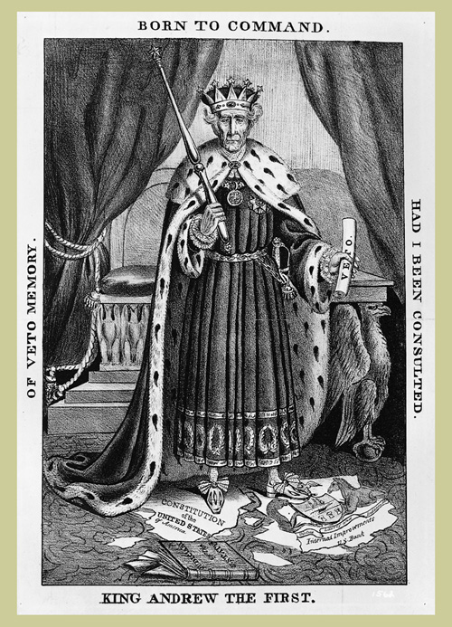
Bell Ringer: Who would have created this cartoon of Andrew Jackson—a Democrat or a Whig? How do you know?

Slide 15
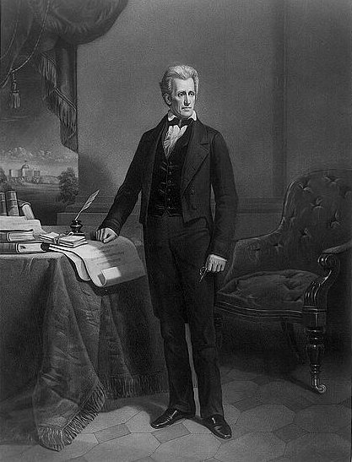
Election of 1824
All candidates were Republican
John Quincy Adams, son of a Federalist president, Secretary of State under Monroe; represented the interests of the Northeast
Henry Clay of Kentucky, Speaker of the House of Representatives
Andrew Jackson-a Senator from Tennessee and military hero from the Battle of New Orleans in the War of 1812, drew Western support away from Clay
William H. Crawford of Georgia was born in Virginia and hoped to continue the "Virginia Dynasty;” Secretary of the Treasury

Slide 16
Election of 1824
Andrew Jackson-99 electoral votes/152,933 popular votes
John Quincy Adams-84 electoral votes/115,696 popular votes
Because nobody had received a majority of votes in the electoral college, the 12th Amendment dictated that the House of Representatives had to choose between the top three candidates.

Slide 17
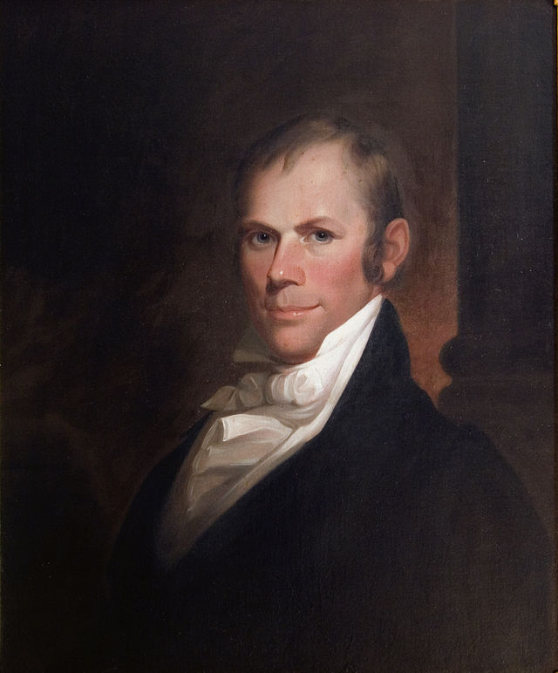
“Corrupt Bargain”
Henry Clay, the speaker of the House of Representatives
Clay forged an Ohio Valley-New England coalition by throwing his support to Adams
John Quincy Adams became President
Adams named Clay as his Secretary of State
Jackson and his supporters declared this a corrupt bargain; formed the Democratic Party

Slide 18
Election of 1828
.
Jackson’s campaign began almost immediately after the “corrupt bargain”. It was managed by Senator Martin Van Buren of NY
Created the Democratic Party from the remains of Jefferson’s old party
Support came from:
Northern farmers and artisans.
Southern slave owners.
Farmers with small land holdings.
Created a national committee that oversaw local and state party units.
Mass meetings, parades, picnics.

Slide 19
Election of 1828
.
One of the dirtiest campaigns in American history
Editor of Philadelphia Press documented Jackson’s alleged murders of twelve men in duels
Editor of Cincinnati Gazette reported on Jackson’s gambling and cursing
Others labeled Jackson’s mother a British prostitute who had married a black man by whom she had given birth to Jackson
Opponents called Jackson’s wife, Rachel, an adulteress and accused Jackson of being a wife stealer
Jackson blamed Henry Clay for much of the slander

Slide 20
Election of 1828
Intense feuding between the two factions of the Republican party
National Republicans supported President John Quincy Adams
Democrats supported Jackson
Jackson defeated Adams 178 electoral votes to 83
800,000 more males voted in this election compared to the one in 1824. The “Old Hero” from frontier Tennessee had defeated the incumbent president, son of a previous office holder.

Slide 21
Election of 1828
First president from the West; seen as a great common man; Ironically, he owned one of largest plantations in the west and owned many slaves.
Jackson’s support came from the West, South, and laborers on the east coast
Adams won New England and wealthy voters in the Northeast.
No sitting president had been removed since John Adams in 1800.
Increased voter turnout from the “New Democracy” was decisive.
Balance of power was shifting from the East to the expanding West.
America up to this point had been ruled by educated wealthy elites: Federalist shippers and Jeffersonian planters.
The elite were out and the people were in.

Slide 22
The Common Man/Jacksonian Democracy
Andrew Jackson and his supporters felt they had won a victory over major corruption in 1828
The “corrupt bargain” had demonstrated what was wrong with American society and politics: Corrupt elitists used the government for their own benefit at the expense of the common people
Jacksonians insisted that they would have honest government for the benefit of all

Slide 23
Andrew Jackson
Saw the federal gov't as a protector of the wealthy that was detached from common folks.
Like Jefferson, sought to reduce role of federal gov’t in favor of states’ rights; he hated Clay’s "American System“
Strong unionist and nationalist (to the surprise of the South); federal supremacy over states.
Believed in a strong presidency: he defied will of Congress and the Supreme Court
Used the veto 12 times; his six predecessors combined only used the veto 10 times
At times, he tested the authority of the Supreme Court
Opponents accused him of being "King Andrew I" for his perceived abuse of power

Slide 24
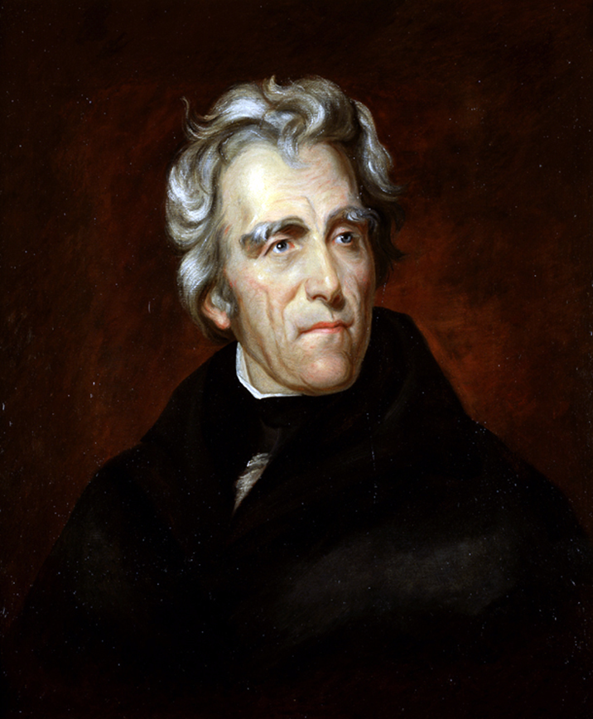
Inauguration
Took the oath of office on March 4, 1829 at the age of 61.
One of the most popular men ever elected president of the U.S.; record numbers of people, between 15,000 and 20,000, came to Washington to see “Old Hickory” inaugurated.

Slide 25
Inauguration
Jackson came in mourning; In December Rachel Jackson had gone shopping in Nashville and stopped to rest in a newspaper office.
She read for the first time accusations against her; she fainted and would eventually die of a heart attack
Jackson arrived in Washington wearing a black suit and black tie, a black armband and hatband that trailed down his neck in what was known as a weeper

Slide 26
Inauguration
Inaugural address was vague
Promised “proper respect” for states rights and a “spirit of compromise” over the tariff
Promised to reform civil service by replacing “unfaithful or incompetent” officers
He noted that he had “been elected by the choice of a free people”

Slide 27
Margaret Bayard Smith's account
But what a scene did we witness! The Majesty of the People had disappeared, and a rabble, a mob, of boys, negroes, women, children, scrambling fighting, romping. What a pity what a pity! No arrangements had been made no police officers placed on duty and the whole house had been inundated by the rabble mob…
The President, after having been literally nearly pressed to death and almost suffocated and torn to pieces by the people in their eagerness to shake hands with Old Hickory, had retreated through the back way or south front and had escaped to his lodgings at Gadsby's.
Cut glass and china to the amount of several thousand dollars had been broken in the struggle to get the refreshments, punch and other articles had been carried out in tubs and buckets…
Ladies fainted, men were seen with bloody noses and such a scene of confusion took place as is impossible to describe, - those who got in could not get out by the door again, but had to scramble out of windows. At one time, the President who had retreated and retreated until he was pressed against the wall, could only be secured by a number of gentleman forming around him and making a kind of barrier of their own bodies…

Slide 28
“Andrew Jackson, I am given to understand, was a patriot and a traitor. He was one of the greatest of generals, and wholly ignorant of the art of war. A writer brilliant, elegant, eloquent, without being able to compose a correct sentence, or spell words of four syllables. The first of statesmen, he never devised, he never framed a measure. He was the most candid of men, and was capable of the profoundest dissimulation. A most law-defying, law-obeying citizen. A stickler for discipline, he never hesitated to disobey his superior. A democratic autocrat. An urbane savage. An atrocious saint.“
James Parton, Jackson biographer

Slide 29
Jackson’s Presidency
Spoils System
Tariff of Abominations
National Bank
Indian Removal

Slide 30
Spoils System
The practice involved rewarding political supporters with public offices, regardless of merit.
Secretary of State Martin Van Buren was the main architect of the spoils system as he had engineered a political machine in NY (known as the “Albany Regency”)
Jackson believed in the ideal of "rotation in office" or "turn about is fair play"
Goal: Let as many citizens as possible hold office for at least a short time.
Sought to remove Adams-Clay officials and replace with loyal Jacksonians.
Set a precedent for "clean sweeps" in subsequent presidencies.

Slide 31
Spoils System
Consequences of the spoils system
A national political machine was built around Jackson.
Competence and merit were not as important and many able citizens were left out as a result.
Political corruption resulted

Slide 32
Spoils System
"Kitchen Cabinet"
Jackson met at times with an unofficial group of about 13 temporary advisors.
Some were newspaper people who kept Jackson in touch with public opinion.
Critics were angry that advisors not answerable to Congress as was the official cabinet
Congress saw it as a threat to checks and balances
Yet, the group never met officially and its influence was greatly exaggerated.
Not unconstitutional: presidents are free to consult with unofficial advisers

Slide 33
Tariff of Abominations
Congress had increased the tariff in 1824 from 23% on dutiable goods to 37%; the tariff was largely protective
New England pushed for passage of a new tariff in 1828 that would raise duties to an unprecedented 45%
Daniel Webster argued for it (reversing his previous position on the 1816 tariff)
John C. Calhoun argued against it arguing the tariff would hurt the South.

Slide 34
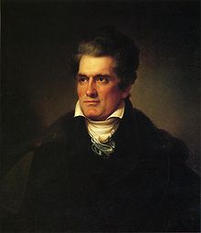
Tariff of Abominations
The tariff passed and furious Southerners called it the “Tariff of Abominations”
Southerners feared the power of the federal gov’t had become too strong.
Southerners argued they would suffer both as consumers and exporters.
John C. Calhoun's "The South Carolina Exposition"
Written secretly as Calhoun was Adams’ vice-president
Denounced the tariff as unjust and unconstitutional
Said states should nullify the tariff (similar to Jefferson’s and Madison’s Virginia and Kentucky Resolutions of 1798)

Slide 35
Webster-Hayne Debate
S.C. Senator Robert Y. Hayne argued against the “Tariff of Abominations” of 1828; argued for state’s rights
Accused New England of disloyalty during the War of 1812
Condemned New England's selfishness regarding the protective tariff.
Proclaimed Calhoun's doctrine of nullification was the only means of protecting southern rights.
Hayne’s arguments later used by nullifiers and secessionists

Slide 36
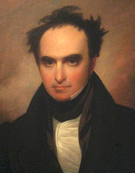
Webster-Hayne Debate
Daniel Webster, from New England, spoke on behalf of the Union.
Insisted the people not the states had framed the Constitution; assailed the doctrine of nullification
He went against Jefferson and Madison’s “compact theory” of government
"Liberty and Union, now and forever, one and inseparable.”
Result of the debate:
Illustrated the rising sectionalism in the country
Some credit Webster for helping win the Civil War by arousing a new generation of northerners to fight for ideal of Union.

Slide 37
Tariff of 1832 and Nullification Crisis
Calhoun resigned the vice presidency in 1832.
The 1832 Tariff Controversy became the major wedge between Calhoun and Jackson
Up until this time, Calhoun had publicly been a strong nationalist.
Saw himself in line for the presidency after Jackson served 1 term.
His falling out with Jackson destroyed his presidential hopes.
Calhoun became a fierce sectionalist: as a leader of the Senate he protected slavery and states rights’

Slide 38
Tariff of 1832 and Nullification Crisis
Jackson attempted to lower the tariff of 1828 to conciliate the South
Lowered duties to 35% from 45%
law was still protective; not merely a revenue-based tariff
Fell far short of meeting all Southern demands
South Carolina took drastic action by nullifying the Tariff of 1832
Called upon state legislature to make necessary military preparations
Threatened to secede from the Union if Jackson attempted tariff collections by force

Slide 39
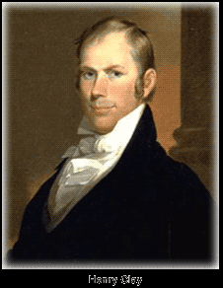
Tariff Compromise & Force Bill
Henry Clay proposed a compromise tariff in 1833.
The 1832 tariff would be reduced by 10% over eight years.
Many in New England and the Mid-Atlantic states opposed it.
Calhoun and the South favored it; South Carolina accepted it.
Force Bill (1833) was passed by Congress as a face-saving device
President in the future could use military force to collect federal tariffs if necessary.
Dubbed the "Bloody Bill" by South Carolinians (who symbolically nullified it)

Slide 40
Main Idea Activity
In one or two concise sentences demonstrate the relationship between the following terms. Use past tense and show “change over time”.
Five Civilized Tribes
Indian Removal Act
Worcester v. Georgia
Trail of Tears

Slide 41
Main Idea Activity
In one or two concise sentences demonstrate the relationship between the following terms. Use past tense and show “change over time”.
Nicholas Biddle
Pet Banks
Specie Circular
Panic of 1837

Slide 42
DBQ Analysis Activity
Accountability Teams
25 minutes: Use your DBQ analysis sheet to analyze the Documents using the HIPP strategy

Slide 43
Works Cited
Marszalek, John F. “Andrew Jackson: Flamboyant Hero of the Common Man”, 1998.
Murrin, John, et al. Liberty, Equality & Power. 3rd Edition

