Slide 1
Nationalism and Sectionalism during the Age of Jackson
The 19th Century industrial expansion of the United States demonstrated both a strong spirit of nationalism and a growing sectional divide between the North and the South.

Slide 2
The Industrial Revolution, which took place from the 18th to 19th centuries, was a time period when many agrarian and rural societies in Europe and America became industrial and urban.
The revolution began in Britain and spread to the U.S. in the late 1700s
Before the Industrial Revolution manufacturing was mostly done in people’s homes, using hand tools
Industrialization marked a shift to powered, special-purpose machinery, factories and mass production.
Begins with the iron and textile industries and the development of the steam engine
It included improved systems of transportation, communication and banking.
Good and Bad: Industrialization increased the amount and variety of manufactured goods and an improved standard of living for some; But it also resulted in unemployment and poor living conditions for the new working classes.

Slide 3
Industrial Revolution
Antebellum United States (1789-1860)

Slide 4
Warm Up- Harriet Robinson: Lowell Mill Girls
Read the excerpted account from Robinson and answer the following questions:
What was characteristic of the Lowell Mill girls and their work?
What was the “most prevailing incentive to labor”?
How did making money potentially change these women?
How were the rights of women limited during this time period?
How did the Lowell Mill girls gain rights?
Predict: How do you think the Lowell experience would impact the girls that worked there as they grew older?

Slide 5
Industrial Revolution
The North and the South developed different
Economic systems that led to differences between the regions.
During the 19th Century factories became the centers of industry.
New approaches to manufacturing, such as interchangeable parts, took industry out of American households and artisan’s workshops
Factory system used power-driven machinery and laborers assigned to different tasks which made mass production possible.
New technologies in early 19th century America brought many changes:
Industrialization
Communication
Transportation

Slide 6
Interchangeable Parts
The first use of interchangeable parts was created by inventor Eli Whitney.
Before this time, guns were made one at a time. Each gun was different.
If a part broke, a new part had to be created.
Whitney created muskets with exactly the same parts, so any part would fit any gun.
The use of interchangeable parts speeded up production, made repairs easier, and allowed the use of lower-paid, less skilled workers.

Slide 7
Northern Economy
The North and the South developed different
Economic systems that led to differences between the regions.
Industrial Revolution
First began in Great Britain when inventors came up with ways to generate power using streams/rivers and coal.
Thomas Jefferson’s Embargo Act of 1807 and the War of 1812 forced Americans to become more self sufficient and industrial
The biggest push to develop industry occurred in New England where the shipping industry had declined due to lack of trade; and the availability of natural resources such as water

Slide 8
Northern Economy
The North and the South developed different
Economic systems that led to differences between the regions.
Industrial Revolution
1793, a British immigrant Samuel Slater started first mechanized textile factory in Pawtucket, Rhode Island
1813, Francis Cabot Lowell built a weaving factory in Waltham, Massachusetts
Thousands of people-mostly young women-traveled to Lowell, Massachusetts to find work (Lowell Girls)

Slide 9
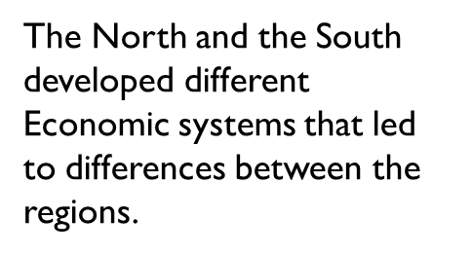
Northern Economy
An Englishman Samuel Slater stole industrial secrets from England in 1789 and brought them to America.
He opened a textile mill (Produced Cotton)in Pawtucket, Rhode Island. He became a millionaire.

Slide 10
Northern Economy
Samuel Slater
English Factory Worker
“Father of the American factory system”
Worked for a cotton mill in England as a young child
Rose to superintendent
Became extremely familiar with the mill machines (Richard Arkwright – eventually used water to power his machines, divided labor among groups)
Sneaky Departure 1789=British law forbade textile workers from sharing technological information or to leave the country. (Brain drain)
Slater memorized the plans and brought them to the U.S.

Slide 11
Northern Economy
Slater’s Rhode Island Mill
Built America’s first water-powered cotton spinning mill
Pawtucket, Rhode Island
Workers originally walked a treadmill to generate power
By 1791 a waterwheel drove the machinery that carded - a mechanical process that disentangles, cleans and intermixes - and spun the cotton into thread
Employed families – including children – to live and work in the mills
Large Mill
Tenement houses
Company store

Slide 12
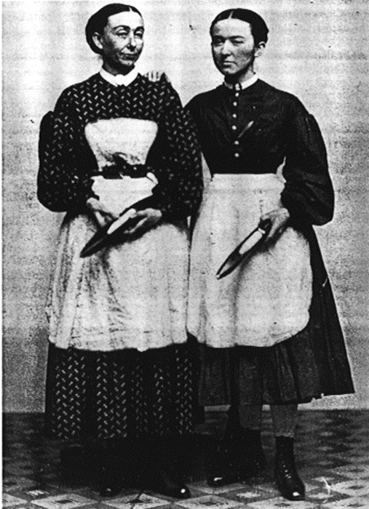
Northern Economy
In 1813, Francis Cabot Lowell built a weaving factory in eastern Massachusetts, near the Concord River.
The factory spun cotton into yarn and wove the cotton into cloth.
Something was different about this factory, they hired women.
The “Lowell girls” lived in company-owned boardinghouses.
The girls worked over 12 hours a day in deafening noise.
They came for the good wages: between two and four dollars a week.

Slide 13
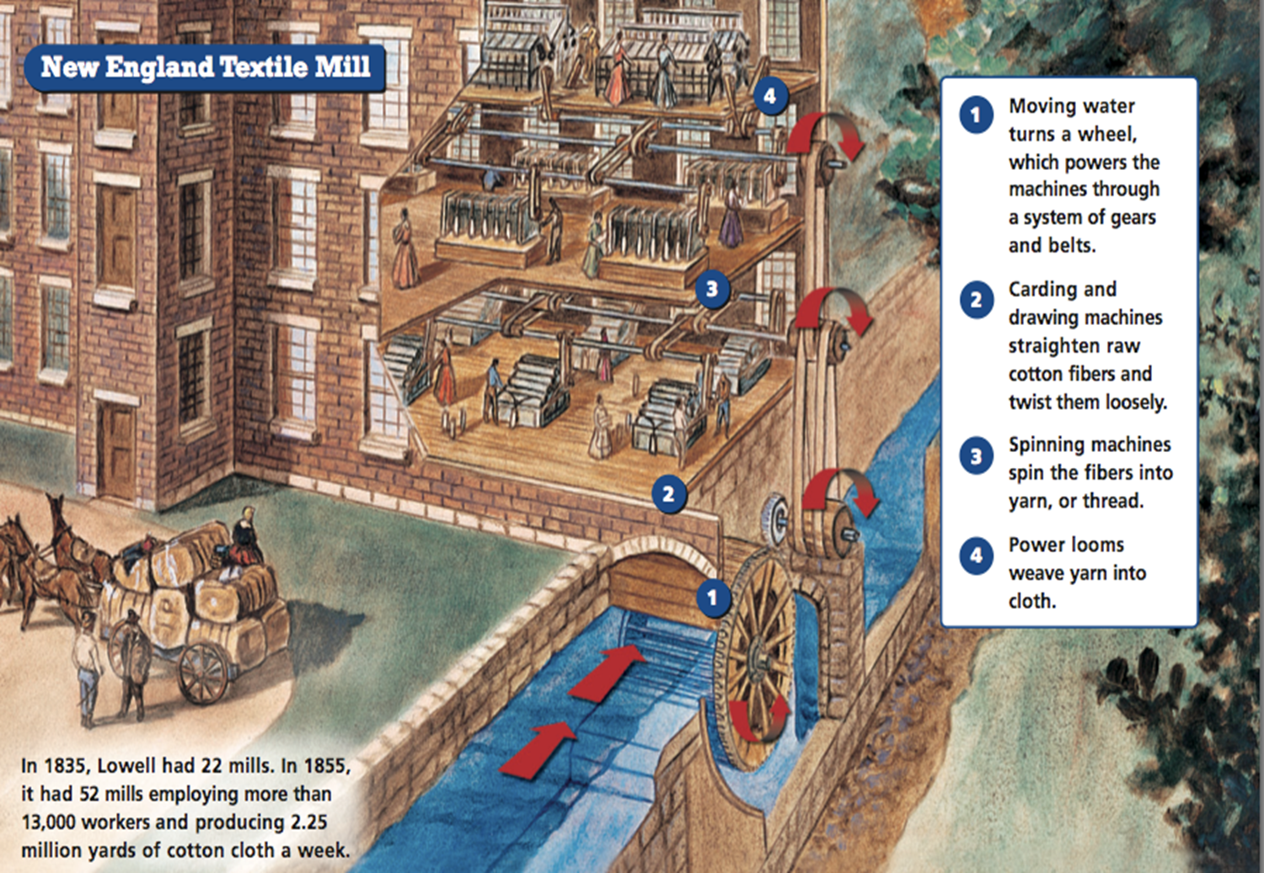

Slide 14
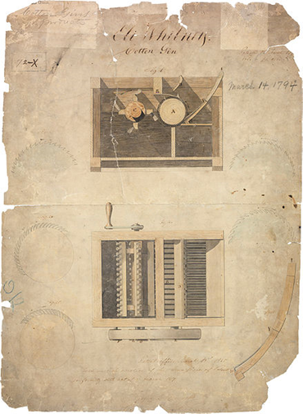
Southern Economy
The North and the South developed different
Economic systems that led to
differences between the regions.
Cotton is King in the South
Eli Whitney’s invention of the Cotton gin in 1793 helped the South develop differently from the North. Short staple cotton was easier to grow but harder to clean. Whitney’s gin changed that.
Cotton was in high demand in Great Britain and in the North
By 1820 the plantation system of farming had made Louisiana, Mississippi and Alabama a booming Cotton Kingdom

Slide 15
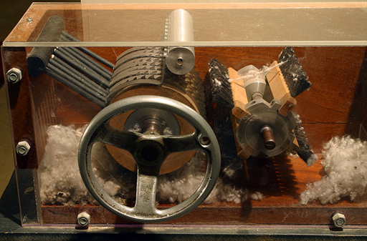
Southern Economy
The North and the South developed different
Economic systems that led to differences between the regions.
Cotton is King in the South
Cotton gin accelerated the expansion of slavery
From 1790 to 1810 cotton production increased from 3,000 bales a year to 178,000 bales.
The number of slaves in the South jumped from 700,000 to 1.2 million

