Slide 1
Immigration during the Gilded Age
New Immigrants

Slide 2
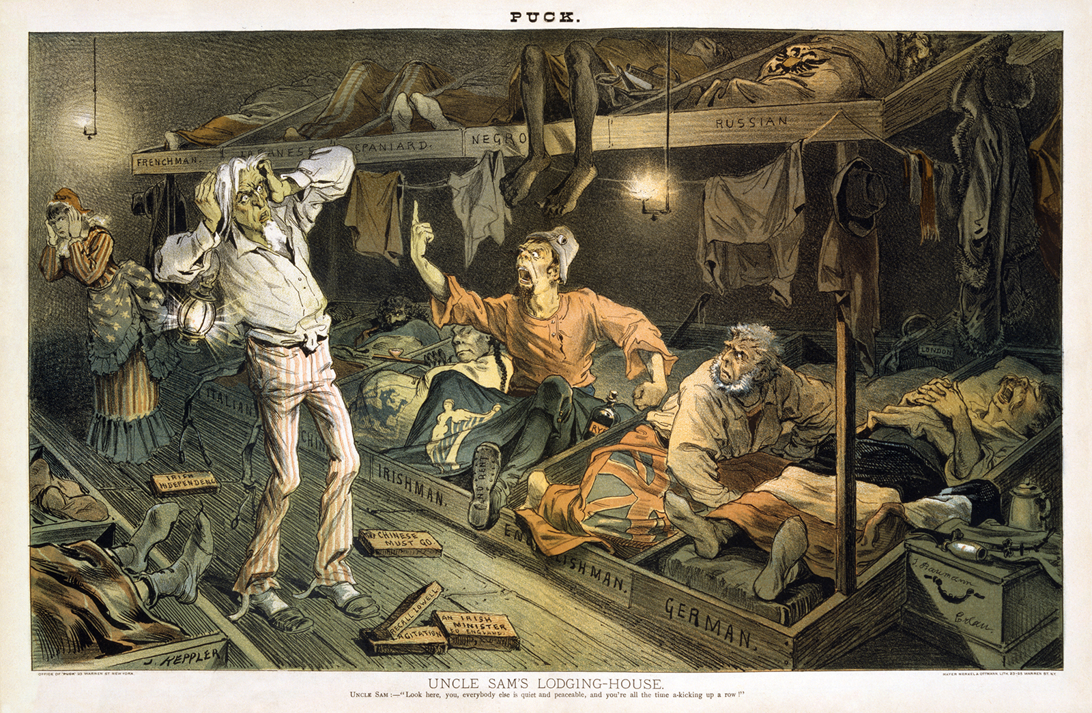

Slide 3
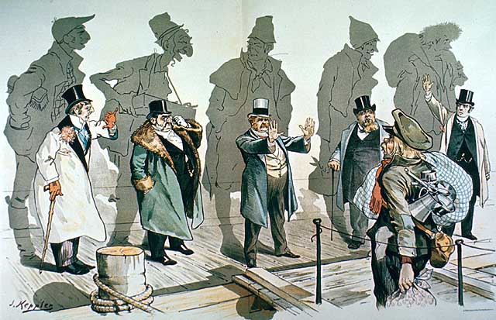

Slide 4
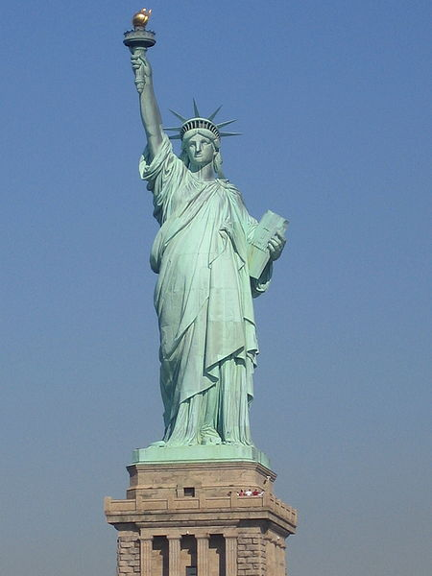

Slide 5
New Immigrants
Between 1870 and 1920, 20 million Europeans arrived in the United States
Before 1890 most immigrants came from countries in western and northern Europe
By the 1890s more immigrants came from southern and eastern Europe
In 1907 about 1 million people arrived from Italy, Austria-Hungary and Russia

Slide 7
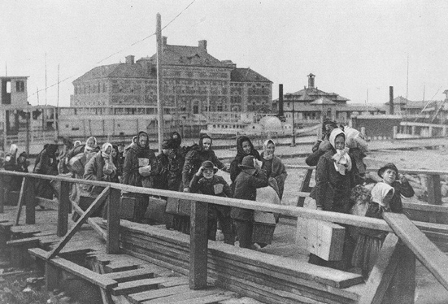

Slide 8
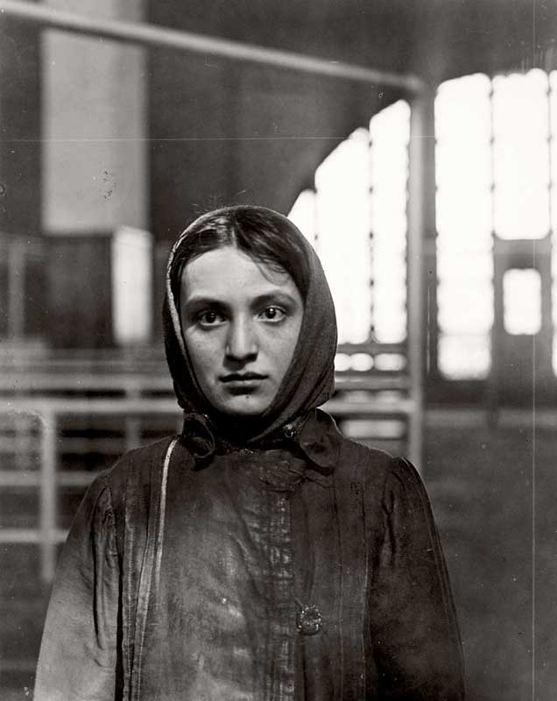
Push/Pull Factors
Many immigrants left to escape religious persecution (whole Jewish villages were driven out of Russia by organized attacks, or pogroms, led by local authorities
Many came because of population increases (Between 1800 and 1900 the population in Europe doubled to 400 million) which resulted in scarcity of land
Spirit of revolt and reform had spread across Europe; many young Europeans sought independent lives in the U.S.

Slide 9
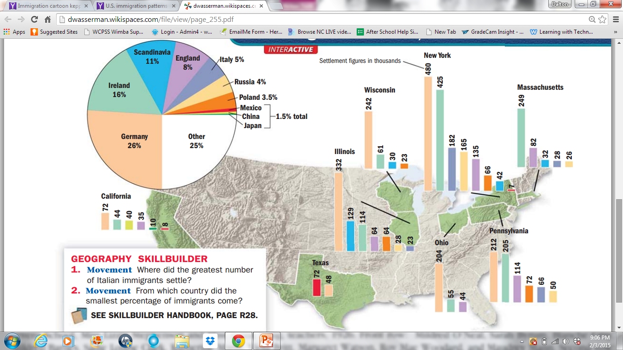

Slide 10
A Difficult Journey
In the 1870s almost all immigrants traveled by steamship
Trip across the Atlantic from Europe to about one week; Pacific crossing from Asia took about 3 weeks
Many immigrants traveled in steerage, the cheapest accommodations in the holds of a cargo ship
Rarely allowed on deck to breathe fresh air or exercise; exposed to lice; shared toilets
Disease spread rapidly on ships

Slide 11
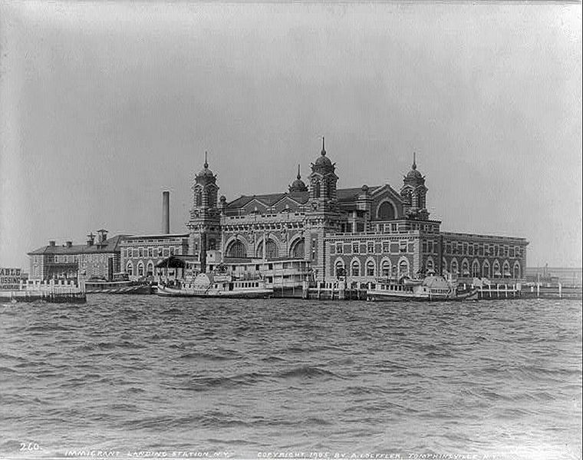
Notes:
1905

Slide 12
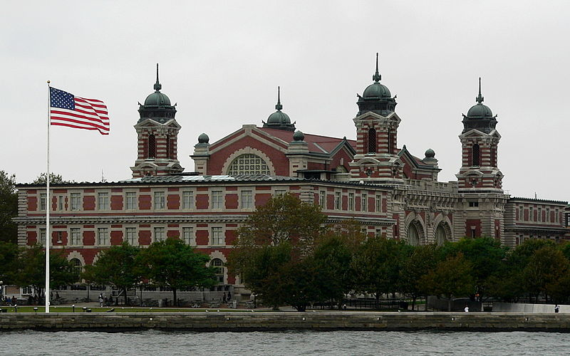

Slide 13
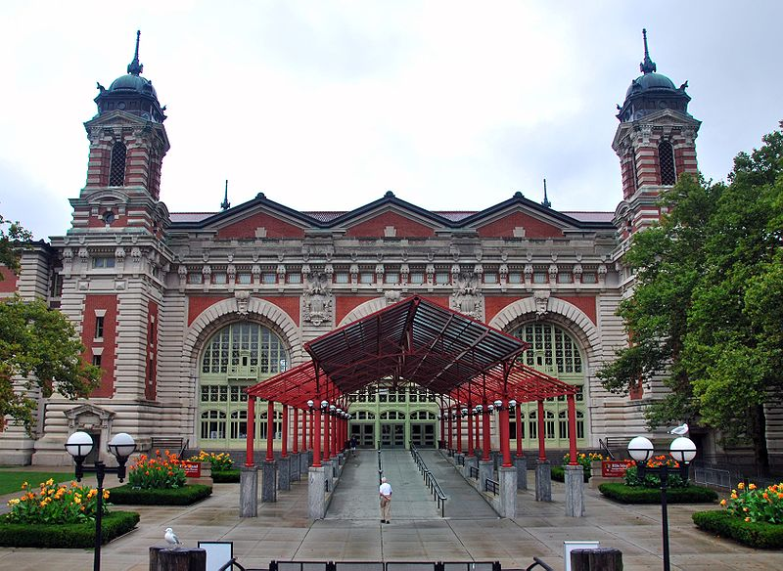

Slide 14
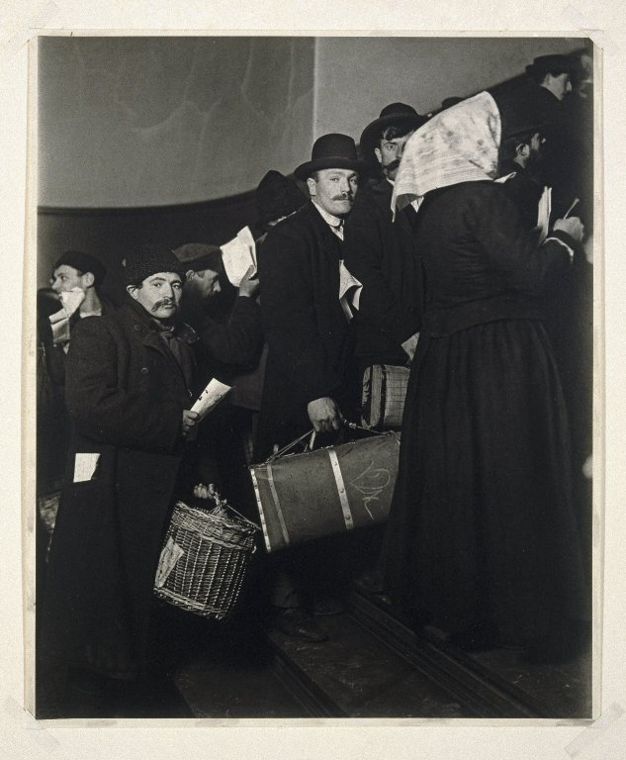
Ellis Island
Immigrants faced the anxiety of not knowing whether they would be admitted into the U.S.
Had to pass inspection at immigration stations such as Castle Garden in N.Y. which was later moved to Ellis Island in N.Y. Harbor
About 20% were detained for a day or more before being inspected
About 2% were denied entry

Slide 15


Slide 16
Ellis Island
Processing of immigrants might take 5 hours or more
Had to pass a physical examination by a doctor
Anyone with a serious health problem or contagious disease such as tuberculosis, was sent home
Those who passed the medical exam then reported to a government inspector
Inspector checked documents and questioned immigrants to see if they met legal requirements to enter
Legal requirements included proving they had never been convicted of a felony, showing that they could work, and showing that they had some money (at least $25)

Slide 17
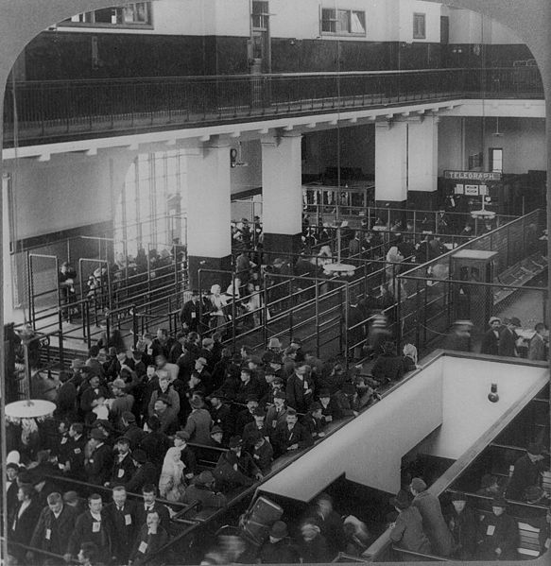
Notes:
1904

Slide 18
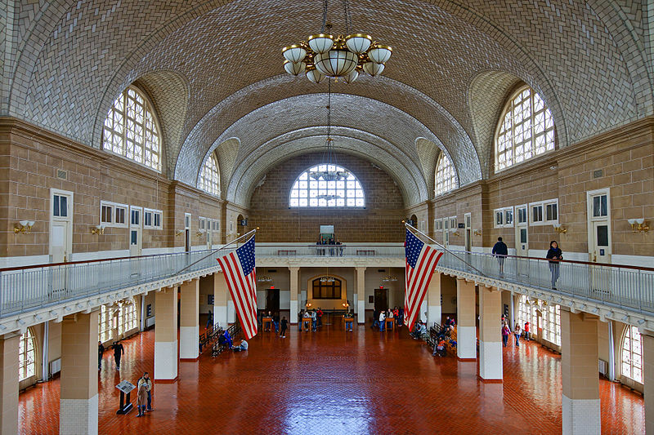

Slide 19
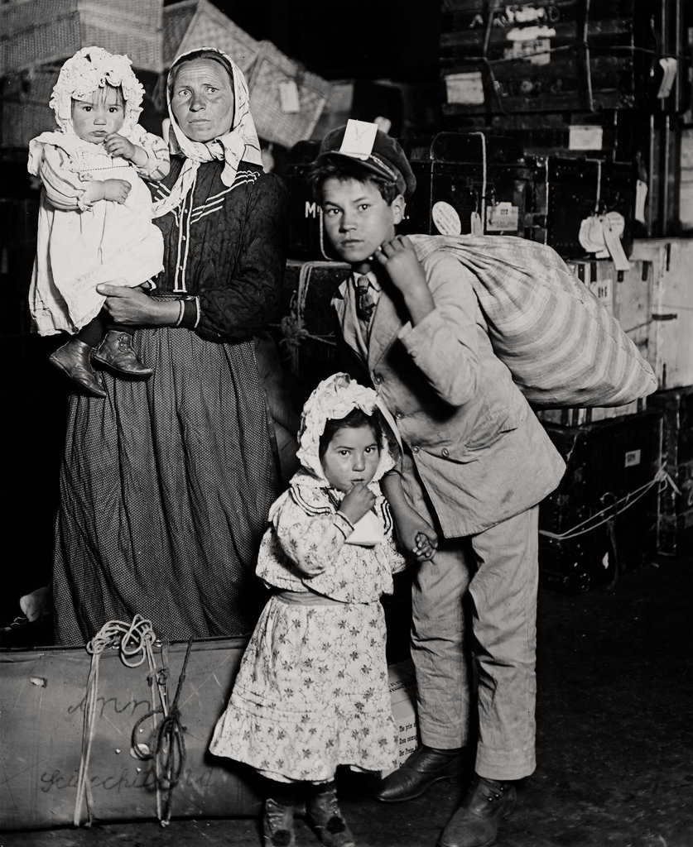
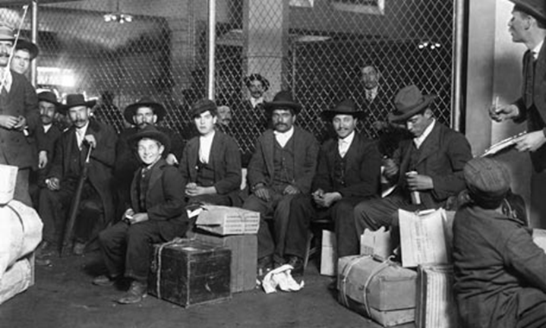
Ellis Island
From 1892 to 1924, Ellis Island was the chief immigration station in the U.S.
17 million immigrants passed through during that time

Slide 20
Angel Island
Between 1851 and 1883 about 300,000 Chinese arrived on the West Coast
Many came due to the California Gold Rush
Chinese immigrants helped build the first continental railroad
Asians, primarily Chinese, arriving on the West Coast gained admission at Angel Island in San Francisco Bay
Between 1910 and 1940 about 50,000 Chinese immigrants entered the U.S.
Processing was more difficult than Ellis Island
Immigrants endured harder questioning and long detention if filthy buildings

Slide 21
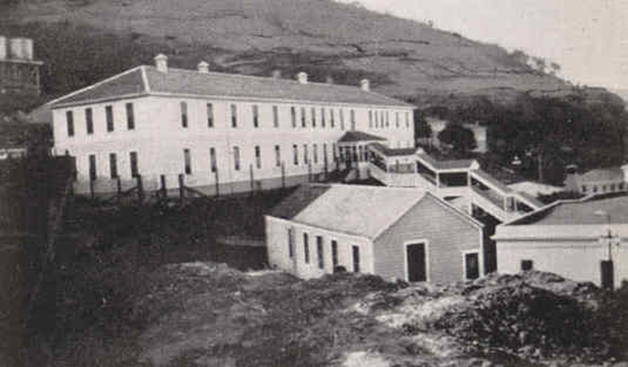
Angel Island

Slide 22
Cooperation for Survival
Once admitted to the country, immigrants faced challenge of finding a place to live, getting a job, getting along in daily life
Tried to understand an unfamiliar language and culture
Many sought out people who shared their own cultural values, and practiced the same religion and spoke the same language
Many ethnic communities formed which allowed people to pool resources in order to survive (churches or synagogues, social clubs, aid societies, orphanages, old people’s homes, cemeteries)
Hyphenated Americans-Polish-Italian-Chinese-
Many New Immigrants did not embrace the idea of a “melting pot”; wanted to keep cultural identities

Slide 23
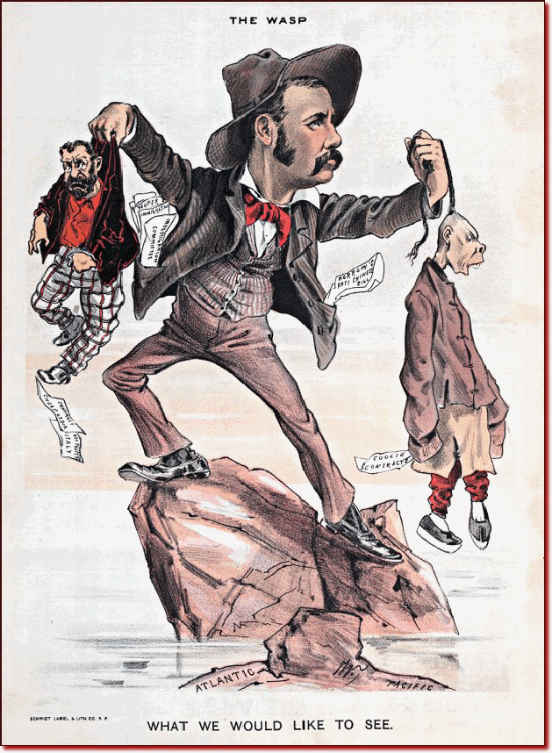
Nativism during the Gilded Age
Nativism gave rise to anti-immigrant groups and demand for immigrant restrictions
Pro WASP
American Protective Association founded in 1887 launched Anti-Catholic and Anti-Semitic attacks to convince colleges, businesses and social clubs to not admit Jews
In 1897 the Immigration Restriction League convinced Congress to pass a bill requiring a literacy test for immigrants (would be vetoed)

Slide 24
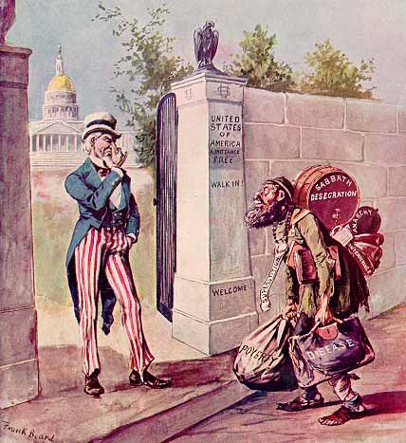
Notes:
THE IMMIGRANT: THE STRANGER AT OUR GATE.
EMIGRANT.--Can I come in?
UNCLE SAM.--I 'spose you can; there's no law to keep you out.
http://ehistory.osu.edu/osu/sources/

Slide 25
Anti-Asian Sentiment
Nativism influenced the labor movement, especially in the West
Native born workers feared jobs would go to Chinese immigrants who would accept lower wages
Depression of 1873 increased anti-Chinese sentiment
In 1882, Congress locked out the Chinese for 10 years by passing the Chinese Exclusion Act
Act banned entry to all Chinese except students, teachers, merchants, tourists and government officials
In 1892, Congress extended the law for another 10 years; In 1902 Chinese immigration was restricted indefinitely; law was not repealed until 1943
Gentlemen’s Agreement of 1907-08; Japan’s government agreed to limit emigration of unskilled workers to U.S. in exchange for the repeal of San Francisco school segregation

Slide 26
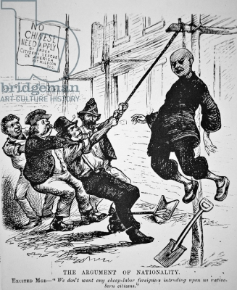

Slide 27
Ethnic Neighborhoods?

