Slide 1
Immigration during the Gilded Age
New Immigrants

Slide 2
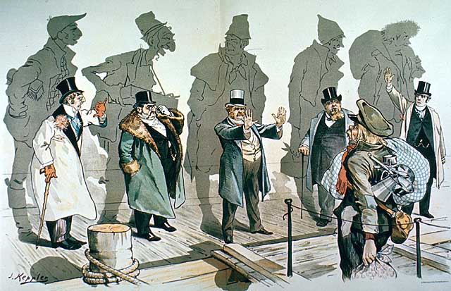

Slide 3
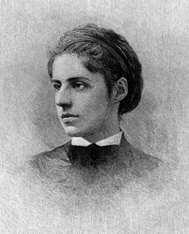
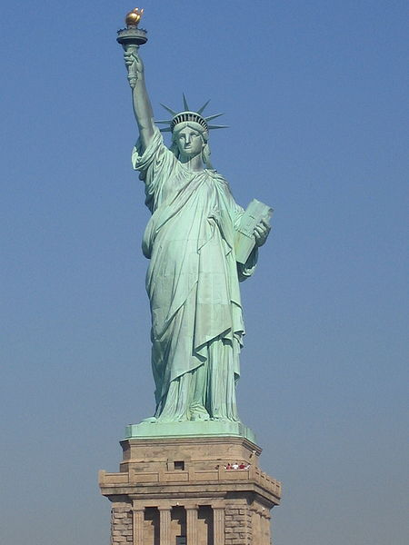
The New Colossus
1883-campaign to raise money for the pedestal of the Statue of Liberty
That same year, Georgina Schuyler, a patron of the New York arts scene found a poem that had been written as part of a contest to raise money for the pedestal
“Give me your tired, your poor, your huddled masses yearning to breathe free”
The author was Emma Lazarus, who had written the poem from personal experience
Lazarus was a member of the N.Y. elite; she had a privileged childhood; Ralph Waldo Emerson was her writing mentor
She began to defend Jewish rights and spoke out against Jewish persecution in Eastern Europe; began to work for the relief of Jewish immigrants to America
Died at the age of 38 from Hodgkin's Disease worsened by depression; her poem “the New Colossus” lives on at the base of the Statue of Liberty
Poem compares Lady Liberty to the Colossus of Rhodes of the Ancient Greeks

Slide 4
The New Colossus
Not like the brazen giant of Greek fame,
With conquering limbs astride from land to land;
Here at our sea-washed, sunset gates shall stand
A mighty woman with a torch, whose flame
Is the imprisoned lightning, and her name
Mother of Exiles. From her beacon-hand
Glows world-wide welcome; her mild eyes command
The air-bridged harbor that twin cities frame.
"Keep ancient lands, your storied pomp!" cries she
With silent lips. "Give me your tired, your poor,
Your huddled masses yearning to breathe free,
The wretched refuse of your teeming shore.
Send these, the homeless, tempest-tost to me,
I lift my lamp beside the golden door!"

Slide 5
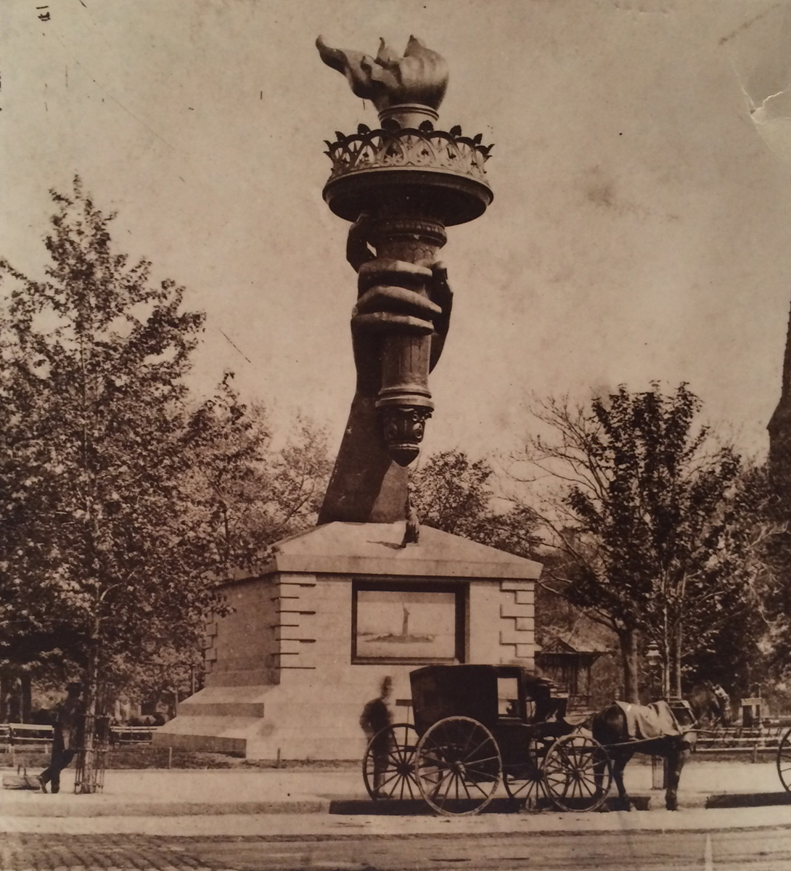
The New Colossus
Statue of Liberty stands 151 feet; weighs 225 tons
To travel from Paris to N.Y. she had to be disassembled into 300 pieces and shipped in more than 200 wooden crates
June 17, 1886-Liberty was installed
October 1886-President Grover Cleveland delivered a dedication

Slide 6
The New Colossus
Romantic version of the gift: The French generously offered the statue as a gift, honoring American ideals of freedom and opportunity for all
True story:
  French sculptor Frederic Bartholdi, wanted to wake up his fellow Frenchmen by stirring up emotions for liberty and freedom
  Bartholdi positioned the statue to face outward to Europe hoping that the rest of Europe would recognize the symbolism and promote democratic ideas in Europe

Slide 7
The New Colossus
But in the U.S. the statue was interpreted completely different (and still is)
  The statue became a symbol for those people leaving Europe
  The statue meant freedom to come to the U.S. and create a new life without religious and ethnic persecution
  This was the interpretation of Lazarus as well.

Slide 8
New Immigrants
Between 1870 and 1920, 20 million Europeans arrived in the United States
Before 1890 most immigrants came from countries in western and northern Europe
By the 1890s more immigrants came from southern and eastern Europe (Italy, Russia, Poland and Greece), as well as Asian locales such as China and Japan
In 1907 about 1 million people arrived from Italy, Austria-Hungary and Russia
For the most part “New” immigrants were not WASP

Slide 10
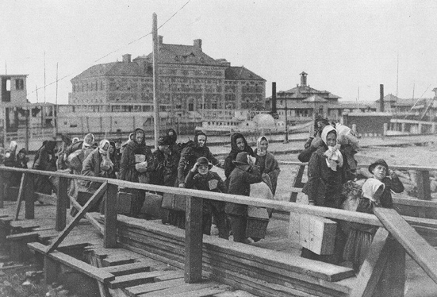

Slide 11
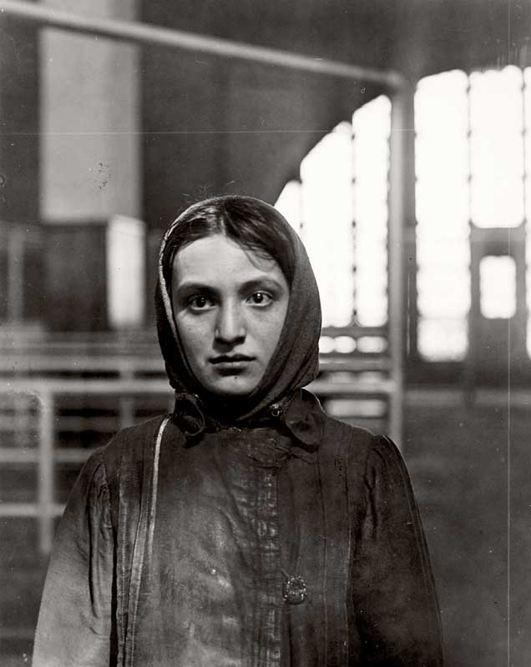
Push/Pull Factors
Many immigrants left to escape religious persecution (whole Jewish villages were driven out of Russia by organized attacks, or pogroms, led by local authorities)
Many came because of population increases (Between 1800 and 1900 the population in Europe doubled to 400 million) which resulted in scarcity of land
Spirit of revolt and reform had spread across Europe; many young Europeans sought independent lives in the U.S.

Slide 12
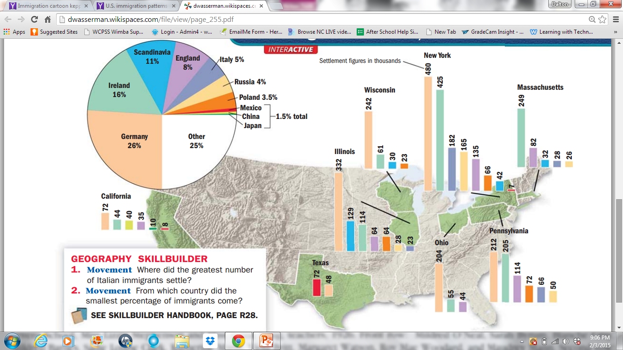

Slide 13
A Difficult Journey
In the 1870s almost all immigrants traveled by steamship
Trip across the Atlantic from Europe to about one week; Pacific crossing from Asia took about 3 weeks
Many immigrants traveled in steerage, the cheapest accommodations in the holds of a cargo ship
Rarely allowed on deck to breathe fresh air or exercise; exposed to lice; shared toilets
Disease spread rapidly on ships

Slide 14
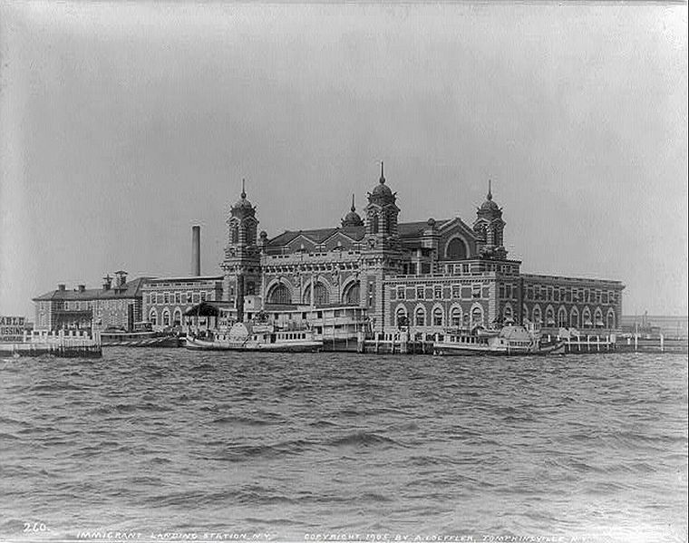
Notes:
1905

Slide 15
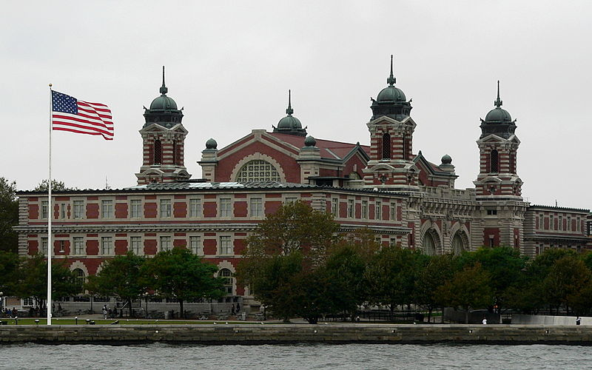

Slide 16
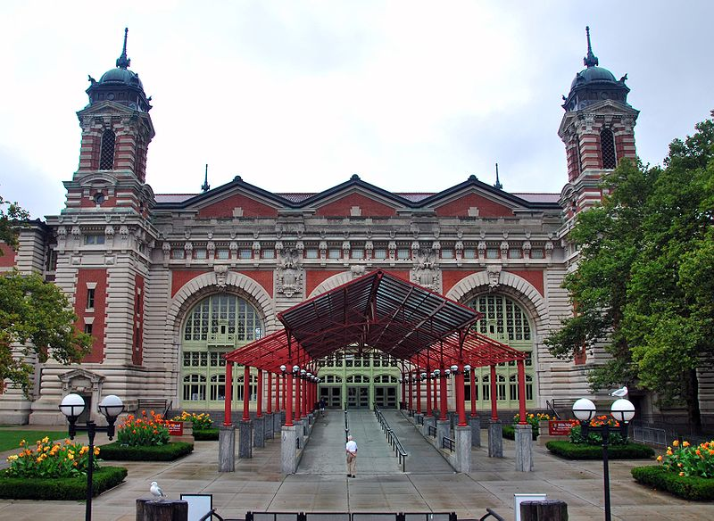

Slide 17
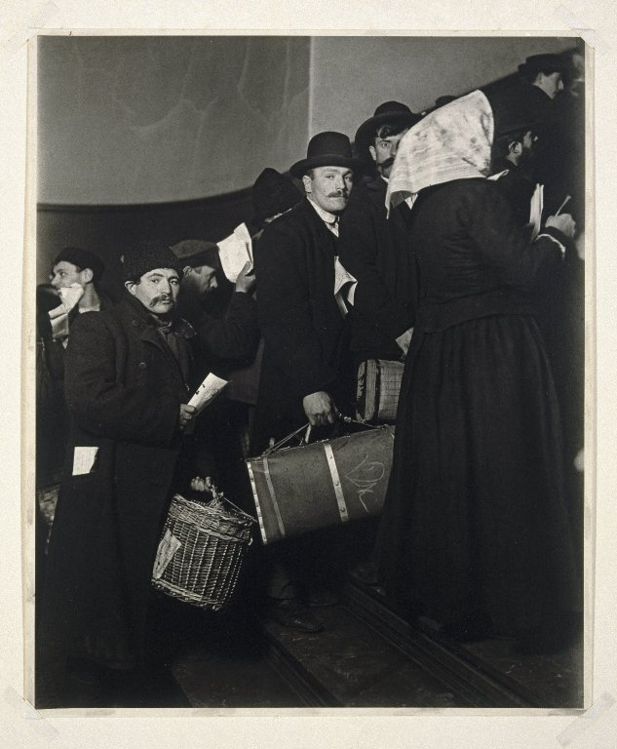
Ellis Island
Immigrants faced the anxiety of not knowing whether they would be admitted into the U.S.
Had to pass inspection at immigration stations such as Castle Garden in N.Y. which was later moved to Ellis Island in N.Y. Harbor
About 20% were detained for a day or more before being inspected
About 2% were denied entry

Slide 18
Ellis Island
Processing of immigrants might take 5 hours or more
Had to pass a physical examination by a doctor
Anyone with a serious health problem or contagious disease such as tuberculosis, was sent home
Those who passed the medical exam then reported to a government inspector
Inspector checked documents and questioned immigrants to see if they met legal requirements to enter
Legal requirements included proving they had never been convicted of a felony, showing that they could work, and showing that they had some money (at least $25)

Slide 19
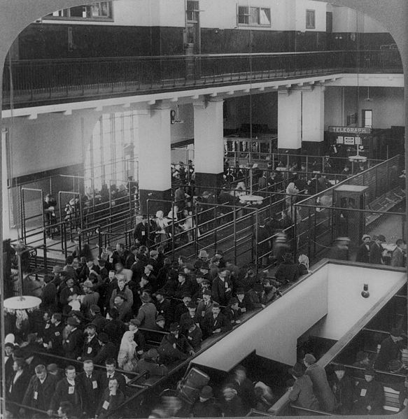
Notes:
1904

Slide 20
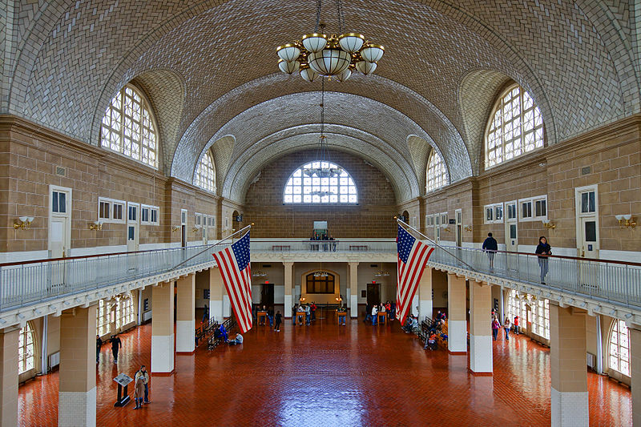

Slide 21
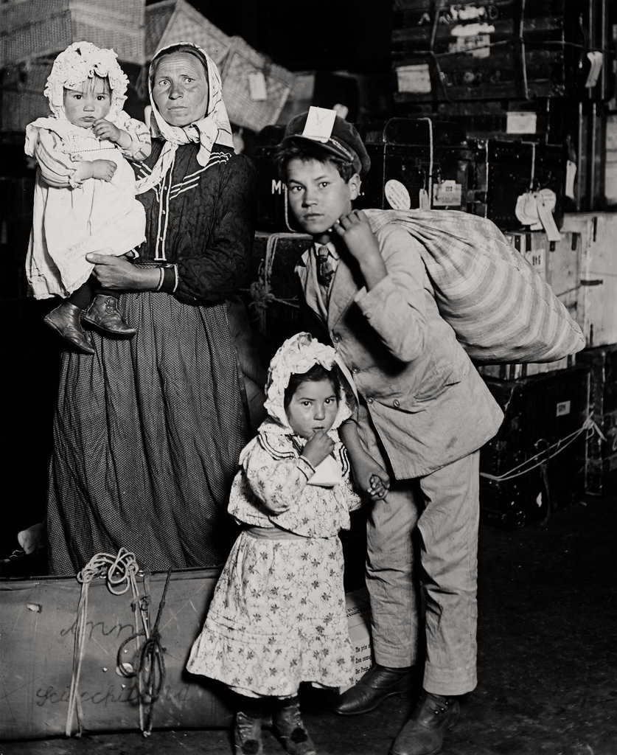
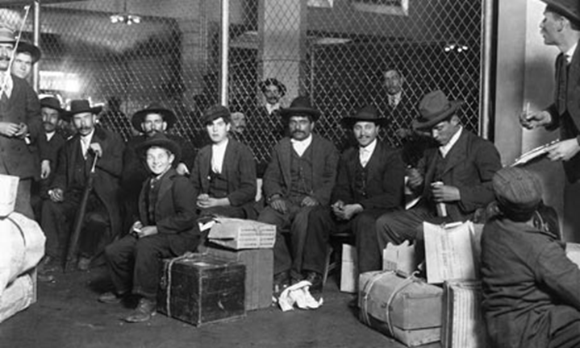
Ellis Island
From 1892 to 1924, Ellis Island was the chief immigration station in the U.S.
17 million immigrants passed through during that time

Slide 22
Angel Island
Between 1851 and 1883 about 300,000 Chinese arrived on the West Coast
Many came due to the California Gold Rush
Chinese immigrants helped build the first continental railroad
Asians, primarily Chinese, arriving on the West Coast gained admission at Angel Island in San Francisco Bay
Processing was more difficult than Ellis Island
Immigrants endured harder questioning and long detention in filthy buildings

Slide 23
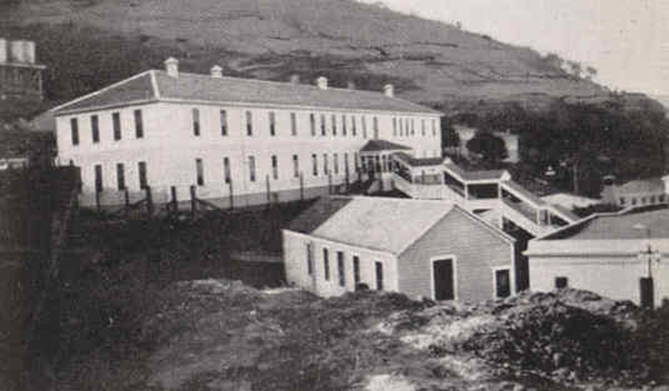
Angel Island

Slide 24
Cooperation for Survival
Once admitted to the country, immigrants faced challenge of finding a place to live, getting a job, getting along in daily life
Tried to understand an unfamiliar language and culture
Many sought out people who shared their own cultural values, and practiced the same religion and spoke the same language
Many ethnic communities formed which allowed people to pool resources in order to survive (churches or synagogues, social clubs, aid societies, orphanages, old people’s homes, cemeteries)
Hyphenated Americans-Polish-Italian-Chinese-
Many New Immigrants did not embrace the idea of a “melting pot”; wanted to keep cultural identities

Slide 25
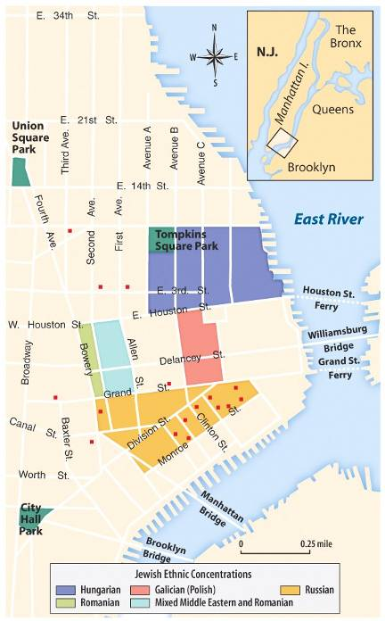
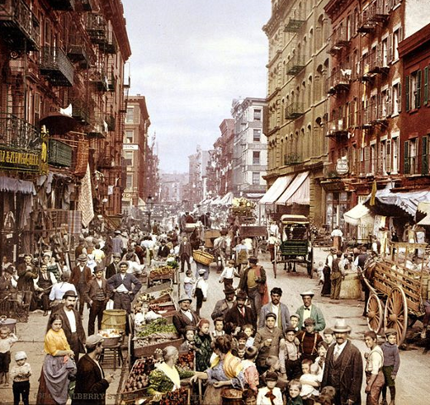
About 2/3 of immigrants settled in cities, such as New York, Chicago, Boston, or Philadelphia and lived in ethnic neighborhoods called enclaves
Enclaves provided new immigrants with a sense of community and security, as the immigrants were surrounded by the familiar customs, food and language of their homeland

Slide 26
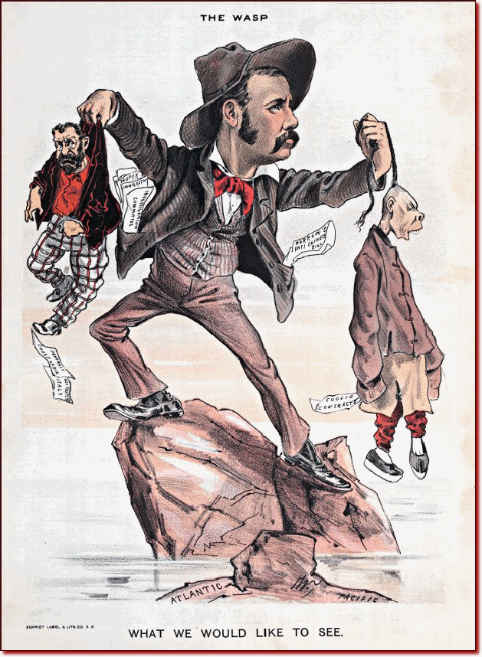
Nativism during the Gilded Age
Nativism gave rise to anti-immigrant groups and demand for immigrant restrictions
  Pro WASP
  American Protective Association founded in 1887 launched Anti-Catholic and Anti-Semitic attacks to convince colleges, businesses and social clubs to not admit Jews
  In 1897 the Immigration Restriction League convinced Congress to pass a bill requiring a literacy test for immigrants (would be vetoed)

Slide 27
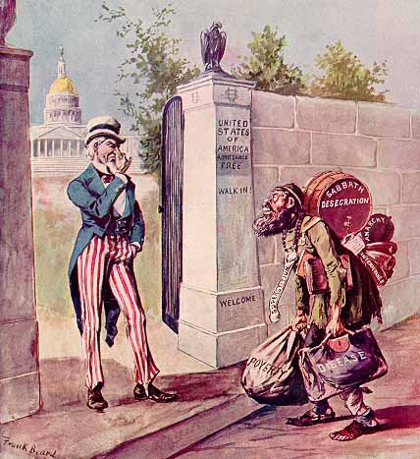
Notes:
THE IMMIGRANT: THE STRANGER AT OUR GATE.
EMIGRANT.--Can I come in?
UNCLE SAM.--I 'spose you can; there's no law to keep you out.
http://ehistory.osu.edu/osu/sources/

Slide 28
Anti-Asian Sentiment
Nativism influenced the labor movement, especially in the West
Native born workers feared jobs would go to Chinese immigrants who would accept lower wages
Depression of 1873 increased anti-Chinese sentiment
In 1882, Congress locked out the Chinese for 10 years by passing the Chinese Exclusion Act
Act banned entry to all Chinese except students, teachers, merchants, tourists and government officials
In 1892, Congress extended the law for another 10 years; In 1902 Chinese immigration was restricted indefinitely; law was not repealed until 1943
Gentlemen’s Agreement of 1907-08; Japan’s government agreed to limit emigration of unskilled workers to U.S. in exchange for the repeal of San Francisco school segregation

Slide 29
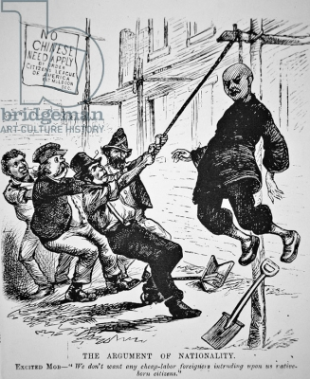

Slide 30
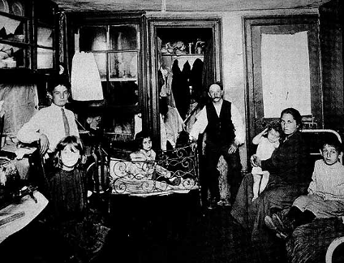
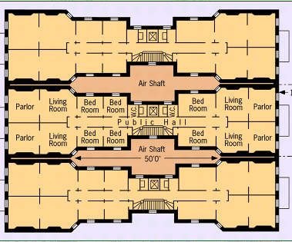
Most American cities
were not prepared for such rapid population growth
Many urban poor developed lung disease or tuberculosis; About 60% of immigrant babies died before their first birthday
Most urban immigrants lived in tenements: low rent apartments built the poorest parts of town called slums
Notes:
Half of Manhattan’s fires were in tenement buildings.

