Slide 1
Gilded Age Politics
1877-1900

Slide 2
Gilded Age Politics
Era was most highly competitive politically in US history
Voter turnout reached highest levels in US history
Between 1860 and 1900 78% of eligible voters turned out to vote in presidential elections
Between 60-80% turned out for non-presidential elections
Parties avoided controversial issues that might alienate voters
Led to issue-free campaigns
Turn out reflected party loyalty & regional, religious, & ethnic ties
16 states were solidly Republican; 14 States were solidly Democratic; 5 states (including NY and Ohio) were in doubt
Margin of victory for presidential elections was 1.5% of the popular vote

Slide 3
Political Parties
Republican Party
Stressed strict codes of personal morality and government’s involvement in regulating both economic & moral affairs of the community as a whole (temperance and restricting immigration)
Appealed to Northern Protestants, middle class, “old stock”, businessmen & African Americans
Support from Midwest & small & rural towns in northeast
Democratic Party
Opposed government efforts to impose a single moral standard on society
Emphasized economic equity
Consisted of many immigrant German Lutherans & Catholics (especially Irish)
Support from the Solid South & large industrial cities where immigrants factored in significantly under political machines

Slide 4
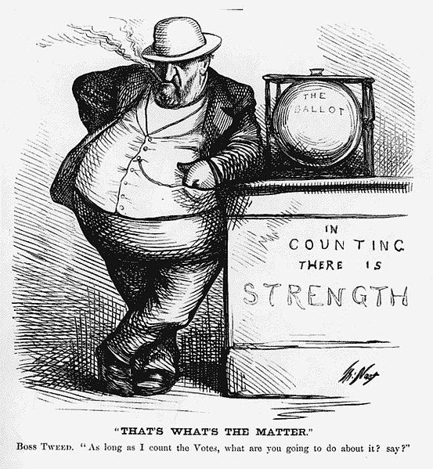
Political Corruption
Political Machines: Tightly organized groups of politicians that controlled the political parties in urban areas
Headed by a “boss”
Provided services to business, immigrants, & the poor in exchange for votes on election day
Exemplified by “Boss” William Tweed of the Tammany Hall machine (Tweed Ring) in NY city

Slide 5
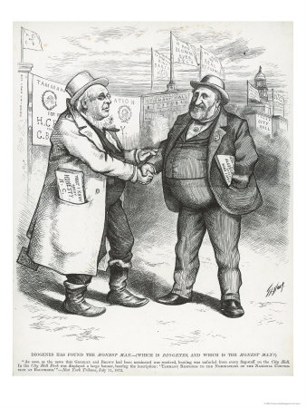
Political Corruption
Politics focused on winning and holding office, not on issues or legislation
Led to an increase in patronage, i.e. giving away government offices for votes, kickbacks, & party service
Government employment expanded significantly (e.g. postal service)
Reformers targeted spoils system as being inefficient & corrupt

Slide 6
Presidents & Patronage
Presidents of Gilded Age were subject to power of party bosses
Office only had symbolic importance; most important job of the president was to distribute government appointments (over 100,000)
Many of these appointments went to the post office (the largest government agency during the Gilded Age)
Had to avoid upsetting various factions within the party

Slide 7
Gilded Age Presidents
Rutherford B Hayes (1877-1880)
Republican
Elected as a result of the Compromise of 1877; ended Reconstruction
Attempted to reestablish honest government after Grant
Supported temperance

Slide 8
Republican Party Factions
Presidency of Rutherford B. Hayes demonstrated growing factions within the Republican Party
Stalwarts, Half-Breeds, and Mugwumps
Stalwarts: Led by Roscoe Conkling, New York Senator who favored spoils system and traditional machine politics
Half-Breeds: Led by James G. Blaine, Maine Congressman who favored civil service reform
Mugwumps: young liberal reformers
Favored Reconstruction policies to help African Americans
Anti-corruption
Would bolt party in favor of supporting an “honest” Democrat-- Grover Cleveland, 1884

Slide 9
Gilded Age Presidents
James Garfield (1881)
Republican – Half-Breed
Appointed most patronage jobs to Half-Breeds; angered Conkling & the Stalwarts
Assassinated by a deranged Stalwart office seeker in 1881
Became a martyr in a corrupt civil service system—spurred public demand for reform

Slide 10
Gilded Age Presidents
Chester A Arthur (1881-1885)
Republican – Stalwart
Became president when Garfield died
To the dismay of Stalwarts, he failed to use patronage to benefit the group and he supported civil service reform
Signed the Pendleton Act (1883)
Nation’s first civil service legislation; Prohibited appointing certain office holders based on wealth and patronage
Established a merit system for making appointments
Set up Civil Service Commission to give open competitive examinations to applicants
Impact: Forced politicians to look to corporations for campaign funds

Slide 11
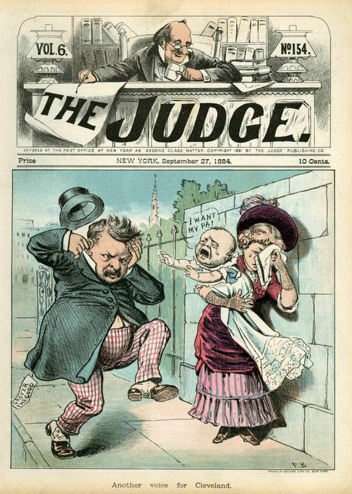
Election of 1884
Republicans – James Blaine
Democrats – Grover Cleveland
Campaign
Republicans publicized Cleveland’s claim of having an illegitimate child
A NY Republican clergyman labeled the Democrats as the party of “Rum, Romanism, and Rebellion”
Insulted NY’s Irish community
Blaine failed to repudiate the statement
The nativist phrase ultimately cost Blaine crucial NY

Slide 12
Election of 1884

Slide 13
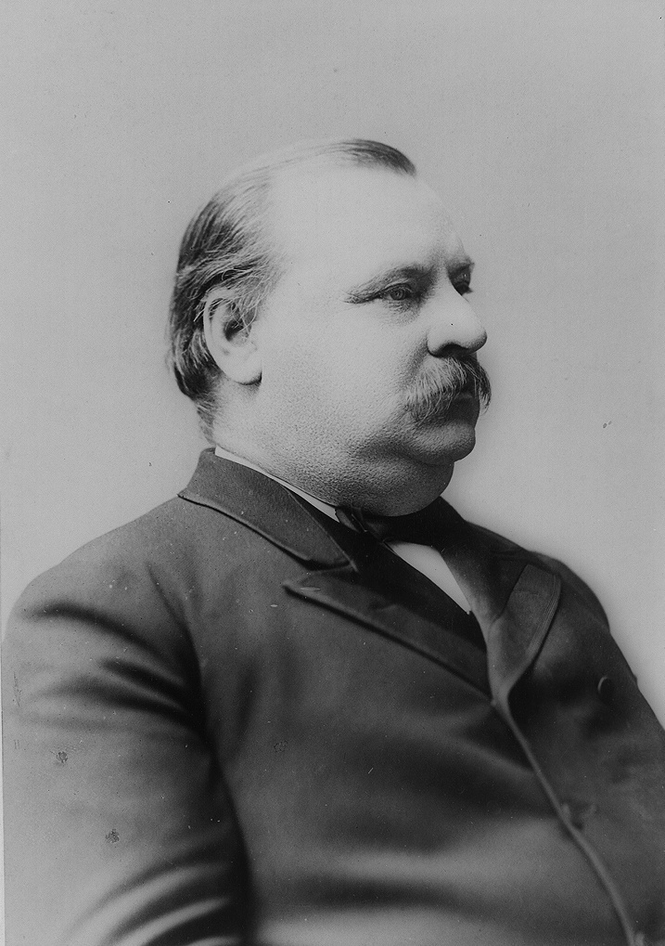
Cleveland’s Presidency
First Democrat in 28 years
Staunch believer in laissez faire economics
Believed in the merit system, but eventually replaced Republicans with “deserving Democrats”
Vetoed farm assistance – “Though the people support the government, the government should not support the people.”
Vetoed Civil War pension bills
Supported a lower tariff
First real issue that divided the Democrats & Republicans
Would end a treasury surplus
Meant lower prices for consumers and less protection for monopolies

Slide 14
Interstate Commerce Act
Interstate Commerce Act passed in 1887
Banned discrimination in rates between long and short hauls
Required that railroads publish rate schedules
Declared that all rates must be “reasonable and just”
Established a 5 person agency-Interstate Commerce Commission-to administer the act

Slide 15
Election of 1888

Slide 16
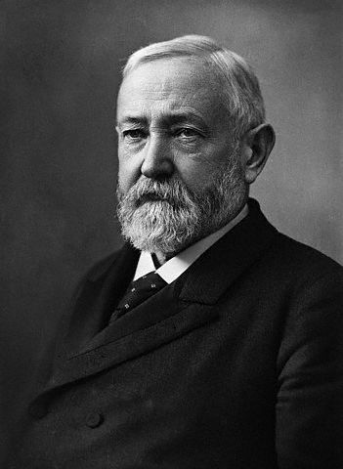
Benjamin Harrison’s Presidency
Reversed most of Cleveland’s policies
Non-descript presidency
Public Opinion began to put pressure on the federal government to pass legislation to curb the power of trusts
Sherman Anti-Trust Act of 1890 (initially used to combat labor unions instead of corporations)
McKinley Tariff Act of 1890
Raised tariffs to highest peacetime level: 48%
Damaged farmers who voted the Republicans out in the next election

Slide 17
Cleveland’s 2nd term
Presidential Election of 1892
Benjamin Harrison-incumbent Republican
Grover Cleveland-Democrat
James Weaver-People’s Party (Populist)
Cleveland won and the Democrats gained control of the House and Senate
Again pushed for tariff reductions
Pressure mounting for regulation of railroad industry

Slide 18
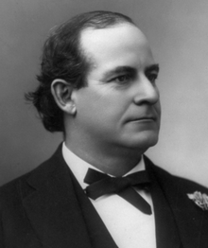
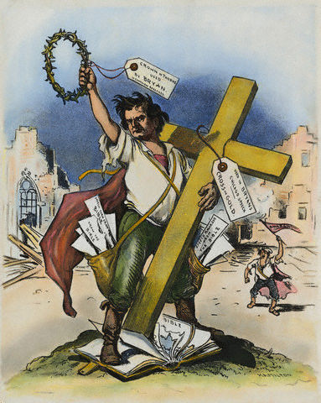
Election of 1896

