Slide 1
Consumerism
The Gilded Age 1870-1900

Slide 2
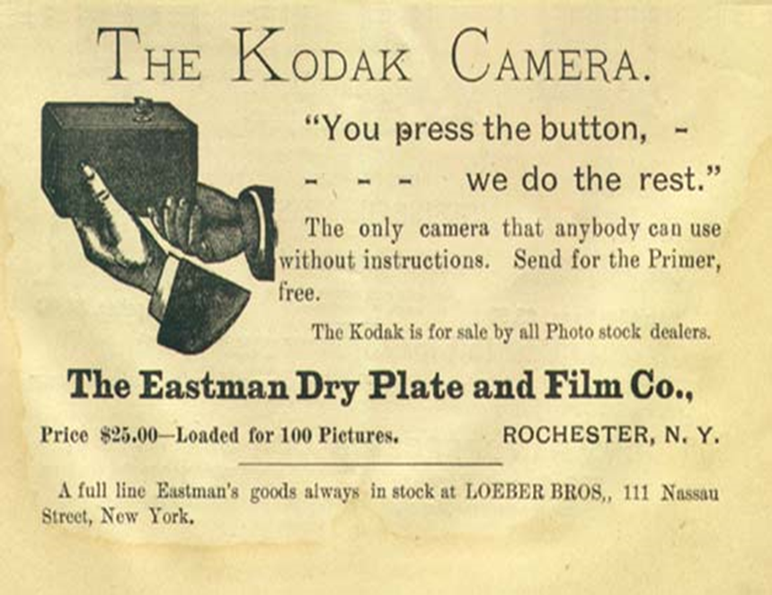

Slide 3
The Gilded Age
The late 19th century saw the advent of new communication technologies, including the phonograph, the telephone, and radio
The rise of mass-circulation newspapers and magazines; the growth of commercialized entertainment, as well as new sports, including basketball, bicycling, and football
The appearance of new transportation technologies, such as the automobile, electric trains and trolleys.

Slide 4
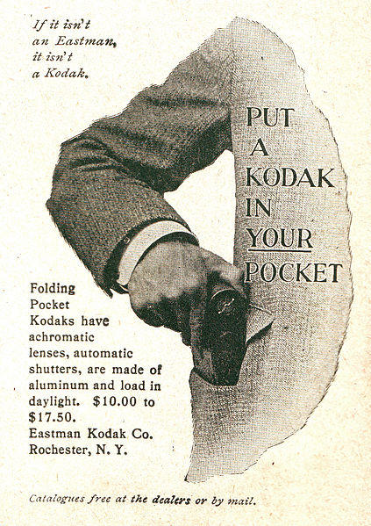
Consumerism of the Gilded Age
Industrialism and Urbanization created a “mass consumer culture” during the Gilded Age
lives would now be sometimes organized around buying things that satisfied desires more than needs

Slide 5
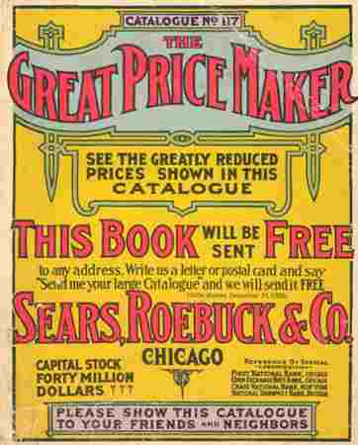
Consumerism of the Gilded Age
Products would now carry brand names so consumers could identify with them.
Welch’s grape juice, Ivory Soap, Quaker Oates, Coca Cola, Heinz Soups all became household names
Some brand names became so popular, they became synonymous with the product—Kodak, Kleenex
Because of consumerism department stores would become popular during the Gilded Age

Slide 6
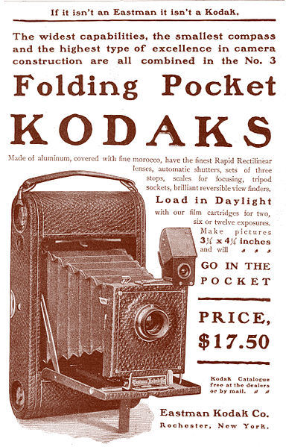
Consumerism of the Gilded Age
A wide variety of consumer goods were created during this time period (new technologies, household items, clothing, foods, entertainment)
Advertising was a prominent feature of this consumer culture (In the past products were just local)
Because of the 2nd Industrial Revolution consumers bought products that were made by strangers in factories far away.

Slide 7
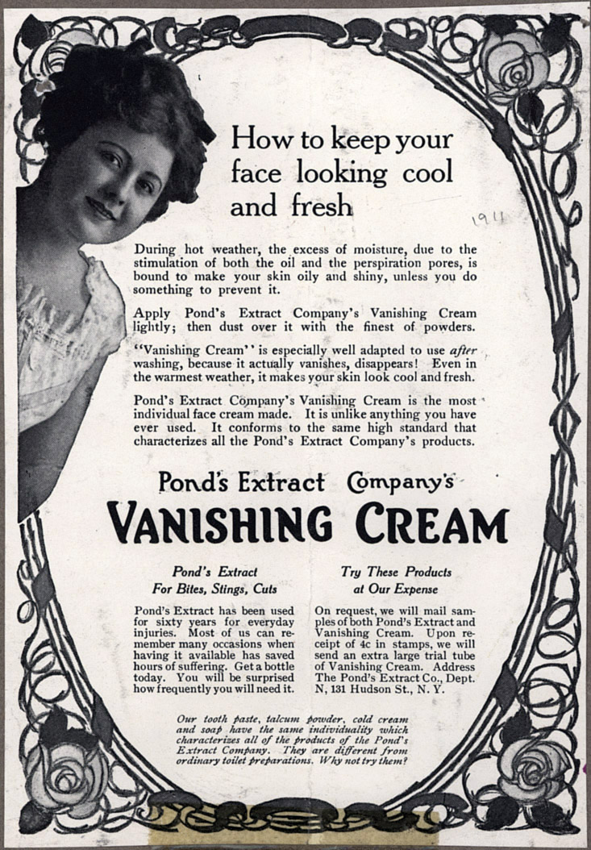
Advertising during the Gilded Age
Several advertising techniques were developed during the Gilded Age
Repetition
Claims
Association
Bandwagon
Promotions

Slide 8
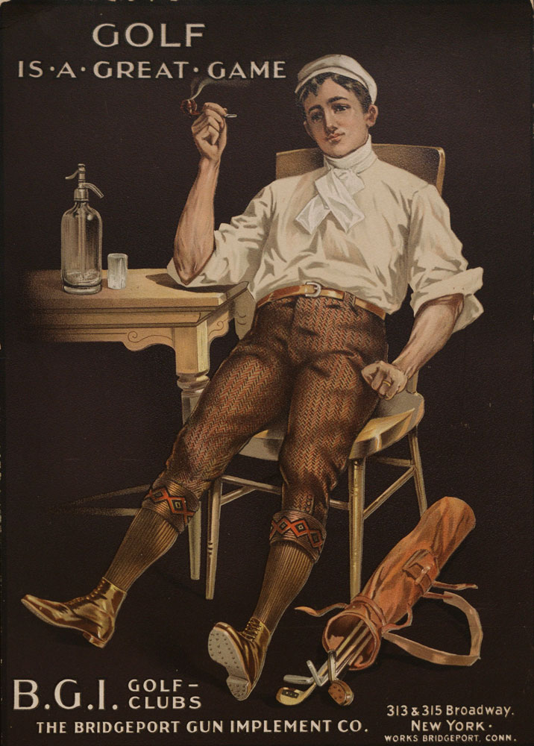
Advertising Assignment

