Slide 1
Expansion and Compromise
Compromise of 1850

Slide 2
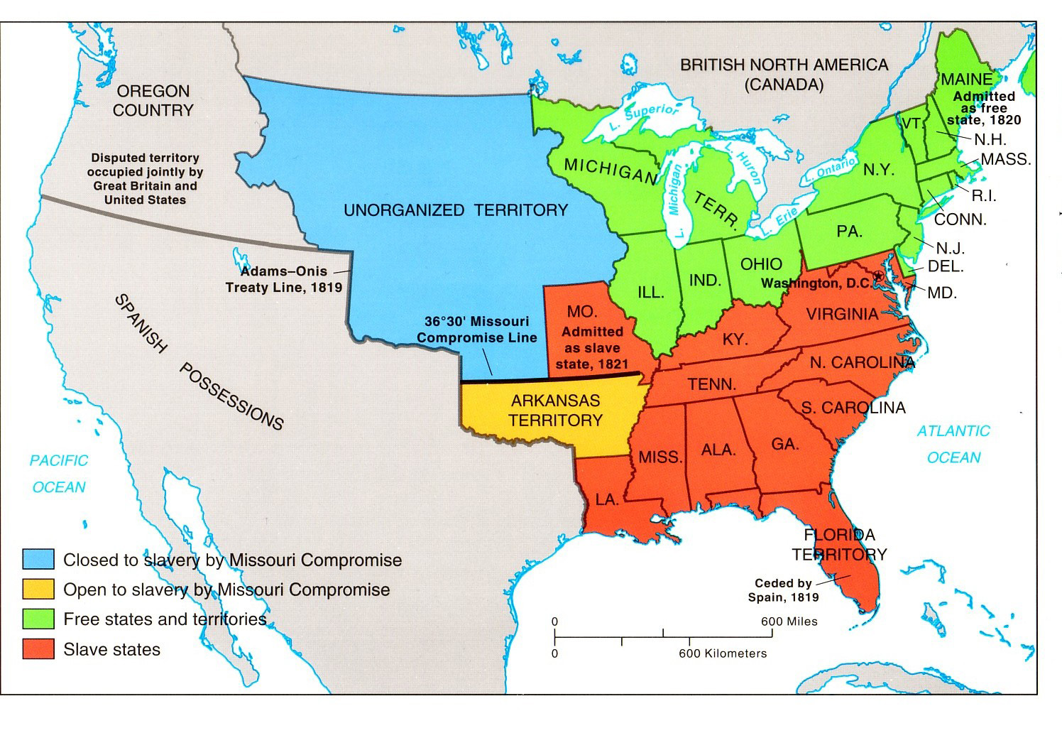
Missouri Compromise (1820)
Notes:
http://faculty.umf.maine.edu/~walters/web%20103/Missouri%20Compromise%20map.jpg

Slide 3
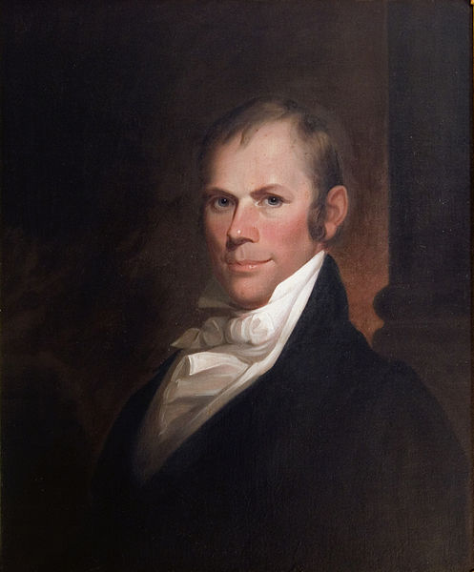
Missouri Compromise
Temporarily solved the issue of new states created from the Louisiana Purchase (slave/free).
Tried to maintain the balance in Congress between North & South by allowing slavery in Missouri & creating the free state of Maine. Henry Clay,
36’30 applied to Louisiana Territory – example of sectionalism

Slide 4
Mexican War
Treaty of Guadalupe Hidalgo-1848
Gadsden Purchase-1853

Slide 5
Wilmot Proviso
August 8, 1846 amendment to a bill in Congress
proposed by Pennsylvania Democrat David Wilmot
Proposed ban to slavery in the Mexican territory
Southerners were angry. They claimed slaves were property and the Constitution protected property; and southerners feared losing balance of power

Slide 6
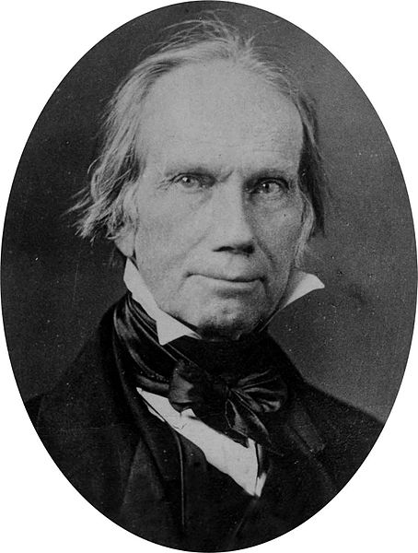
Compromise of 1850
Henry Clay-”The Great Compromiser”

Slide 7
Clay Compromise Measures Debates Activity
You will be responsible for researching one of the following debaters of the compromise:
  John C. Calhoun
  Daniel Webster
  William Seward
Using your phone, find biographical information on your assigned debater.
Analyze their excerpted debate speech by answering the four questions for your assigned speech. Speeches may be found on the Unit 5 Resource Page at dedwardshistory.weebly.com

Slide 8
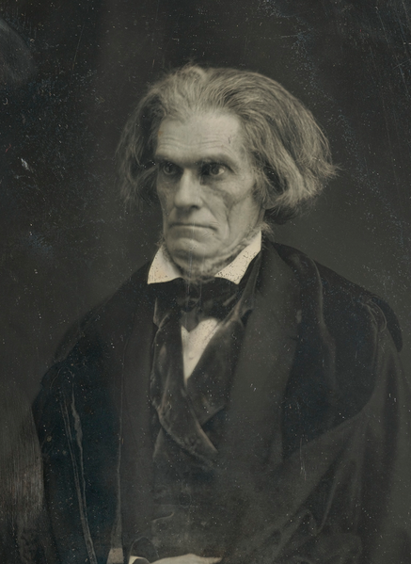
John C. Calhoun
1850-South Carolina Senator John C. Calhoun opposed Clay’s compromise
Strongly believed in state’s rights over federal power

Slide 9
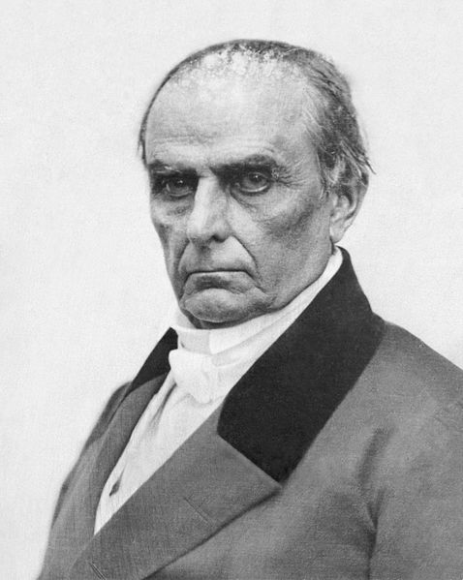
Daniel Webster
1850-Massachusetts’ Senator Daniel Webster supported Clay’s compromise
Believed Slavery should not be extended and wanted to preserve the Union

Slide 10
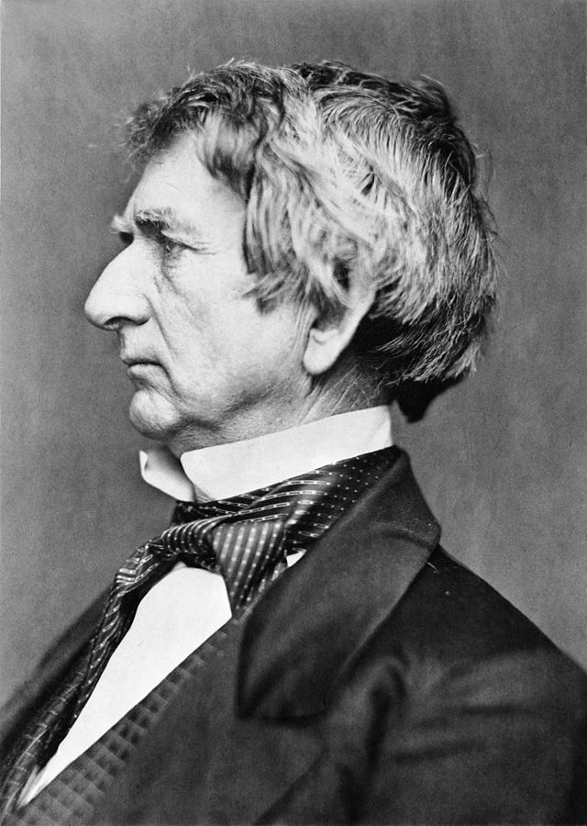
William Seward
1850-New York Senator who opposed Clay’s Compromise
Against the Fugitive Slave Act

Slide 11
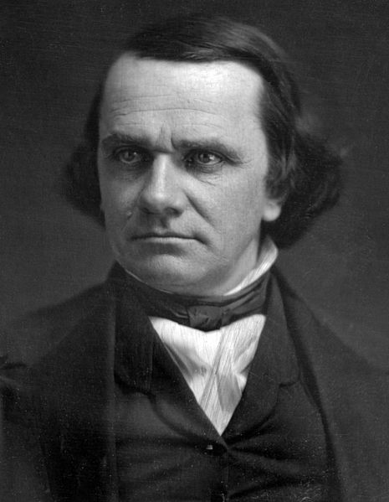
Stephen Douglas
Illinois Senator Stephen Douglas developed unbundling plan to pass Clay’s compromise

Slide 12
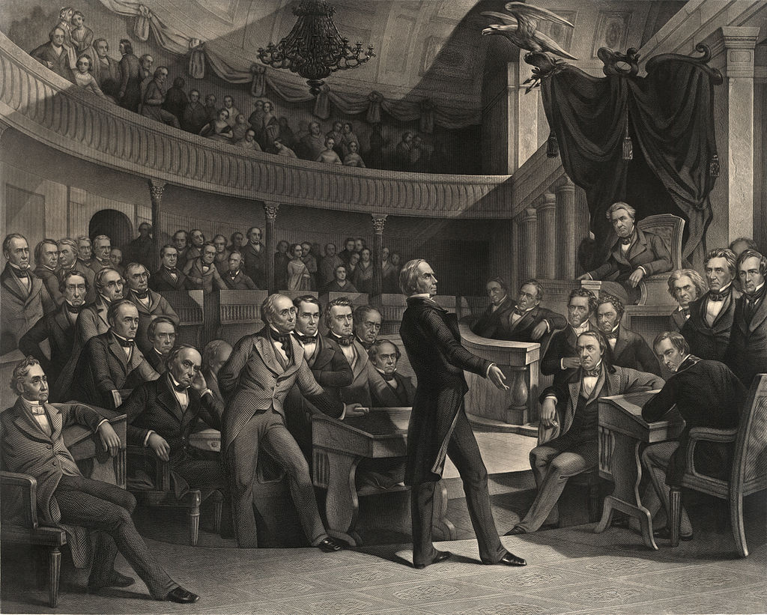

Slide 13
Compromise of 1850
Henry Clay-”The Great Compromiser”

Slide 14
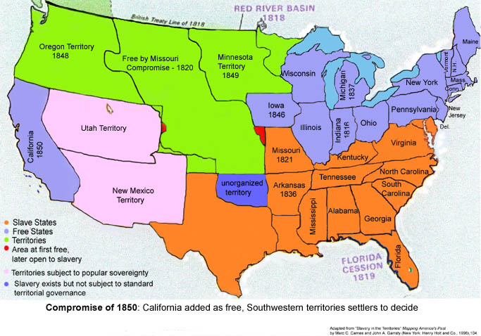
Compromise of 1850

Slide 15
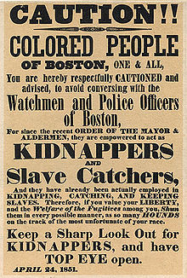
Fugitive Slave Law
Fugitives not allowed trial by jury
Could not testify on their behalf
Slave owner testimony was all that was required to have a slave returned

Slide 16
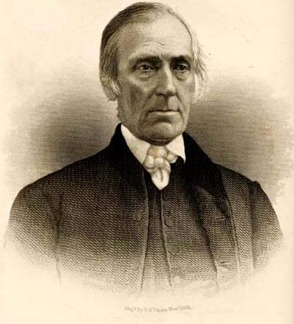
Fugitive Slave Law
Commissioners charged with enforcing law received $10 if they returned slave; $5 if they freed
Anyone accused of helping a fugitive was subject to $500 fine and/or 6 months in prison
Levi Coffin, Quaker abolitionist

Slide 17
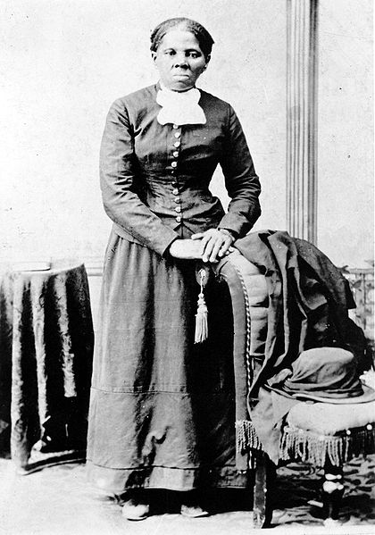
Fugitive Slave Law
9 Northern states passed personal Liberty Laws nullifying parts of the federal law and allowing jury trials for fugitives
Led to increased development of the Underground Railroad
Harriett Tubman was the most famous “conductor”

