Slide 1
Bell Ringer-Document Analysis
Document A-Thomas Paine, Common Sense
Document B-Benjamin Franklin, Testimony on the Stamp Act
Document C-John Dickinson, Letter from a Pennsylvania Farmer
Document D-James Otis, Rights of the British Colonies Asserted

Slide 2
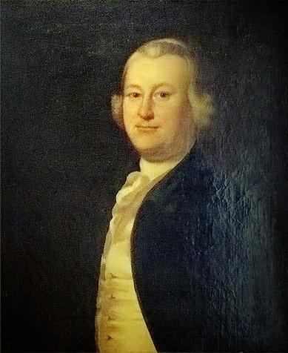
James Otis, The Rights of the British Colonies Asserted, 1764
“The end of government being the good of mankind, points out its great duties: It is above all things to provide for the security, the quiet, and happy enjoyment of life, liberty, and property.”

Slide 3
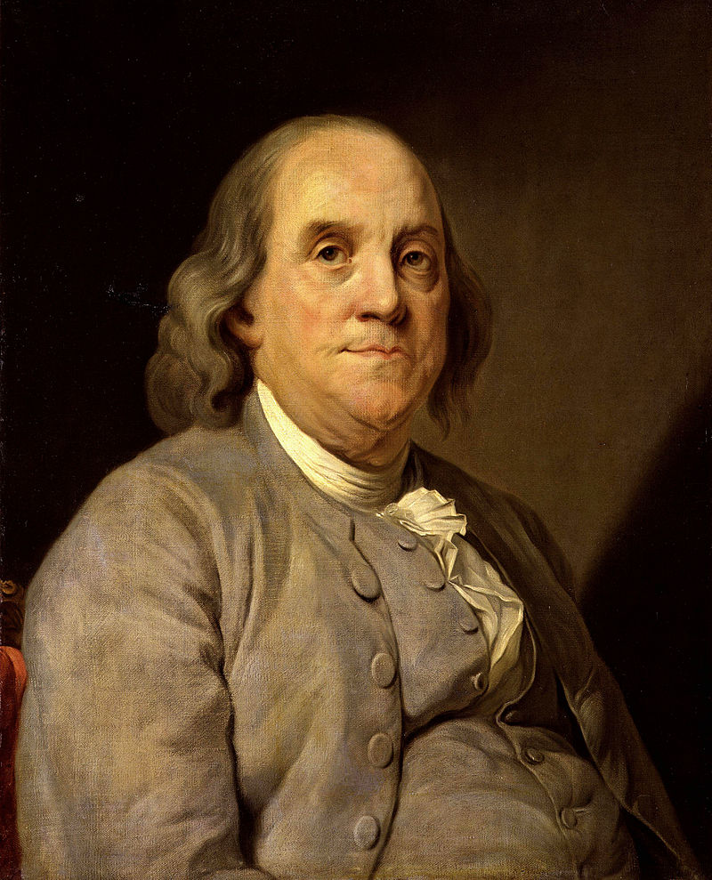
Ben Franklin, Testimony Against the Stamp Act, 1765
Q: What used to be the pride of the Americas?
A: To indulge in the fashions and manufactures of Great Britain
Q: What is now their pride?
A: To wear their old clothes over again, till they can make new ones.

Slide 4
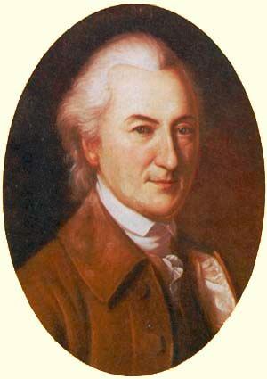
John Dickinson, Letters from a Farmer in Pennsylvania, 1767
“Here we may observe an authority expressly claimed and exerted to impose duties on these colonies, not for the regulation of trade, not for the preservation or promotion of a mutually beneficial intercourse between the several constituent parts of the empire…but for the single purpose of levying money upon us. This I call an innovation, and a most dangerous innovation”

Slide 5
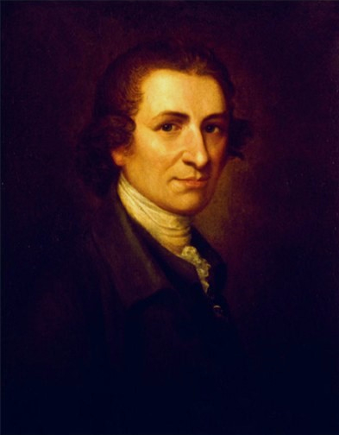
Thomas Paine’s Common Sense
Published on January 10, 1776 in Philadelphia
Sold up to 150,000 copies in American and England
Written by an Englishman who had only been in American for 15 months
Expressed America’s pent up rage against the mother country in “fighting” words
His common language helped convince common folk to rise up against British tyranny

Slide 6
Historian Gordon Wood on Thomas Paine
“Something about him bothered members of the American gentry…he lacked connections.”
“What was frightening to authorities about his writings was not so much what he said but how he said it and to whom”

Slide 7
Thomas Paine Argued…
It was absurd for an island (England) to rule a continent (America).
America was not a "British nation"; it was composed of influences and peoples from all of Europe.
The distance between the two nations made governing the colonies from England tough.
Britain ruled the colonies for its own benefit, and did not consider the best interests of the colonists in governing them.

Slide 8
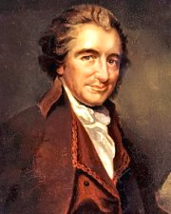
Thomas Paine, Common Sense, 1776
“But Britain is the parent country say some. Then the more shame upon her conduct. Even brutes do not devour their young: nor savages make war upon their families.”
“There is something very absurd, in supposing a continent to be perpetually governed by an island.”
“In America, the law is King.”

Slide 9
Bell Ringer: Founding Father’s Project
Getting Started
As a group, review the GRASPS outline and rubric
Performance: Discuss your strengths, potential contributions and comfort level (Does anyone play an instrument? Sing? Dance? What can your role be? Have you helped to choreograph a performance?)
Research: Start individually with the following suggestions located under Unit 3 Resources:
Secondary Source: Gordon Wood, Revolutionary Characters, Introduction
Secondary Source: Gordon Wood’s essay on your specific character
Source links: Founding Father’s
Primary source online data bases: Library of Congress, Gilder Lehrman Institute, National Humanities Center
Next steps:
What needs to happen next?

Slide 10
Halifax Resolves
In April 1776 the fourth Provincial Congress decided that all of North Carolina must declare independence from England
The Halifax Resolves of April 12, 1776 authorized the delegates in Philadelphia to join other colonies in seeking independence
North Carolina became first colony to endorse independence
William Hooper, Joseph Hewes, and John Penn signed the Declaration of Independence

Slide 11
Mecklenburg Declaration of Independence
An account claimed that on May 19, 1775, some two-dozen North Carolina patriots had gathered in Mecklenburg County
The men intended to discuss the colonies’ deteriorating relationship with Great Britain
While they were in session, a rider appeared with news of the “shot heard round the world” at the Battle of Lexington.
Overcome with patriotism, the delegates drew up a series of revolutionary measures.
“That we the citizens of Mecklenburg County, do hereby dissolve the political bands which have connected us to the Mother Country, and…declare ourselves a free and independent people…”
The Mecklenburg delegates supposedly signed their Declaration of Independence on May 20
Account wasn’t printed until April 1819, in the Raleigh Register newspaper

Slide 12
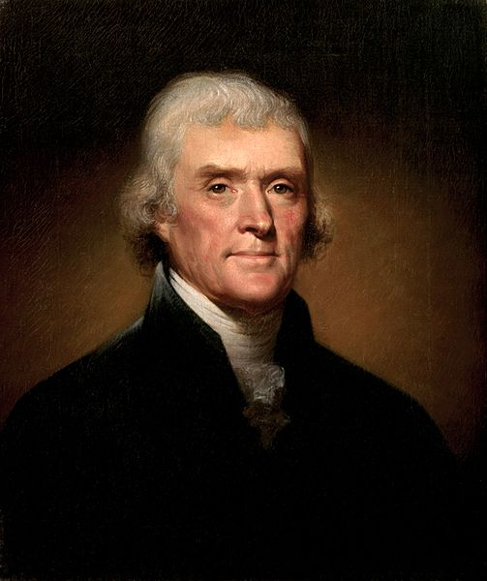
Thomas Jefferson and the Declaration of Independence

Slide 13
Thomas Jefferson at the Second Continental Congress
33 years old
Committee man
Spoke softly
May 1776, he wanted to return to Virginia
June 1776 writing the Declaration
17 days

Slide 14
Historian Gordon Wood on Thomas Jefferson
“No American could stand up to his knowledge”
“For him, there could be no power independent of the people, in whom he had an absolute faith”
“He foresaw that eventually the whole world would follow the American lead”

Slide 15
Committee of Five
Benjamin Franklin
John Adams
Robert R. Livingston
Roger Sherman
Thomas Jefferson

Slide 16
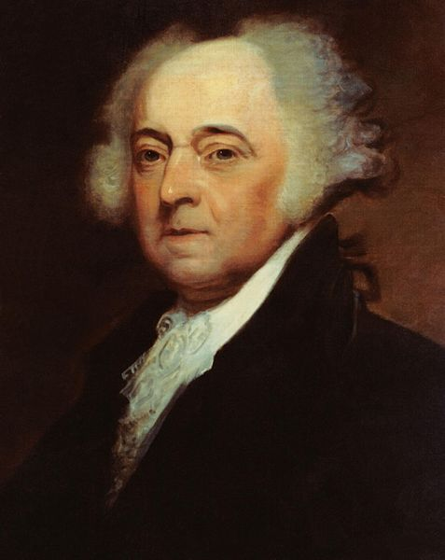
John Adams on why Jefferson should write the Declaration of Independence
“You are a Virginian, and a Virginian should be at the head of this business”
“I am obnoxious, suspected, and unpopular. You are very much otherwise”
“You can write ten times better than I can”

Slide 17
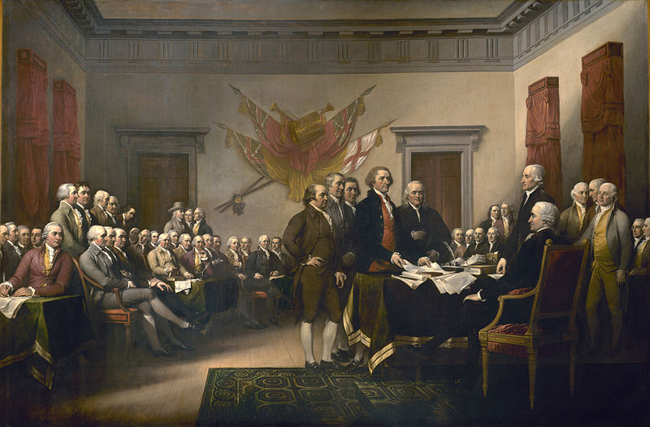
John Trumbell Declaration of Independence

Slide 18
Interpreting the Declaration
What does it say?
What could it have said?
Who was the audience?

Slide 19
What does it say?
1. Introduction: The Preamble
Why the document was written
& The Declaration of Natural Rights
Unalienable rights (can’t be taken away rights)
2. The List of Grievances
Complaints against the British King and government
3. Conclusion: The Resolution of Independence
Claims that the colonists are free and independent

Slide 20
What could it have said?
Jefferson detested that his draft of the declaration was edited
25% of the Declaration’s original language was removed
86 changes were made by one person or another, including Jefferson

Slide 21
Who was the audience?
The King
Parliament
British people
France and “a candid world”
Colonists
Themselves

Slide 22
Misconceptions
Congress declared independence on the 2nd of July, not the 4th
Most members signed the engrossed parchment on the 2nd of August
All the signers of the Declaration never met together in the same room at one time

Slide 23
John Trumbell Declaration of Independence

Slide 24
Douglas Wilson, “Thomas Jefferson and the Meanings of Liberty”
Was Thomas Jefferson a racist and a hypocrite for writing that “all men are created equal” while owning slaves?

Slide 25
First Period Group Assignments-Founding Fathers Musical
Group Madison
Caleb Baker
Sebastian De La Torre
Sean Flanigan
Chloe Neunsinger
Josephine Njangi
Justin Tanhauser
Group Paine
Abby Barnes
Taylor Branch
Jayden Gardner
Kara Haselton
Andy Nguyen
Group Franklin
Matthew Becker
Allison Campbell
Randy Davis
Alexis Roberts
Brian Thomas
Czesty Williams
Group Jefferson
Lydia Bjorkland
Madison Buckley
Jaden Burner
Jonathan Olund
Rose Sall
Anna Zinn
Group Washington
Abigail Blatz
Nick Kondichook
Brittany Kropp
Beau Smith
Olivia Warner
Group Adams
Cameron Daniels
Olivia Henrion
Chris Morel
Julia Omolo
Nate Praught

Slide 26
Second Period Group Assignments-Founding Fathers Musical
Group Franklin
Fiona Benson
Thomas Brown
Grayson Giugno
Chris Nalley
Alexis Robertson
Erika Ruskie
Group Madison
Joe Berry
Josh Coleman
Ellie Harris
Maria Horney
Rachel Mehl
Ryan Sprumont
Group Adams
Ryan Best
Kayla Cook
Alex Corsar
Amber Harvey
Alex Juzwick
Braden Nease
Group Paine
Faryal Ahamd
Anthony Butler
Savannah Douglas
Jake Palazzo
Thomas Petty
Group Washington
Danyal Ansari
Jayden Giap
David Halatek
Jack Hinds
Elena Knudsen
Audrey Wallace
Group Jefferson
Jordan Atkinson
Nick Benik
Allison DeRoche
Paige Martin
Ian Urton

Slide 27
Fourth Period Group Assignments-Founding Fathers Musical
Group Franklin
Averi Bogan
Qwest Cockman
Ana Jimenez
Ryan Kelly
Alex Norris
Group Madison
Angelo Bryan
Hayden Davis
Evan Dorsey
Madison Ford
Angela Maxwell
Group Washington
Khoi Bui
Nydra Furr
Evan Hrbek
Max Howard
Nick Percise
Caitlin Singleton
Group Jefferson
Luke Bundros
Desiree Davis-Crabtree
Alex Good
Morgan Whitt
James Riemesch
Group Adams
Andrew Ciampi
Cameron Hogan
Lillie Moran
Phillip Ross
Calyn Teemsma

Slide 28
Founding Father’s Project
Getting Started
As a group, review the GRASPS outline and rubric
Performance: Discuss your strengths, potential contributions and comfort level (Does anyone play an instrument? Sing? Dance? What can your role be? Have you helped to choreograph a performance?)
Research: Start individually with the following suggestions located under Unit 3 Resources:
Secondary Source: Gordon Wood, Revolutionary Characters, Introduction
Secondary Source: Gordon Wood’s essay on your specific character
Source links: Founding Father’s
Primary source online data bases: Library of Congress, Gilder Lehrman Institute, National Humanities Center
Next steps:
What needs to happen next?

