Slide 1
Warm Up Activity
  Use the battles summary sheet that you researched for the European and Pacific Theaters of War
  Which two battles for each of the theaters do you feel were the biggest turning points of the war? Why?

Slide 2
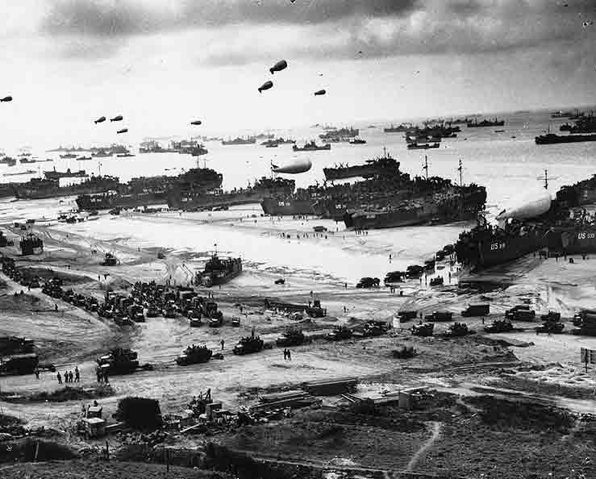
D-DAY June 6, 1944

Slide 3
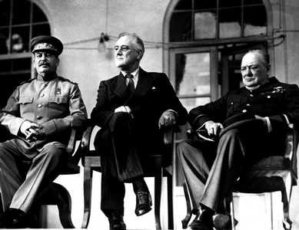
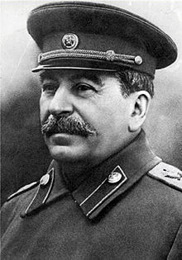
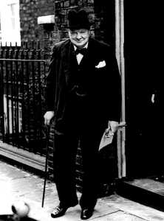
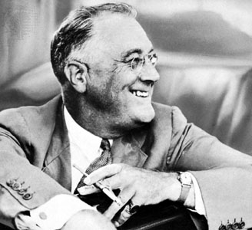
Joseph Stalin
Russian Leader
Not pictured: Charles de Gaulle President of France
Franklin Delano Roosevelt
US President
Allied Powers
Winston Churchill
British Prime Minister

Slide 4
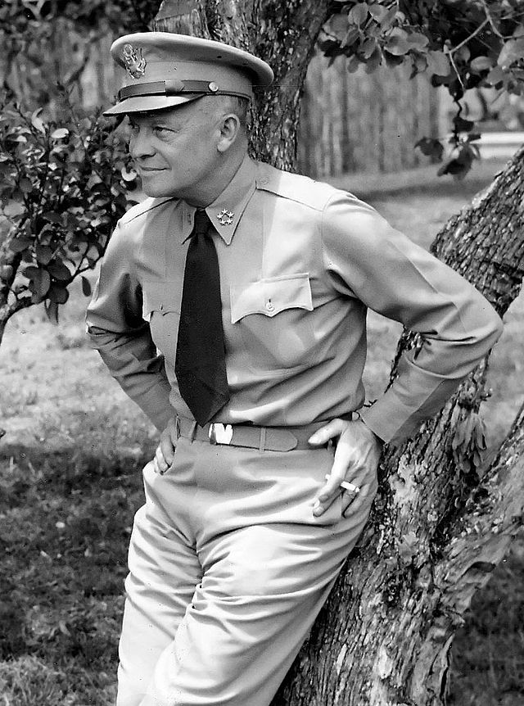
Operation Overlord
By 1942 the Americans and the British were considering the possibility of a major Allied invasion across the English Channel.
Operation Overlord was the codename for the Allied invasion of Normandy, France
Overlord was the largest air, land, and sea operation undertaken before or since June 6, 1944.
During this time, Soviet Union was pushing into Poland and Allies were pushing North in Italy
In January 1944, General Dwight Eisenhower was appointed Supreme Allied Commander of Operation Overlord.

Slide 6
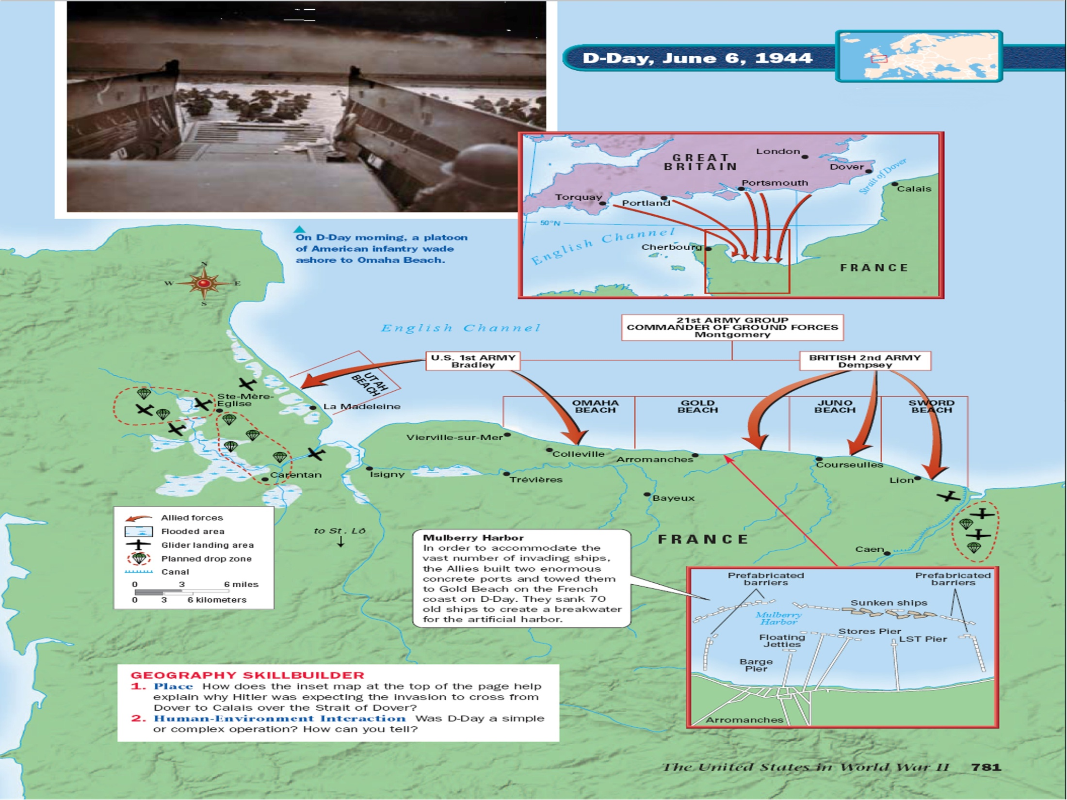

Slide 7
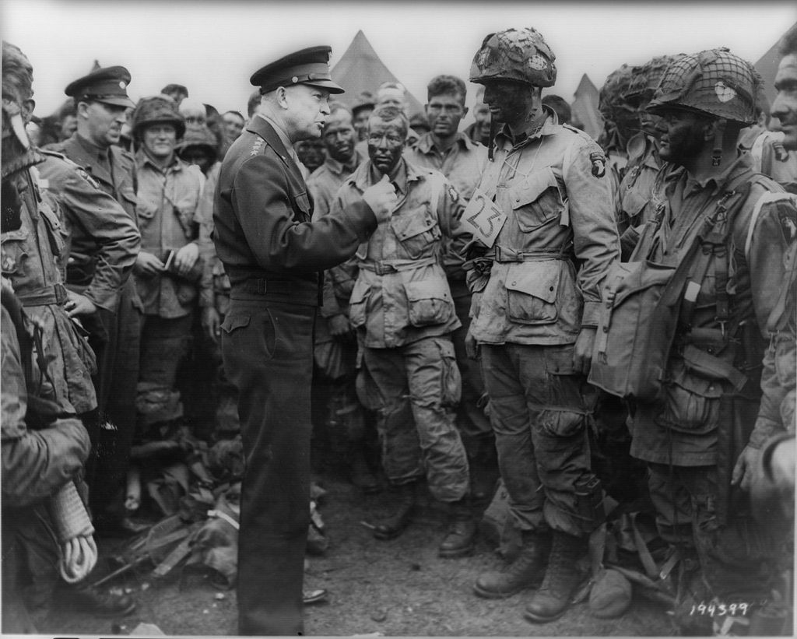
Eisenhower with U.S. paratroopers of the 502d Parachute Infantry Regiment, 101st Airborne Division on June 5, 1944

Slide 8
Operation Overlord
Before D-Day, the Allies carried out a massive deception operation intended to make the Germans think the main invasion target was Calais (the narrowest point between Britain and France) and not Normandy.
Many tactics was used to carry out the deception, including fake equipment; a phantom army commanded by George Patton and supposedly based in England, across from Calais; double agents; and phony radio transmissions.

Slide 9
Battle of Normandy (D-Day)
D-Day for the invasion of Normandy was set for June 5, 1944, but it actually occurred on June 6. Therefore, D-Day, as it applies to Overlord, is June 6, 1944.
By dawn on June 6, thousands of paratroopers were already on the ground behind enemy lines, securing bridges and exit roads (101st Airborne Division)
The amphibious invasions began at 6:30 a.m. The British and Canadians captured beaches codenamed Gold, Juno and Sword, as did the Americans at Utah Beach.
U.S. forces faced heavy resistance at Omaha Beach, where there were over 2,000 American casualties.

Slide 10
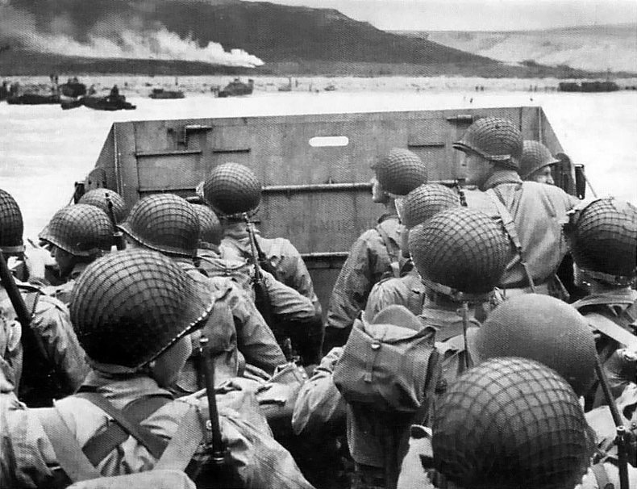

Slide 11
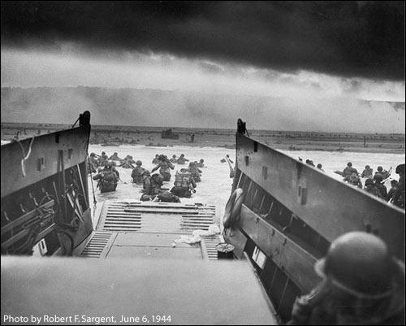

Slide 12
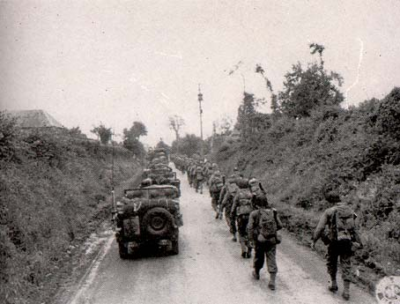
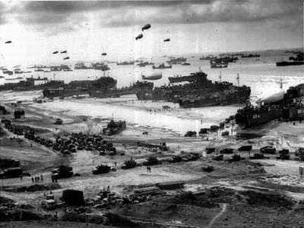
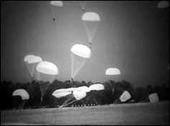
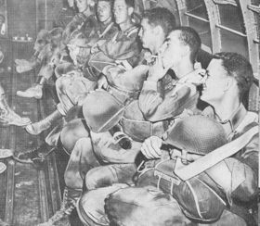

Slide 13
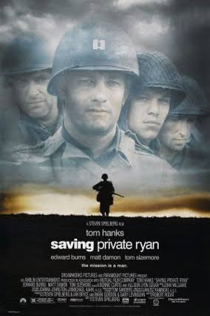
Saving Private Ryan
1998
Directed by Stephen Spielberg
Starring Tom Hanks

Slide 14
Battle of Normandy (D-Day)
By day’s end, approximately 156,000 Allied troops had successfully stormed Normandy’s beaches
4,000 landing craft, 600 warships, 11,000 planes
Estimated that more than 4,000 Allied troops lost their lives in the D-Day invasion, with thousands more wounded or missing.
Less than a week later, on June 11, the beaches were fully secured and over 326,000 troops, more than 50,000 vehicles and some 100,000 tons of equipment had landed at Normandy.
By the end of August 1944, the Allies had liberated Paris and the Germans had been removed from northwestern France
The Allied forces then prepared to enter Germany, where they would meet up with Soviet troops moving in from the east.

Slide 15
Battle of the Bulge
Last major counteroffensive of the Germans in World War II
On December 16, three German armies (more than a quarter-million troops) launched the deadliest and most desperate battle of the war
Adolph Hitler attempted to split the Allied armies in Europe by means of a surprise blitzkrieg push through the Ardennes region of southeast Belgium
This was a repeat of what the Germans had done three times previously–in September 1870, August 1914, and May 1940.
In an attempt to take Antwerp, German tanks broke through American lines (80 mile front)

Slide 16
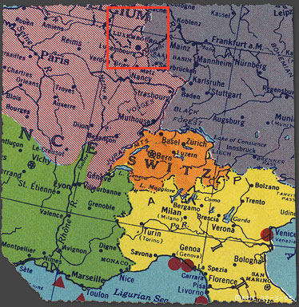

Slide 17
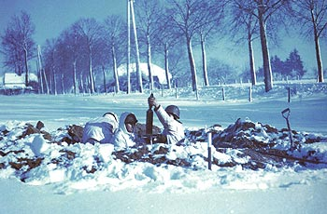
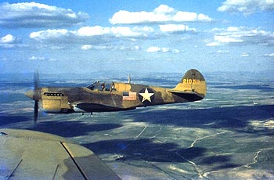
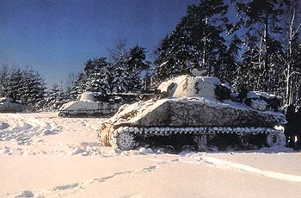
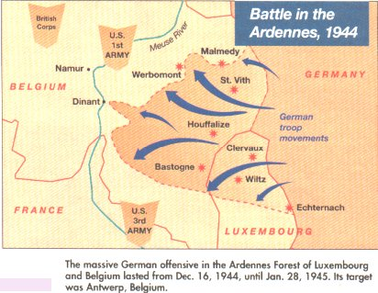

Slide 18
Battle of the Bulge
The Allied line took on the appearance of a large bulge, giving rise to the battle’s name
Caught off-guard, American units fought desperate battles to stem the German advance at St.-Vith, Elsenborn Ridge, Houffalize and Bastogne.
Lieutenant General George S. Patton’s turned the Third Army ninety degrees from Lorraine to relieve the town of Bastogne to stop the German counteroffensive.
The Battle of the Bulge was the costliest action ever fought by the U.S. Army, which suffered over 100,000 casualties.
120,000 Germans died

Slide 19
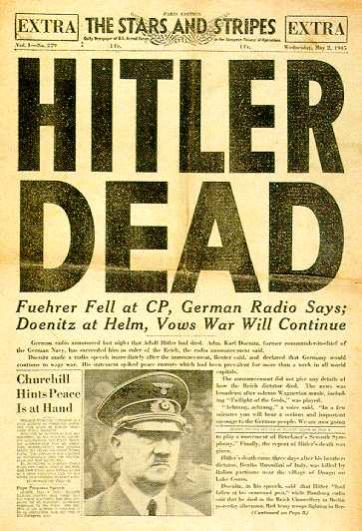
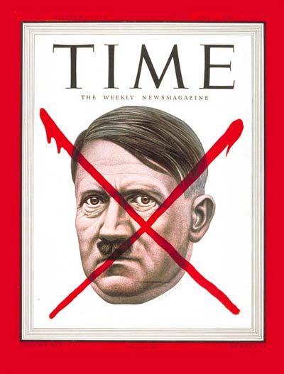
The End of Hitler
April 30, 1945 Hitler and Eva Braun commit suicide
Cover of Time magazine May 7, 1945

Slide 20
V-E Day
May 8, 1945
General Eisenhower accepted a surrender by the Third Reich
V-E day = Victory in Europe day
1st part of War was over

Slide 21
Was President Truman justified in using the atomic bomb to end World War 2?
Access Google Classroom with a partner for an activity on the Pacific Theater and the end of the war.
With a partner, complete the activity in Google Classroom and be prepared to share your thoughts with the your classmates.

Slide 22
Research Assignment
Using the essential question as a guide review the following evidence to draw some conclusions. Take notes accordingly.
  National Park Service Website
    https://www.nps.gov/articles/trumanatomicbomb.htm
  Pro/Con Seattle Times article
  Pacific Theater Battles Research

Slide 23
Group Short Answer Question (SAQ)
Using the evidence provided to you in class (Pacific Theater Power Point, Website, Pro/Con Article), write a group response to the following prompt:
What do you think were the major factors influencing President Truman’s decision to use the atomic bomb effectively ending World War II?
Given the pros and cons of using the atomic bomb, and the options available to Truman do you feel he was justified in using the weapon to end World War II? Why or why not?

Slide 24
President Harry S. Truman’s Press Release Announcing the Atomic Bombing of Hiroshima on August 6, 1945 and Statement Defending the Use of Atomic Weapons
“...The Japanese began the war from the air at Pearl Harbor. They have been repaid many fold. And the end is not yet. With this bomb we have now added a new and revolutionary increase in destruction to supplement the growing power of our armed forces. In their present form these bombs are now in production and even more powerful forms are in development. We are now prepared to obliterate more rapidly and completely every productive enterprise the Japanese have above ground in any city. We shall destroy their docks, their factories, and their communications. Let there be no mistake; we shall completely destroy Japan's power to make war... It was to spare the Japanese people from utter destruction that the ultimatum of July 26... Their leaders promptly rejected that ultimatum. If they do not now accept our terms they may expect a rain of ruin from the air, the like of which has never been seen on this earth.”
“We have used it against those who attacked without warning at Pearl Harbor, against those who have abandoned the pretense of obeying international laws of warfare. We have used it to shorten the agony of war, in order to save the lives of thousands and thousands of young Americans.”

