Slide 1
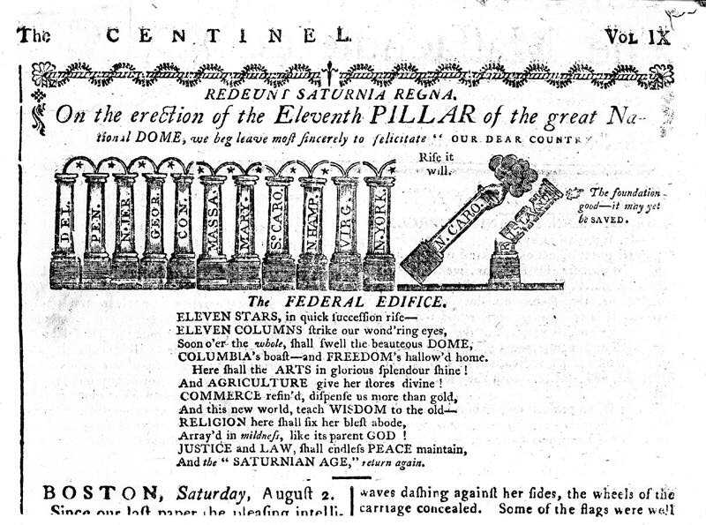

Slide 2
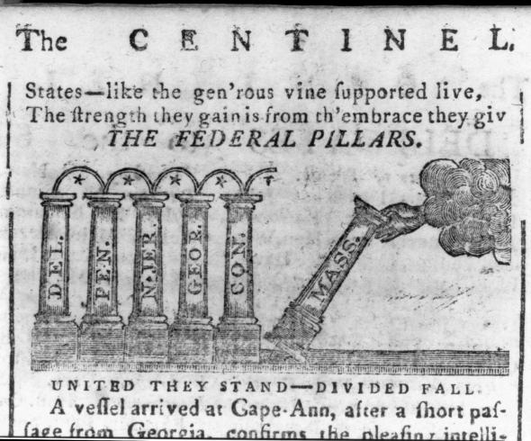

Slide 3
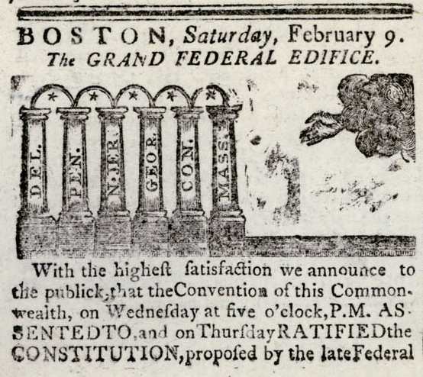

Slide 4
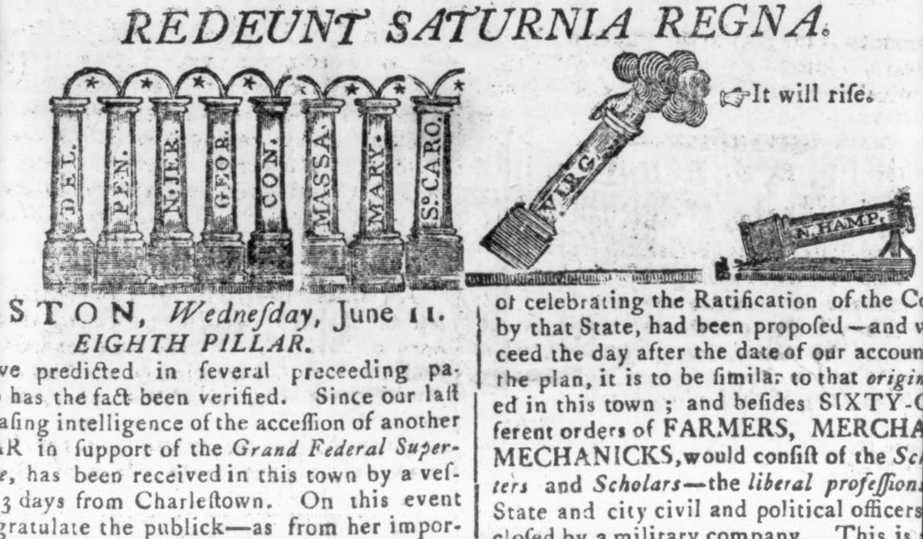

Slide 5
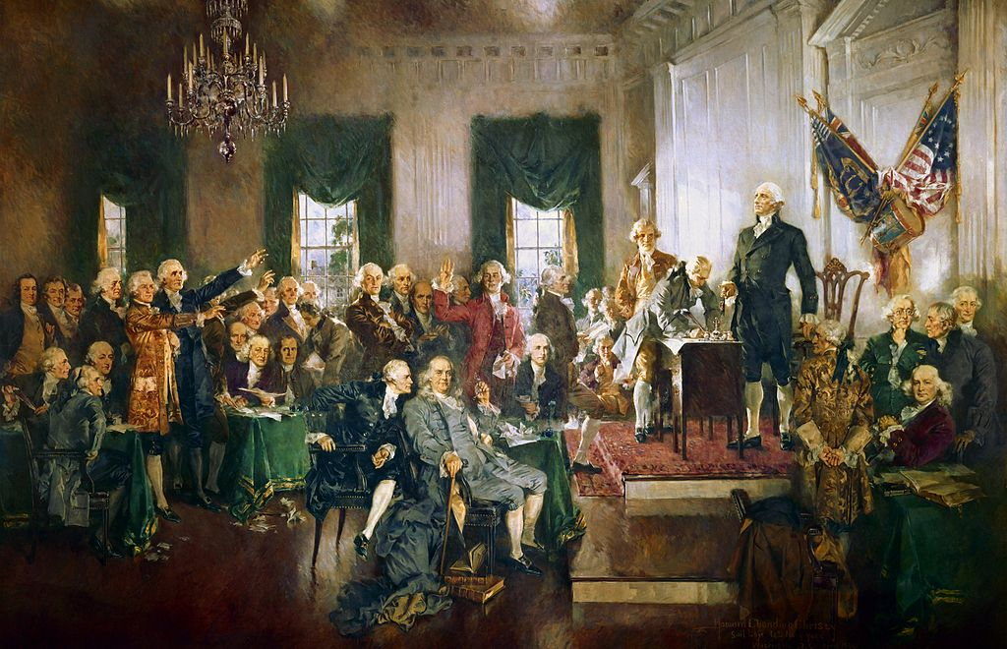

Slide 6
I. The Road to the Constitution
A. The debate over the Articles of Confederation waged for ten years
1. Proposed Solutions
Solution #1—Combine the 13 independent states into one large state with one central government

Slide 7
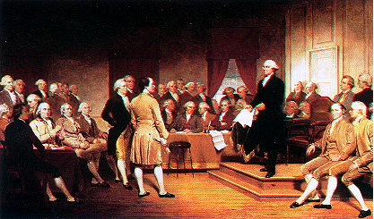
I. The Road to the Constitution
Solution #2—Develop a federal system, in which the power to govern would be divided between a national government and the states
"GEORGE WASHINGTON ADDRESSING THE CONSTITUTIONAL CONVENTION" Oil, by Junius Stearns, c 1856. Virginia Museum of Fine Arts.

Slide 8
I. The Road to the Constitution
B. The Constitutional Convention (May-September 1787, Philadelphia)
1. Basic Facts
A total of 55 delegates from 12 states were in attendance
Rhode Island sent no delegate because it opposed a stronger central government (beginnings of conflict between large and small states)
Original intent was to revise the Articles of Confederation
Quickly realized that the Articles were not worth saving; began to develop a new document— The Constitution —that would set up a central government

Slide 9
Independence Hall
Federal Hall, The Seat of Congress. Amos Doolittle (1754-1832). Engraving, 1790. Library of Congress, Prints and Photographs Division. Reproduction Number: LC-USZ62-333.

Slide 10
I. The Road to the Constitution
2. Demographic Make-up of Delegates
All were white men
Most were professional and businessmen, rather than farmers and laborers
More than half of the delegates were under the age of 40
Half were college graduates and had experience in government
Several had been active in the fight for independence
George Washington was chosen to preside over the Convention

Slide 11
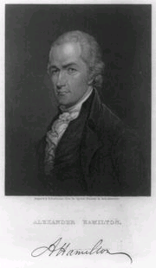
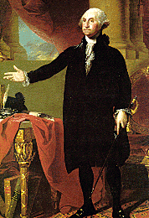
Franklin, Hamilton, Washington

Slide 12
I. The Road to the Constitution
3. Early Decisions
Each state would have only one vote, regardless of the number of delegates it sent to the Convention.
Issues would be decided by a simple majority vote (in this case, seven votes were needed to approve anything)
The debate in the Convention would be kept secret
Kept public pressure off the delegates
Allowed delegates to speak freely—they did not have to worry about reaction of their constituency
Result—we have no official records of the Convention

Slide 13
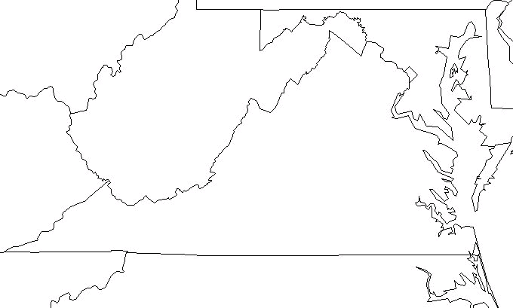
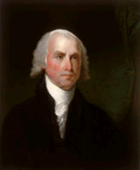
II. Creating and Ratifying the Constitution
Two Plans of Government
The Virginia Plan —proposed by James Madison and other delegates from Virginia
1. This plan included a president, courts, and a bicameral legislature called Congress.
2. Representation in each house would be based on population of each state—more populous states would have more representation than less populous states.
3. Was similar to the type of government we have today

Slide 14
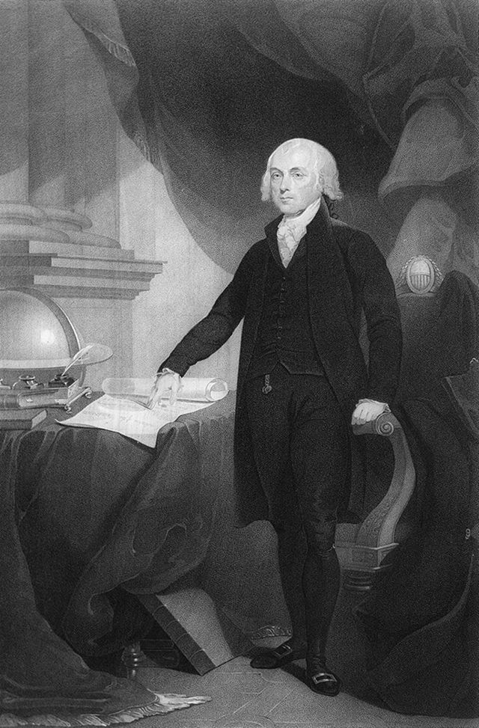
Creating the Constitution
The Virginia Plan (James Madison and VA Delegates)
Executive Branch (Powerful President)
Legislative Branch
House of Representatives
Senate
Judiciary (Federal Courts)
# of Reps Based on State Population
# of Reps Based on State Population
Father of the Constitution

Slide 15
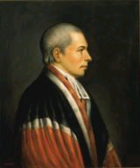
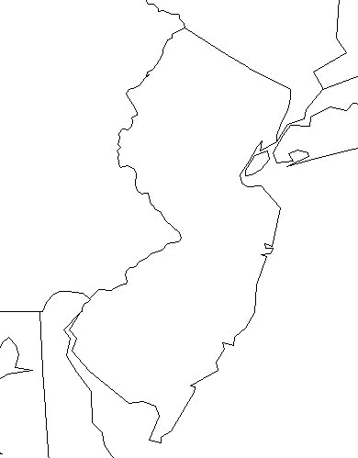
II. Creating and Ratifying the Constitution
New Jersey Plan—proposed by William Patterson from New Jersey
1. Proposed out of fear that large states would dominate Congress and small states would have little power
2. Plan included a federal executive (consisting of more than one person), a federal judiciary, and a federal legislature called Congress which would be a unicameral body with equal representation for each state
3. Was similar to the government under the Articles of Confederation

Slide 16
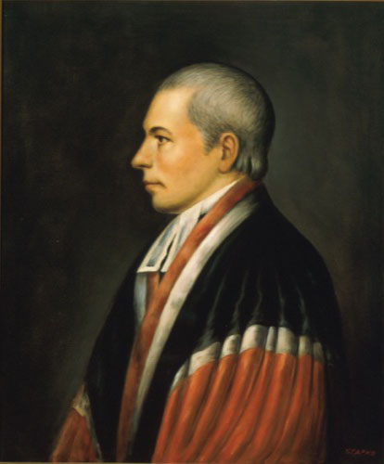
Creating the Constitution
The New Jersey Plan (William Patterson from NJ)
Feared large states would dominate Congress
Similar to Articles of Confederation
Legislative Branch (unicameral)
Executive Committee
# of Reps equal for all states
No power to veto state laws
More than one person

Slide 17
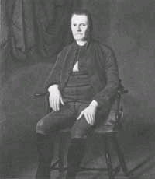
II. Creating and Ratifying the Constitution
The Great Compromise (The Connecticut Compromise) proposed a bicameral legislature
1. Representation in one house would be based on population- House of Representative
2. Representation in the other house would be equal- Senate
Roger Sherman

Slide 18
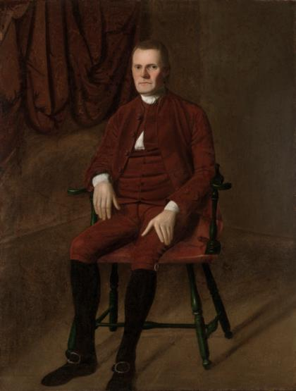
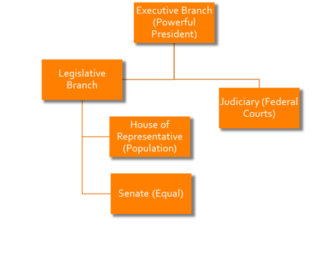
Creating the Compromise
The Great Compromise (Roger Sherman from CT)
Compromise between large and small states
Sometimes known as Connecticut Compromise
# of Reps in House of Representatives based on population
# of Reps in Senate is equal

Slide 19
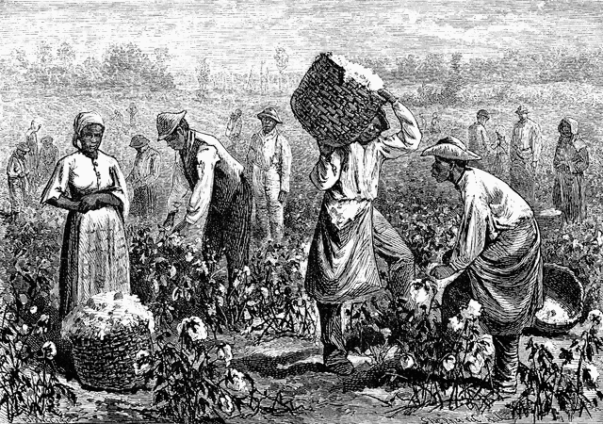
II. Creating and Ratifying the Constitution
Three-Fifths Compromise
1. In an effort to increase their power in the House of Representatives, southern states wanted slaves counted as part of their population
2. This idea was opposed by northern states that had fewer slaves
3. In the compromise, enslaved persons would be counted as 3/5 of other persons
4. This number would be used to determine representation and taxes

Slide 20
II. Creating and Ratifying the Constitution
Commerce and Slave Trade Compromise- Northerners wanted Congress to regulate foreign and interstate trade. Southerners feared taxes on exports and slowing of slave trade.
1. Congress would regulate interstate commerce and international trade
2. Congress could not tax exports
3. Congress could not interfere with the slave trade for 20 years

Slide 21
II. Creating and Ratifying the Constitution
How will the President be chosen?
a. Option #1—President will be chosen by members of Congress
b. Option #2—President will be elected by the people
c. Compromise—delegates decided on a system called the Electoral College where each state legislature would choose a number of electors who would select the President and Vice President

Slide 22
II. Creating and Ratifying the Constitution
How will Congress be chosen?
a. Many delegate feared popular elections. Considered the masses too easy swayed by popular passion.
b. Senators would be elected by the state legislators
c. Members of the House of Representatives would be elected directly by the people.

Slide 23
Bellringer: Convene With Other Delegates
You will meet with three other delegates from the Constitutional Convention.
Role play the delegate that you researched and introduce yourselves as if this were the first time meeting each other.
See if you can come to a consensus on the following dilemmas confronted by the Constitutional Convention:
Representation in a legislature for both small and largely populated states
Representation in a legislature for both large slave holding states and small slave holding states
Be prepared to share your findings

Slide 24
Federalist #51 Close Reading
Define the following terms to prepare for our class reading: rigorously, magistracies, emoluments, encroachments, commensurate, ambition, auxiliary, precautions, predominates
As we read the essay together, underline the part of the essay that you feel is the main idea.
Was your delegate a Federalist? Or an Anti-Federalist? How do you know?

Slide 25
II. Creating and Ratifying the Constitution
Delegates signed the Constitution on September 17, 1787 and decided it would take nine out of the thirteen states to ratify the document

Slide 26
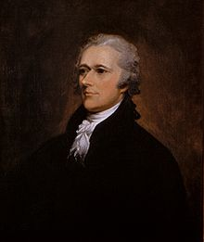
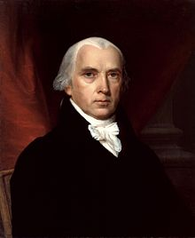
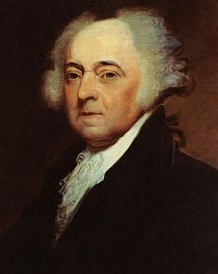
Federalists
Supported the Constitution
Nation couldn’t survive without a strong national government
Proof: Articles of Confederation
Did not think a bill of rights was necessary
Made up of mainly Large farmers, rich merchants and artisans
“The Federalist” Papers
Written by James Madison, John Jay, and Alexander Hamilton
Defended the constitution and attempted to persuade citizens to vote for ratification

Slide 27
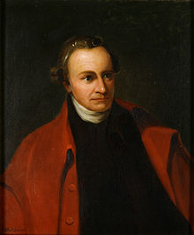
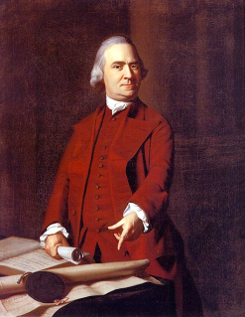
Anti-Federalists
Opposed the Constitution
Felt it gave too much power to the national government
Too much like the King and Parliament
Took too much power away from the states
Wanted a Bill of Rights Added To guarantee basic liberties
Articles of Confederation needed to be fixed, not thrown away
Made up of small farmers and poor merchants
Wrote a series of essays (Anti-Federalist Essays)
Discouraged ratification of the Constitution

Slide 28
Federalists
Anti-Federalists
President | Strong leader for nation | Feared would become dictator
Role of Congress | Strong Congress to make laws for nation | State legislatures to have most power
Courts | Handle disputes that affect nation | State courts most power
Role of States | National gov’t supreme | State gov’t supreme
Bill of Rights? | No need, each state already had one | Must have one to prevent abuse
Federal gov’t | Division of power would keep federal under control | Federal gov’t would abuse rights of citizens (like King)
Examples | Alexander Hamilton, James Madison, John Jay, Federalist Papers | NC, Anti-Federalist essays

Slide 29
II. Creating and Ratifying the Constitution
Ratification of the Constitution
1. Delaware was the first state to ratify the document on December 17, 1787
2. On June 21, 1788, New Hampshire became the ninth state to ratify the Constitution, putting it into effect
3. North Carolina ratifies Constitution on November 1, 1789, the 12th state to do so
4.Rhode Island was the last to ratify the Constitution in 1790

Slide 31
Cracking the Constitutional Code Scavenger Hunt
Partner with a classmate to complete this task.
Use a copy of the U.S. Constitution found in your textbook to answer the guided questions.
The group that finishes first with all of the correct answers receives a “homework pass”

Slide 32
Gordon Wood-”The Greatness of George Washington”
This assignment will be due Wednesday, October 7 for class discussion.
Access Wood’s essay on the class website at http://dedwardsushistory.weebly.com/unit-3-resources.html
Be prepared to define any words that you don’t understand.
Think critically about the following questions as you read the essay:
What is Gordon Wood’s thesis?
What are 3 incidents or factual examples in Washington’s life that Wood uses to interpret and support his thesis?
Do you agree with Wood’s thesis? Why or why not?

Slide 33
Washington’s Cabinet Meeting Role Play Project
Assume the role of a member of Washington’s cabinet.
In a group project, develop a stage script involving Washington, Secretary of the Treasury Hamilton, and Secretary of State Jefferson and one other member in a cabinet meeting together.
From the stage script develop a role play that should also include the setting, make up, props and directions for the characters involved. Dialogues should include conversations among Washington, Hamilton, and Jefferson demonstrating the two cabinet officer’s differing opinions about the role of government and how it should treat its citizens. In addition students should demonstrate an understanding of conflicts and/or compromises that occurred during Washington’s two terms in office.
Students will be given some class time this week to research, practice, perform and record their skits.
A historical role playing rubric will be used to assess your work. This project will be the equivalent of a test
Finished project should be uploaded into Edmodo by Monday, 10/12

Slide 34
Reflective Journal Entry
Identify a time in your life when you have had to compromise over something in which you strongly believed.
What was the issue? How and why did you compromise over the issue?

