Slide 1
Themes in American History I
Exploration
Diversity
Migration
Conflict
Compromise
Expansion
Liberty
Equality
Power
Progress
Reform
Identity

Slide 2
Theme
An organizing idea or concept; a mental construct that is timeless, universal, abstract, represented by 1-2 words, examples may be factual and share common attributes

Slide 3
Themes in American History 1
In your group of three use your textbook and/or a website to research and display the following information about your assigned theme:
A general definition of the theme written in one or two concise statements
A picture or symbolic representation of the theme
Identify this theme’s significance in the study of history (So what? Why is it important?)
Provide a list of three historical examples of this theme in action (include dates for these examples, what happened and who was involved)
Exploration
Diversity
Migration
Conflict
Compromise
Expansion
Liberty
Equality
Power
Progress
Reform
Identity
This should be neatly completed on a poster.
Split your poster into a quad.

Slide 4
Bellringer
1st Period-American I-Edwards
Sign up in Edmodo for your 1st period class
Group Code:9bwujf
Access PDF file for both Chapters 2 & 3

Slide 5
Bellringer
2nd Period-American I-Edwards
Sign up in Edmodo for your 2nd period class
Group Code: x35ry3
Access PDF file for both Chapters 2 & 3

Slide 6
Bellringer
4th Period-American I-Edwards
Sign up in Edmodo for your 4th period class
Group Code: d8x8z3
Access PDF file for both Chapters 2 & 3

Slide 7
Christopher Columbus
Unit 1-Should Christopher Columbus Be Remembered as a Hero?

Slide 8
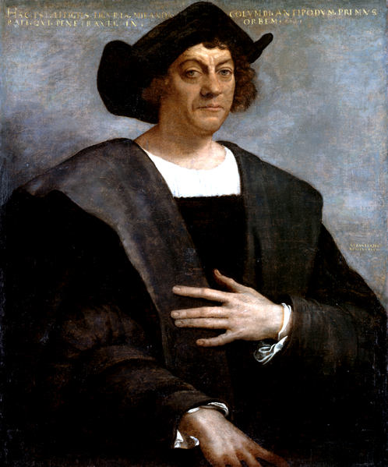
Christopher Columbus Biography
Grew up in Genoa, Italy
Sailed on trading vessels as a child/learned to handle a caravel
Moved to Lisbon, Portugal/center of European knowledge about sea travel
Developed a theory about a Western route to Asia
Spent most of 1480s trying to persuade European monarchs to sponsor westward voyage
Queen Isabella of Spain accepted proposal
1st voyage left Spain on August 3, 1492 and landed in San Salvador on October 12, 1492

Slide 9
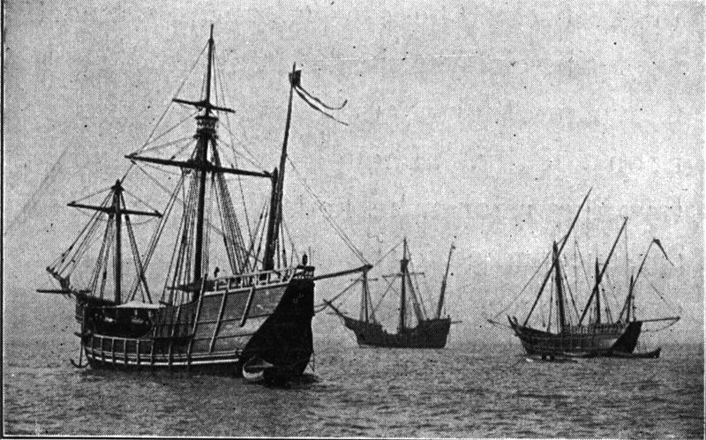
Replicas of Niña, Pinta and Santa Maria sailed from Spain to the Chicago Columbian Exposition of 1893.

Slide 10
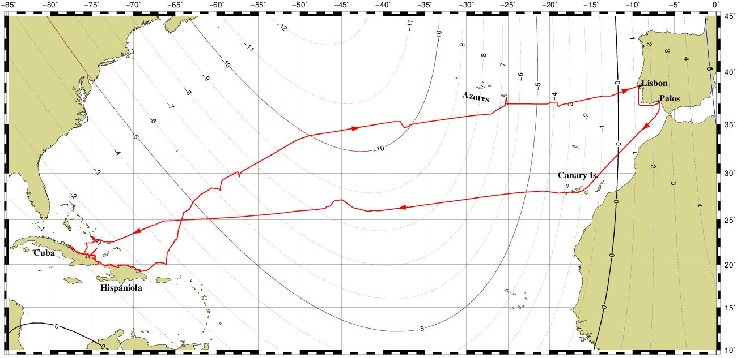
Notes:
The transatlantic track of Columbus's first voyage, drawn on an isogonic chart showing compass declination during 1492-93 according to the CALS3K magnetic model of Korte & Constable 2003. Negative numbers indicate westerly declination in degrees, while positive numbers are easterly. CALS3K is the only magnetic model that has been shown to correctly replicate both of Columbus's first two voyages. See the transatlantic track page for details.
Christopher Columbus departed on his first voyage from the port of Palos (near Huelva) in southern Spain, on August 3, 1492, in command of three ships: the Niña, the Pinta and the Santa Maria. His crew mostly came from surrounding towns such as Lepe and Moguer.
Columbus called first at the Canary Islands, the westernmost Spanish possessions. He was delayed there for four weeks by calm winds and the need for repair and refit. Columbus left the island of Gomera on September 6, 1492, but calms again left him within sight of the western island of Hierro until September 8.
Columbus had expected the voyage to take four weeks, but that deadline came and went without sighting land. The crews of his ships became restless and some argued that a return to Spain was in order. On October 10, Columbus struck a deal with his men: if no land was found in the next three days, they would turn back for Spain. At two hours past midnight on October 12, land was sighted by Rodrigo de Triana (also known as Juan Rodriguez), a sailor aboard the Pinta.

Slide 11
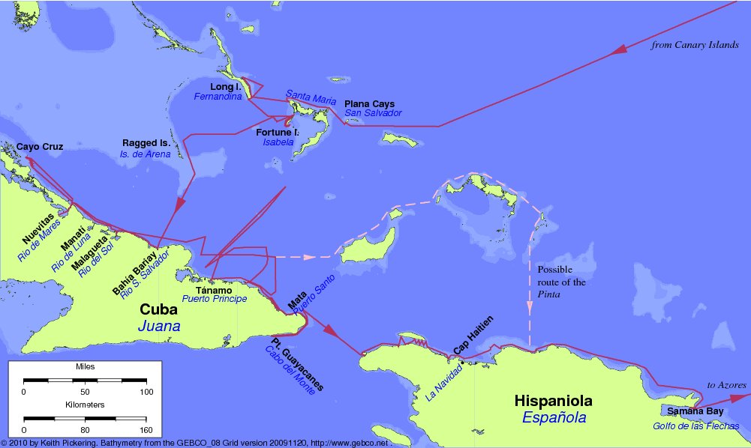
Notes:
Columbus went ashore the next morning at an island he called San Salvador, which the natives called Guanahani. The identity of his landfall island is in dispute, but it was most likely one of the Plana Cays in the Bahamas.
Columbus spent fruitless weeks in Cuba searching for gold, or for the Chinese civilization he had read about from Marco Polo. He reached as far west as Cayo Cruz on October 31 before north winds and increasing frustration caused a change of plan. His kidnapped Native American guides had indicated that gold was to be found on another island to the east, so Columbus reversed course. While sailing north of Cuba on November 22, Martín Alonso Pinzón, captain of the Pinta, left the other two ships without permission and sailed on his own in search of an island called "Babeque" or "Baneque", where he had been told by his native guides that there was much gold. Columbus continued his exploration of Cuba with the remaining two ships, rounding the eastern end and reaching as far as Punta Guayacanes before he arrived at Hispaniola on December 5.
On Christmas Eve, the flagship Santa Maria grounded on a reef near Cap Haitien and sank the next day. Columbus used the remains of the ship to build a fort on shore, which he named La Navidad (Christmas). But the tiny Niña could not hold all of the remaining crew, so Columbus was forced to leave about 40 men behind to await his return from Spain. He departed from La Navidad in the Niña on January 2, 1493.
Now down to just one ship, Columbus continued eastward along the coast of Hispaniola, and was surprised when he came upon the Pinta on January 6. Columbus's anger at Pinzón was eased by his relief at having another ship for his return to Spain, and by the fact that Pinzón had finally found the long-sought gold nuggets in the bed of a local river.
The two ships departed Hispaniola from Samana Bay (in the modern Dominican Republic) on January 16, but were again separated by a fierce storm in the North Atlantic on February 14; Columbus and Pinzón each believed that the other had perished. Columbus sighted the island of Santa Maria in the Azores the next day. After a run-in with the local governor, he arrived at Lisbon on March 4, and finally made it back to his home port of Palos on March 15, 1493.
Meanwhile, Pinzón and the Pinta had missed the Azores and arrived at the port of Bayona in northern Spain. After a stop to repair the damaged ship, the Pinta limped into Palos just hours after the Niña. Pinzón had expected to be proclaimed a hero, but the honor had already been given to Columbus. Pinzón died a few days later.
At Guanahani, Columbus met and traded with the Native Americans of the Lucayan tribe. He also kidnapped several of the natives to act as guides before leaving two days later. He stopped at three other islands in the Bahamas over the next two weeks, which he named Santa Maria de la Concepción, Fernandina, and Isabela. These are most likely the Crooked-Acklins group, Long Island, and Fortune Island, respectively. His final stop in the Bahamas was at the Ragged Islands, which he called the Islas de Arena (Sand Islands). Following the directions of his native guides, he arrived at Bariay Bay, Cuba on October 28.

Slide 12
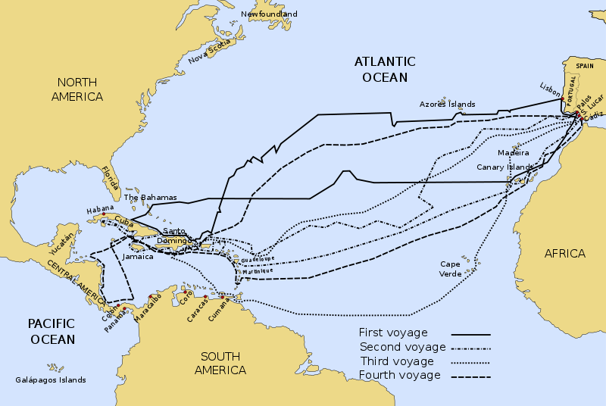

Slide 13
Christopher Columbus Contact
Christopher Columbus Contact
Called people of Caribbean “Indios”
Thought Indios would be easy converts to Catholic faith
Began requerimiento-statement of allegience to Pope and Spain
Introduced “encomienda system” in 1503
In 1492 the native population of Hispaniola was 8 million; by 1496 4-5 million; by 1508 100,000; by 1518 20,000; by 1535 extinct
Indian labor replaced by African slave labor by 1550.

Slide 14
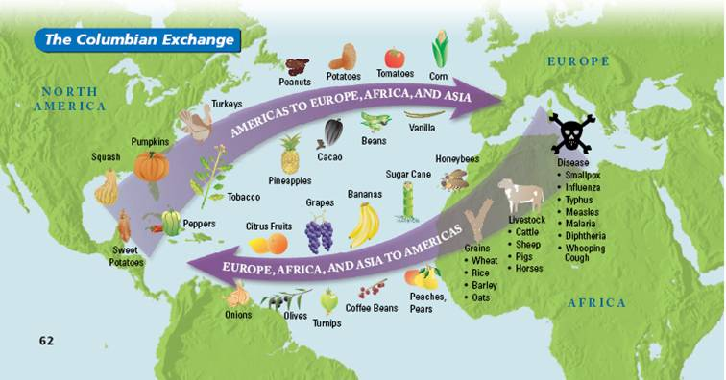

Slide 15
Christopher Columbus
Class Directions/ Secondary Source:
Read your assigned essay on the Columbian Exchange: You will either have “Colombo” or “Metamuza”
Complete the following as you read or after you have read:
What is the main idea? (2-3 sentences)
What evidence is used to support the main idea? (3-4 factual examples)
Do you agree with this interpretation of the Columbian Exchange? Why or why not?

Slide 16
Christopher Columbus
Class Directions/ Secondary Source:
Read the secondary historical essay by Alfred Crosby entitled “The Columbian Exchange”. Complete the following as you read:
What is the main idea of the essay?
What evidence does the author use to support the main idea?
Do you agree with the historian’s interpretation of Columbus and the Columbian Exchange?
Read the excerpted historical essay by Howard Zinn from A People’s History of the U.S. (Chapter 1)
What is the main idea of the essay?
What evidence does the author use to support the main idea?
Do you agree with Zinn’s interpretation of Columbus and the Columbian Exchange?

Slide 17
Historical interpretation/perspective
Left Wing
Right Wing
Liberal
Revisionist interpretation (new or uncommon interpretation)
Social justice
Attempts to correct the wrongs of the past
Conservative
Traditional interpretation
Stability
Continuity

