Slide 1
Causes of the Civil War
19th Century

Slide 2
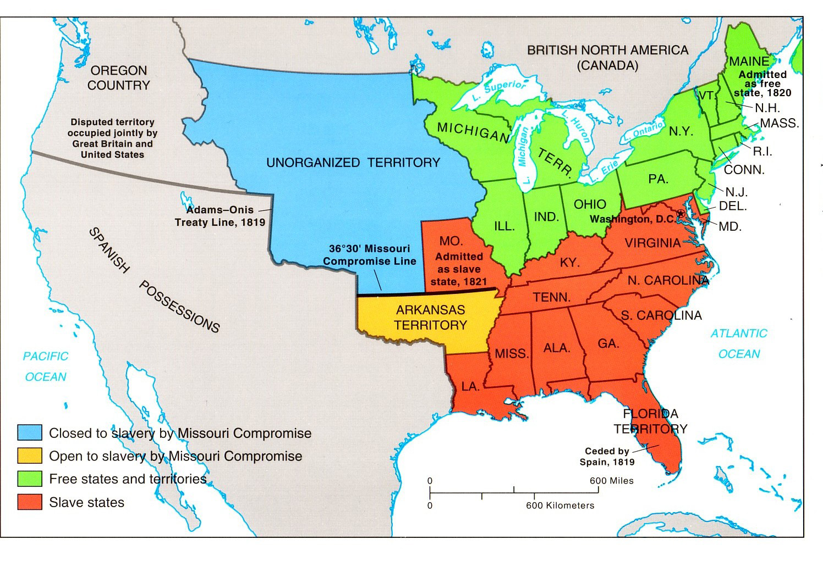
Missouri Compromise (1820)
Notes:
http://faculty.umf.maine.edu/~walters/web%20103/Missouri%20Compromise%20map.jpg

Slide 3
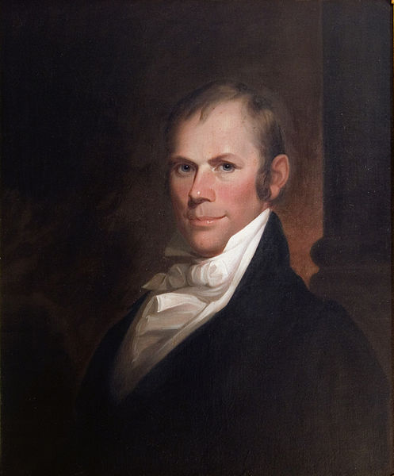
Missouri Compromise
Temporarily solved the issue of new states created from the Louisiana Purchase (slave/free).
Tried to maintain the balance in Congress between North & South by allowing slavery in Missouri & creating the free state of Maine. Henry Clay,
36’30 applied to Louisiana Territory – example of sectionalism

Slide 4
Wilmot Proviso
August 8, 1846 amendment to a bill in Congress
proposed by Pennsylvania Democrat David Wilmot
Proposed ban to slavery in the Mexican territory
Northerners were angry about Southerners not supporting internal improvements and supported the bill
Southerners claimed slaves were property and the Constitution protected property; and southerners feared losing balance of power

Slide 5
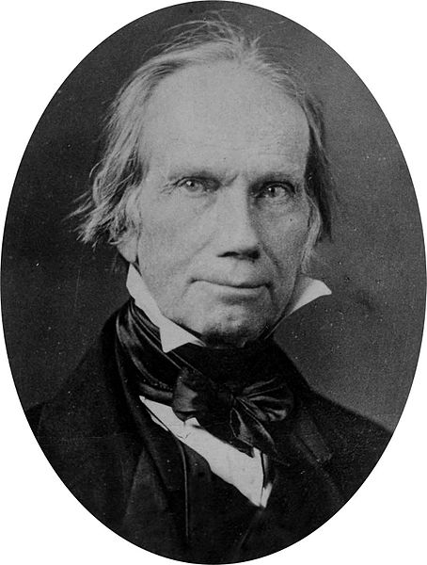
Compromise of 1850
Henry Clay-”The Great Compromiser”

Slide 6
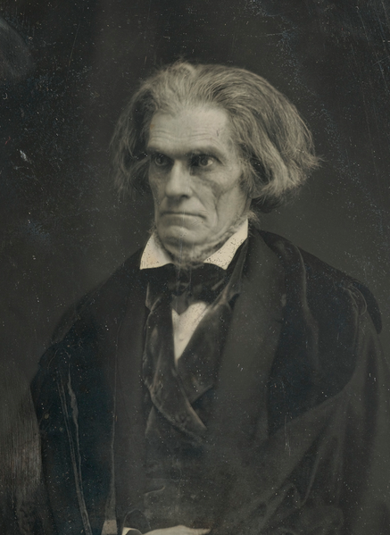
Senate Debates
South Carolina Senator John C. Calhoun opposed Clay’s compromise
Strongly believed in state’s rights over federal power

Slide 7
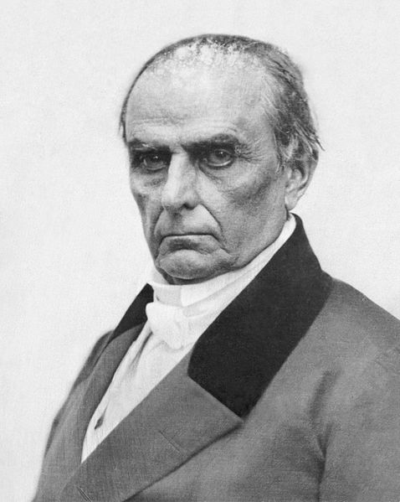
Senate Debates
Massachusetts’ Senator Daniel Webster supported Clay’s compromise
Believed Slavery should not be extended and wanted to preserve the Union

Slide 8
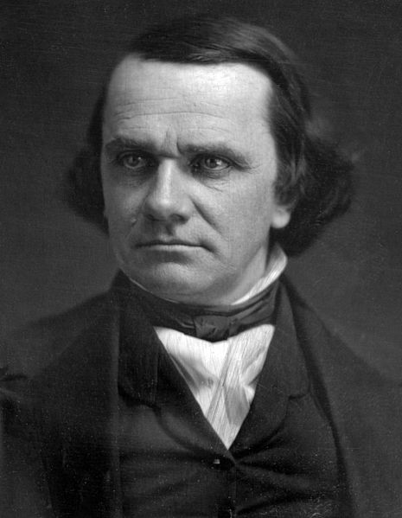
Senate Debates
Illinois Senator Stephen Douglas developed unbundling plan to pass Clay’s compromise

Slide 9
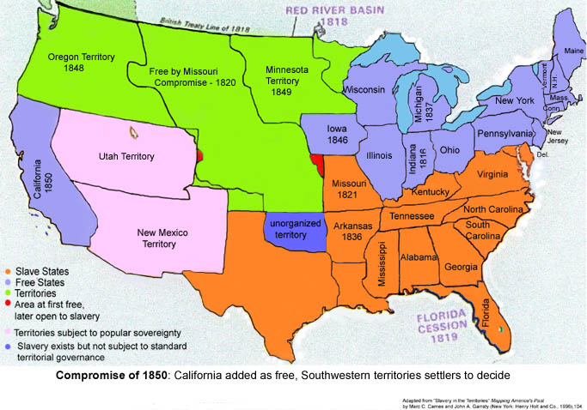
Compromise of 1850

Slide 10
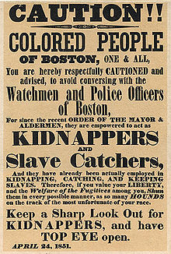
Fugitive Slave Law
Fugitives not allowed trial by jury
Could not testify on their behalf
Slave owner testimony was all that was required to have a slave returned

Slide 11
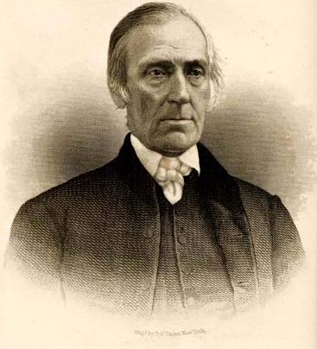
Fugitive Slave Law
Commissioners charged with enforcing law received $10 if they returned slave; $5 if they freed
Anyone accused of helping a fugitive was subject to $500 fine and/or 6 months in prison
Levi Coffin, Quaker abolitionist

Slide 12
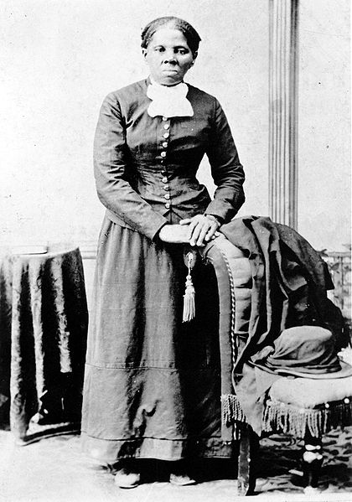
Fugitive Slave Law
9 Northern states passed Personal Liberty Laws nullifying parts of the federal law and allowing jury trials for fugitives
Led to development of the Underground Railroad
Harriett Tubman was the most famous “conductor”

Slide 13
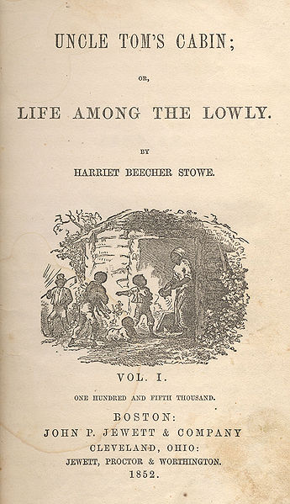
Uncle Tom’s Cabin
Written by abolitionist writer Harriet Beecher Stowe and published in 1852
Sold more than 1 million copies by 1853
Delivered message that slavery was not just a political fight but a moral struggle

Slide 14
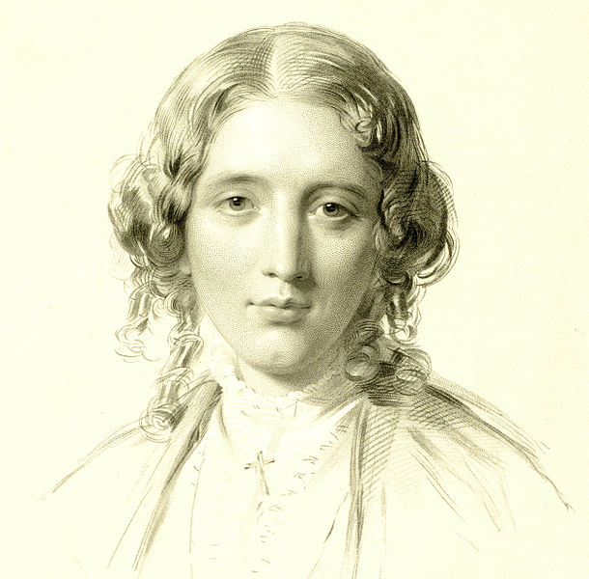
Uncle Tom’s Cabin
When he met Stowe, Lincoln said “So you’re the little woman who wrote the book that made this great war”

Slide 15
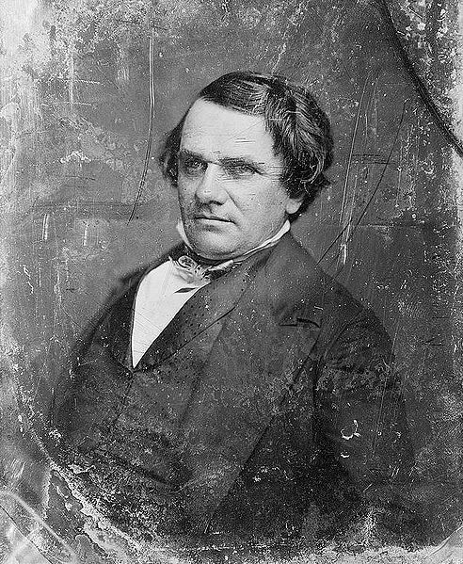
Kansas-Nebraska Act-1854
1854-Stephen Douglas suggested that two new territories be formed - Kansas Territory and Nebraska Territory
Slavery in the new territories would be decided by voting-popular sovereignty
Cancelled out Missouri Compromise

Slide 16
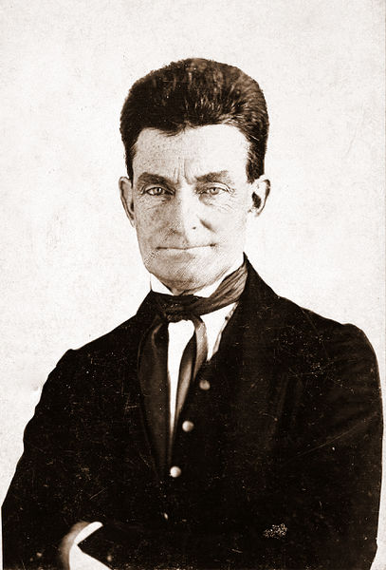
Bleeding Kansas
Thousands of Missourian “border ruffians” entered Kansas to illegally vote in the election to make the state a free or slave state
Kansas voted a slave state
Antislavery citizens refused to accept the election results
Proslavery and Antislavery sides began fighting - violent - earned Kansas name “Bleeding Kansas”
Abolitionist John Brown led massacre at “Pottawattamie Creek” May 1856

Slide 17
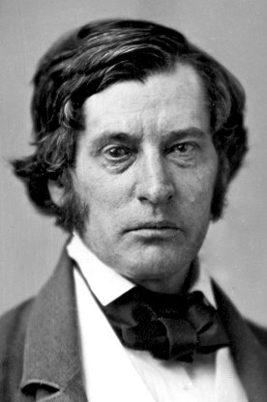
Bleeding Sumner
1856 Abolitionist Senator Charles Sumner of Massachusetts delivered blistering speech against popular sovereignty-- “The Crime Against Kansas”
Condemned pro slavery men as “hireling picked from the drunken spew and vomit of an uneasy civilization”
Also insulted South Carolina senator Andrew Butler

Slide 18
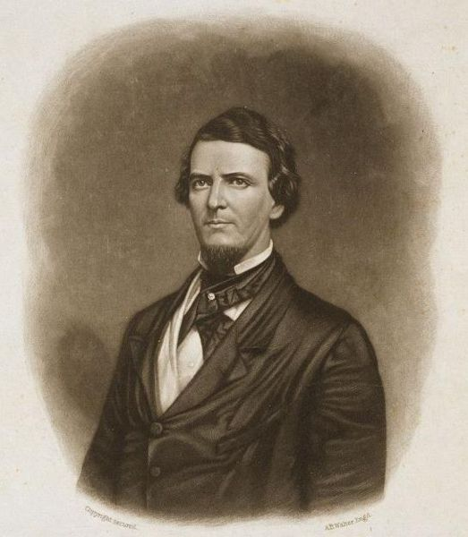
Bleeding Sumner
Preston Brooks, a South Carolina congressman and related to Andrew Butler
May 22, 1856 Brooks approached Sumner at his Senate desk and pounded him with a cane until it broke
Injuries to Sumner kept him out of the Senate for 3 ½ years
Brooks resigned
Southerners sent him more canes

Slide 19
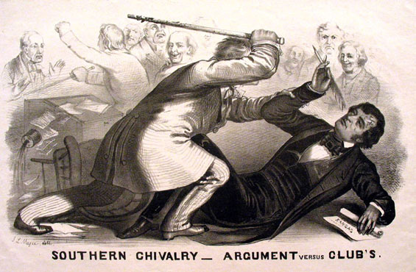
Bleeding Sumner

Slide 20
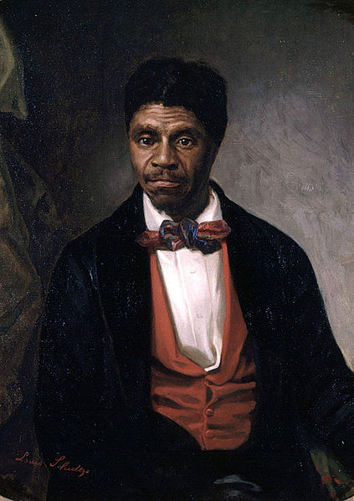
Dred Scott decision-1857
Decision handed down by the Supreme Court on March 6, 1857
Slave who moved with his owner to free territory of Illinois and Wisconsin and then back to the South
Scott sued for his freedom arguing that he should be a free man because he had lived in free territory
Chief Justice Roger B. Taney said Scott was not a free man and he had no right to sue because he was property

Slide 21
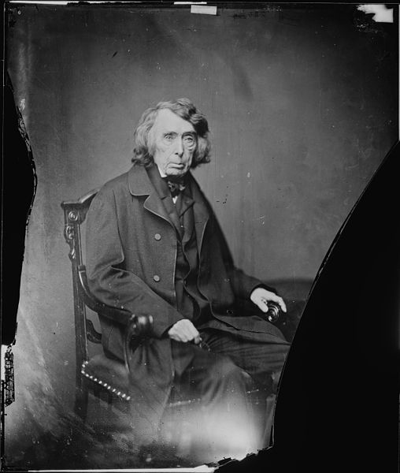
Dred Scott decision-1857
Court ruled that a slave could be taken into any territory as property
5th Amendment protected people’s property rights (could not deprive people of property without due process of law)
Court ruled that the Missouri Compromise had been unconstitutional all along
Congress had no right to ban slavery from the territories

Slide 22
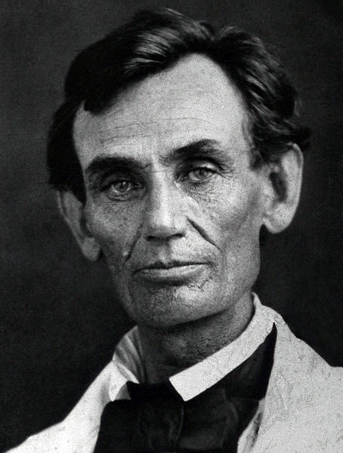
Lincoln-Douglas Debates-1858
From August 21 until October 15, incumbent Stephen Douglas battled the challenger Abraham Lincoln in 7 face to face debates around the state.
The campaign was for one of Illinois' two United States Senate seats.
In each debate either Douglas or Lincoln would open with an hour address. The other would then speak for an hour and a half. The first then had 30 minutes of rebuttal.

Slide 23
Lincoln-Douglas Debates-1858
During the debates, Douglas still supported "popular sovereignty," which maintained the right of the citizens of a territory to permit or prohibit slavery.
Lincoln pointed out that Douglas's position directly challenged the Dred Scott decision, which ruled that the citizens of a territory had no such power.
Douglas won the election in 1858 and Lincoln became famous because of the debates

Slide 24
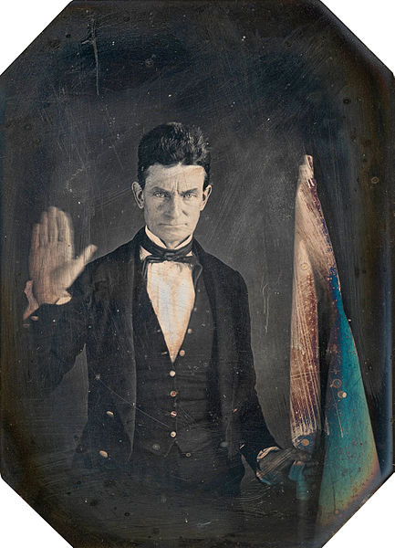
Harper’s Ferry-1859
John Brown - Plan to raise an army and free slaves in the South
1859 Attacked Harpers Ferry in Virginia to raid a federal arsenal and seize guns stored there
He thought that the slaves would support him and he would lead them in a revolt
Brown gained control of the arms but before he could escape he was captured; found guilty of treason and hanged

Slide 25
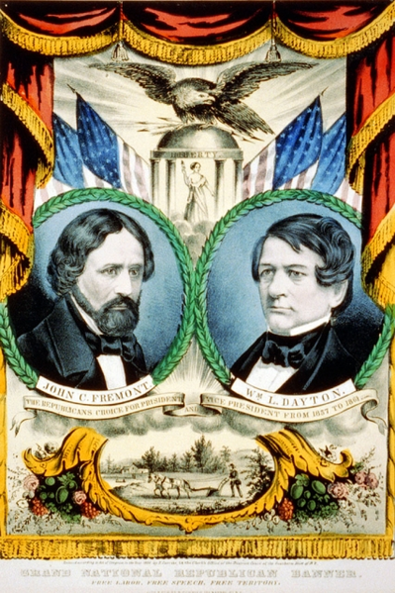
Birth of Republican Party
Anti-slavery Whigs met in Wisconsin on March 20, 1854, and founded the Republican Party.
The Republicans gained supporters in the North
In1856 their first presidential candidate, John C. Fremont, won 11 of the 16 Northern states.
By 1860, the majority of the Southern slave states were publicly threatening secession if the Republicans won the presidency.

Slide 26
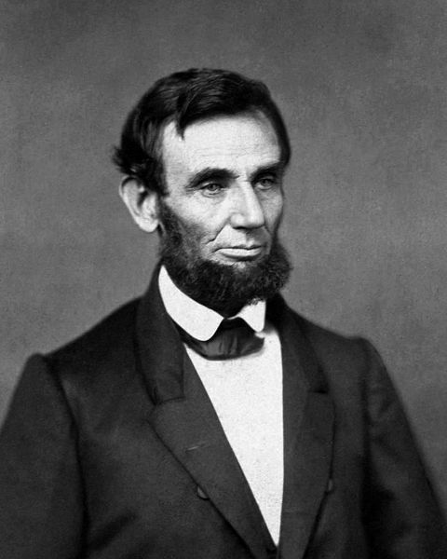
Election of 1860
Election of 1860 –Republican candidate Abraham Lincoln wins election without winning a single Southern state
South Carolina secedes soon after Lincoln’s election to the presidency

Slide 27
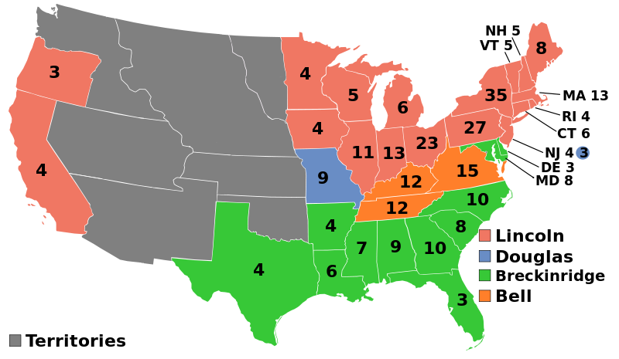
Election of 1860

