Slide 1
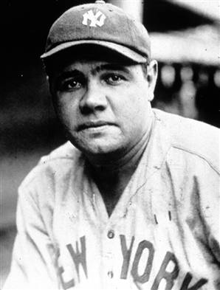
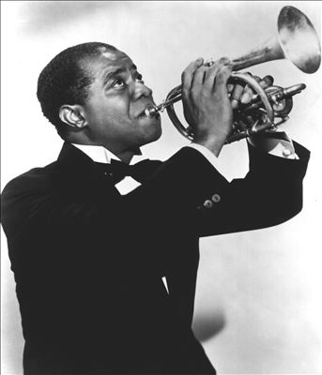
Calvin Coolidge (1923-1929)
1920s Popular Culture
Technology, like the radio, was beginning to break down cultural barriers
New Culture glorified the individual-Common heroes-Jim Thorpe, Red Grange, Bobby Jones, Jack Dempsey, Helen Wills, Charles Lindbergh
Growth of cities change leisure patterns; average workweek dropped to 45 hours a week by 1929
Salaries increased as amount of work time dropped to 5-6 days a week
Opportunity to enjoy a game of baseball and its greatest hero of the 1920s-Babe Ruth
Opportunity to enjoy jazz music-at home on the radio, at a speakeasy; its greatest hero-Louis Armstrong

Slide 2
Journal Prompt
“There are only three things that America will be remembered for 2000 years from now when they study this civilization: The Constitution, Jazz music, and Baseball. These are the 3 most beautiful things this culture's ever created.” Gerald Early, essayist
Based upon your knowledge of American history and your understanding of the 1920s, do you agree with this assessment? Why or why not?
Step 1—As you are watching clips from the documentaries on baseball and jazz take notes using the graphic organizer with this question in mind.
Step 2—Answer the question using your notes and your knowledge of American history. Use the Rubric for Reflective Journal Entry to guide your answer.

